Slide 1
An Approach to Outreach
Operations Meeting
Marina del Rey
17 November 2011

Slide 2
Outreach Fundamentals
ICANN success dependent upon robust bottom-up,
multi-stakeholder model
Multi-stakeholder model succeeds through broad, representative cross-section of participants
Outreach should:
  encourage, support, and enhance participation in the outreach framework at all levels among all stakeholders
  build capacity and encourage growth and increased involvement among participants
  be measurable
  contribute to ICANN’s success

Slide 3
Challenge
Define “outreach” through its objectives
Coordinate activities across ICANN to be:
  Effective
  Economical
Provide tool for investment decisions, what activities should be undertaken:
  ICANN staff work
  Community requests

Slide 4
Outreach Definition

Slide 5
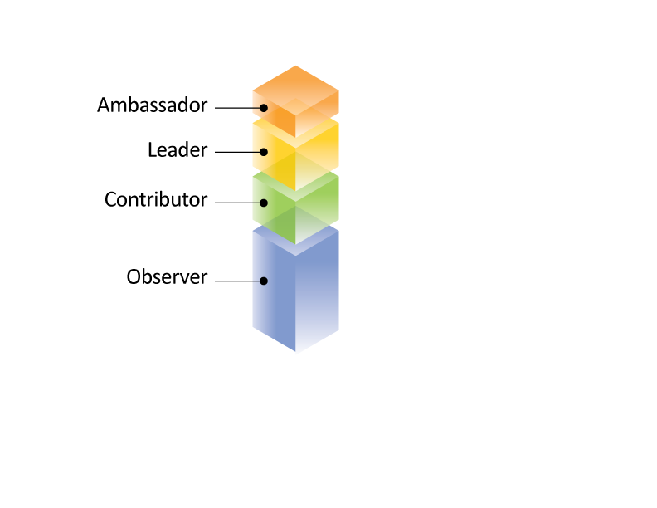
It’s the people….

Slide 6
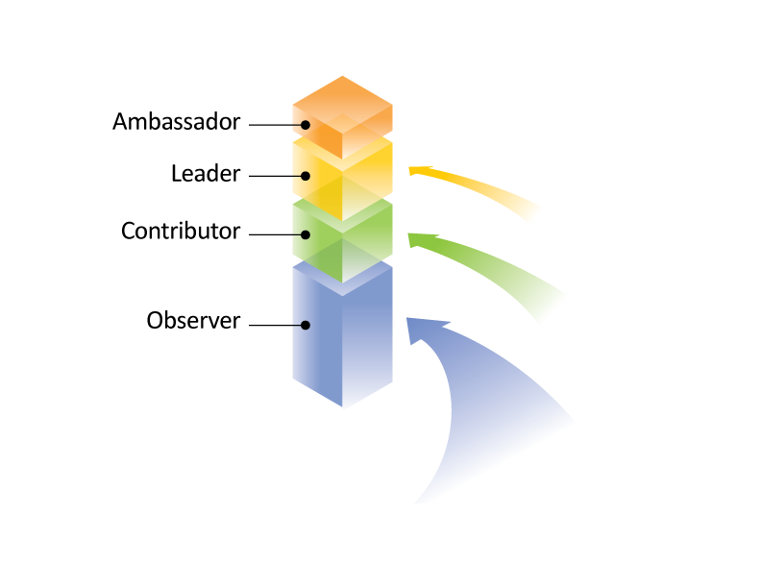
participating in the ICANN model…..

Slide 7
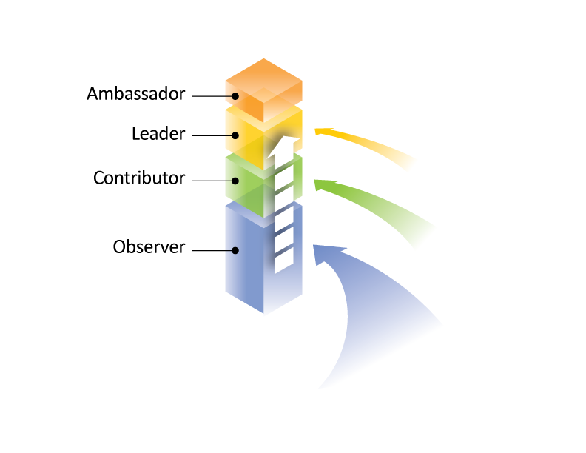
and making them more effective…..

Slide 8
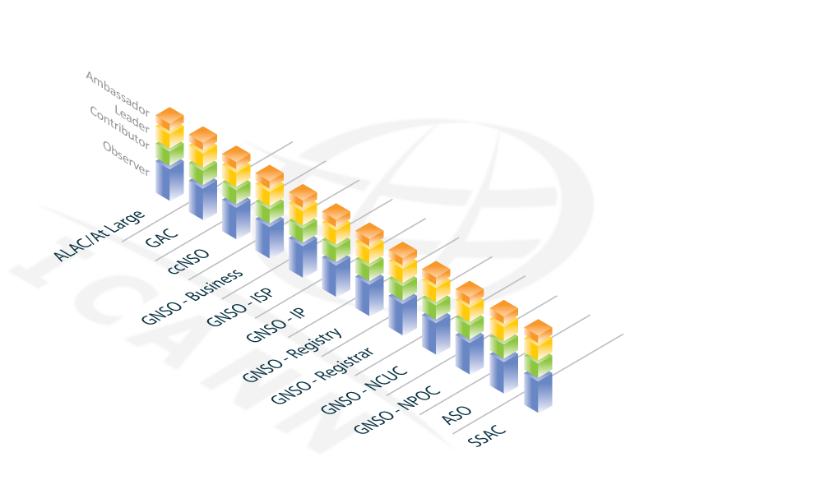
Opportunities for participation….

Slide 9

in all regions…..

Slide 10
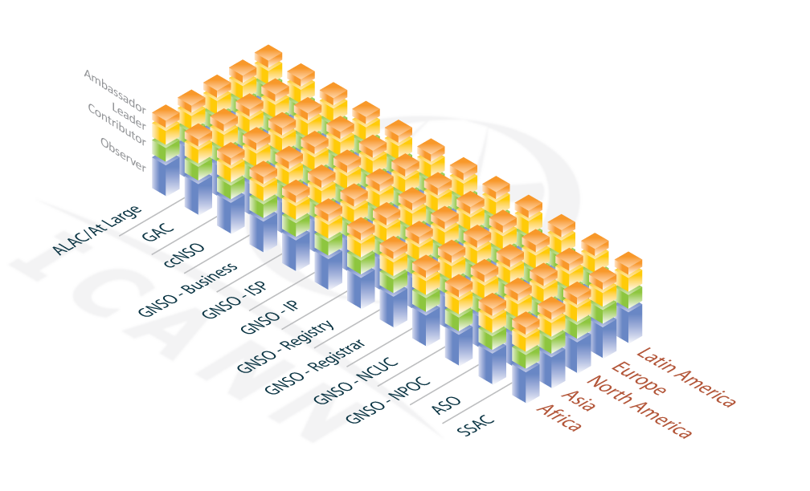
Goal: robust participation in all sectors & in all regions

Slide 11
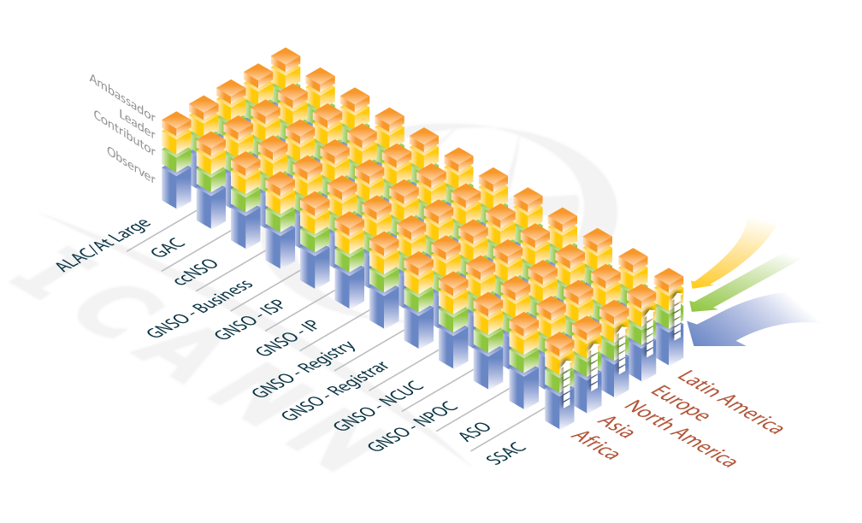
by moving people “in” and “up”…..

Slide 12
Moving “Up”: Good, not Necessary
ICANN needs participants at all levels
All levels are important
Goal:
  nothing blocks you from achieving
  as much as you want at ICANN
  outreach is in place to help participants
  achieve their desired level of participation
Notes:
In reality, long-term participants at ICANN move up and down this engagement spectrum. If you chair a couple of Working Groups one year, the odds are your other life demands will cause you to back off of your ICANN time commitment next year. That is perfectly fine and natural (and to be encouraged, to avoid volunteer burn-out).
When we say “move people up,” what we mean is that if someone wants to try on a greater commitment or higher leadership role, we have activities that support them – that might mean greater staff support, or training, or funding. So this framework is intended to help the community figure out ways to grow new leaders.

Slide 13
Managing outreach
Develop “activities inventory”
Test each existing or proposed activity, does it:
  move people into ICANN, or
  make participants more effective
Coordinate all activities among functions to:
  Eliminate redundancy
  Prioritize most effective activities
  Find most effective “home”
Find the blanks – where are we NOT moving people in or up?

Slide 14
Examples: Activities
New public comment forum
  Turns observers into contributors
Translation, plain English, web site redesign
  Welcomes new observers
Fellowship
  Turns observers into contributors
  Targets various SOs and ACs
  …..
BUT: what activity creates leaders?

Slide 15
Completing and employing the framework…..
Complete activities inventory
Coordinate activities across ICANN operations
Introduce concept to community
Use to evaluate proposed and existing outreach activities
  In operating plan & budget
  Proposed by community

