Slide 1
Community Building through Outreach
28 June 2012

Slide 2
Goals for the Session
Review/Examples of Current “Outreach” Activities
Discussion of Next Steps For Improved Coordination and Strategy
Notes:
Desired Outcomes: This is the start of a dialog and process – we do not have to decide today.
Discussion of what Outreach means to the community
Discussion of possible methods for awareness of and coordination between staff and community efforts

Slide 3
Agenda
Introductions
Dialogue
  Defining “Outreach”
  Current Activities
  Coordination
  Next Steps
Action Items
Notes:
Desired Outcomes: This is the start of a dialog and process – we do not have to decide today.
Discussion of what Outreach means to the community
Discussion of possible methods for awareness of and coordination between staff and community efforts

Slide 4
Discussion: Outreach
A proposed definition of “Outreach” is “that which moves participants in, up, and/or makes participant more effective”
What else does “Outreach” mean to you: other legitimate, worthwhile activities
Notes:
Community examples

Slide 5
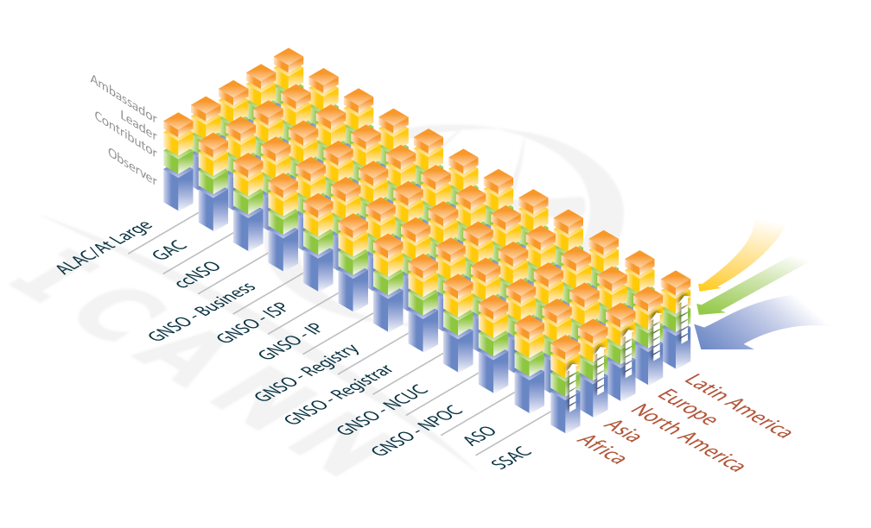
Move In, Move Up, Make Effective

Slide 6
Discussion: Current Activities
Outreach activities in your communities
Examples of successful Outreach efforts to share

Slide 7
Discussion: Coordination
How do we best coordinate the efforts of the ICANN staff and community?
Notes:
Ideas for information sharing?

Slide 8
Discussion: Next Steps
Establish next steps between the Prague and Toronto meetings to further this effort
Notes:
What are the next steps identified or community ideas for continuing the dialog.
Conference calls? Wiki space? Mailing list?

Slide 9
Action Items

Slide 10
Thank You

