Slide 1

Introduction to IPv6
Leo Vegoda
17 October 2013

Slide 2
Overview
What is Internet Protocol?
IPv4 deployment
Designing and deploying IPv6
Current IPv6 deployment
Issues with not deploying IPv6
Issues ALAC might want to consider

Slide 3

What is Internet Protocol?
When you need to send or receive a large file it is broken up into packets
Each packet is sent separately
Packets can travel different routes and arrive out of sequence
The whole is reassembled at the end when all the pieces have arrived

Slide 4

IPv4 deployment
Started in 1983
Revised in 1985
    Introduction of Class A, B, C
CIDR introduced in 1993
Just 3.7 billion addresses available for normal use, in contrast to the 7 billion people on the planet

Slide 5
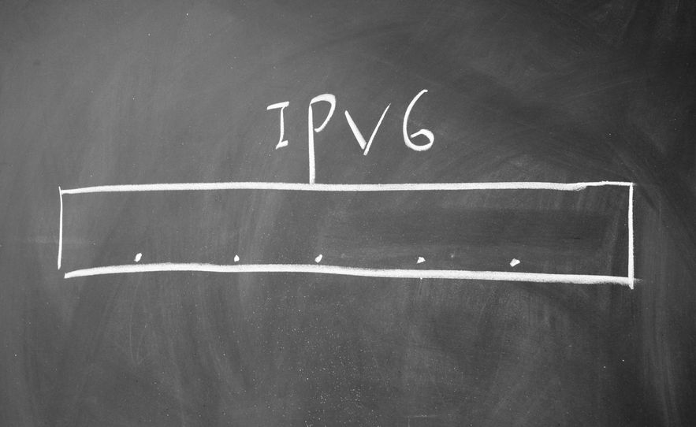
Designing and deploying IPv6
IPng protocol design competition in 1993 - comparison
IPv6 selected and standard published in 1995
6bone tested network was established in 1996 and reached its height in 2003
Production allocation began in 1999
6bone experiment ended on 6 June 2006

Slide 6
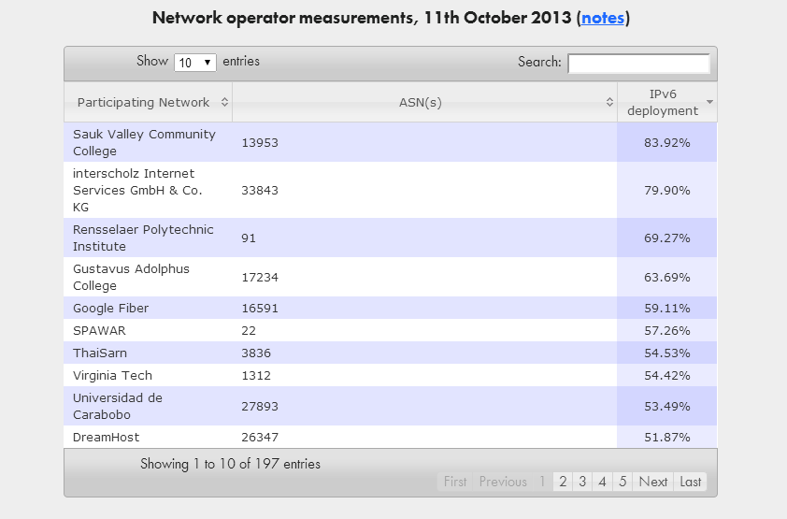
Current IPv6 deployment
Cisco deployment map
Google deployment map
APNIC Labs deployment map
Source: http://www.worldipv6launch.org/measurements/

Slide 7

Don’t turn off IPv6
“We do not test Windows with IPv6 disabled, and definitely do not recommend
disabling it. From a security point of view, you are much better off actually disabling IPv4.”
--Christian Huitema, Microsoft
Technet FAQ

Slide 8

Issues ALAC might want to consider
National and regional ALSs might want to engage with ISPs, regulators and OTT service providers
Given a choice between CGNAT and IPv6, IPv6 is preferable
    Will gaming work?
    Will video/voice work?
    Will maps work?
    Will current audit trail tools continue to work?

Slide 9
Thank You & Questions?

