Slide 1
IPv6 Webinar for ALAC
ASO Address Council
17 October 2013
Notes:
.

Slide 2
Agenda
RIR Policy Development
Status of IPv4 Address Space
IPv4 Address Recovery policy
IPv6 Allocation Policy
Q & A

Slide 3
Introductions
Jason Schiller
  ASO AC member from the ARIN region
  Network Engineer for Google
  Google’s Chief Numberista
Ricardo Patara
  ASO AC member from LACNIC region
  Registration Service Manager for Registro.br

Slide 4
What is an RIR
Regional Internet Registry
  Established in ICP-2
  http://www.icann.org/en/resources/policy/global-addressing/new-rirs-criteria
  Operate a continental sized international geography
  Have broad support of their community
  Bottom up self Governance
    Open
    Transparent
  Neutrality and impartiality
    Independent
    Not for Profit
    Open membership
  Technical expertise
  Adherence to global policies – conservation, aggregation, registration

Slide 5
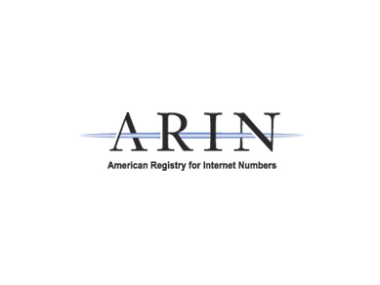
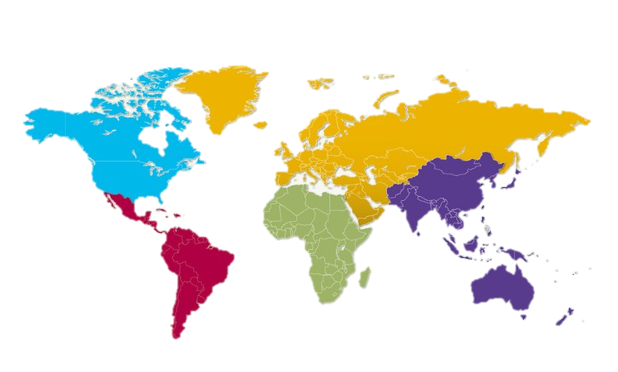




What is an RIR

Slide 6
Regional Policy
Each RIR establishes its own regional policy
Each RIR has its own policy development process (PDP)
  Policy developed from the community
    Bottom up
    Consensus based
  Open policy mailing list
  Open public policy meeting
Transparently documented
  PDP
  Number Policy

Slide 7
Regional Policy
Development
Each RIR has
  Published policy manual
    Documents current number resource policy
  Policy Development Process (PDP)
    Documents the process for changing policy
    Transparent
    Bottom up
    Community consensus
  Publishes the draft policies under discussion
  Mailing lists
    Where policy proposals are discussed
    Archived
    Open
  Meetings
    Twice a year
    Open
    Remote participation

Slide 8
Regional Policy
Development
Details differ, but all RIRs have the following steps in their PDP:
Community individual or groups submit a proposal
Community discusses the proposal on the mailing list
Staff provides their assessment on changes to their operations, and legal impact
Community discusses the proposal at an open public policy meeting
Consensus evaluation
Last call
Board completes fiduciary risk assessment
Adoption/Ratification
Implementation

Slide 9
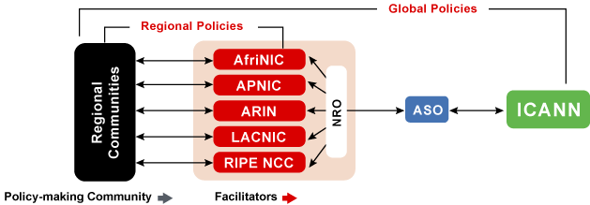
Global Policy Development
Each region has its own policy development process
  All open, transparent, and bottom-up
Global policy proposals are submitted in all 5 regions
Each region follows its own process
It then gets passed to the NRO for review
And forwarded to the ICANN board
Notes:
Global Policy Development Process

Slide 10
Global Policy Development
Same policy adopted in all five regions
The NRO NC must
  Validate the proposal went through the policy development process of each region
  Adequate consideration of viewpoints
  The same text passed in all regions
  Or any rewrite from the NRO EC is not a substantive change compared to what the individual region passed
The NRO NC that recommends to the ICANN board to ratify
ICANN Board can ratify, ask for clarification, or send it back for specific reconsideration of concerns
Notes:
Global Policy Development Process

Slide 11
ARIN Number Policy
Policy Development Process
Number Resource Policy Manual (NRPM)
  https://www.arin.net/policy/nrpm.html
Policy Development Process (PDP)
  https://www.arin.net/policy/pdp.html
Current proposals and draft policies
  https://www.arin.net/policy/proposals/
Mailing lists
  https://www.arin.net/participate/mailing_lists/index.html
  arin-ppml – draft policy and proposal discussion
Meetings
  https://www.arin.net/participate/meetings/index.html
  ARIN 33 – Chicago, Illinois, April 13 - 16

Slide 12
RIPE NCC Number Policy
Policy Development Process
RIPE policies
  http://www.ripe.net/ripe/docs/current-ripe-documents/ripe-policies
Policy Development Process (PDP)
  https://www.ripe.net/ripe/docs/ripe-500
Recent proposals
  https://www.ripe.net/ripe/policies/current-proposals/current-policy-proposals
Mailing lists
  https://www.ripe.net/ripe/mail/ripe-mailing-lists
  Address Policy WG – draft policy and proposal discussion
Meetings
  http://www.ripe.net/ripe/meetings
  RIPE 68 – Warsaw, Poland, May 12 - 16

Slide 13
APNIC Number Policy
Policy Development Process
Current Policies
  http://www.apnic.net/community/policy/current
Policy Development Process (PDP)
  http://www.apnic.net/community/policy/process
Current proposals and draft policies
  http://www.apnic.net/community/policy/proposals
  http://www.apnic.net/community/policy/draft
Mailing lists
  http://www.apnic.net/community/participate/join-discussions
  APNIC Policy SIG– draft policy and proposal discussion
Meetings
  http://conference.apnic.net/
  APNIC 37 – Bangkok, Thailand, Feb 18 - 28

Slide 14
LACNIC Number Policy
Policy Development Process
Policy Manual (NRPM)
  http://www.lacnic.net/web/lacnic/manual
Policy Development Process (PDP)
  http://www.lacnic.net/en/web/lacnic/proceso-de-desarrollo-de-politicas
Current policy proposals
  http://www.lacnic.net/web/lacnic/archivo-de-propuestas-politicas
Mailing lists
  http://www.lacnic.net/web/lacnic/lista-de-discusion
  Policies List – policy proposal discussion
Meetings
  http://www.lacnic.net/en/web/eventos/lacnic20
  Lacnic 20 – Willemstad, Cuaçao, October 28 – November 1

Slide 15
AFRINIC Number Policy
Policy Development Process
Number Resource Policy Manual (NRPM)
  https://www.arin.net/policy/nrpm.html
Policy Development Process (PDP)
  https://www.arin.net/policy/pdp.html
Current proposals and draft policies
  https://www.arin.net/policy/proposals/
Mailing lists
  https://www.arin.net/participate/mailing_lists/index.html
  arin-ppml – draft policy and proposal discussion
Meetings
  https://www.arin.net/participate/meetings/index.html
  ARIN 33 – Chicago, Illinois, April 13 - 16

Slide 16
Status of IPv4 Address Space

Slide 17
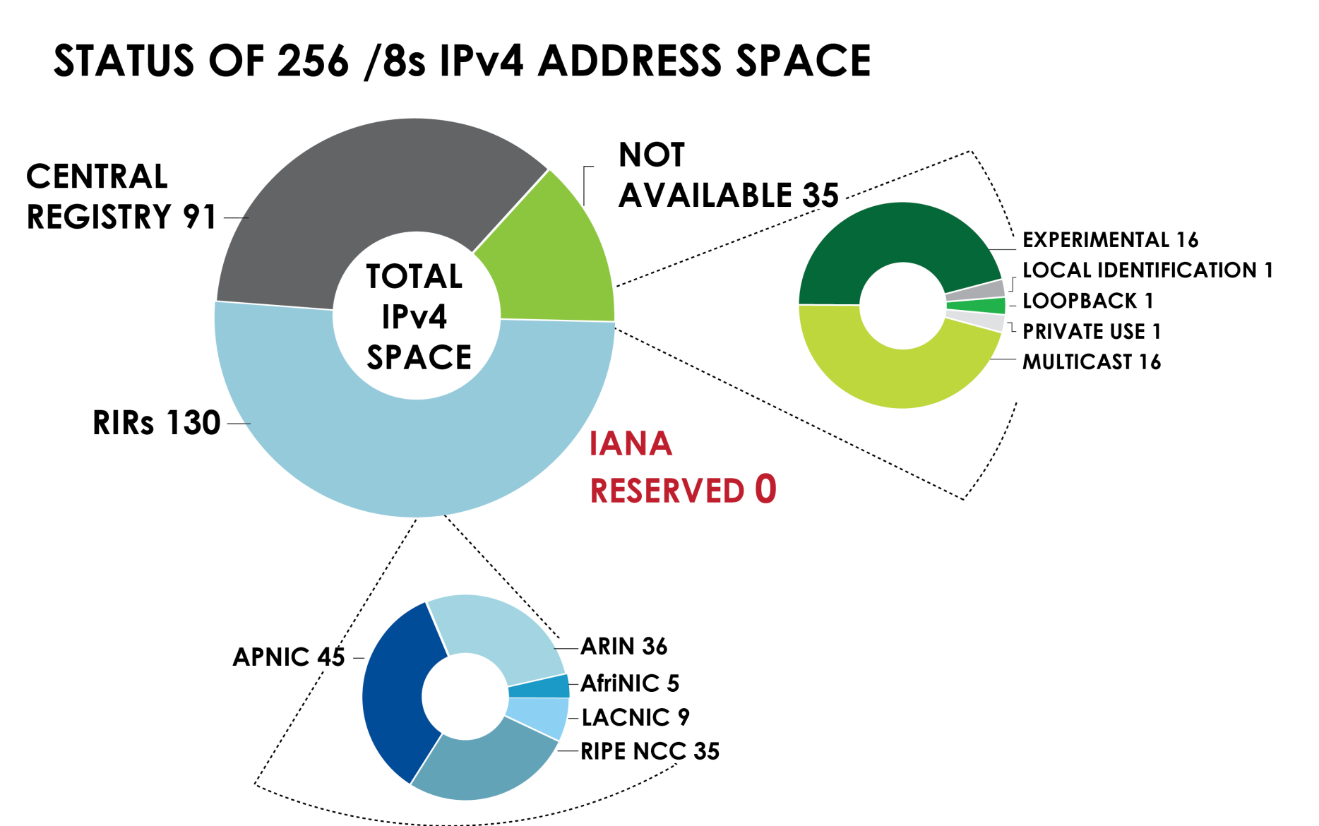
Source: INTERNET NUMBER RESOURCE STATUS REPORT (NRO, 30 June 2013)
http://www.iana.org/assignments/ipv4-address-space/ipv4-address-space.txt

Slide 18
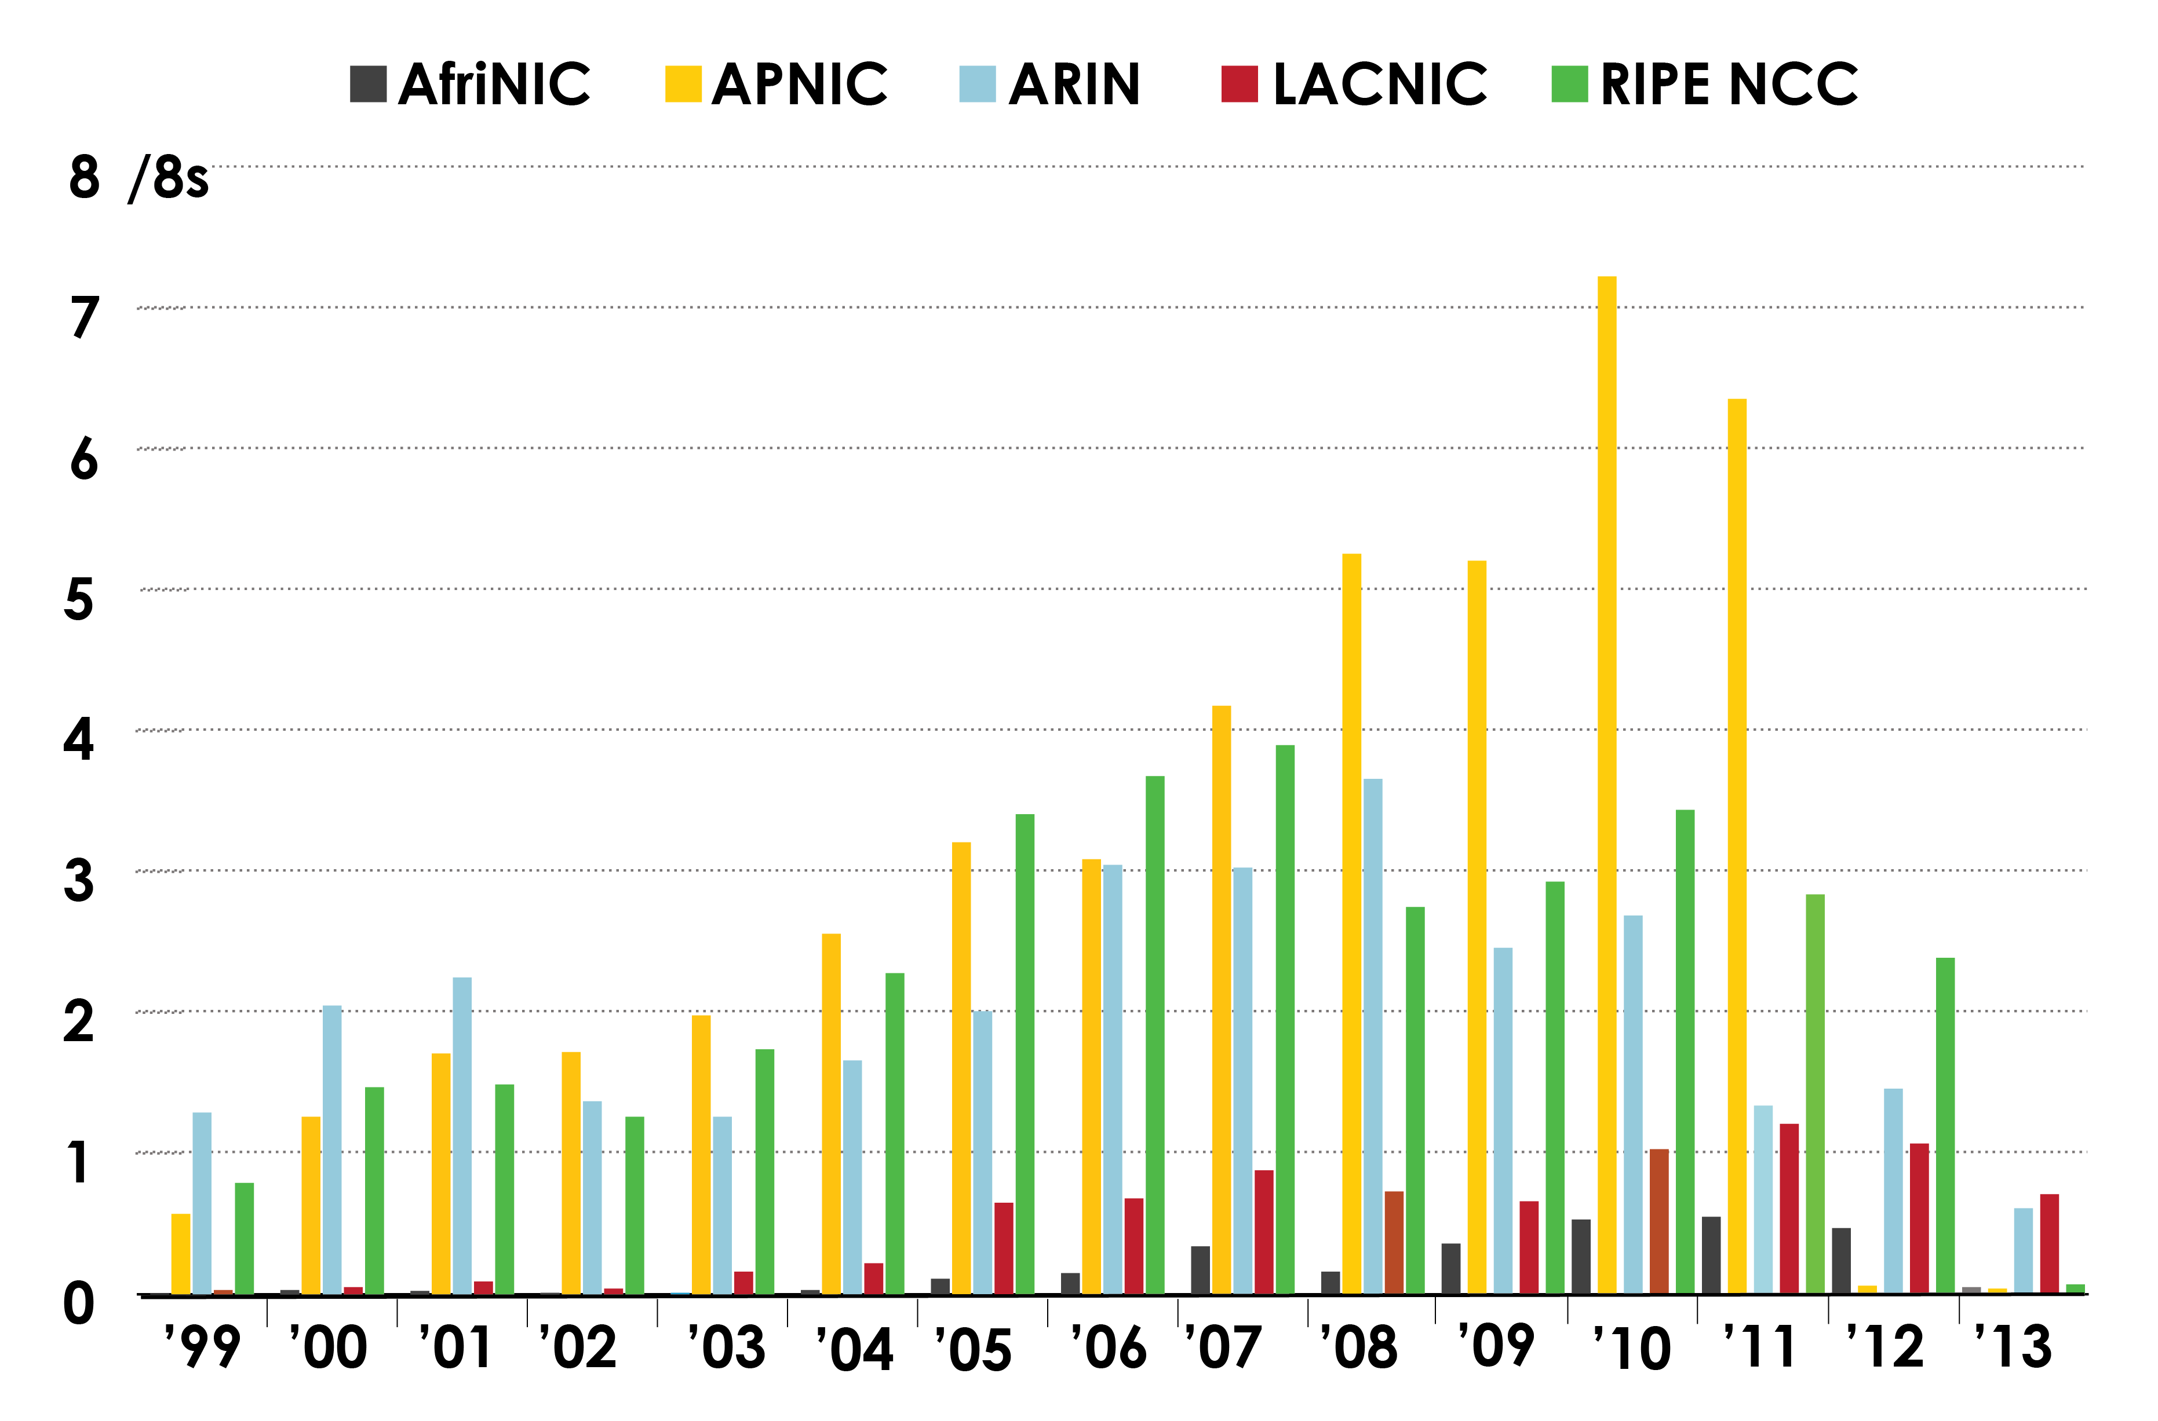
IPv4 Address Space issued (RIRs to customers) by years
Source: INTERNET NUMBER RESOURCE STATUS REPORT (NRO, 30 June 2013)

Slide 19
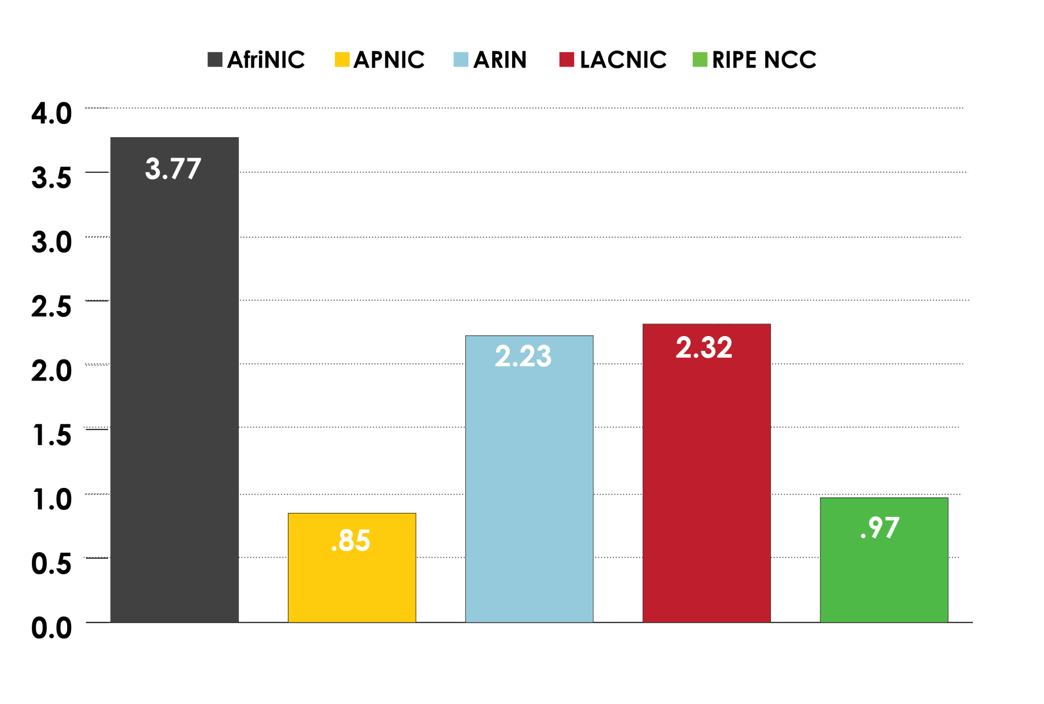
Available IPv4 /8 in each RIR
Source: INTERNET NUMBER RESOURCE STATUS REPORT (NRO, 30 June 2013)

Slide 20
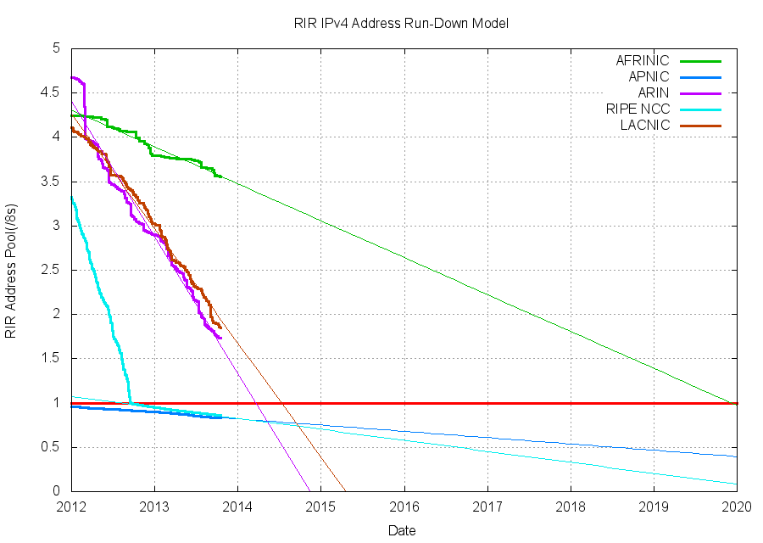
RIR IPv4 Address Run-Down Model
Projected RIR Address Pool Exhaustion Dates:
 | RIR | Projected Exhaustion Date | Remaining Addresses in RIR Pool (/8s)
 | APNIC: | 19-Apr-2011 (actual) | 0.8289
 | RIPE NCC: | 14-Sep-2012 (actual) | 0.8586
 | ARIN: | 20-Jan-2015 | 1.7351
 | LACNIC: | 22-Apr-2015 | 1.8518
 | AFRINIC: | 22-Aug-2022 | 3.5584
Source: http://www.potaroo.net/tools/ipv4/index.html

Slide 21
IPv4 Address Recovery
Notes:
This concludes my report. Thank you.

Slide 22
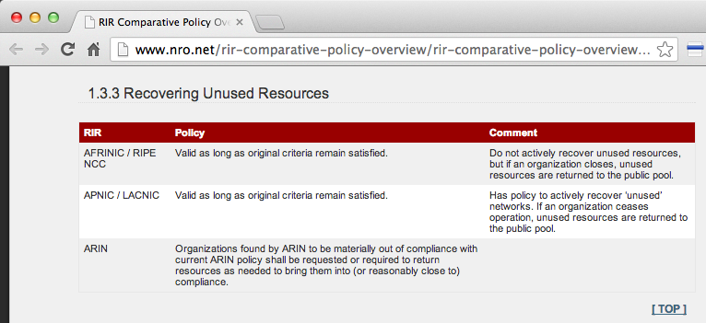
What is the Policy for
IPv4 Recovery?
NRO RIR comparative overview
http://www.nro.net/rir-comparative-policy-overview/rir-comparative-policy-overview-2013-03

Slide 23
What is the Policy for
IPv4 Recovery?
APNIC & LACNIC
  Valid as long as original criteria continues to be met
  Actively recover unused resources
  Resources of organizations who cease are returned to the RIR free pool
RIPE
  Valid as long as original criteria continues to be met
  Resources of organizations who cease are returned to the RIR free pool
ARIN
  Organizations out of compliance are requested or required to return resources to bring them back (or reasonably close) to compliance
  Resources revoked for lack of payment
  Resources revoked for fraud

Slide 24
ARIN Resource Review
12. RESOURCE REVIEW
1.ARIN may review the current usage of any resources maintained in the ARIN database. The organization shall cooperate with any request from ARIN for reasonable related documentation.
2. ARIN may conduct such reviews:
  a. when any new resource is requested,
  b. whenever ARIN has reason to believe that the resources were originally obtained fraudulently or in contravention of existing policy, or
  c. whenever ARIN has reason to believe that an organization is not complying with reassignment policies, or
  d. at any other time without having to establish cause unless a full review has been completed in the preceding 24 months.
At the conclusion of a review in which ARIN has solicited information from the resource holder, ARIN shall communicate to the resource holder that the review has been concluded and what, if any, further actions are required.
Organizations found by ARIN to be materially out of compliance with current ARIN policy shall be requested or required to return resources as needed to bring them into (or reasonably close to) compliance.
The degree to which an organization may remain out of compliance shall be based on the reasonable judgment of the ARIN staff and shall balance all facts known, including the organization's utilization rate, available address pool, and other factors as appropriate so as to avoid forcing returns which will result in near-term additional requests or unnecessary route de-aggregation.

Slide 25
ARIN Resource Review
To the extent possible, entire blocks should be returned. Partial address blocks shall be returned in such a way that the portion retained will comprise a single aggregate block.
If the organization does not voluntarily return resources as requested, ARIN may revoke any resources issued by ARIN as required to bring the organization into overall compliance. ARIN shall follow the same guidelines for revocation that are required for voluntary return in the previous paragraph.
Except in cases of fraud, or violations of policy, an organization shall be given a minimum of six months to effect a return. ARIN shall negotiate a longer term with the organization if ARIN believes the organization is working in good faith to substantially restore compliance and has a valid need for additional time to renumber out of the affected blocks.
In case of a return under paragraphs 12.4 through 12.6, ARIN shall continue to provide services for the resource(s) while their return or revocation is pending, except any maintenance fees assessed during that period shall be calculated as if the return or revocation was complete.
This policy does not create any additional authority for ARIN to revoke legacy address space. However, the utilization of legacy resources shall be considered during a review to assess overall compliance.
In considering compliance with policies which allow a timeframe (such as a requirement to assign some number of prefixes within 5 years), failure to comply cannot be measured until after the timeframe specified in the applicable policy has elapsed. Blocks subject to such a policy shall be assumed in compliance with that policy until such time as the specified time since issuance has elapsed.

Slide 26
ARIN Annual Renewal
4.2. Allocations to ISPs (Requirements for Requesting Initial Address Space)
4.2.1.2. Annual Renewal
An annual fee for registered space is due by the anniversary date of the ISP's first allocation from ARIN. ISPs should take care to ensure that their annual renewal payment is made by their anniversary due date in accordance with the Registration Services Agreement. If not paid by the anniversary date, the address space may be revoked. Please review the Annual Renewal/Maintenance Fees Page for more details.

Slide 27
ARIN IPv4 Transfers
8. TRANSFERS
8.1. Principles
Number resources are nontransferable and are not assignable to any other organization unless ARIN has expressly and in writing approved a request for transfer. ARIN is tasked with making prudent decisions on whether to approve the transfer of number resources.
It should be understood that number resources are not 'sold' under ARIN administration. Rather, number resources are assigned to an organization for its exclusive use for the purpose stated in the request, provided the terms of the Registration Services Agreement continue to be met and the stated purpose for the number resources remains the same. Number resources are administered and assigned according to ARIN's published policies.
Number resources are issued, based on justified need, to organizations, not to individuals representing those organizations. Thus, if a company goes out of business, regardless of the reason, the point of contact (POC) listed for the number resource does not have the authority to sell, transfer, assign, or give the number resource to any other person or organization. The POC must notify ARIN if a business fails so the assigned number resources can be returned to the available pool of number resources if a transfer is not requested and justified.

Slide 28
ARIN IPv4 Transfers
8.2. Mergers and Acquisitions
ARIN will consider requests for the transfer of number resources in the case of mergers, acquisitions, and reorginizations under the following conditions:
The new entity must provide evidence that they have acquired assets that use the resources to be transferred from the current registrant. ARIN will maintain an up-to-date list of acceptable types of documentation.
The current registrant must not be involved in any dispute as to the status of the resources to be transferred.
The new entity must sign an RSA covering all resources to be transferred.
The resources to be transferred will be subject to ARIN policies.
The minimum transfer size is the smaller of the original allocation size or the applicable minimum allocation size in current policy.
In the event that number resources of the combined organizations are no longer justified under ARIN policy at the time ARIN becomes aware of the transaction, through a transfer request or otherwise, ARIN will work with the resource holder(s) to return, aggregate, transfer, or reclaim resources as needed to restore compliance via the processes outlined in current ARIN policy.

Slide 29
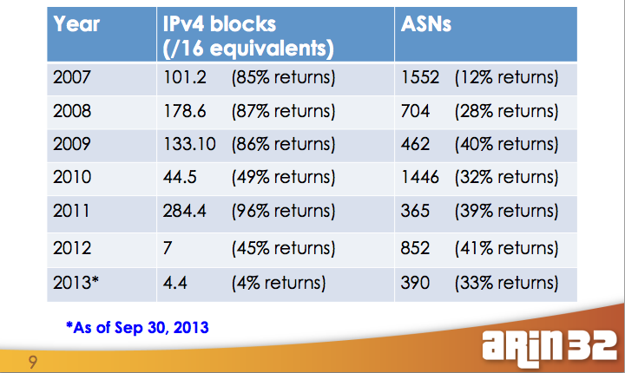
ARIN IPv4 Recovery

Slide 30
LACNIC Recovery
45 ASNs
~250,000 IPv4 address
  Nearly a /14 equivalent

Slide 31
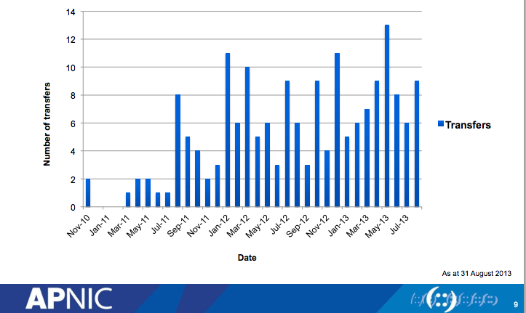
APNIC IPv4 Transfers

Slide 32
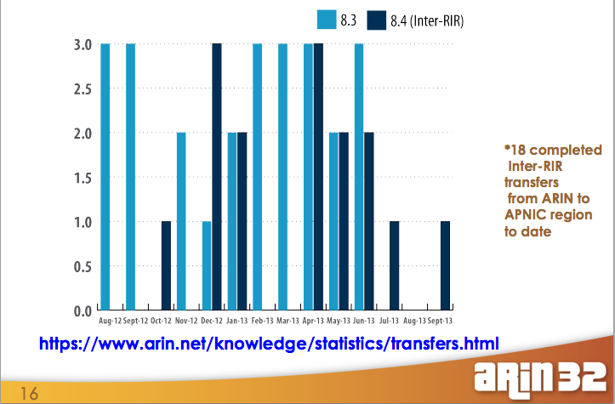
ARIN IPv4 Transfers

Slide 33
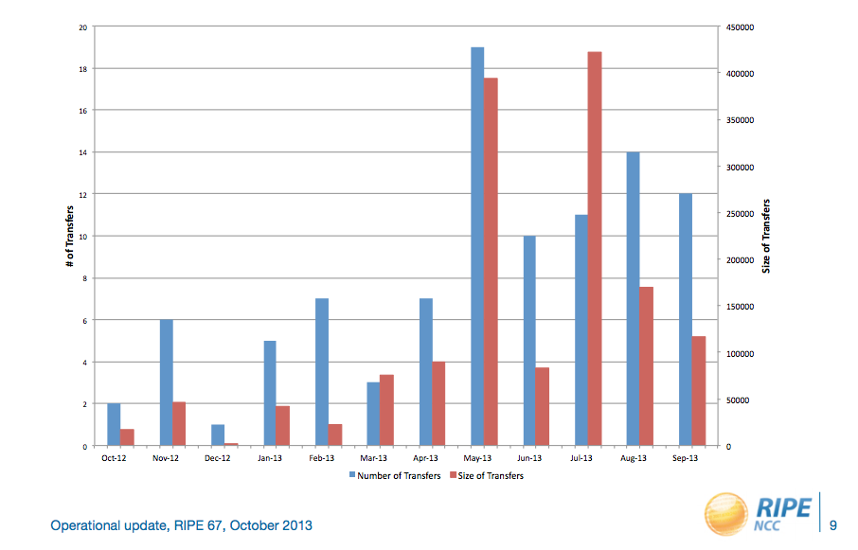
RIPE IPv4 Transfers

Slide 34
Status of IPv6 Address Space

Slide 35
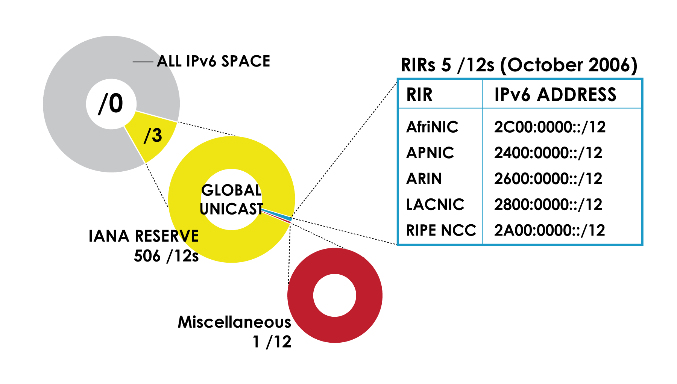
IPv6 Address Space
Source: INTERNET NUMBER RESOURCE STATUS REPORT (NRO, 30 June 2013)

Slide 36
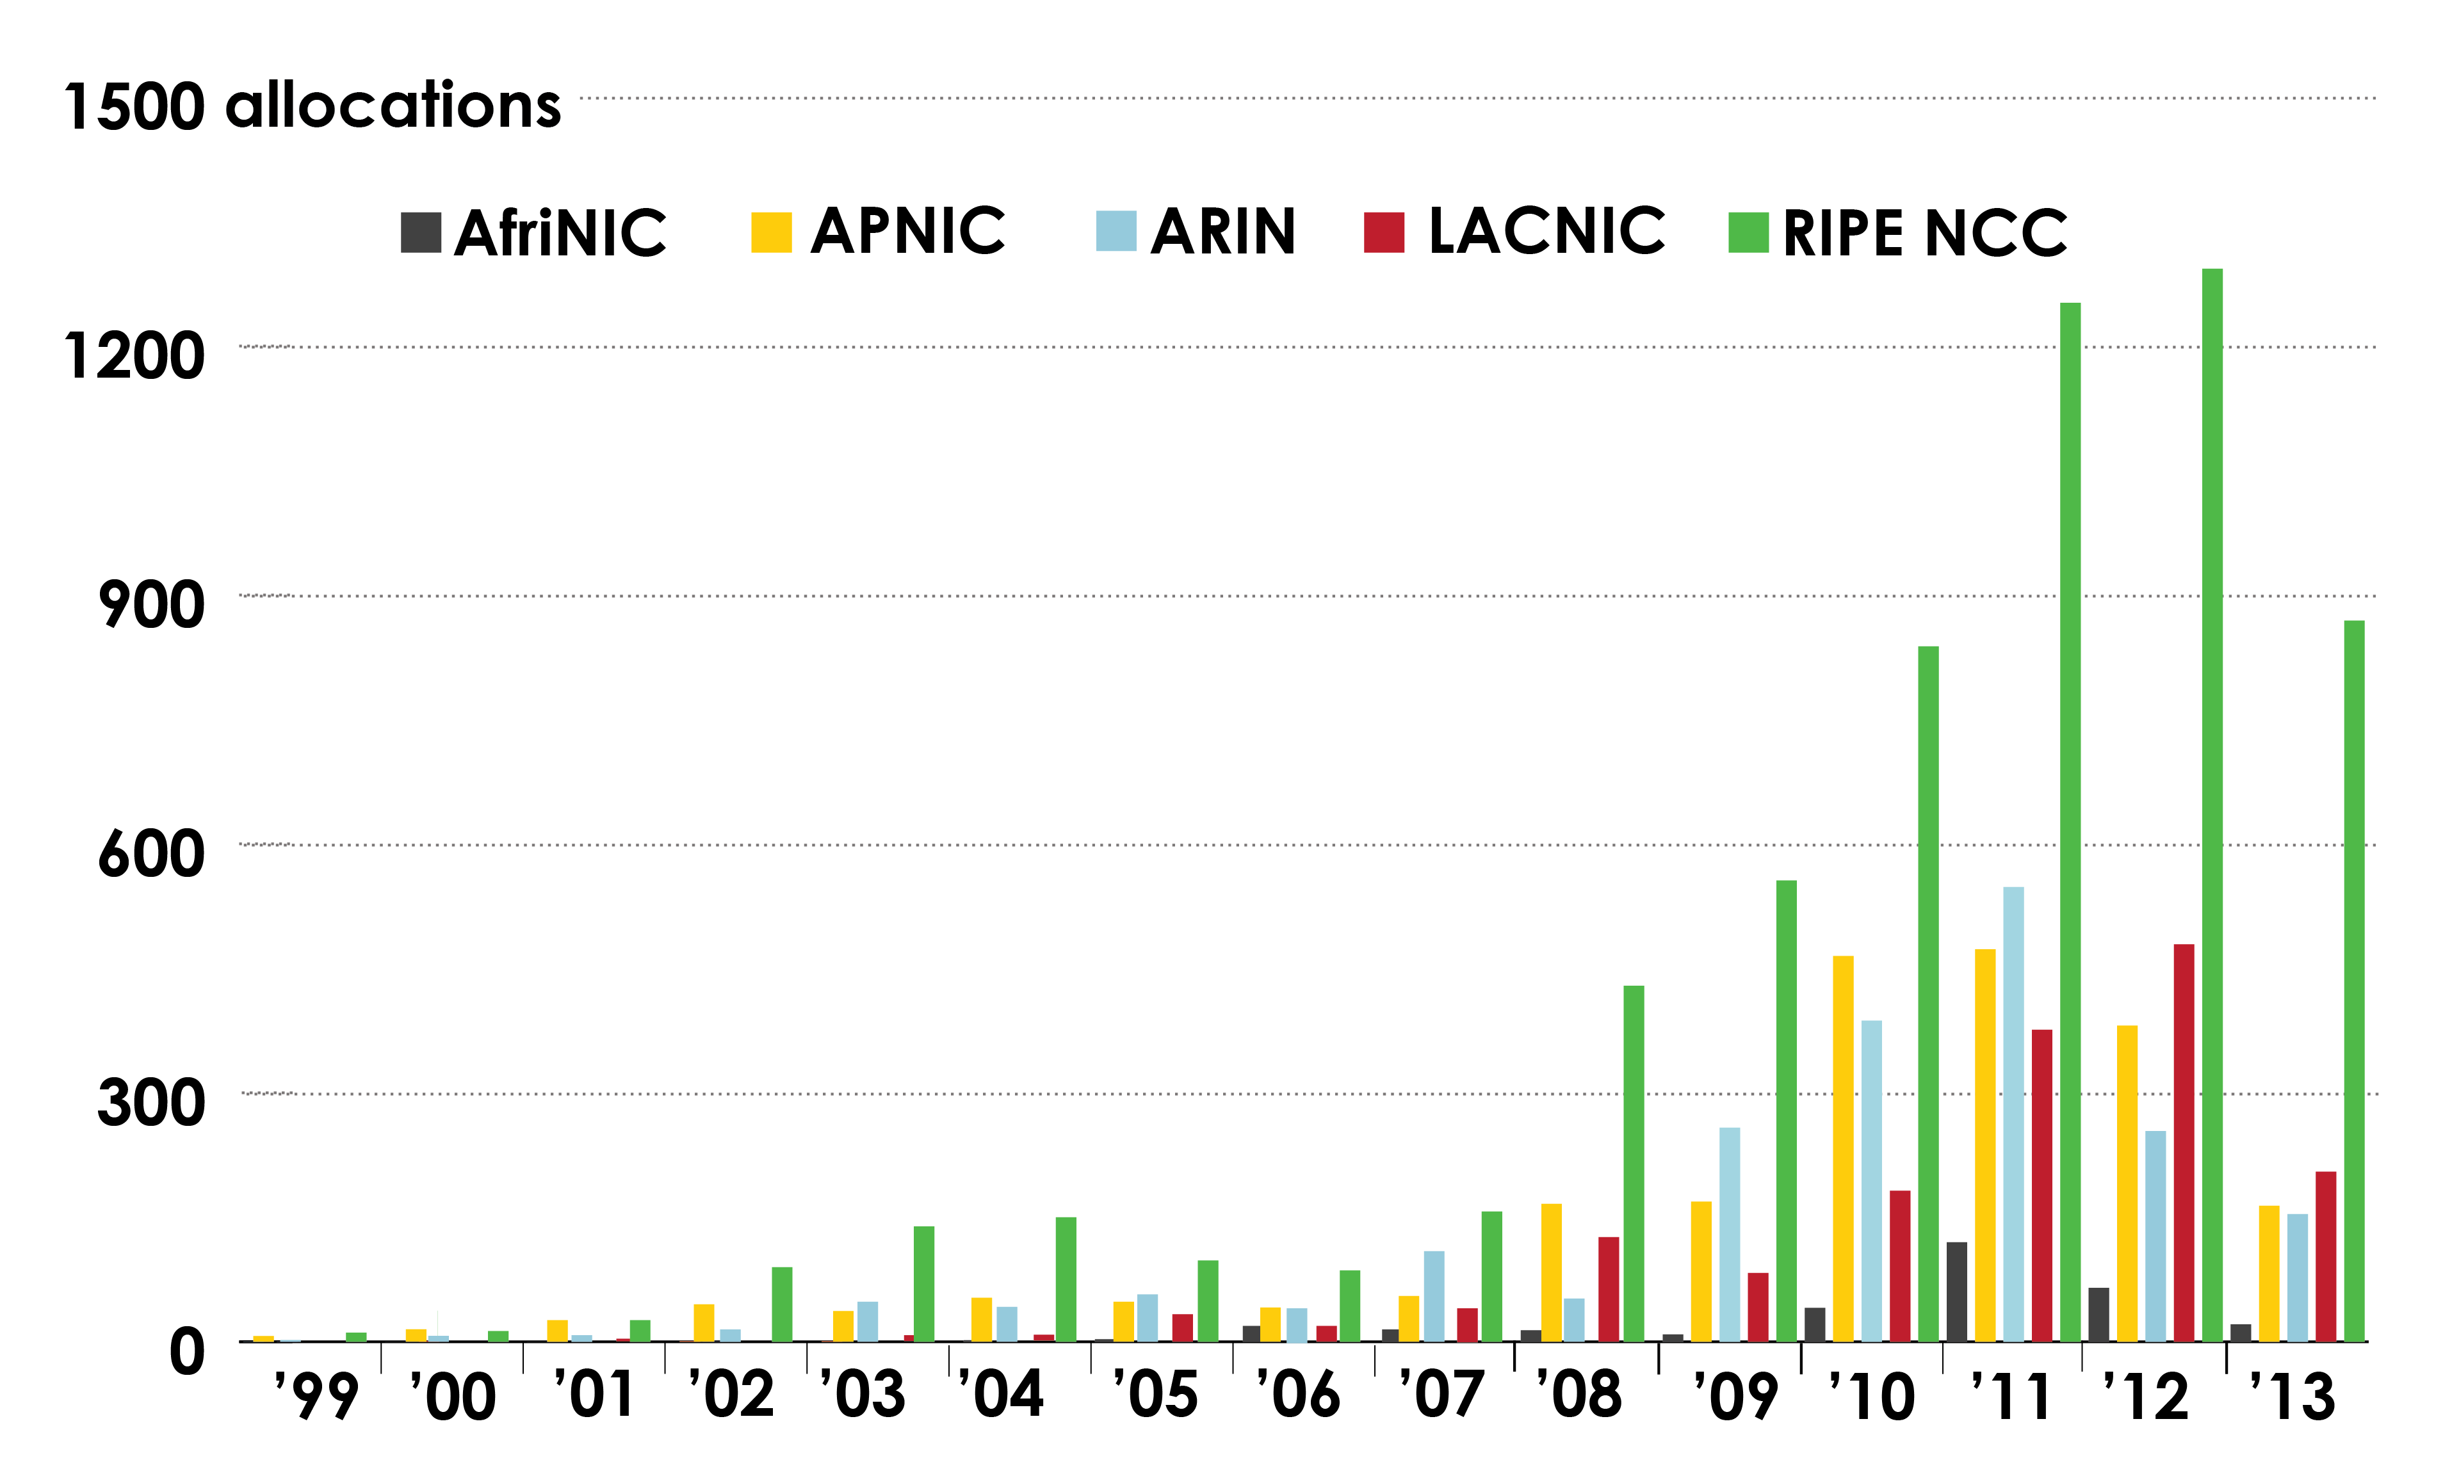
IPv6 Allocations (RIRs to LIRs/ISPs) by years
Source: INTERNET NUMBER RESOURCE STATUS REPORT (NRO, 30 June 2013)

Slide 37
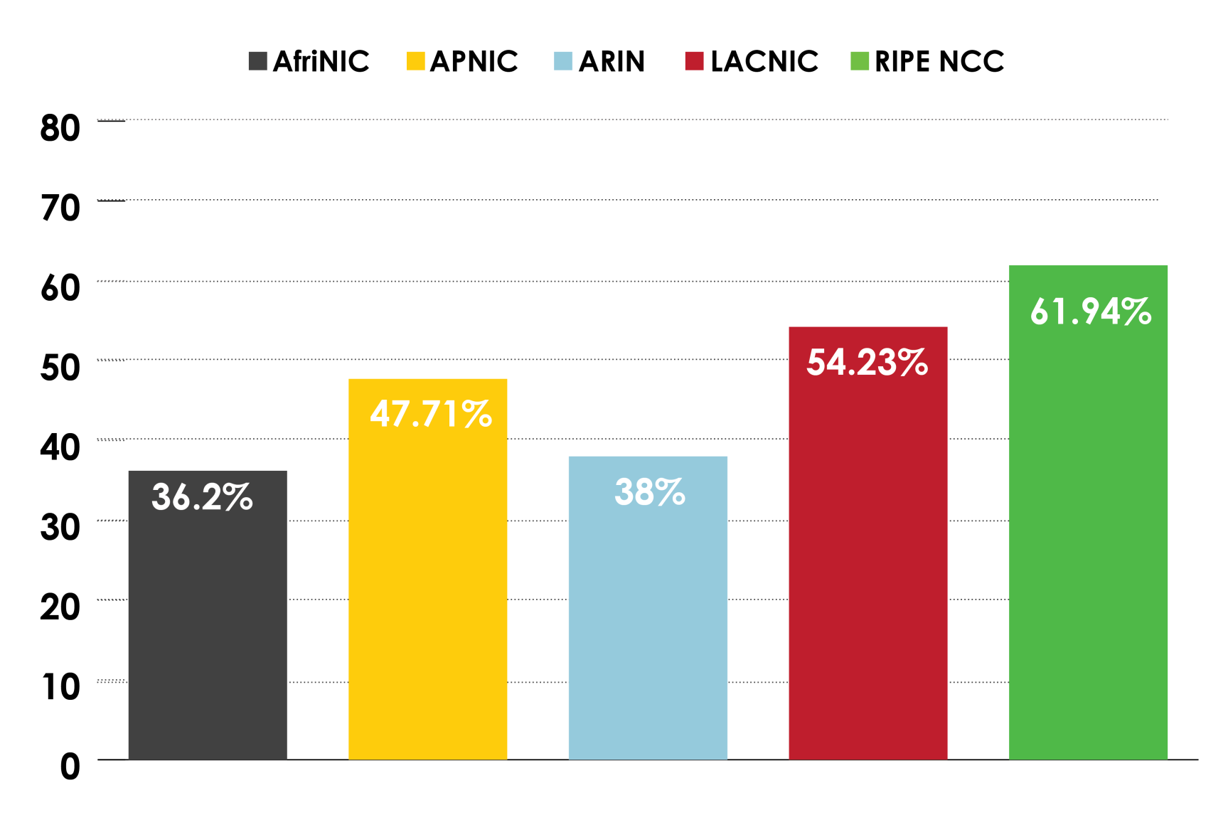
Percentage of members with both IPv4 and IPv6 in each RIR
Source: INTERNET NUMBER RESOURCE STATUS REPORT (NRO, 30 June 2013)

Slide 38
IPv6 Allocation /
Assignment Policy

Slide 39
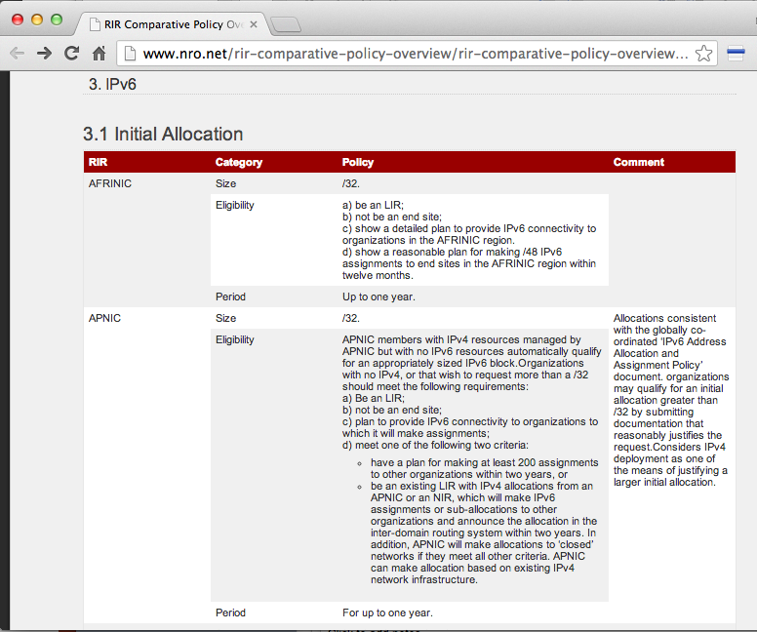
What is the Policy for
IPv6 Initial Allocation to ISPs
http://www.nro.net/rir-comparative-policy-overview/rir-comparative-policy-overview-2013-03

Slide 40
What is the Policy for
IPv6 Initial Allocation to ISPs
All RIRs provide a /32 by default to ISPs
ARIN offers a /36 upon request
  Allows and organization to stay in the x-small billing bucket
  End site assignments start at /48

Slide 41
AFRINIC Policy for IPv6 Initial Allocation / Assignment
AFRINIC ISP allocation
  Must be an ISP, not an end-site
  Show plans to deploy IPv6 in Africa
  Show plans to have down stream customers within a year
  Announce the IPv6 space within one year
  Default /32
  Larger than /32 available by justification
    Existing customer base and infrastructure
  Additional space when HD ration of /48s >= 0.94
  Two year supply
AFRINIC end site Assignment
  Must be an end site, not an LIR (ISP)
  Must have or be able to qualify for ARFINIC PI IPv4 space
  Must show a need for IPv6 PR space
  Must put into service with in 1 year
  /48 by default
  Larger block if justified

Slide 42
APNIC Policy for IPv6 Initial Allocation / Assignments
APNIC LIR (ISP) allocation
  Default /32
  Have APNIC ISP IPv4 address space
  OR all of the following
    Be an LIR (ISP), not an end site
    Have a plan for down stream customers
    Have a plan for 200 customers in 2 years OR provide IPv6 transit to customer with in 2 years
  Can get larger with justification
    Planned customer base and infrastructure as justification for larger
    OR current IPv4 customer base and infrastructure as justification if it plans to support IPv6 within 2 years
  Additional space when HD ration of /56s >= 0.94
  Two year supply
APNIC end-site PI assignments
  /48 by default
  Have APNIC IPv4 PI addresses
  OR multi-homed
  OR demonstrate an ISP provided IPv6 space is not suitable
  Additional if justified need of an additional PI assignment

Slide 43
RIPE Policy for IPv6 Initial Allocation / Assignments
RIPE LIR (ISP) allocation
  Must be an LIR (ISP)
  Have plans for IPv6 customers in 2 years
  Default /32
  Can get up to a /29 with no additional justification
  Current IPv4 customer base and infrastructure as justification for larger than /29
  Additional space when HD ration of /56s >= 0.94
  Two year supply
RIPE end-site PI assignments
  /48 by default
  Larger if justified by
    Number of subnets
    Discreet routing of sites
    Cannot re-assign or re-allocate

Slide 44
LACNIC Policy for IPv6 Initial Allocation / Assignments
LACNIC LIR (ISP) allocation
  Must be an LIR (ISP)
  Have LACNIC IPv4 addresses
    OR all of the following:
    Have a plan for down stream customers using /48s
    Announce the space within 12 months
    Have down stream customers within the LACNIC region within 2 years
  Default /32
  Can more than a /32 with justification:
    Four year time horizon
    Document current customer and infrastructure
    Can subnet addressing to POPs, but each POP must be currently 30% utilized
  Additional space when HD ration of /48s >= 0.94
  Two year supply
  Within 6 months can return IPv6 addresses and re-apply as an initial allocation
RIPE end-site PI assignments
  Assignment between /48 and /32
  Assignment to end sites holding LACNIC IPv4 PI address
    OR all of the following:
    Not be an LIR or ISP
    Plan for how the space will be used over the next 3, 6, 12 months
    Provide 1 year addressing plan showing subnets and host counts
    Provide network topology and routing plans

Slide 45
ARIN Policy for IPv6 Initial Allocation
ARIN ISP allocation
  Always on a nibble boundary (/36, /32, /28, /24, /16)
  /32 by default
  /36 upon request for reduced billing
  smallest nibble-boundary aligned block that can provide an equally sized nibble-boundary aligned block to each of the requesters serving sites large enough to satisfy the needs of the requesters largest single serving site using no more than 75% of the available addresses.
  Must have down stream customers AND one of the following
    Must have and ARIN IPv4 ISP
    Be IPv6 multi-homed
    Plan for a minimum of 50IPv6 customers within 5 years, including detailed assignment plans and proposed customers over 1, 2, and 5 years. Description of network infrastructure.
  Additional space when any of the following are true:
    75% total address utilization
    90% of any serving site
    90% allocated to serving sites and the size block allocated is justified
  Bumping up to the next nibble up to a /12, then additional /12s at a time there after.

Slide 46
ARIN Policy for IPv6 Initial Assignments
ARIN end-site PI assignments
  /48 by default
  Must meet one of the following:
    Have ARIN issues IPv4 PI space
    Be IPv6 multi-homed
    Use 2,000 IPv6 addresses with one year
    Have 200 .64 sized subnets with in one year
    Provide reasonable justification of why an IPS IPv6 block won’t work
  Larger if justified by
    Number of subnets
    Discreet routing of sites

Slide 47
Thank you.
Questions?

