Slide 1
ICANN Mission, Structure and Constituencies
Capacity Building Program
June 20 2013

Slide 2
ICANN’s Mission
The mission of The Internet Corporation for Assigned Names and Numbers ("ICANN") is to coordinate, at the overall level, the global Internet's systems of unique identifiers, and in particular to ensure the stable and secure operation of the Internet's unique identifier systems. In particular, ICANN:
1. Coordinates the allocation and assignment of the three sets of unique identifiers for the Internet, which are
a. Domain names (forming a system referred to as "DNS");
b. Internet protocol ("IP") addresses and autonomous system ("AS") numbers; and
c. Protocol port and parameter numbers.
2. Coordinates the operation and evolution of the DNS root name server system.
3. Coordinates policy development reasonably and appropriately related to these technical functions.
Notes:
What Does ICANN Do?
To reach another person on the Internet you have to type an address into your computer -- a name or a number. That address must be unique so computers know where to find each other. ICANN coordinates these unique identifiers across the world. Without that coordination, we wouldn't have one global Internet.
In more technical terms, the Internet Corporation for Assigned Names and Numbers (ICANN) coordinates the Internet Assigned Numbers Authority (IANA) functions, which are key technical services critical to the continued operations of the Internet's underlying address book, the Domain Name System (DNS). The IANA functions include: (1) the coordination of the assignment of technical protocol parameters including the management of the address and routing parameter area (ARPA) top-level domain; (2) the administration of certain responsibilities associated with Internet DNS root zone management such as generic (gTLD) and country code (ccTLD) Top-Level Domains; (3) the allocation of Internet numbering resources; and (4) other services. ICANN performs the IANA functions under a U.S. Government contract.

Slide 3
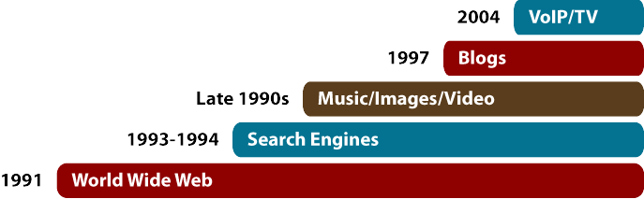


ICANN’s limited role
Content and applications standards (HTML, XML, Java) – Promotes creativity and innovation in applications leading to email, World Wide Web, e-banking, Google, Skype, and much more
Internet protocols and standards (TCP/IP, DNS, SSL) – TCP/IP, divides data traffic into packets before they are transmitted on the Internet
ICANN is one of many organizations
and groups involved here
Telecommunications infrastructure –
Physical network made up of underwater cables, telephone lines, fiber optics, satellites, microwaves, Wi-Fi, and so on – facilitates transfer of electronic data over the Internet
Notes:
What Does ICANN Do?
To reach another person on the Internet you have to type an address into your computer -- a name or a number. That address must be unique so computers know where to find each other. ICANN coordinates these unique identifiers across the world. Without that coordination, we wouldn't have one global Internet.
In more technical terms, the Internet Corporation for Assigned Names and Numbers (ICANN) coordinates the Internet Assigned Numbers Authority (IANA) functions, which are key technical services critical to the continued operations of the Internet's underlying address book, the Domain Name System (DNS). The IANA functions include: (1) the coordination of the assignment of technical protocol parameters including the management of the address and routing parameter area (ARPA) top-level domain; (2) the administration of certain responsibilities associated with Internet DNS root zone management such as generic (gTLD) and country code (ccTLD) Top-Level Domains; (3) the allocation of Internet numbering resources; and (4) other services. ICANN performs the IANA functions under a U.S. Government contract.

Slide 4
How does ICANN work?
Bottom-up consensus building model
  Governments
  Private sector
  Technical community
  Users
Internationally diverse Board of Directors overseeing the policy development process
President & CEO, staff

Slide 5
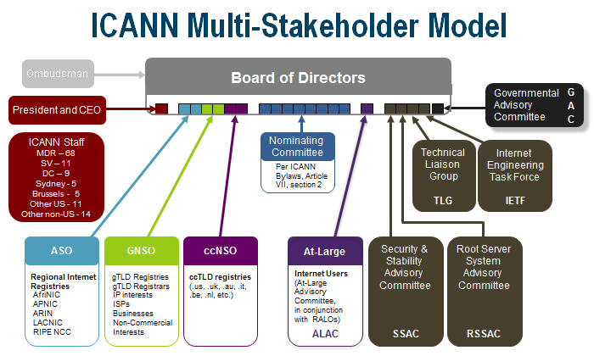
Notes:
MSM

Slide 6
Thank You
Questions?

