Slide 1
FY14 Budget Process
Community Review – March 5th 2013

Slide 2
Agenda
Introduction – Janice & Maya (5 min)
  Welcome and roll call
  Session guidelines (Q&A, Wiki link, etc…)
Update on FY14 Budget Process Timeline – Aba (5 min)
FY13 Portfolio Management Update – Carole (10 min)
FY14 Revenue Target – Ken (5 min)
SO/AC/SG budget request /status – Aba (5 min)
Next steps per revised timeline – Xavier (5 min)
Question and Discussion (25 min)

Slide 3
Introduction – Session Guidelines
Q & A session at the end of the presentation
Please visit the community wiki page:
https://community.icann.org/display/projfinadhocws

Slide 4
FY14 Budget Process and Timeline

Slide 5

PORTFOLIO MANAGEMENT DISCIPLINE
65
165
PORTFOLIO
Description
Owner
Timeline
(e.g. FY14)
Metric
PROGRAM
Description
Owner
Timeline
(e.g. FY14 T3)
Metrics
Priority
(within Portfolio)
Dependencies
Risks
Stakeholders
Budget
PROJECT/
ACTIVITY
Description
Owner
Timeline
(start & end date)
Metrics
Priority
(e.g. urgent, high, normal, low)
Team
Budget
4
16
OBJECTIVE
Description
Owner
GOAL
Description
Owner
Metrics

Slide 6
Explanation of Nomenclature
ICANN Definitions
Objective | Core foundational strategies upon which measurable targets are based
Goal | Desired achievable outcome to meet an organization-wide objective
Portfolio | Cross-functional work undertaken in support of goals (above) to fulfill core deliverables and services.
Program | A group of interdependent projects/activities managed in a coordinated way to obtain benefits and control not available from managing them individually. Programs may include elements of related work (ongoing operational efforts) outside of the scope of discrete projects
Project / Activity | A temporary endeavor that has a defined beginning and end to bring about beneficial change or added value to a program or initiative and that uses cross-functional resources Cyclical Projects (aka ongoing work) that are accomplished in a fiscal year timeframe
Task | A specific piece of work or duty assigned, of typically less than 90 days duration to a person(s)

Slide 7
Nomenclature for Program
Description – a detailed definition of the scope of work
Owner – name identified with each entry that is responsible for the work at ICANN
Timeline – target date designation
Portfolio – Fiscal Year
Program – the last trimester of the current year e.g. FY13 T3
Metric – description of quantifiable measurement of success
Priority – indicates level of priority within the fiscal year (e.g. Urgent, High, Normal and Low)
Budget – approved budget amount in US dollars
Dependencies – resource or activity that is critical to the success for completing the work
Risks – factors that may have a negative impact on the completion of the work
Stakeholders – community members that are either interested or impacted by the work

Slide 8
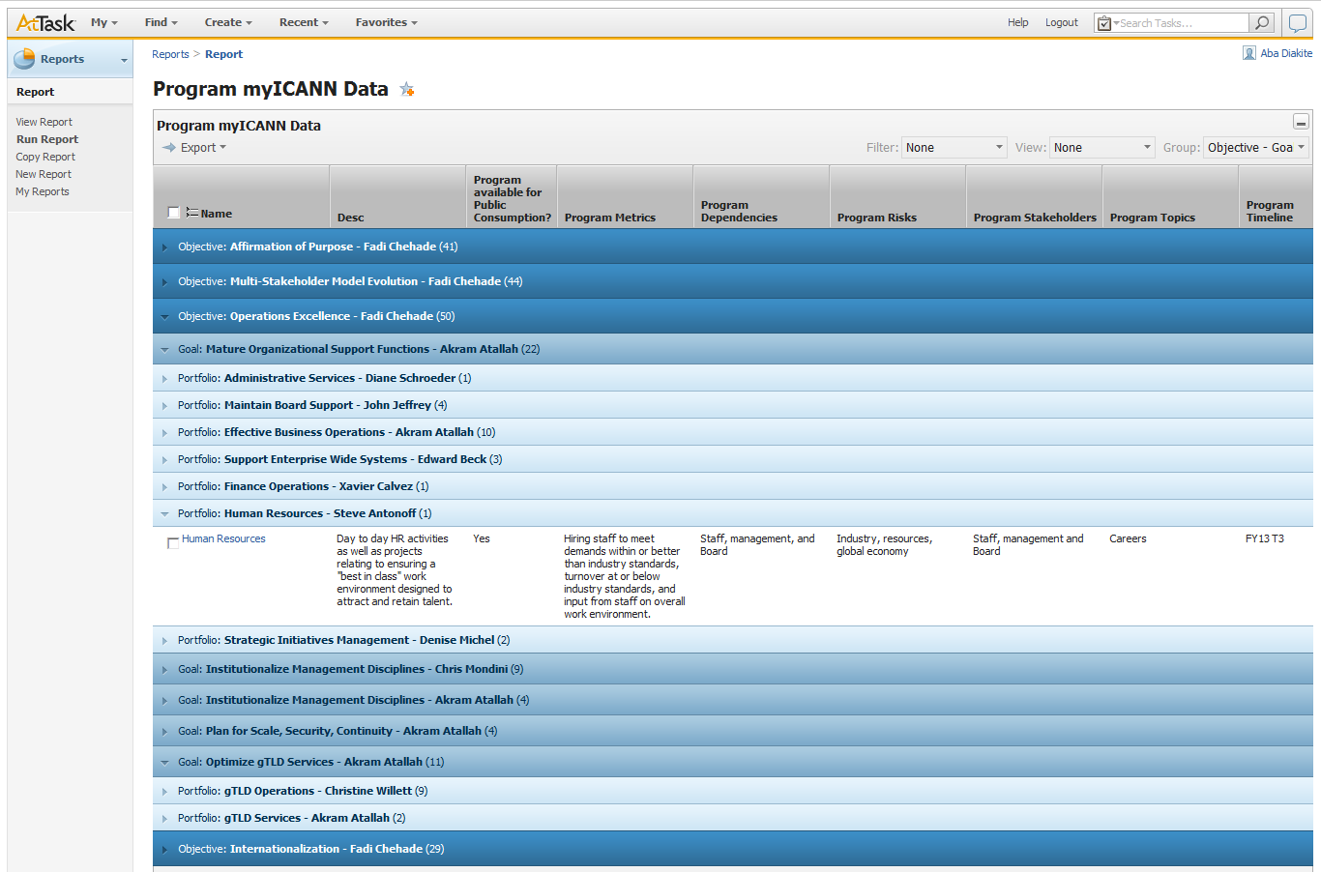
Portfolio Management Data via AtTask

Slide 9
Top-Down Preliminary Revenue Target
To be provided at the time of the presentation

Slide 10
SO/AC Special Budget Request
  SO/AC Special Budget template
  Wiki workspace
  Fast Track Request – due Fri 3/22/13
  Regular Track Request – due Fri 4/19/13
  Evaluation process
  Implementation
  Procurement
  Deliverables / Metrics

Slide 11
Next Steps
Community feedback on FY14 Programs
Beijing Meeting Finance update
FY14 draft Ops Plan and Budget Published

Slide 12
Questions & Discussion

