Slide 1


ICANN LAC Regional Strategy
Final Results
URUGUAY
February 7-8, 2013

Slide 2
Regional SWOT Matrix

Slide 3
INTERNAL FACTORS
EXTERNAL FACTORS
STRENGTHS
Associations with ccTLDs and gTLDs
Policy-Setting Model
IANA Functions Model
Organization and Structure
Accumulated Experience
Achieved Knowledge
Transparency Policy
Multistakeholder
Image and recognition
ICANN Public Meetings held in the region every year and a half
OPPORTUNITIES
Potential link with local communities
Demonstrate that the MSH model is functional
Define its role in the ATRT Policy
Opportunity to grow given high Internet penetration against small number of domains in the region
Increase ICANN’s physical presence at a local level
Strengthen ICANN’s image and communication
New players, new organizations in the industry
Increase regional commercial focus
WEAKNESSES
Language barriers
Lack of coordination in order to use and maximize capacity building
Inadequate knowledge of how to influence on ICANN’s agenda
Weak link between discussions at ICANN and the day-to-day issues of Stakeholders in the region
Low budget
Unclear relevance of the subjects on ICANN’s agenda
Low representation of the region within ICANN
Low involvement of the private sector
Low involvement of governments
THREATS
Lack of consideration of the region in decision-making related to Internet management and development, resulting in low participation
Security aspects in relation to local ISPs
New players, new organizations in the industry.

Slide 4
What are we pursuing as a region? Why should ICANN consider our region’s needs in its Strategic Plan?

Slide 5
What are we pursuing as a region?
Group 1
Have more legitimate topics of interest.
Increased participation in decision-making.
More attractive content from ICANN.
Catch governments’ interest in ICANN-related topics.
Focus on the Domain Name Industry and associates.
Group 2
Have the capacity to influence upon ICANN as a region.
Group 3
We are pursuing a balanced participation of our region within ICANN’s world.
We want to be listened to and acknowledged in order to strengthen the LAC Community.

Slide 6
Why should ICANN consider our region’s needs in its Strategic Plan?
Group 1
It is ICANN’s obligation to be global; ICANN needs us as a region and we need ICANN as well.
In order to establish distinct policies for our region.
To encourage the creation of new Regional Interest Groups within ICANN.
To ensure the allocation of resources and facilitate the region’s participation.
To guarantee ICANN’s accountability towards the community and the public in general.
Group 2
To fulfil its multistakeholder role as an organization and promote the bottom-up policy development process. We want to influence so that ICANN policies can have a positive impact on the region.
To achieve an adequate industry development in the region regarding ICANN-related aspects.
We want to set our expectations at a regional level within ICANN’s strategic framework, but by means of the bottom-up model.
Group 3
To ensure the allocation of financial resources and staff in order to facilitate and guarantee ICANN’s response to the community in view of its commitment to the AoC and the global public interest.

Slide 7
Key Areas of Interest

Slide 8
Key Areas Defined for the Region
The key areas defined for the region are:
1. Political Aspects
2.Capacity Building
3. Operations
4. Financial Aspects
For each of these areas, participants worked in groups in order to define strategic objectives for the region within a three-year time frame.

Slide 9
Objectives, Indicators & Alignment Matrix

Slide 10
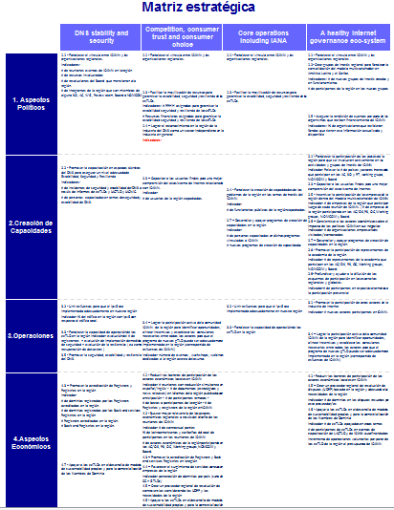
Objectives, Indicators & Strategic Alignment Matrix
Final objectives, their alignment with ICANN’s strategic areas and their defined follow-up indicators are displayed separately in the file “Matriz_alineación_estratégica_fecha” so that they can be better visualized.

Slide 11
Inputs

Slide 12
Key Areas for the Region – GroupWork

Slide 13
Key Areas for the Region – Group Work
Group 1
Operations
Multistakeholder Model
Internationalization
Capacity Building
Group 2
Financial aspects
Educational Aspects
Political Aspects
Group 3
Infrastructure
Capacity Building
Representation
Coordination of stakeholders within the region

Slide 14
Identify the issues that are most relevant to the region.
Which aspects should be prioritized within the Internet Ecosystem in order to benefit the region?

Slide 15
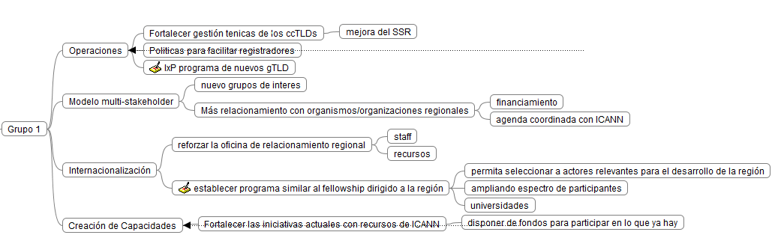
Group 1

Slide 16
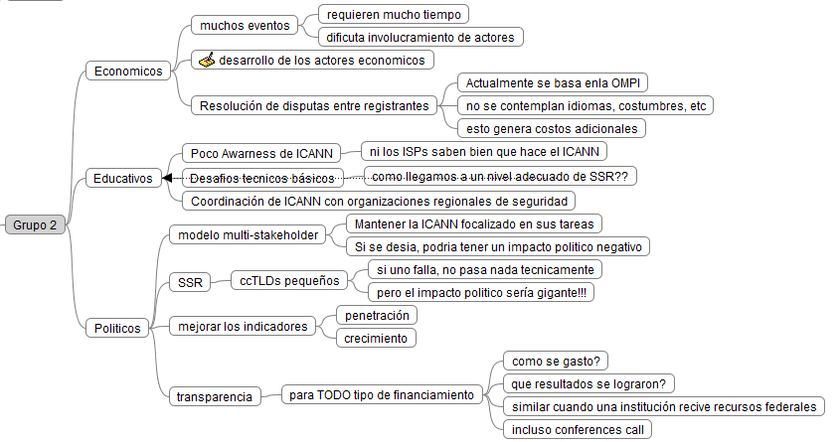
Group 2

Slide 17
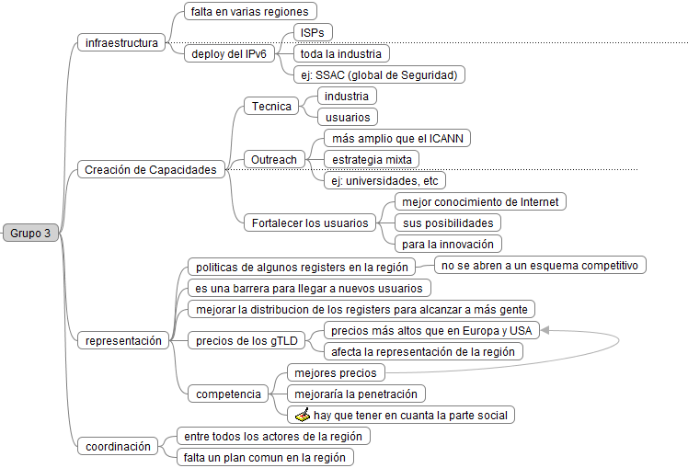
Group 3

Slide 18
Strategic Objectives Presented by the Groups - First Version

Slide 19
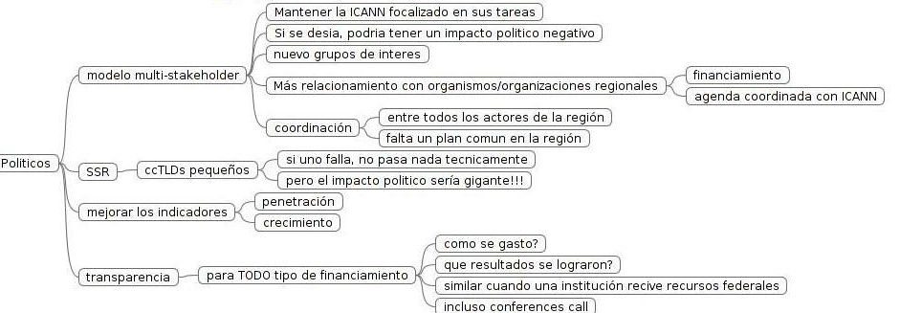
Summarized View
Strategic Objectives – First Version
1.Political Aspects
Strengthen ICANN’s link with regional organizations by drafting a joint biannual agenda.
Create Regional Interest Groups to strengthen the consolidation of the multistakeholder model in Latin America and the Caribbean.
Facilitate the mobilization of resources in order to guarantee the stability, security and resiliency of ccTLDs.
The regional strategy for Latin America and the Caribbean must support ICANN’s focus on the technical aspects of managing critical Internet resources.
Focus on ICANN’s actions remaining mainly within the technical remit of critical Internet resources.

Slide 20
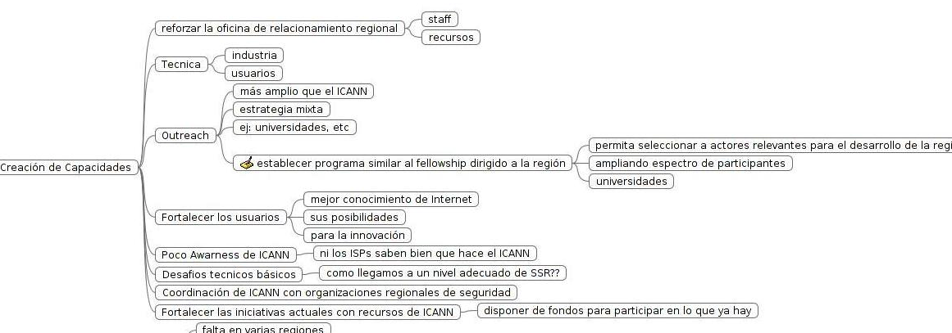
Summarized View
Strategic Objectives – First Version
Strengthen the participation of all the countries in the region so that they can actively engage in ICANN’s Interest Groups and activities, promoting mutistakeholder coordination at a national and regional level to make the most of these capacity building initiatives.
Promote training in DNS technical aspects to ensure an adequate level of Stability, Security and Resiliency.
Educate end users so that they can better understand the Internet Ecosystem.
Strengthen capacity building for governments in the region.
Encourage the participation of companies in the region within ICANN’s multistakeholder model.
Strengthen and make the most of existing capacity building programs in the region.
Promote the participation of regional academia representatives and create alliances with universities to encourage research and education regarding topics linked to ICANN’s vision and mission.
2.Capacity Building

Slide 21
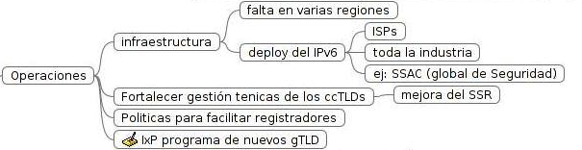
Summarized View
Strategic Objectives – First Version
Promote the participation of other Internet industry stakeholders, like Internet exchanges, university networks, online services providers (OSPs) - Google, Microsoftware, Amazon, Yahoo -, data centers, cell phone operators (not regulators, but individuals in business and operational areas).
Join efforts so that IPv6 can be adequately implemented in our region.
Have the region acknowledge the Internet industry as independent from the industry sector in general.
Strengthen ccTLDs operational capabilities in the region with the support of existing initiatives.
Create enabling/ facilitating policies for registrars.
Achieve the active participation of the existing ICANN community (ourselves) to identify opportunities, align incentives and establish the necessary links among all stakeholders so that the New gTLD Program can be adequately implemented in the region (as ICANN’s efforts counterpart).
3.Operations

Slide 22
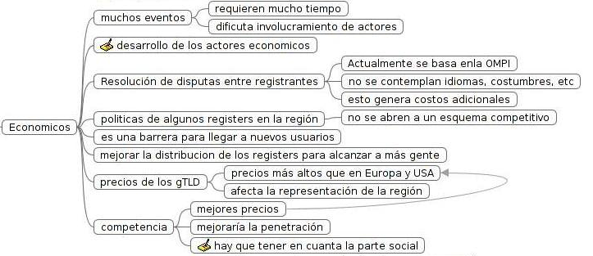
Summarized View
Strategic Objectives – First Version
Reduce barriers that hinder the participation of local economy stakeholders within ICANN.
Seek higher relevance of local economy stakeholders through the design of ICANN meetings.
Raise companies’ awareness of how ICANN impacts upon their business operations.
Promote Registrar and Registry accreditations in the region.
Favor the emergence of related services in the companies of the region.
Create a regional UDRP (Uniform Dispute Resolution Policy) provider based in the region and able to meet the region’s needs.
Support the ccTLDs in the development of their own sustainability and domain names marketing models.
4.Financial Aspects

Slide 23
Some initiatives received by e-mail

Slide 24
Initiatives
Area | Objective | Initiatives
3 | 3.5 Promote DNS security, stability and resiliency. | Deploy replications of the 13 root servers in the region. Coordinate with regional organizations to that end.
2 | 2.1 – Strengthen the participation of the countries in the region so that they can actively engage in ICANN’s Interest Groups and activities. | Create educational and informative materials (online and offline) to explain ICANN’s vision and mission, with content that will suit the intended target audience.
2 | 2.3 – Educate end users so that they can better understand the Internet Ecosystem. | Promote opportunities for innovation by using the Internet.
2 | 2.4 – Strengthen capacity building for governments in the region regarding ICANN’s topics of interest. | Use programs for sponsored participants. Induction for new government representatives.

