Slide 1
ICANN Mission, Structure and Constituencies
Capacity Building Program
Dakar, 23-27
October 2011
Anne-Rachel Inné

Slide 2

ICANN’s Mission
The mission of The Internet Corporation for Assigned Names and Numbers ("ICANN") is to coordinate, at the overall level, the global Internet's systems of unique identifiers, and in particular to ensure the stable and secure operation of the Internet's unique identifier systems. In particular, ICANN:
1. Coordinates the allocation and assignment of the three sets of unique identifiers for the Internet, which are
a. Domain names (forming a system referred to as "DNS");
b. Internet protocol ("IP") addresses and autonomous system ("AS") numbers; and
c. Protocol port and parameter numbers.
2. Coordinates the operation and evolution of the DNS root name server system.
3. Coordinates policy development reasonably and appropriately related to these technical functions.

Slide 3
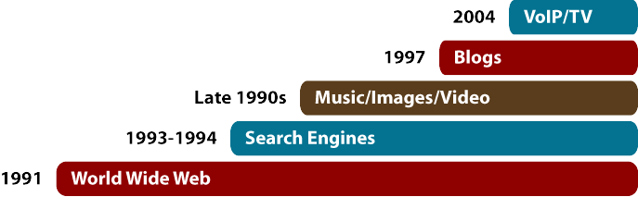


ICANN’s limited role
Content and applications standards (HTML, XML, Java) – Promotes creativity and innovation in applications leading to email, World Wide Web, e-banking, Google, Skype, and much more
Internet protocols and standards (TCP/IP, DNS, SSL) – TCP/IP, divides data traffic into packets before they are transmitted on the Internet
ICANN is one of many organizations
and groups involved here
Telecommunications infrastructure –
Physical network made up of underwater cables, telephone lines, fiber optics, satellites, microwaves, Wi-Fi, and so on – facilitates transfer of electronic data over the Internet

Slide 4
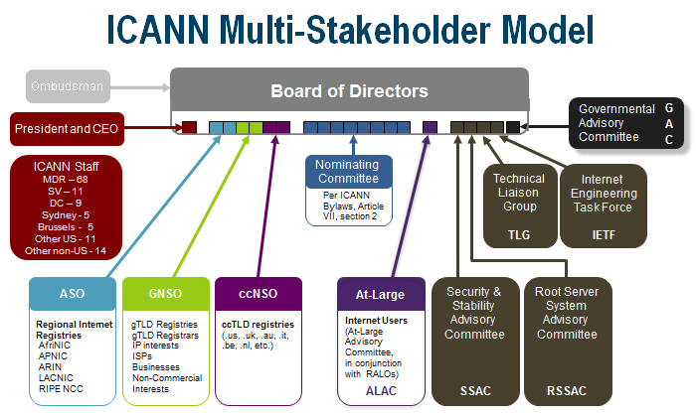

Slide 5
Thank You

Slide 6
Questions

