Slide 1

ICANN Academy
Understanding and developing ICANN for a better multi-stakeholder model

Slide 2

Point of departure
ICANN – a highly complex multistakeholder organization
Only little literature available
„Learning by doing “
2-3 ICANN meetings to understand complex procedures
2

Slide 3
Point of departure
Potential of ICANN leaders not available from the beginning
Various capacity building programs in place (i.e. fellowship program)
Don’t meet the special need for newly appointed SO/AC officers and other leaders
3

Slide 4
The ICANN Academy could fill this existing gap!
4

Slide 5
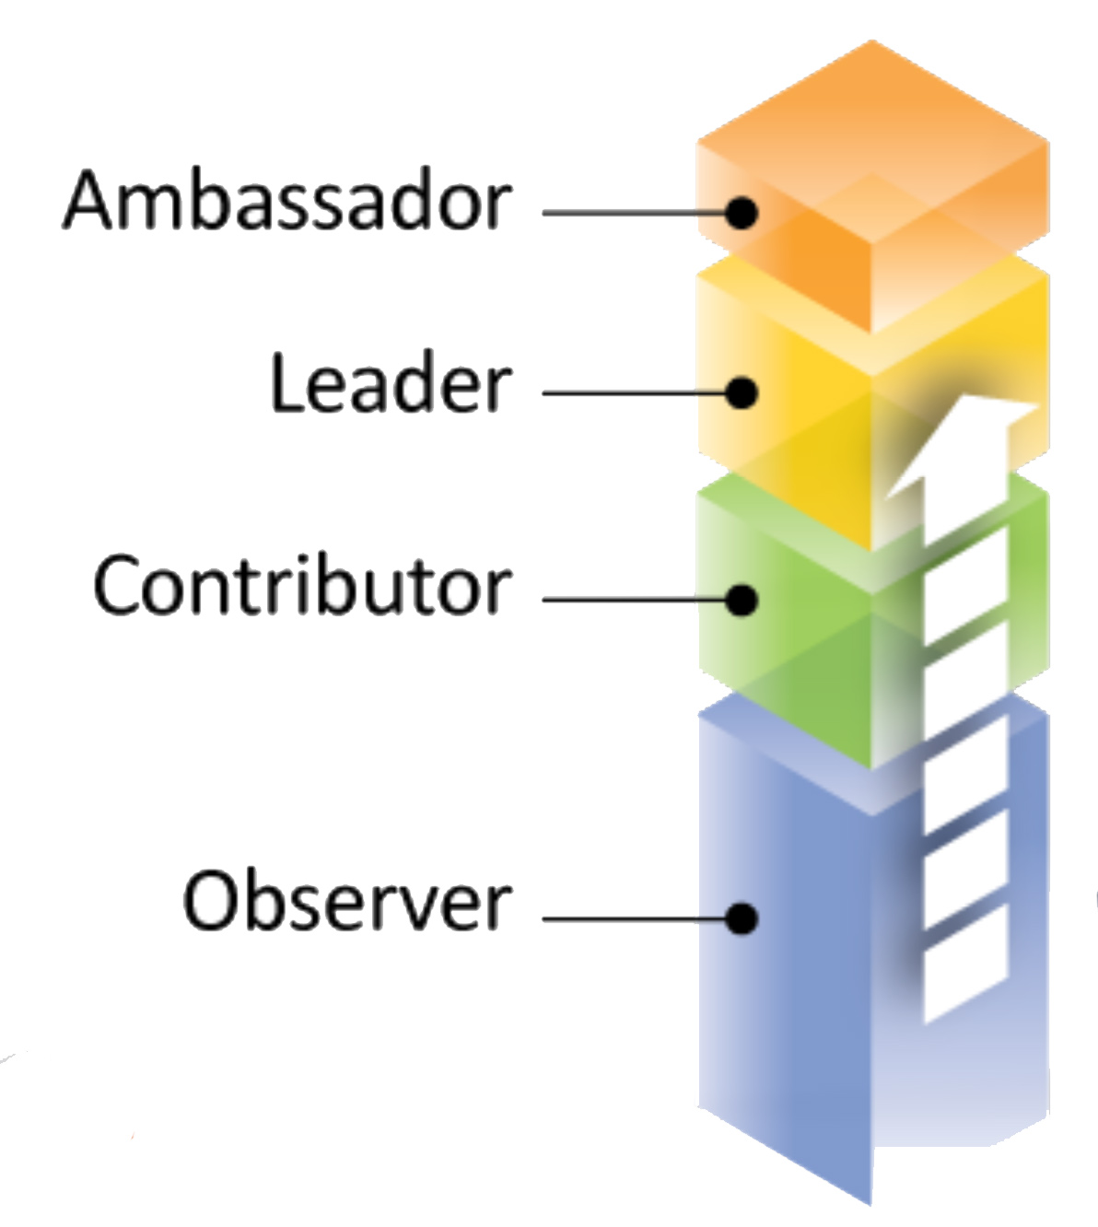
Framework
ICANN Academy
Knowledgetransfer
Inter constituency capacity building ¹
Advanced virtual learning
Newcomers
Track
Newcomers
Lounge
Fellowship Programm
Video and Transcript Support
e-Learning:
Podcasts, Webinars, Audio Briefings
Multilingual info material
Factsheets,
Glossary, FAQ
Beginners Guides
Kurt Pritz , Advancing Outreach
¹ Tech Day, RALOS capacity building and the like
Level of Engagement
Capacity building provisions

Slide 6
Key elements
Knowledge transfer
Basics about ICANN’s complex structure, function, procedures, policies, ongoing issues
2. Socializing aspect
In order to develop the multistakeholder model and foster cross community work during their term.
6

Slide 7
Target Group
Board Members
Supporting Organization council members
Advisory Committee members
New Senior Level staff as potential trainees
7

Slide 8
Target Group
Different groups with specific backgrounds
Convey a basic understanding:
1. about ICANN issues
2. for the different perspectives of each
group
foster interaction and dialogue among these stakeholder groups
8

Slide 9
Concept
15 participants
3 days / 20 hours
Face 2 face meeting
Before their term starts
Prior to ICANN meeting
(AGM / Wednesday – Friday)
Half day wrap up
9

Slide 10
Format of the Academy
English language
In an isolated environment
Interactive format
Interaction also besides the meeting room
To be continued during and after the ICANN meeting
10

Slide 11
Curriculum
Core topics (Day 1)
Specific ICANN training (Day 2)
Current ICANN Issues (Day 3)
Wrap Up at the end of the ICANN meeting (1/2 day)
11

Slide 12
Methodology
Lecture, debating, Q&A session
Follow up during beginners session, webinars, TechDay
Lecturer available for 3 days
Peer to peer mentoring
Moodle, Wiki workspace
Multilingual support by translating documents
12

Slide 13
Next steps
WG meeting in Prague
Wednesday, 27 June 2012, 9:00-10:00
Meeting Room: Roma
Pilot in Toronto (ICANN No. 45)
Review and improvements phase
Annual ICANN Academy
(after NomCom appointments have been
made and announced)
13

Slide 14
Goals of this expanded WG
Create a programme committee
Define the curriculum
Produce course material
Define and approach the faculty
Review after the pilot and propose improvements
14

Slide 15
The current proposal should be implemented into an inclusive ICANN Academy concept, synchronized with existing capacity building programmes offered by ICANN, to meet the needs of other ICANN stakeholder groups by using various inclusive training methods like virtual learning.
Looking ahead
15

Slide 16
Thank You

Slide 17
Questions

