Slide 1
Global Stakeholder Engagement:
Update on Outreach

Slide 2
AGENDA
Welcome and Rules of Engagement – 5 min / Hayley LaFrambroise
Confirm Attendees / Agenda – 5 min / Janice Lange
Where We Have Been (Toronto) – 5 min / Janice
Where We Are Now – 5 min / Mandy Carver
Where We Are Going / Beijing – 10 min / Sally Costerton
Speaker Bureau - 10 min / Jim Trengrove
Community Input on Agenda Items/Session – 45 min
Wrap up and action items – 5 min -
Notes:
Sally to come in at end of Mandy to gut check community understanding in buy-in / 10 min max

Slide 3
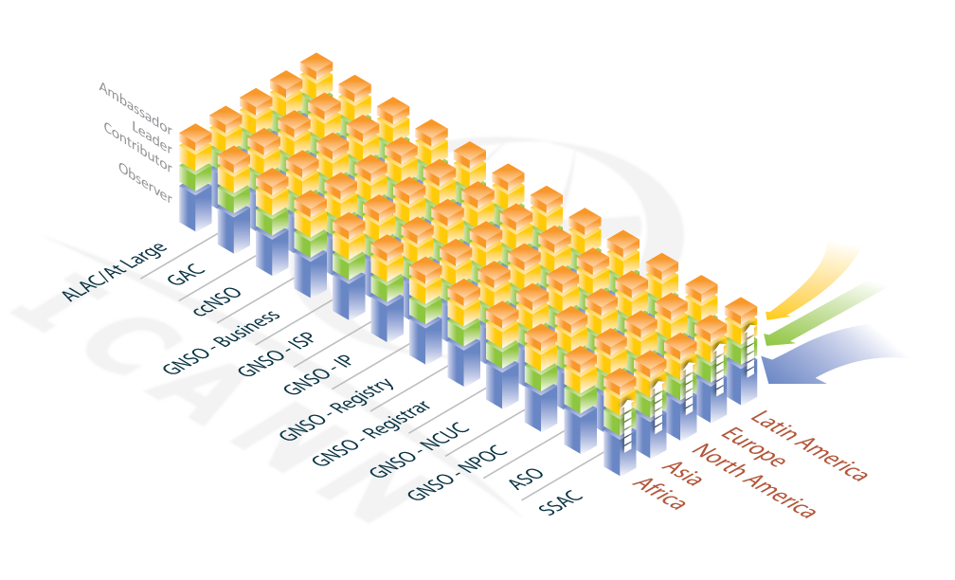
Move In, Move Up, Make Effective
Notes:
Janice: When many of us first started working on the Outreach Initiative, this “waffle iron” diagram was the summary of how we thought Outreach needed to look. With Marilyn Cade’s and others input, determined that the wording “Awareness, Participation and Contribution” were perhaps better suited to describe how we saw new people’s journey into ICANN and what we needed to focus on going forward

Slide 4
Toronto Summary: Building Blocks for Outreach
Vision/
Message
Collaboration
Strategy/
Planning
Awareness
Participation
Contribution
Roles
Materials
Collateral
Methods
Notes:
Janice: Message: need clear, thought out vision, and messaging around image needs to be in plain English; Strategies developed –use community “on the ground” in the regions to advise and share information; Planning: assess current activities, determine new, expectations for success/need clear objectives and determine roles for staff and community (driver vs facilitator) and prioritize outreach efforts; Collateral/Materials: assess current and usefulness, new required for multiple use as well as customized for specific use; Methods: use methods that work for different regions, different types of outreach, different gatherings; Collaborate with entities outside of ICANN as well as within, including calendaring; as well as utilizing the expertise within the community; plan ahead for global meetings and opportunities and don’t schedule against them as much as possible

Slide 5
Where We Are Now: GSE and Outreach
Three pillars of Outreach
1. Community Outreach: to and also by the community – constituency groups
2. Technical Engagement – technical skills, capacity building
3. ICANN in the Internet Ecosystem
Notes:
Mandy: there are 3 pillars to all of ICANN’s outreach activities. GSE has a coordination role for all three and actively participates in all 3 kinds but for example Security would be more in technical engagement and community outreach.1. Community outreach can be about recruitment and awareness raising, what is ICANN, what does it do and what are the structures – why should you care, how to get involved and where – But we also do awareness raising about challenges to the MSM and the importance of certain venues and efforts – why you should care, what is at stake, what you can do – that has nothing to do with recruiting membership into ICANN constituencies.
2. Technical engagement – driven by community requests and in support of the single stable interoperable Internet – DNSSEC, DNS Ops, requests for training on security, DDOS attacks, business continuity, best practices models; participating in working groups and study groups
3. ICANN in the Internet Ecosystem – Diplomacy in governmental and intergovernmental settings; working with the I* partners and with allied groups in defense of the multi-stakeholder model; translating the MSM into a framework that is understood in various regions and cultures and governance models; for example using a message of partnering with governments is better received in some parts of the world and addresses the concern that the MSM replaces or displaces the role of governments.

Slide 6
Where We Are Going / Beijing
Proposal: Interactive Work session
production of collateral (products that we can all use: websites, ppts, printed and digital material)
conferences, event and speaker panels, workshops
digital engagement (online platforms, access tools)
Populate the waffle iron model
Notes:
Sally: I will provide community with an overall presentation on GSE, with David Olive and SO AC Engagement and Xavier on resourcing SO AC requests…then propose to break into 4 groups working several opportunities that were mentioned in previous Outreach sessions, based on what the stakeholder groups have in common and how we work together best
-Is there something we have missed as a priority?

Slide 7
Speaker Bureau
On ICANN website at http://www.icann.org/en/contact/speakers
Facilitate and streamline the speaker request process
Statistics since January
https://www.myicann.org/calendar

Slide 8
Action Items

Slide 9
Move In, Move Up, Make Effective
Notes:
Community and Regional VPs start to populate for Beijing interactive

Slide 10
Questions? Comments?

