Slide 1
Update on Evolving Organizational Reviews into a Continuous Improvement Program
[insert community structure/group] input on the draft Continuous Improvement Program Framework in progress by the CIP-CCG
[insert name of CIP-CCG representative and alternate]
Virtual (Zoom) - June 2024
Notes:
Hello, I am (name), the (community structure/group) (representative/alternate) to the Continuous Improvement Program Community Coordination Group.
I am presenting to you today to provide you with an update on the work of the Continuous Improvement Program Community Coordination Group, and the progress made thus far towards the development of a draft Continuous Improvement Program framework for the community. The Community Coordination Group has met nine times already in 2024, including one hybrid meeting during the ICANN79 Community Forum.
I was appointed by the (community structure/group) because…share your relevant experience in and outside of ICANN related to continuous improvement, and motivation to contribute to the continuous improvement of your community structure.
I welcome your questions and input from the perspective of the (community structure/group) as a part of this presentation. I am also regularly engaging with you throughout 2024 on the development of the draft CIP framework by the Community Coordination Group, so there will be many opportunities for your input.

Slide 2
Purpose of today’s presentation
As per the Terms of Reference (TOR) for the CIP-CCG, “the representatives in the CIP-CCG will share best practices and collaborate on community-wide implementation of ATRT3 Recommendation 3.6, while relaying information back to their constituencies to inform the process and voice decisions”.
It is important for the community to develop a shared understanding of the CIP framework being developed by the CIP-CCG, and the goal of this presentation is threefold:
Education: Educate the community on the Principles, Criteria, Indicators framework.
Questions: Answer questions about the framework.
Feedback: Invite input on the criteria and indicators.
Notes:
This is the purpose of today’s presentation.
As described in the Terms of Reference for the Continuous Improvement Program Community Coordination Group, “the representatives in the group will share best practices and collaborate on community-wide implementation of ATRT3 Recommendation 3.6, while relaying information back to their constituencies to inform the process and voice decisions”.
It is important for the community to develop a shared understanding of the Continuous Improvement Program framework being developed by the Community Coordination Group, and the goal of this presentation is threefold:
Education: Educate the community on the Principles, Criteria, Indicators framework.
Questions: Answer questions about the framework.
Feedback: Invite input on the criteria and indicators. Previously, I presented to you for input on the principles.
I will first provide a high level overview of the recommendation to establish a Continuous Improvement Program for the ICANN Community, and then the progress made on the development of the draft framework by the Community Coordination Group, including work on this next phase to develop criteria and input relevant to our group.

Slide 3
ATRT3 Recommendation 3.6: Evolving Organizational Reviews
The Third Accountability and Transparency Review (ATRT3) Recommendation 3.6 calls for the evolution of Organizational Reviews conducted by an Independent Examiner into a Continuous Improvement Program (CIP) led by the ICANN community. The Board deferred upcoming Organizational Reviews until 2025 so that this recommendation and others from ATRT3 could be implemented.
The ICANN community demonstrated great interest in contributing to the evolution of Organizational Reviews into a CIP, with 21 out of 22 of the groups across the ICANN community represented in a Continuous Improvement Program Community Coordination Group (CIP-CCG) which convened in January 2024.
The CIP-CCG is tasked with developing a framework for the CIP, which will be published for Public Comment prior to adoption by each SO, AC, and the NomCom.
The CIP will include a regular survey of members/participants for assessment, utilizing the framework.
Notes:
The Third Accountability and Transparency Review (ATRT3) Recommendation 3.6 calls for the evolution of Organizational Reviews conducted by an Independent Examiner into a Continuous Improvement Program (CIP) led by the ICANN community.
There are community-perceived shortcomings of Organizational Reviews, which led to ATRT3 Recommendation 3.6. The perceived shortcomings include the ability of the Independent Examiners that have conducted Organizational Reviews to understand the complexities of the ICANN structures and produce useful recommendations. The quality of the Independent Examiner recommendations has been debated by the community, and the volume of recommendations has led to a current backlog to implement a number of recommendations.
One of the goals for the CIP is to accomplish the objectives of the Organizational Reviews without undertaking the volume of work required in the past.
The Board deferred upcoming Organizational Reviews until 2025 so that this recommendation and others from ATRT3 could be implemented.
The ICANN community demonstrated great interest in contributing to the evolution of Organizational Reviews into a CIP, with 21 out of 22 of the groups across the ICANN community represented in a Continuous Improvement Program Community Coordination Group (CIP-CCG) which convened in January 2024.
The CIP-CCG is tasked with developing a framework for the CIP, which will be published for Public Comment prior to adoption by each SO, AC, and the NomCom.
The Continuous Improvement Program will include a regular survey of members/participants for assessment, utilizing the framework once it is developed and adopted by the community.
The Board will consider the progress made toward evolving Organizational Reviews into a Continuous Improvement Program, including the framework for adoption, by June 2025.

Slide 4





CIP-CCG Roadmap (2024)
ICANN81 Prep Week
28-31 Oct (est)
CIP-CCG Webinar
The CIP-CCG finalize principles
5 Jun
The CIP-CCG receive input on Criteria and Indicators
5 Jun - 24 Jul
ICANN81 Annual General Meeting
9-14 Nov
Community and Board socialization of the framework
4 Sept - 16 Oct
ICANN80 Prep Week
28-30 May
APR
2024
MAY
2024
5 JUN
2024
JUL
2024
7 AUG
2024
SEPT
2024
OCT
2024
21 NOV 2024
ICANN80 Policy Forum
10-13 Jun
The CIP-CCG receive input on Principles
3 Apr - 29 May
The CIP-CCG finalize criteria and indicators
7 Aug
CIP Framework
published for
Public Comment*
21 Nov
*The CIP-CCG will address input received and revise the CIP Framework, where relevant.
Notes:
This slide shows the details about the work of the Community Coordination Group this year, within the overall Continuous Improvement Program Roadmap. Our work has been divided into four phases over 2024.
From April to the end of May, CIP-CCG volunteers presented to our groups for input on the draft principles.
In June and July, we are moving forward from work on principles to work on the next phase - which is organizing working sessions with our individual groups to gather feedback on the Criteria and Indicators relevant to our group.
The Continuous Improvement Program Community Coordination Group is also planning our work around the ICANN meetings, including the Policy Forum in June and Annual General Meeting in November.
By August, we plan to conclude our substantive work on criteria and indicators, and ICANN org will begin preparations for the Public Comment proceeding. The Community Coordination Group will also socialize the framework with our groups at that time, beginning in September ahead of the ICANN81 Annual General Meeting and a potential Prep Week webinar facilitated by the Community Coordination Group volunteers.
The target for the opening of the Public Comment will be soon after ICANN81, at the end of November - and the Community Coordination Group will be available to address input on the framework, as needed.
Where possible, this timeline is to be expedited by the Community Coordination Group, but it is anticipated to take at least the calendar year 2024 based on the current cadence of the community’s work.

Slide 5
Phases of CIP-CCG Timeline
Phase 1 (January - March) COMPLETE: The CIP-CCG made substantial progress toward developing principles for the CIP, which provide a common base for the assessment of the different ICANN community structures. The principles stem from Article 4.4 of the ICANN Bylaws describing objectives for Organizational Reviews.
Phase 2 (April) COMPLETE: Community representatives went to their groups to inform them of the progress of the CIP-CCG and their work-to-date, including work the Principles, Criteria, Indicators approach for the draft CIP framework, how the framework will be utilized in the (first) CIP assessment phase. Ongoing CIP-CCG meetings and regular updates from your CIP-CCG representative (and alternate) throughout 2024.
Phase 3 (May, June) IN PROGRESS: Once Community reps have educated their structures on CIP-CCG progress on the Principles, Criteria, Indicators approach and how the process of the CIP will work, they are now organizing working sessions with their community reps in Q2-3 2024 to gather feedback on the Criteria and Indicators for their group. Provide input to your CIP-CCG representative!
Phase 4 (July, August): Finally, community reps work with groups to reach consensus on Criteria and Indicators applicable to their organizational structures (this will occur after iterations of CIP-CCG meetings during Phase 2). Draft CIP Framework will be published for Public Comment (est. Oct/Nov 2024).
Notes:
So on the screen here are the four general phases of our work, as reflected in the timeline for 2024.
Phases 1 and 2 have already progressed.
Now during Phase 3, we are organizing a working session with (community structure/group) in to gather your feedback on the Criteria and Indicators for (community structure/group).
Please note that in June there will be the ICANN80 Policy Forum, which may provide opportunities for us to engage on the work on the draft CIP framework and for the ICANN org Reviews team to engage with us on the progress and facilitation of this work.
The CIP-CCG meetings will refine the input from all the community groups during our meetings in June and July.
In phase 4 in July and August: We will reach consensus on Criteria and Indicators applicable to our organizational structures.
The draft CIP Framework will eventually be published for Public Comment in November.

Slide 6
Continuous Improvement Program Roadmap
CIP Assessment
Period 2
estimated to begin
in 2028
Conclude at the end
of 2030 (3 years)
Initial development phase of
CIP Framework,
12-month estimation, concluding by Dec 2024
Board consideration of
CIP pilot and progress made towards evolving Organizational Reviews
NOV
2024
DEC
2024
JAN
2025
FEB-MAY
2025
JUN
2025
DEC
2027
JAN
2028
DEC
2030
CIP Assessment
Period 1
estimated to begin upon
adoption of the Framework
Conclude at the end
of 2027 (3 years)
CIP Framework
published for
Public Comment
The results of the
CIP assessments will inform the Holistic Review*
*Subject to community support, Board approval and incorporation into the ICANN Bylaws.
Notes:
On this slide you see the overall roadmap for the Continuous Improvement Program.
The recommendation states “ICANN org shall work with each Supporting Organization, Advisory Committee, and the Nominating Committee to establish a continuous improvement program [that shares] a common base between all [organizational structures] but will also allow for customization so as to best meet the needs of each individual SO/AC/NomCom.”
This draft CIP Framework currently being developed by the Continuous Improvement Program Community Coordination Group (CIP-CCG) will be published for ICANN Public Comment in 2024 before adoption, and the first CIP Assessment Period would take place afterwards. It is estimated to last 3 years, including a survey of each organizational structure and their stakeholders, that utilizes the CIP framework.
The results of the CIP assessments will inform the Holistic Review.
As your (representative/alternate) to the CIP-CCG, I have shared the existing and ongoing continuous improvement activities of (community structure/group), which is informing the draft CIP framework in progress and will be taken into consideration during each CIP assessment phase.
In June 2025, the ICANN Board will evaluate the progress made thus far towards evolving Organizational Reviews into a Continuous Improvement Program pilot. The related Bylaws Amendment to formalize the Evolution of Organizational Reviews into a CIP would occur thereafter, including Public Comment proceeding(s) as required.
The work of the CIP-CCG to produce a framework for the CIP will be done by then, but the overall implementation of ATRT3 Rec. 3.6 will continue under the first CIP assessment.

Slide 7
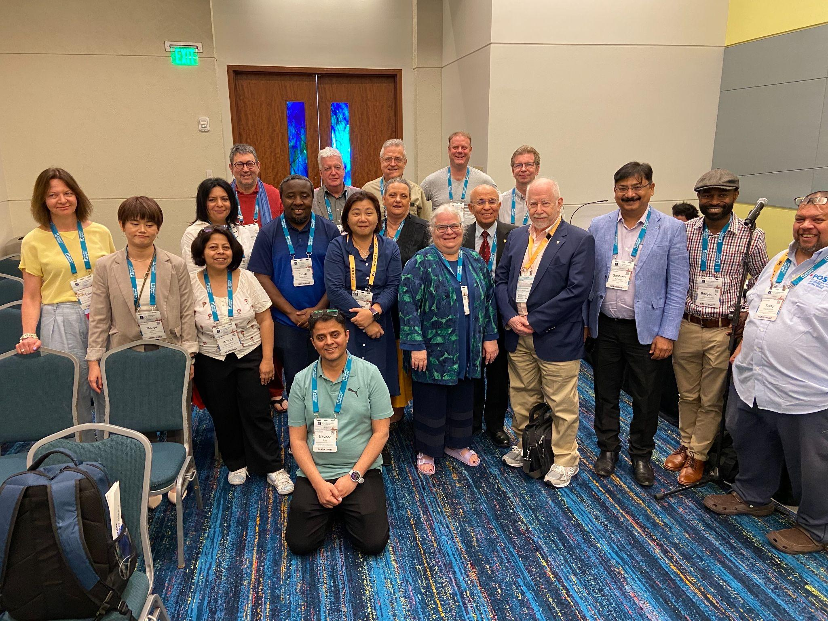
ICANN Community and the CIP-CCG
Pictured: CIP-CCG volunteers during the ICANN79 Community Forum.
CIP-CCG volunteers are sharing best practices and collaborating on community-wide implementation of ATRT3 Rec. 3.6. In work to-date, they have considered a range of methodologies for effective continuous improvement programs, utilizing a Principles-Criteria-Indicators framework fit for ICANN purpose.
CIP-CCG volunteers are drafting the CIP Framework, to be used by each SO, AC, and NomCom, while relaying information back to their groups to inform the process.
Notes:
Here is a nice photo of the CIP-CCG volunteers during the ICANN79 Community Forum.
As noted, CIP-CCG volunteers have shared the extensive work already underway within all the structures towards continuous improvement, and are collaborating on community-wide implementation of ATRT3 Rec. 3.6. In work to-date, we have considered a range of methodologies for effective continuous improvement programs, utilizing a Principles-Criteria-Indicators framework fit for ICANN purpose.
CIP-CCG volunteers are drafting the CIP Framework, to be used by each SO, AC, and NomCom, while relaying information back to their groups to inform the process.
I will provide more information on this framework later in the presentation.
Here is a recent blog on the significant progress and work of the CIP-CCG during ICANN79.
Share link in chat:
ICANN Continuous Improvement Program Makes Progress on a Draft Framework: https://www.icann.org/en/blogs/details/icann-continuous-improvement-program-makes-progress-on-a-draft-framework-28-03-2024-en

Slide 8
Principles / Criteria Framework
Principles / Criteria Framework: consists of principles, criteria, and indicators:
Principles describe the objectives of the Continuous Improvement Program. They define what the CIP is fundamentally trying to do.
Criteria are the conditions that need to be met in order to comply with a principle. Criteria define how a principle will be achieved, without themselves being a measure of performance.
Indicators define what the CIP will measure to assess whether or not criteria are being met. Indicators can include metrics, assessments, and or new processes put in place to meet criteria.
Notes:
Now I would like to provide more detail on this framework, including what Principles, Criteria, and Indicators framework means for the ICANN community and for (community structure/group). An illustrative example of how this framework works is included later in the presentation.
These Principles describe the objectives of the Continuous Improvement Program. They define what the CIP is fundamentally trying to do, and they come from the current ICANN Bylaws pertaining to Organizational Review objectives.
Criteria are the conditions that need to be met in order to comply with a principle. Criteria define how a principle will be achieved, without themselves being a measure of performance.
Indicators define what the Continuous Improvement Program will measure to assess whether or not criteria are being met. Indicators can include metrics, or new processes put in place to meet criteria.
A common base for the community assessment is provided by having shared principles. Flexibility is provided because each stakeholder group can prioritize criteria to focus on and develop custom indicators.

Slide 9
CIP Framework Considerations
Recommendation 3.6 states “ICANN org shall work with each SO/AC/NomCom to establish a continuous improvement program [that shares] a common base between all SOs, ACs, and the NomCom but will also allow for customization so as to best meet the needs of each individual SO/AC/NomCom.
Notes:
As noted, Recommendation 3.6 states “ICANN org shall work with each SO/AC/NomCom to establish a continuous improvement program [that shares] a common base between all SOs, ACs, and the NomCom but will also allow for customization so as to best meet the needs of each individual SO/AC/NomCom.”
This common base is the framework that is currently being developed by the CIP-CCG.

Slide 10
Current Objectives of Organizational Reviews
Source: Article 4.4 of the ICANN Bylaws
(i) whether that organization, council or committee has a continuing purpose in the ICANN structure.
(ii) if so, whether any change in structure or operations is desirable to improve its effectiveness.
(iii) whether that organization, council or committee is accountable to its constituencies, stakeholder groups, organizations and other stakeholders.
Notes:
As noted, these objectives provided by Article 4.4 of the ICANN Bylaws provide the foundation for the shared principles for the community under the new CIP.

Slide 11
ICANN Principles of Continuous Improvement (Draft as of 5 June)
Historically, ICANN Organizational Reviews have asked whether the Supporting Organizations (SOs), Advisory Committees (ACs), and the Nominating Committee (NomCom) have a continuing purpose within the ICANN community. Rather than articulating this as a single principle, it is an overarching consideration that is addressed through five separate principles that would guide the successful execution of the Continuous Improvement Program (CIP):
The SO, AC, or NomCom is fulfilling its purpose.
The operations of SO, AC, or NomCom are effective.
Principle 1
Principle 2
The SO, AC, or NomCom is accountable internally to its stakeholders and substructures (where applicable), and externally to the wider ICANN community.
The operations of SO, AC, or NomCom are efficient.
Principle 3
Principle 4
The SO, AC, or NomCom collaborates to further the mission of ICANN and the effectiveness of the ICANN bottom-up multistakeholder model.
Principle 5
Notes:
Here are the five draft principles discussed and developed by the CIP-CCG.
Historically, ICANN Organizational Reviews have asked whether the Supporting Organizations, Advisory Committees, and the Nominating Committee have a continuing purpose within the ICANN community. Rather than articulating this as a single principle, it is an overarching consideration that is addressed through five separate principles that would guide the successful execution of the Continuous Improvement Program.
The first principle is “The SO, AC, or NomCom is fulfilling its purpose”.
The second principle is “The structures of SO, AC, or NomCom are effective”.
The third principle is “The operations of SO, AC, or NomCom are efficient”.
The fourth principle is “The SO, AC, or NomCom is accountable internally to its stakeholders and substructures (where applicable), and externally to the wider ICANN community.”
The fifth principle is: “The SO,AC, or NomCom collaborates to further the mission of ICANN and the effectiveness of the ICANN bottom-up multistakeholder model”.
It is worth noting that the origin of “Accountable” in Principle 4 is from related Work Stream 2 – Recommendations to Increase SO/AC Accountability.
Share link in chat:
Work Stream 2 – Recommendations to Increase SO/AC Accountability: https://www.icann.org/resources/work-stream-2-implementation/increase-so-ac-accountability-en

Slide 12
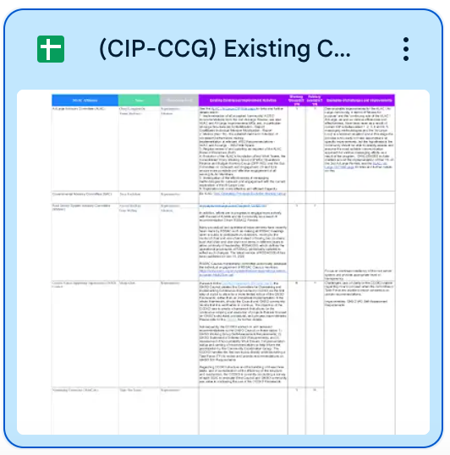
Mapping existing CI and Jamboard content
Principles
Criteria
Indicators (SMART)
Notes:
As mentioned, the CIP-CCG volunteers mapped the existing continuous improvement activities of (community structure/group) onto these draft principles, criteria, and indicators for the draft CIP framework in progress.
This included content from a collaborative Jamboard from the hybrid meeting during the ICANN79 Community Forum.
The group determined to use the “SMART” approach for indicators - An indicator, or metric to measure or form a process for criteria, should be Specific, Measurable, Achievable, Relevant, and Time-Bound, or (SMART).

Slide 13
Principles to Criteria Example
Example of Principle 3:
The operations of SO, AC, or NomCom are efficient.
Examples of potential Criteria for our community structure/group:
Each structure has a process for planning and setting priorities.
Each structure efficiently assesses inputs related to their scope of responsibility.
Each structure efficiently develops and recommends outputs relevant to their purpose (policy development, support policies, leadership placement).
Each structure’s outputs are implemented efficiently and implementation of outputs is monitored.
Notes:
I would now like to explain the relationship between the common Principles and customizable Criteria through an example.
Taking Principle 3 as an example: The operations of SO, AC, or NomCom are efficient. What criteria apply to this principle?
You can see on the screen here, suggested criteria. We also have the opportunity as (community structure/group) to use our existing continuous improvement activities to inform these criteria.
The CIP-CCG has a Google Drive workspace dedicated specifically to (community structure/group), where I can take your input and draft specific criteria.
We will organize a working session for (community structure/group) to develop our criteria and indicators, and relay our input to the CIP-CCG.

Slide 14
Principles to Criteria to Indicators Example
Example of Principle 3:
The operations of SO, AC, or NomCom are efficient.
Examples of potential Criteria for our community structure/group:
Each structure has a process for planning and setting priorities.
Each structure efficiently assesses inputs related to their scope of responsibility.
Each structure efficiently develops and recommends outputs relevant to their purpose (policy development, support policies, leadership placement).
Each structure’s outputs are implemented efficiently and implementation of outputs is monitored.
Examples of potential Indicator for Criteria: “Each structure has a process for planning and setting priorities”.
Yes.
If No, indicator could be to develop a process, that is Specific, Measurable, Achievable, Relevant, and Time-Bound (SMART).
Notes:
Next, you will see an example of how the principles and criteria relate to an indicator.
Using the example criterion of (community structure/group) having a process for planning and setting priorities, an indicator would ask whether that currently exists, and if not, could suggest that a process be developed that is Specific, Measurable, Achievable, Relevant, and Time-Bound, or (SMART).

Slide 15

Collaborative Input on Criteria and Indicators
Collaborative meeting with advance homework:
Develop Criteria and Indicators relevant to our structure
Brainstorm based on current continuous improvement activities to
form criteria for each SO/AC/NomCom.
5 June - 24 July
(see CIP-CCG roadmap):
The CIP-CCG present to their groups to receive input on Criteria and Indicators applicable to their SOACs, gather feedback for framework in progress.
Notes:
So our task is to develop Criteria and Indicators relevant to our structure.
We will brainstorm based on our current continuous improvement activities to form criteria for our structure.
As noted, from June to July, the CIP-CCG is presenting to our groups to receive input on Criteria and Indicators applicable to our SOACs, gathering feedback for the framework in progress.

Slide 16
Criteria for [insert community structure/group] consideration
Resources
Link to our dedicated workspace in the CIP-CCG Google Drive: Many groups already began developing criteria and indicators relevant to their structures. We may leverage our dedicated workspace, or other preferred collaborative tools such as Jamboards.
Link to database of the ICANN community’s existing continuous improvement activities: The objective of the CIP implementation is leverage work that the community is already doing toward continuous improvement, to inform development of the criteria and indicators.
Notes:
We have these resources available to us for this collaborative work.
Including a link to our dedicated workspace in the CIP-CCG Google Drive: Many groups already began developing criteria and indicators relevant to their structures. We may leverage our dedicated workspace, or other preferred collaborative tools such as Jamboards.
And a link to the database of the ICANN community’s existing continuous improvement activities: The objective of the CIP implementation is to leverage work that the community is already doing toward continuous improvement, to inform development of the criteria and indicators.

Slide 17
Criteria for [insert community structure/group] consideration
Sample criteria provided to each community group.
Principle 1: The SO, AC, or NomCom is fulfilling its purpose - Draft Criteria
Criteria 1: There is an agreement that the SO, AC, or NomCom is fulfilling its purpose. This may include assessing how each organizational structure contributes to ICANN's mission, “to help ensure a stable, secure, and unified global Internet.” This includes initiatives to advance ICANN’s mission; to combat domain name security threats, produce and offer capacity-building resources, and to expand and build a multilingual Internet.
Criteria 2: How each organizational structure contributes to the global public interest, as described in the ICANN Articles of Incorporation (2016): “in recognition of the fact that the Internet is an international network of networks, owned by no single nation, individual or organization, (ICANN) shall, except as limited by Article IV hereof, pursue the charitable and public purposes of lessening the burdens of government and promoting the global public interest in the operational stability of the Internet by carrying out the mission set forth in the (ICANN Bylaws). Such global public interest may be determined from time to time. Any determination of such global public interest shall be made by the multistakeholder community through an inclusive bottom-up multistakeholder community process.”
Criteria 3: How each organizational structure contributes to the ICANN Strategic Plan (FY21-25) objectives, especially the strategic objective to “Improve the effectiveness of ICANN’s multistakeholder model of governance.”
Notes:
These next few slides show each principle, with draft criteria for our consideration and prioritization.
(Read off the principles and criteria on slides 17-21).

Slide 18
Criteria for [insert community structure/group] consideration
Sample criteria provided to each community group.
Principle 2: The operations of SO, AC, or NomCom are effective - Draft Criteria
Criteria 1: Each structure has a working group or process to address their goals and priorities each year, in line with their purpose.
Criteria 2: Structures in place are accessible and clearly communicated.
Criteria 3: Structures help each SO, AC, or NomCom operate to meet its purpose.
Criteria 4: Process(es) is (are) in place for planning and prioritizing work.
Criteria 5: Process(es) is (are) in place for assessing and measuring output.
Criteria 6: Output has produced the desired outcome.
Criteria 7: Output is implemented in a timely fashion.

Slide 19
Criteria for [insert community structure/group] consideration
Sample criteria provided to each community group.
Principle 3: The operations of SO, AC, or NomCom are efficient - Draft Criteria
Criteria 1: Each structure has a process for planning and setting priorities, and identifying relevant emerging issues to focus on within established timeframes.
Criteria 2: Each structure assesses inputs related to their scope of responsibility.
Criteria 3: Each structure develops and recommends outputs relevant to their purpose (policy development, support policies, leadership placement).
Criteria 4: Each structure’s outputs are implemented and implementation of outputs is monitored.
Criteria 5: Workloads are managed.
Criteria 6: Each structure nurtures consensus within their constituency.
Criteria 7 : Each structure coordinates with ICANN SOs, ACs, Committees, and constituencies within the ICANN global multistakeholder community.
Criteria 8: There is an agreement that the structure operates efficiently overall.
Criteria 9: Appropriate level of funding support.

Slide 20
Criteria for [insert community structure/group] consideration
Sample criteria provided to each community group.
Principle 4: The SO, AC, or NomCom is accountable internally to its stakeholders and substructures (where applicable), and externally to the wider ICANN community - Draft Criteria
Criteria 1: Adequate representation of the diversity of the global multistakeholder community within group membership and SO, AC, NomCom roles (Guided by ICANN Core Value 4).
Criteria 2: SO, AC, and NomCom objectives align with planned objectives of ICANN as a whole.
Criteria 3: SO, AC, and NomCom is accountable to the wider ICANN community, its organizations, committees, constituencies, and stakeholder groups in recruiting, developing, and maintaining membership needed to achieve its purpose.
Criteria 4: Support and resources for recruiting and onboarding newcomers to the SO, AC, or NomCom.
Criteria 5: Maintaining skill sets and technical expertise needed through capacity building.
Criteria 6: Maintaining effective levels of active participation.
Criteria 7: Each structure maintains sufficient levels of transparency of information.
Criteria 8: Each structure communicates and engages with its constituents and the broader multi-stakeholder community.
Criteria 9: SO, AC, or NomCom has implemented prior review recommendations.
Criteria 10: Processes are in place to assess, prioritize, and implement suggestions for improvement received as outputs from the Continuous Improvement Program.
Criteria 11: There is an agreement that the SO, AC or NomCom is accountable to the wider ICANN community, its organizations, committees, constituencies, and stakeholder groups.

Slide 21
Criteria for [insert community structure/group] consideration
Sample criteria provided to each community group.
Principle 5: The SO, AC, or NomCom collaborates to further the mission of ICANN and the effectiveness of the ICANN bottom-up multistakeholder model - Draft Criteria
Criteria 1: The organizational structures have a process in place for communicating and coordinating within the ICANN global multistakeholder community.
Criteria 2: The organizational structure meets regularly with the ICANN Board.
Criteria 3: The SOAC Leadership Roundtables and meetings are organized at each ICANN Meeting, and help to improve overall communication, setting priorities, and planning.

Slide 22
Question for [insert community structure/group] consideration
Do you feel comfortable with the criteria and indicators developed by your CIP-CCG representative and alternate in consultation with our structure/group, to allow for customization so as to best meet the needs of each individual SO, AC, NomCom and its substructures (where applicable)?
Note from ATRT3 Report, p.73: “For SOs and ACs that are composed of substructures, this should apply to their individual substructures and the results of all sub-structures shall be aggregated to generate a result for the given SO or AC.”
Notes:
Ultimately, we must ask ourselves whether we feel comfortable with the criteria and indicators we have developed through the work of the CIP-CCG, to allow for customization so as to best meet the needs of our overall organizational structure?
Please note as specified from ATRT3 Report, p.73: “For SOs and ACs that are composed of substructures, (the continuous improvement program assessment) should apply to their individual substructures and the results of all sub-structures shall be aggregated to generate a result for the given SO or AC.”

Slide 23
Resources: Please Read and Share!
Continuous Improvement Program Home: https://community.icann.org/display/CIP
Continuous Improvement Program Community Coordination Group (CIP-CCG) Meetings
CIP-CCG Resources
CIP-CCG Membership and Mailing List
ICANN Continuous Improvement Program Makes Progress on a Draft Framework: March 2024
ICANN Launches the Continuous Improvement Program Community Coordination Group: January 2024
ICANN Reviews Program Update: February 2024
ICANN Reviews Program Update and Interim President and CEO Goal 11: October 2023
Notes:
Finally, before opening the floor for your comments and questions, I would like to share these resources with you on the Continuous Improvement Program and the important work of the CIP-CCG.
Thank you for your time and attention today regarding this important work for ICANN.

