Slide 1
Update on Evolving Organizational Reviews into a Continuous Improvement Program
[insert community structure/group] input on the draft Continuous Improvement Program Framework in progress by the CIP-CCG
[insert name of CIP-CCG representative and alternate]
Virtual (Zoom) - April 2024
Notes:
Hello, I am (name), the (community structure/group) (representative/alternate) to the Continuous Improvement Program Community Coordination Group.
I am presenting to you today to provide you with an update on the work of the Continuous Improvement Program Community Coordination Group, and the progress made thus far towards the development of a draft Continuous Improvement Program framework for the community. The Community Coordination Group has met six times already in 2024, including one hybrid meeting during the ICANN79 Community Forum.
I was appointed by the (community structure/group) because…share your relevant experience in and outside of ICANN related to continuous improvement, and motivation to contribute to the continuous improvement of your community structure.
I welcome your questions and input from the perspective of the (community structure/group) as a part of this presentation. I will also be regularly engaging with you throughout 2024 on the development of the draft CIP framework by the Community Coordination Group, so there will be many opportunities for your input.

Slide 2
Purpose of today’s presentation
As per the Terms of Reference (TOR) for the CIP-CCG, “the representatives in the CIP-CCG will share best practices and collaborate on community-wide implementation of ATRT3 Recommendation 3.6, while relaying information back to their constituencies to inform the process and voice decisions”.
It is important for the community to develop a shared understanding of the CIP framework being developed by the CIP-CCG, and the goal of this presentation is threefold:
Education: Educate the community on the Principles, Criteria, Indicators framework.
Questions: Answer questions about the framework.
Feedback: Invite input on the principles.
Notes:
This is the purpose of today’s presentation.
As described in the Terms of Reference for the Continuous Improvement Program Community Coordination Group, “the representatives in the group will share best practices and collaborate on community-wide implementation of ATRT3 Recommendation 3.6, while relaying information back to their constituencies to inform the process and voice decisions”.
It is important for the community to develop a shared understanding of the Continuous Improvement Program framework being developed by the Community Coordination Group, and the goal of this presentation is threefold:
Education: Educate the community on the Principles, Criteria, Indicators framework.
Questions: Answer questions about the framework.
Feedback: Invite input on the principles.
I will first provide a high level overview of the recommendation to establish a Continuous Improvement Program for the ICANN Community, and then the progress made on the development of the draft framework by the Community Coordination Group.

Slide 3
ATRT3 Recommendation 3.6: Evolving Organizational Reviews
The Third Accountability and Transparency Review (ATRT3) Recommendation 3.6 calls for the evolution of Organizational Reviews conducted by an Independent Examiner into a Continuous Improvement Program (CIP) led by the ICANN community. The Board deferred upcoming Organizational Reviews until 2025 so that this recommendation and others from ATRT3 could be implemented.
The ICANN community demonstrated great interest in contributing to the evolution of Organizational Reviews into a CIP, with 21 out of 22 of the groups across the ICANN community represented in a Continuous Improvement Program Community Coordination Group (CIP-CCG) which convened in January 2024.
The CIP-CCG is tasked with developing a framework for the CIP, which will be published for Public Comment prior to adoption by each SO, AC, and the NomCom.
The CIP will include an annual satisfaction survey of members/participants, and a regular assessment once the CIP Framework is developed.
Notes:
The Third Accountability and Transparency Review (ATRT3) Recommendation 3.6 calls for the evolution of Organizational Reviews conducted by an Independent Examiner into a Continuous Improvement Program (CIP) led by the ICANN community.
There are community-perceived shortcomings of Organizational Reviews, which led to ATRT3 Recommendation 3.6. The perceived shortcomings include the ability of the Independent Examiners that have conducted Organizational Reviews to understand the complexities of the ICANN structures and produce useful recommendations. The quality of the Independent Examiner recommendations has been debated by the community, and the volume of recommendations has led to a current backlog to implement a number of recommendations.
One of the goals for the CIP is to accomplish the objectives of the Organizational Reviews without undertaking the volume of work required in the past.
The Board deferred upcoming Organizational Reviews until 2025 so that this recommendation and others from ATRT3 could be implemented.
The ICANN community demonstrated great interest in contributing to the evolution of Organizational Reviews into a CIP, with 21 out of 22 of the groups across the ICANN community represented in a Continuous Improvement Program Community Coordination Group (CIP-CCG) which convened in January 2024.
The CIP-CCG is tasked with developing a framework for the CIP, which will be published for Public Comment prior to adoption by each SO, AC, and the NomCom.
The CIP will include an annual satisfaction survey of members/participants, and a regular assessment once the CIP Framework is developed.
The Board will consider the progress made toward evolving Organizational Reviews into a Continuous Improvement Program, including the framework for adoption, by June 2025.

Slide 4





Continuous Improvement Program Roadmap
CIP Assessment
Period 2
estimated to begin
in 2028
Conclude at the end
of 2030 (3 years)
Initial development phase of
CIP Framework,
12-month estimation, concluding by Dec 2024
Board consideration of
CIP pilot and progress made towards evolving Organizational Reviews
NOV
2024
DEC
2024
JAN
2025
FEB-MAY
2025
JUN
2025
DEC
2027
JAN
2028
DEC
2030
CIP Assessment
Period 1
estimated to begin upon
adoption of the Framework
Conclude at the end
of 2027 (3 years)
CIP Framework
published for
Public Comment
The results of the
CIP assessments will inform the Holistic Review
Notes:
On this slide you see the overall roadmap for the Continuous Improvement Program.
The recommendation states “ICANN org shall work with each Supporting Organization, Advisory Committee, and the Nominating Committee to establish a continuous improvement program [that shares] a common base between all [organizational structures] but will also allow for customization so as to best meet the needs of each individual SO/AC/NomCom.”
This draft CIP Framework currently being developed by the Continuous Improvement Program Community Coordination Group (CIP-CCG) will be published for ICANN Public Comment in 2024 before adoption, and the first CIP Assessment Period would take place afterwards. It is estimated to last 3 years, including a survey of each organizational structure and their stakeholders, that utilizes the CIP framework.
The results of the CIP assessments will inform the Holistic Review.
As your (representative/alternate) to the CIP-CCG, I have shared the existing and ongoing continuous improvement activities of (community structure/group), which is informing the draft CIP framework in progress and will be taken into consideration during each CIP assessment phase.
In June 2025, the ICANN Board will evaluate the progress made thus far towards evolving Organizational Reviews into a Continuous Improvement Program pilot. The related Bylaws Amendment to formalize the Evolution of Organizational Reviews into a CIP would occur thereafter, including Public Comment proceeding(s) as required.
The work of the CIP-CCG to produce a framework for the CIP will be done by then, but the overall implementation of ATRT3 Rec. 3.6 will continue under the first CIP assessment.

Slide 5
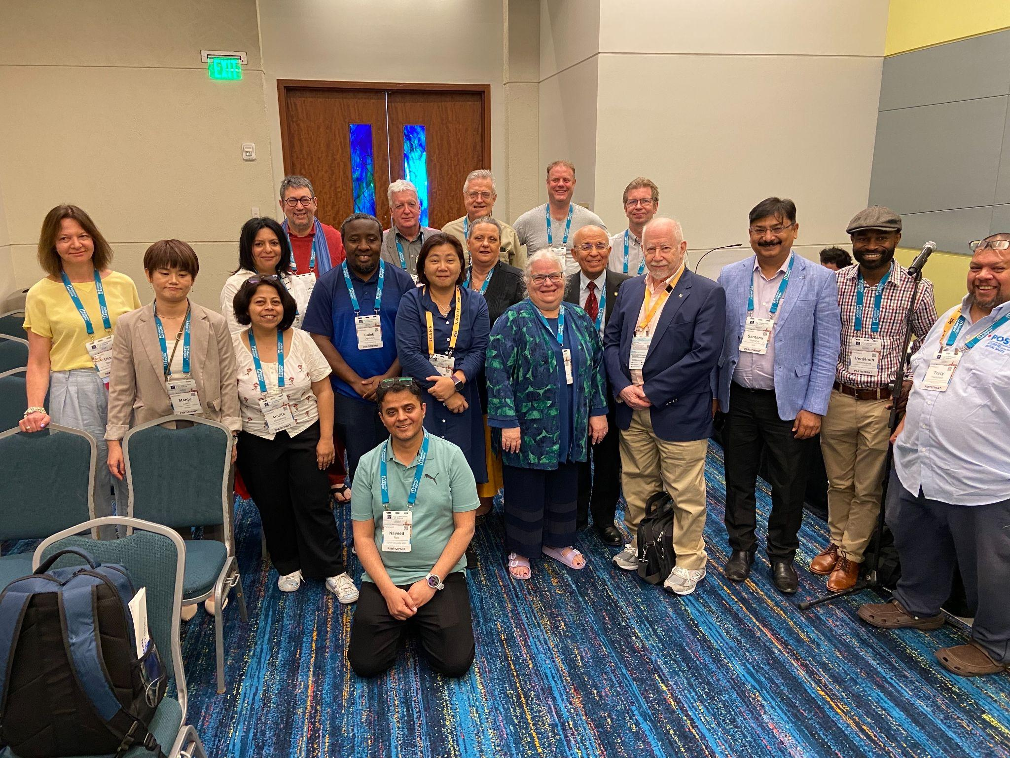
ICANN Community and the CIP-CCG
Pictured: CIP-CCG volunteers during the ICANN79 Community Forum.
CIP-CCG volunteers are sharing best practices and collaborating on community-wide implementation of ATRT3 Rec. 3.6. In work to-date, they have considered a range of methodologies for effective continuous improvement programs, utilizing a Principles-Criteria-Indicators framework fit for ICANN purpose.
CIP-CCG volunteers are drafting the CIP Framework, to be used by each SO, AC, and NomCom, while relaying information back to their groups to inform the process.
Notes:
Here is a nice photo of the CIP-CCG volunteers during the ICANN79 Community Forum.
As noted, CIP-CCG volunteers have shared the extensive work already underway within all the structures towards continuous improvement, and are collaborating on community-wide implementation of ATRT3 Rec. 3.6. In work to-date, we have considered a range of methodologies for effective continuous improvement programs, utilizing a Principles-Criteria-Indicators framework fit for ICANN purpose.
CIP-CCG volunteers are drafting the CIP Framework, to be used by each SO, AC, and NomCom, while relaying information back to their groups to inform the process.
I will provide more information on this framework later in the presentation.
Here is a recent blog on the significant progress and work of the CIP-CCG during ICANN79.
Share link in chat:
ICANN Continuous Improvement Program Makes Progress on a Draft Framework: https://www.icann.org/en/blogs/details/icann-continuous-improvement-program-makes-progress-on-a-draft-framework-28-03-2024-en

Slide 6

CIP-CCG hybrid meeting during ICANN79
Collaborative meeting with advance homework:
Jamboards per Principle
Homework via CIP-CCG list
Brainstormed based on current continuous improvement activities to
form criteria for each SO/AC/NomCom.
After ICANN79 (second quarter 2024):
Community reps going to their groups to update them on CIP-CCG and criteria applicable to their SOACs, gather feedback for framework in progress.
Notes:
At the ICANN79 Community Forum in Puerto Rico, CIP-CCG volunteers had our first hybrid working meeting. During this meeting, the group made substantial progress toward developing common principles for the ICANN Continuous Improvement Program.
These principles stem from Article 4.4 of the ICANN Bylaws which describe the objectives for Organizational Reviews and will provide a common base for the assessment of the different ICANN community structures.
The group’s next steps will be to use the principles to build out the draft CIP Framework for Public Comment later this year.

Slide 7
Principles / Criteria Framework
Principles / Criteria Framework: consists of principles, criteria, and indicators:
Principles describe the objectives of the Continuous Improvement Program. They define what the CIP is fundamentally trying to do.
Criteria are the conditions that need to be met in order to comply with a principle. Criteria define how a principle will be achieved, without themselves being a measure of performance.
Indicators define what the CIP will measure to assess whether or not criteria are being met. Indicators can include metrics, assessments, and or new processes put in place to meet criteria.
Notes:
Now I would like to provide more detail on this framework, including what Principles, Criteria, and Indicators framework means for the ICANN community and for (community structure/group). An illustrative example of how this framework works is included later in the presentation.
These Principles describe the objectives of the Continuous Improvement Program. They define what the CIP is fundamentally trying to do, and they come from the current ICANN Bylaws pertaining to Organizational Review objectives.
Criteria are the conditions that need to be met in order to comply with a principle. Criteria define how a principle will be achieved, without themselves being a measure of performance.
Indicators define what the CIP will measure to assess whether or not criteria are being met. Indicators can include metrics, assessments, and or new processes put in place to meet a criteria.
A common base for the community assessment is provided by having shared principles. Flexibility is provided because each stakeholder group can prioritize criteria to focus on and develop custom indicators.

Slide 8
CIP Framework Considerations
Recommendation 3.6 states “ICANN org shall work with each SO/AC/NomCom to establish a continuous improvement program [that shares] a common base between all SOs, ACs, and the NomCom but will also allow for customization so as to best meet the needs of each individual SO/AC/NomCom.
Notes:
As noted, Recommendation 3.6 states “ICANN org shall work with each SO/AC/NomCom to establish a continuous improvement program [that shares] a common base between all SOs, ACs, and the NomCom but will also allow for customization so as to best meet the needs of each individual SO/AC/NomCom.”
This common base is the framework that is currently being developed by the CIP-CCG.

Slide 9
Current Objectives of Organizational Reviews
Source: Article 4.4 of the ICANN Bylaws
(i) whether that organization, council or committee has a continuing purpose in the ICANN structure.
(ii) if so, whether any change in structure or operations is desirable to improve its effectiveness.
(iii) whether that organization, council or committee is accountable to its constituencies, stakeholder groups, organizations and other stakeholders.
Notes:
As noted, these objectives provided by Article 4.4 of the ICANN Bylaws provide the foundation for the shared principles for the community under the new CIP.

Slide 10
ICANN Principles of Continuous Improvement
Historically, ICANN Organizational Reviews have asked whether the Supporting Organizations (SOs), Advisory Committees (ACs), and the Nominating Committee (NomCom) have a continuing purpose within the ICANN community. Rather than articulating this as a single principle, it is an overarching consideration that is addressed through five separate principles that would guide the successful execution of the Continuous Improvement Program (CIP):
The SO, AC, or NomCom is fulfilling its purpose.
The operations of SO, AC, or NomCom are effective.
Principle 1
Principle 2
The SO, AC, or NomCom is accountable internally to its stakeholders, and externally to the wider ICANN community.
The operations of SO, AC, or NomCom are efficient.
Principle 3
Principle 4
The ICANN community collaborates to further the mission of ICANN and the effectiveness of the ICANN multistakeholder model.
Principle 5
Notes:
Here are the five draft principles discussed and developed by the CIP-CCG.
Historically, ICANN Organizational Reviews have asked whether the Supporting Organizations, Advisory Committees, and the Nominating Committee have a continuing purpose within the ICANN community. Rather than articulating this as a single principle, it is an overarching consideration that is addressed through five separate principles that would guide the successful execution of the Continuous Improvement Program.
The first principle is “The SO, AC, or NomCom is fulfilling its purpose”.
The second principle is “The structures of SO, AC, or NomCom are effective”.
The third principle is “The operations of SO, AC, or NomCom are efficient”.
The fourth principle is “The SO, AC, or NomCom is accountable internally to its stakeholders, and externally to the wider ICANN community”.
The fifth principle is: “The ICANN community collaborates to further the mission of ICANN and the effectiveness of the ICANN multistakeholder model”.
It is worth noting that the origin of “Accountable” in Principle 4 is from related Work Stream 2 – Recommendations to Increase SO/AC Accountability.
Share link in chat:
Work Stream 2 – Recommendations to Increase SO/AC Accountability: https://www.icann.org/resources/work-stream-2-implementation/increase-so-ac-accountability-en

Slide 11
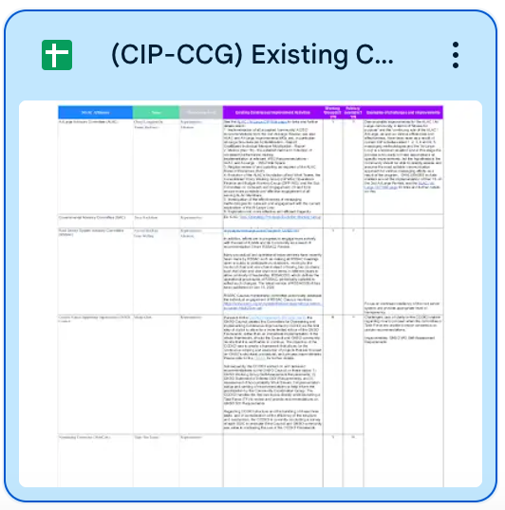
Mapping existing CI and Jamboard content
Principles
Criteria
Indicators (SMART)
Notes:
As mentioned, the CIP-CCG volunteers mapped the existing continuous improvement activities of (community structure/group) onto these draft principles, criteria, and indicators for the draft CIP framework in progress.
This included content from a collaborative Jamboard from the hybrid meeting during the ICANN79 Community Forum.
The group determined to use the “SMART” approach for indicators - An indicator, or metric to measure or form a process for criteria, should be Specific, Measurable, Achievable, Relevant, and Time-Bound, or (SMART).

Slide 12
Principles to Criteria Example
Example of Principle 3:
The operations of SO, AC, or NomCom are efficient.
Examples of potential Criteria for our community structure/group:
Each structure has a process for planning and setting priorities.
Each structure efficiently assesses inputs related to their scope of responsibility.
Each structure efficiently develops and recommends outputs relevant to their purpose (policy development, support policies, leadership placement).
Each structure’s outputs are implemented efficiently and implementation of outputs is monitored.
Notes:
I would now like to explain the relationship between the common Principles and customizable Criteria through an example.
Taking Principle 3 as an example: The operations of SO, AC, or NomCom are efficient. What criteria apply to this principle?
You can see on the screen here, suggested criteria. We also have the opportunity as (community structure/group) to use our existing continuous improvement activities to inform these criteria.
The CIP-CCG has a Google Drive workspace dedicated specifically to (community structure/group), where I can take your input and draft specific criteria.
In the coming weeks, I will organize a working session for (community structure/group) to develop our criteria and indicators, and relay our input to the CIP-CCG.

Slide 13
Principles to Criteria to Indicators Example
Example of Principle 3:
The operations of SO, AC, or NomCom are efficient.
Examples of potential Criteria for our community structure/group:
Each structure has a process for planning and setting priorities.
Each structure efficiently assesses inputs related to their scope of responsibility.
Each structure efficiently develops and recommends outputs relevant to their purpose (policy development, support policies, leadership placement).
Each structure’s outputs are implemented efficiently and implementation of outputs is monitored.
Examples of potential Indicator for Criteria: “Each structure has a process for planning and setting priorities”.
Yes.
If No, indicator could be to develop a process, that is Specific, Measurable, Achievable, Relevant, and Time-Bound (SMART).
Notes:
Next, you will see an example of how the principles and criteria relate to an indicator.
Using the example criterion of (community structure/group) having a process for planning and setting priorities, an indicator would ask whether that currently exists, and if not, could suggest that a process be developed that is Specific, Measurable, Achievable, Relevant, and Time-Bound, or (SMART).

Slide 14
Question for [insert community structure/group] consideration
Do you feel comfortable with the five principles developed by the CIP-CCG (stemming from Article 4.4 of the ICANN Bylaws) to serve as a common base across all structures?
Notes:
Now I would like to pause here for any questions, and ask for your input.
Do you feel comfortable with the five principles developed by the CIP-CCG (stemming from Article 4.4 of the ICANN Bylaws) to serve as a common base across all structures? Note: You may wish to display slide 9 again.
As a reminder, these five principles will apply to all ICANN organizational structures, including the Supporting Organizations, Advisory Committees, and the Nominating Committee.
We will be able to develop our criteria and indicators at a later date, so please focus your input on these principles, which I will relay to the CIP-CCG as your representative.
This is in line with the ATRT3 Recommendation 3.6, “ICANN org shall work with each SO/AC/NomCom to establish a continuous improvement program [that shares] a common base between all SOs, ACs, and the NomCom but will also allow for customization so as to best meet the needs of each individual SO/AC/NomCom.”
These principles serve as that common base, and the criteria and indicators will be used to later assess our adherence to the principles.

Slide 15
Next Steps
Phase 1 (January - March) The CIP-CCG made substantial progress toward developing principles for the CIP, which will provide a common base for the assessment of the different ICANN community structures. The principles stem from Article 4.4 of the ICANN Bylaws describing objectives for Organizational Reviews.
Phase 2 (April): Community representatives go to their groups to inform them of the progress of the CIP-CCG and their work-to-date, including work the Principles, Criteria, Indicators approach for the draft CIP framework, how the framework will be utilized in the (first) CIP assessment phase. Ongoing CIP-CCG meetings and regular updates from your CIP-CCG representative (and alternate) throughout 2024.
Phase 3 (May, June): Once Community reps have educated their structures on CIP-CCG progress on the Principles, Criteria, Indicators approach and how the process of the CIP will work, they then organize a working session with their community reps in Q2-3 2024 to gather feedback on the Criteria and Indicators for their group. Provide input to your CIP-CCG representative!
Phase 4 (July, August): Finally, community reps work with groups to reach consensus on Criteria and Indicators applicable to their organizational structures (this will occur after iterations of CIP-CCG meetings during Phase 2). Draft CIP Framework will be published for Public Comment (est. Oct/Nov 2024).
Notes:
So for next steps for the CIP-CCG and our development of the framework, as you will see on the screen here:
Phase 1 has already occurred from January to March of this year. To champion the work to evolve Organizational Reviews, the Continuous Improvement Program Community Coordination Group was launched in January 2024. The group made substantial progress toward developing principles for the ICANN Continuous Improvement Program, which will provide a common base for the assessment of the different ICANN community structures. The principles stem from Article 4.4 of the ICANN Bylaws that describe the objectives for Organizational Reviews.
Phase 2 in April - which is today’s presentation: The Community representatives are going to our groups to inform them of the progress of the CIP-CCG and our work-to-date, including work the Principles, Criteria, Indicators approach for the draft CIP framework, how the framework will be utilized in the (first) CIP assessment phase. There are ongoing CIP-CCG meetings and I will be providing regular updates as your CIP-CCG (representative/alternate) throughout 2024.
Phase 3 in May and June: Once Community reps have educated our structures on CIP-CCG progress on the Principles, Criteria, Indicators approach and how the process of the CIP will work, I will then organize a working session with (community structure/group) in to gather your feedback on the Criteria and Indicators for (community structure/group).
Please note that in June there will be the ICANN80 Policy Forum, which may provide opportunities for us to engage on the work on the draft CIP framework and for the ICANN org Reviews team to engage with us on the progress and facilitation of this work.
The CIP-CCG meetings will refine the input from all the community groups during their meetings in May and June.
In phase 4 in July and August: We will reach consensus on Criteria and Indicators applicable to our organizational structures.
The draft CIP Framework will eventually be published for Public Comment (est. Oct/Nov 2024).

Slide 16
Resources: Please Read and Share!
Continuous Improvement Program Home: https://community.icann.org/display/CIP
Continuous Improvement Program Community Coordination Group (CIP-CCG) Meetings
CIP-CCG Resources
CIP-CCG Membership and Mailing List
ICANN Continuous Improvement Program Makes Progress on a Draft Framework: March 2024
ICANN Launches the Continuous Improvement Program Community Coordination Group: January 2024
ICANN Reviews Program Update: February 2024
ICANN Reviews Program Update and Interim President and CEO Goal 11: October 2023
Notes:
Finally, before opening the floor for your comments and questions, I would like to share these resources with you on the Continuous Improvement Program and the important work of the CIP-CCG.
Thank you for your time and attention today regarding this important work for ICANN.

