Slide 1

At-Large &
At-Large Advisory Committee
101
Board Seminar
14th of September 2011
Sébastien Bachollet
1

Slide 2
ICANN multi-stakeholder model
Ombudsman
Board of Directors
Chair
GAC
Governmental
Advisory
Committee
President and CEO
16
9
10
13
14
11
12
1
2
3
4
5
6
7
8
15
L
L
L
L
L
ICANN Staff
MDR – 68
SV – 11
DC – 9
Sydney - 5
Brussels - 5
Other US - 11
Other non-US - 14
Nominating
Committee
Technical
Liaison
Group
Internet
Engineering
Task Force
Per ICANN Bylaws, Article VII, section 2
TLG
IETF
ASO
GNSO
ccNSO
At-Large
Security &
Stability
Advisory
Committee
Root Server
System
Advisory
Committee
Regional Internet Registries
ARIN
RIPE NCC
LACNIC
APNIC
AfriNIC
gTLD Registries gTLD Registrars
IP interests
ISPs
Businesses
Universities
Consumers
ccTLD registries (.us, .uk, .au, .it, .be, .nl, etc.)
Internet Users
(At-Large Advisory Committee,
in conjunction with RALOs)
ALAC
SSAC
RSSAC

Slide 3
What is At-Large?
"At-Large" is the name for the community of individual Internet users who participate in the policy development work of ICANN
136 At-Large Structures groups representing the views of individual Internet users who are active throughout the world.
2

Slide 4
What is ALAC?
ALAC = At-Large Advisory Committee
Most of the work the ALAC does is
  Provide Advice to the Board of ICANN
  Communicate At-Large perspectives to ICANN public comment requests
  Issue comments on any subject, process, structure, policy or topic which it deems important to policy development and execution
  Message the At-Large perspective linked to ICANN in one way or another and which affects Internet users
  Initiate PDPs (i.e. domain tasting)
  Takes part in cross-community working groups (CWGs) within ICANN
3

Slide 5
From ICANN Bylaws
j. The ALAC is also responsible, working in conjunction with the RALOs, for coordinating the following activities:
  1. Making a selection by the At-Large Community to fill Seat 15 on the Board. Notification of the At-Large Community’s selection shall be given by the ALAC Chair in writing to the ICANN Secretary, consistent with Article VI, Sections 8(4) and 12(1).
  2. Keeping the community of individual Internet users informed about the significant news from ICANN;
  3. Distributing (through posting or otherwise) an updated agenda, news about ICANN, and information about items in the ICANN policy-development process;
  4. Promoting outreach activities in the community of individual Internet users;
  5. Developing and maintaining on-going information and education programs, regarding ICANN and its work;
  6. Establishing an outreach strategy about ICANN issues in each RALO's Region;
  7. Participating in the ICANN policy development processes and providing input and advice that accurately reflects the views of individual Internet users;
  8. Making public, and analyzing, ICANN's proposed policies and its decisions and their (potential) regional impact and (potential) effect on individuals in the region;
  9. Offering Internet-based mechanisms that enable discussions among members of At-Large structures; and
  10. Establishing mechanisms and processes that enable two-way communication between members of At-Large Structures and those involved in ICANN decision-making, so interested individuals can share their views on pending ICANN issues.

Slide 6
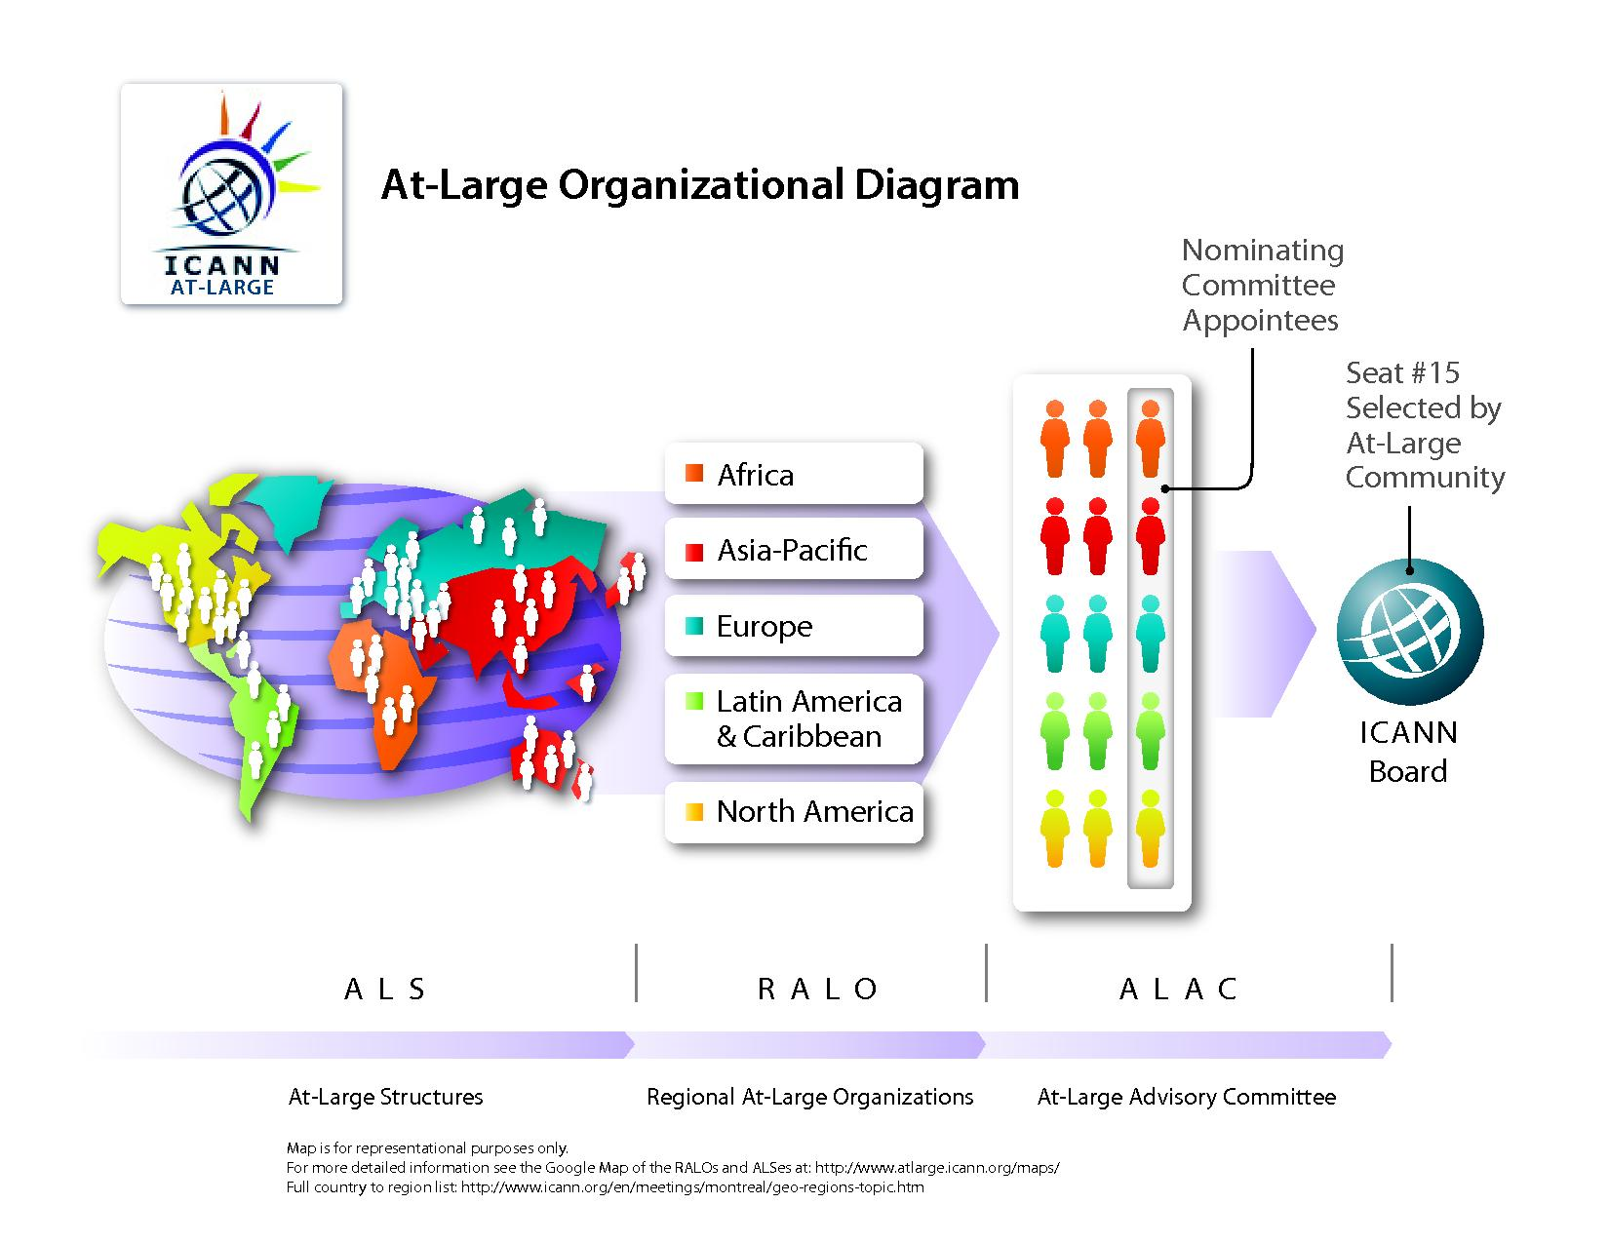
4

Slide 7

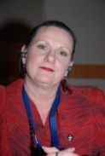

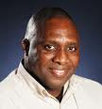
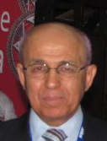
At-Large Advisory Committee
ALAC
ExCom
Mohamed El Bashir (AF-Sudan)
Dave Kissoondoyal (AF-Mauritius)
Edmon Chung (AP-Hong Kong)
James Seng (AP-China)
Sandra Hoferichter (EU-Germany)
Jean-Jacques Subrenat (EU-France)
Sylvia Herlein Leite (LAC-Brazil)
Sergio Salinas Porto (LAC-Argentina)
Gareth Shearman (NA-Canada)
Ganesh Kumar (NA-USA)
Olivier Crépin-Leblond
(EU-France) – Chair
Cheryl Langdon-Orr
(AP-Australia) – Vice Chair
Evan Leibovitch
(NA-Canada) – Vice Chair
Carlton Samuels
(LAC-Jamaica) – Rapporteur
Tijani Ben Jemaa
(AF-Tunisia)
Selected by NomCom
5

Slide 8
Liaisons
ALAC
SO & AC
From ALAC to …
From … to ALAC
ccNSO
Cheryl Langdon-Orr
GNSO – Alan Greenberg
SSAC – (Patrick Vande Walle)
IDN Policy - Edmon Chung
NCSG – Beau Brendler
Dot Mobi – (Andrés Piazza)
ccNSO – Ron Sherwood
GNSO – ?
NCSG – Bill Drake

Slide 9

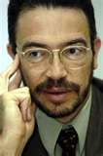
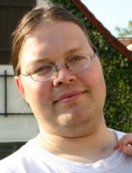

Review Teams
ATRT
Accountability and Transparency Review Team
  Cheryl Langdon-Orr (AU)
SSR-RT
Review Team Security, Stability and Resiliency of the DNS
  Alejandro Pisanty (MX) - Chair
WHOIS-RT
Review Team WHOIS Policy
  Lutz Donnerhacke (DE)
  ?? ??
      Olivier Iteanu (Fr) resigned on 14 June 2011 due to professional reasons

Slide 10
Regional At-Large Organizations leaders
African Regional At-Large Organization (AFRALO)
  Chairperson – Fatimata Seye Sylla – Senegal – Bokk Jang Bokk Jef
  Vice-Chairperson – Tijani Ben Jemaa – Tunisia – FMAI
  Secretariat – Aziz Hilali – Morroco – MISOC
Asian, Australasian and Pacific Islands Regional At-Large Organization (APRALO)
  Chair – Charles Mok – ISOC – HK
  Vice-Chair – Fouad Bajwa – Pakistan ICT Policy Monitor
  Vice-Chair – Holly Raiche – ISOC – AU
  Secretariat – ISOC-HK – Edmon Chung and Pavan Budhrani (.ASIA)

Slide 11
Regional At-Large Organizations leaders
European Regional At-Large Organization (EURALO)
  Chair – Wolf Ludwig – Switzerland – Comunica-ch
  Secretariat – Oksana Prykhodko – Ukraine – European Media Platform
Latin American and Caribbean Islands Regional At-Large Organization (LACRALO)
  Chair – José Francisco Arce – Argentina – AGEIA DENSI
  Secretariat – Dev Anand Teelucksingh – Trinidad & Tobago Computer Society
North-American Regional At-Large Organization (NARALO)
  Chair – Beau Brendler – Unaffiliated Member
  Secretariat – Darlene Thompson – N-CAP

Slide 12

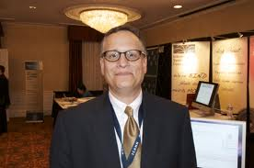

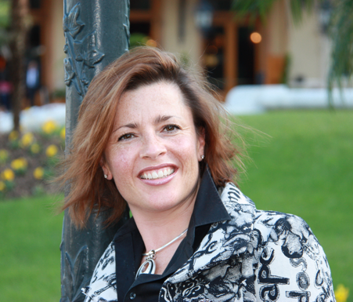
Staff dedicated to At-Large
Heidi Ullrich
  Director for At-Large
Seth Greene
  Contractor (3 month renewable contract)
  ALAC/At-Large Improvements Implementation project
Matt Ashtiani
  At-Large Coordination Officer
Gisella Gruber-White & Nathalie Peregrine
  Administrative Support (also for GNSO)
  Marilyn Vernon (from At-Large to SSAC)
    Executive Assistant (10h/w)
At-Large Regional Manager?

Slide 13
At-Large Structures by RALO (Regional At-Large Organization)
AFRALO – 24
APRALO – 23
EURALO – 29
LACRALO – 37
NARALO – 23 (and unaffiliated members)
Global – 136

Slide 14
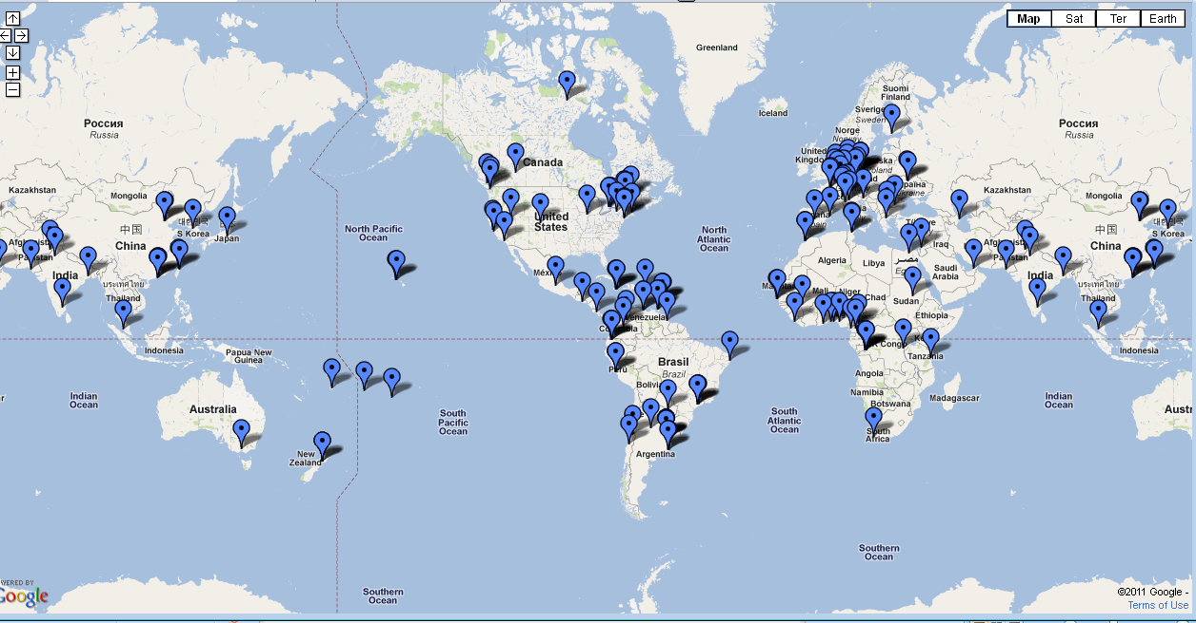
6

Slide 15
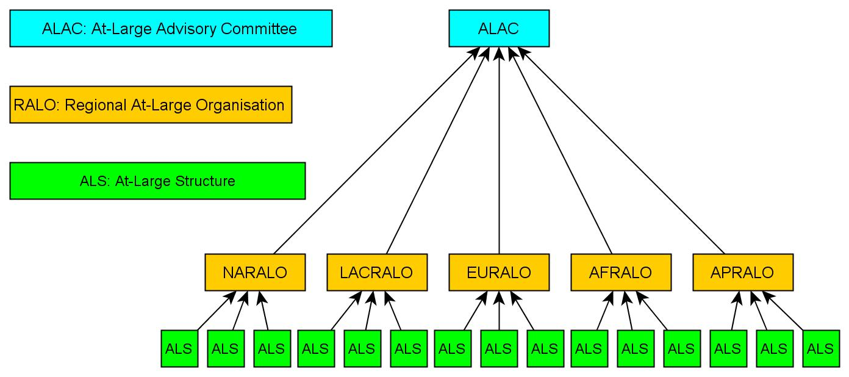
At-Large Bottom-up to the ALAC
Bottom
Up
7

Slide 16

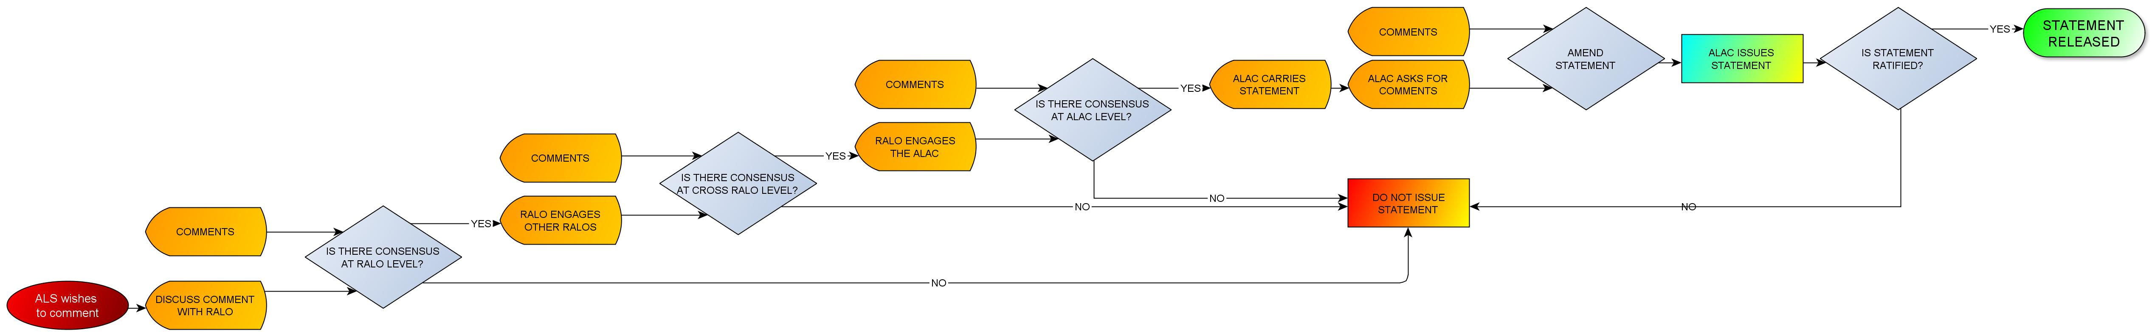

Example of At-Large Structure Input
Bottom-up process
RALO
DISCUSSION
CROSS-RALO
DISCUSSION
SEND TO
ALAC
Notes:
16

Slide 17
Bottom-up process
ALAC
VOTE
STATEMENT
RELEASED
ALAC DISCUSSION
Notes:
17

Slide 18
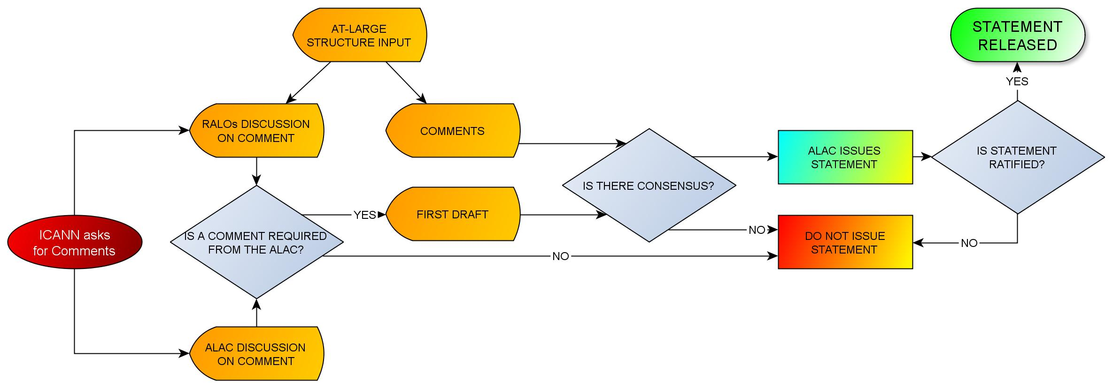
Example of At-Large Structure Input
Response to Public Comment Request
Bottom-up process

Slide 19
ALAC output
Policy statements on major issues (with important inputs from ALSes and Ralos – they can issue direct statements)
  Comments
  Advice to the Board
Supporting & guiding JAS WG
Creation (in June 2011) of Future Challenges WG to facilitate proactive policy input
End-user education (Beginner's Guide) and
warnings (i.e. pre-registrations)
Cross-community cooperation (in addition to liaisons)
  GAC
  Registrars
  Commercial Stakeholder Group (CSG)
8

Slide 20
JAS members (with ICANN staff help)
Name | Affiliation
Carlos Dionisio Aguirre | ALAC
Sébastien Bachollet | ALAC; Board member
Tijani Ben Jemaa | At Large
Fabien Betremieux | Individual; AFNIC
Eric Brunner-Williams | Individual
Olga Cavalli | NomCom Appointee
Rafik Dammak | NCSG; co-chair
Avri Doria | NCS
William Drake | NCSG
Alex Gakuru | NCSG
Dr. Govind | GAC
Alan Greenberg | ALAC
Anthony Harris | ISCPC
Name | Affiliation
Dave Kissoondoyal | At Large
Cheryl Langdon Orr | ALAC
Evan Leibovitch | ALAC; co-chair
Andrew Mack | CBUC
Michele Neylon | RrSG
Elaine Pruis | Individual
Vanda Scartezini | Individual
Baudouin Schombe | AFRALO; At Large
Alioune Traore | Individual
Richard Tindal | Individual
Carlton Samuels | ALAC; co-chair

Slide 21
ALAC / At-Large Improvements
To review and improve
  ALAC/At-Large’s participation in ICANN
  ALSes’ participation in At-Large
To implement the At-Large Review Work Group's Final Report 13 recommendations’
Work Teams
  A: on ALAC’s continuing purpose
  B: on ALS participation
  C: on ALAC planning processes
  D: on ALAC’s policy advice development
Final report due by Dakar
9

Slide 22
ALAC review
Westlake Consulting Limited
Independent external review
January 2008 to July 2008
ALAC Review Working Group (WG) formed in January 2008
  Harald Alvestrand
  Karl Auerbach
  Vittorio Bertola
  Tricia Drakes (Chair)
  Thomas Narten
  Nii Quaynor
  Jean-Jacques Subrenat
Charter for the Working Group approved in April 2008

Slide 23
Summary of Key Points in the final report of the Review Working Group
The ALAC has a continuing purpose in the ICANN structure
This continuing purpose has four key elements
  providing advice on policy
  providing input into ICANN operations and structure
  part of ICANN’s accountability mechanisms
  an organizing mechanism for some of ICANN’s outreach
The section of the ICANN Bylaws that deals with ALAC should be changed to reflect this purpose

Slide 24
Summary of Key Points in the final report of the Review Working Group
Organization
  2. At Large should be given two voting seats on the ICANN Board
  3. The ALAC‐RALO‐ALS structure should remain in place for now

Slide 25
Summary of Key Points in the final report of the Review Working Group
Effectiveness and participation
  4. Educating and engaging the ALSs should be an immediate priority;
  compliance should be a longer term goal
  5. ALAC should develop strategic and operational plans (including performance criteria and cost information) as part of ICANN’s planning process
  6. More effort needs to be put into developing accurate cost models for At Large activity
  7. ALAC should be encouraged to make its own choice of tools for collaborative work
  8. The public comment period should be kept at 30 days except in special circumstances, in which case ALAC may request an extension to 45 days
  9. ICANN should strengthen its translation and interpretation processes

Slide 26
Summary of Key Points in the final report of the Review Working Group
Relationship with other ICANN entities
  10. The ALAC is the primary organizational home for the voice and concerns of the individual Internet user in ICANN processes, although individual users may choose to participate in many other ways in the ICANN process
  11. ICANN should develop a mechanism for allowing the voice of those recognized bodies who represent consumer interests to be heard at critical points in key decisions and to provide input into policy processes
  12. As the provision of advice on policy is part of ALAC’s purpose, ALAC should strive to provide policy advice on any issues that affect individual Internet users
  Processes for providing advice on policy should be strengthened within ALAC for the development of policy advice, within SOs for requesting input from ALAC on policy issues and from SOs, ACs and the Board to provide feedback on how ALAC advice has been used

Slide 27
At-Large Improvements Work Teams
Work Team A: Work team on ALAC’s continuing purpose
  Rec 1: ICANN bylaws to reflect ALAC's continuing purpose
  Rec 10: ALAC/At-Large is home of individual Internet users
  Rec 11: Board statement recognizing Rec 10
Work Team B: Work team on ALS participation
  Rec 3: Remove any obstacles in ALS-RALO-ALAC structure
  Rec 4: ALS education and engagement
  Rec 7: ALAC should choose its own communication/collaboration tools
  Rec 9: ICANN should strengthen its translation/interpretation tools
Work Team C: Work team on ALAC planning processes
  Rec 5: ALAC should develop strategic/operational plans as part of ICANN’s planning process
  Rec 6: At-Large should develop accurate cost models
Work Team D: Work team on ALAC’s policy advice development
  Rec 8: ALAC may request public comment period be extended to 45 days
  Rec 12: Consumer representatives should have input into decisions and policy advice
  Rec 13: ALAC/At-Large policy advice mechanisms should be strengthened

Slide 28

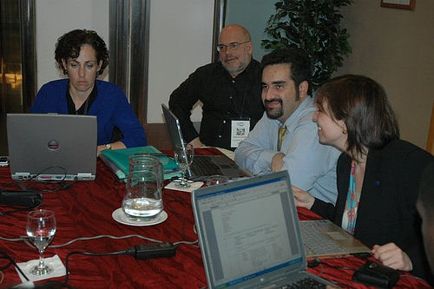
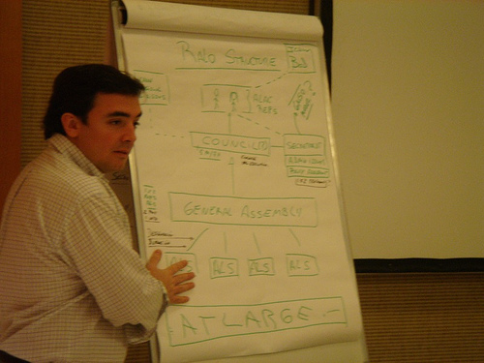
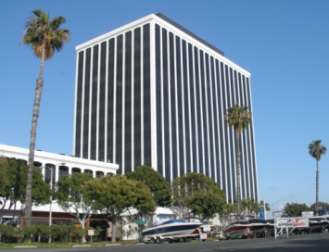
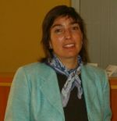
Interim
ALAC
African Region
Pierre Dandjinou (Benin)
Clement Dzidonu (Ghana)
Sunday Folayan (Nigeria) Asia/Pacific Region
Izumi Aizu (Japan)
Xue Hong (China)
Toshifumi Matsumoto (Jap) European Region
Vittorio Bertola (Italy) - Chair
Thomas Roessler (Germ)
Roberto Gaetano (Italy)
Latin America/Caribbean Reg
Erick Iriarte Ahon (Peru)
Sebastián Ricciardi (Arg)
Tadao Takahashi (Brazil)
North American Region
Esther Dyson (USA)
Wendy Seltzer (USA)
Kenneth Hamma (USA)
ALS N°1
15 Dec 2002
2004
4 Dec 2006
10 ALSes
LACRALO MOU
signed by
ICANN and 13 ALSes
ICANN Board decision Creation of ALAC
20 Jan 2003
First Interim ALAC
2005
Chair
Annette Muehlberg
10

Slide 29
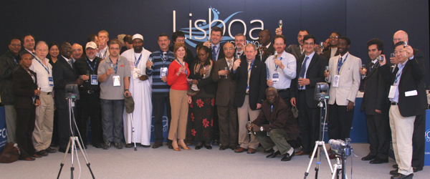
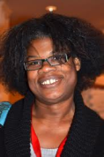
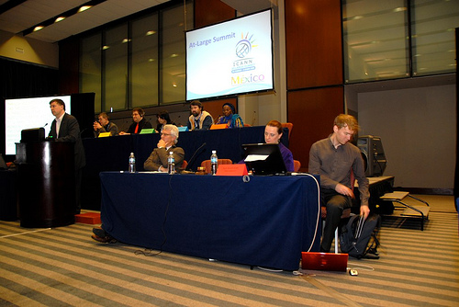
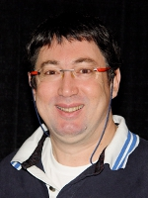
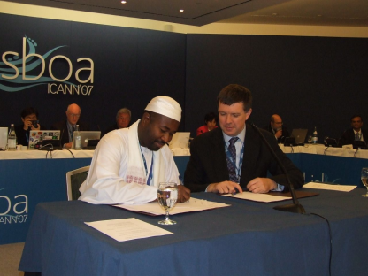
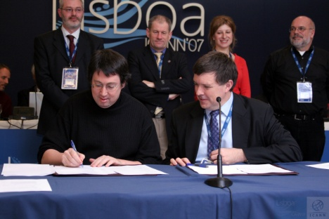
ALAC
Chair
Jacqueline Morris
28 June 2007
San Juan
4 Dec 2006
Sao Paolo
Chair
Cheryl Langdon-Orr
Chair
Olivier Crépin-Leblond
2010
EURALO MOU
APRALO MOU
AFRALO MOU
LACRALO
MOU
NARALO MOU
At-Large Summit
Mexico
March 2009
29 March 2007
Lisbon
Nov 2007
Los Angeles
ALAC
Board Member
(s)elected by At-Large
11

Slide 30
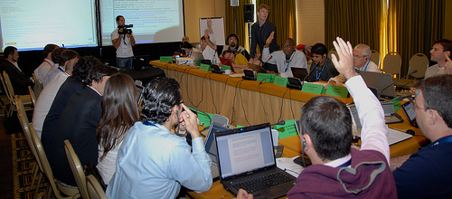
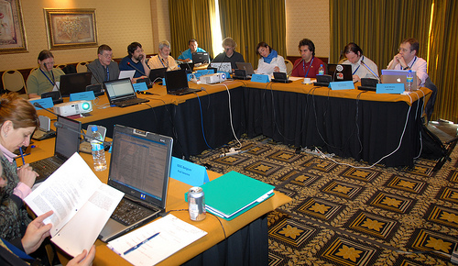
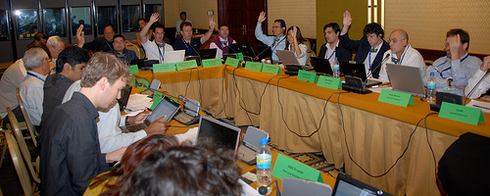
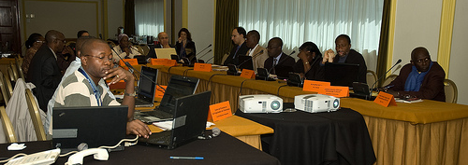

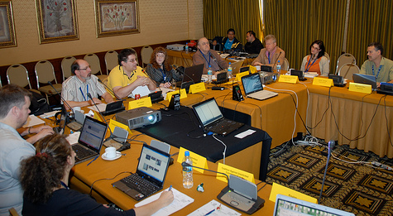
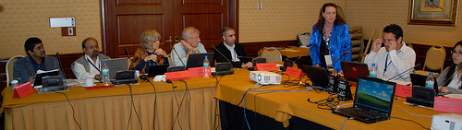
GA LACRALO
GA EURALO
MEXICO
March
2009
GA AFRALO
GA NARALO
GA APRALO

Slide 31
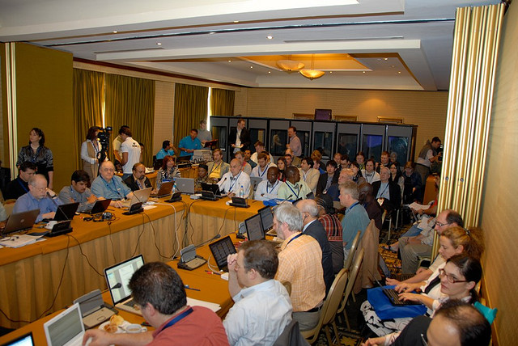
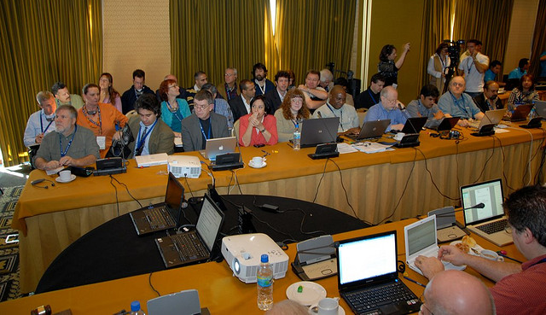
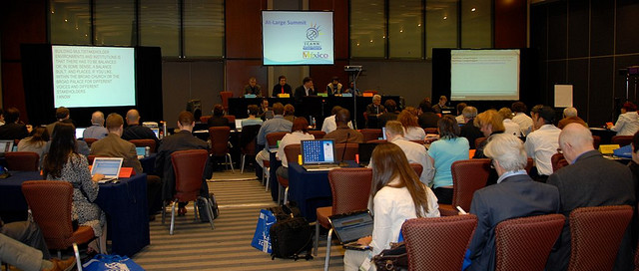

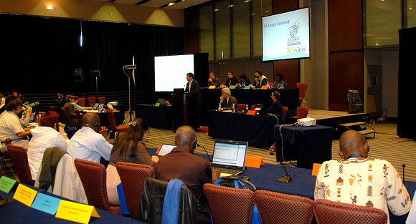
At-Large Summit
MEXICO March 2009

Slide 32
Links
Web
  www.atlarge.icann.org/
Wiki
  https://community.icann.org/category/sub-dashboard.action?categoryKey=atlarge#
Organizational Chart
  www.atlarge.icann.org/orgchart
At-Large Policy Resource Page
  www.atlarge.icann.org/issues
Beginner's Guide (in e-learning page)
  http://www.icann.org/en/learning/
At-Large Director Candidate 2010 Workspace
  https://community.icann.org/display/DirCan/At-Large+Director+Candidate+2010+Workspace

Slide 33
Questions
What is the difference between At-Large and ALAC?
What are the 3 structures of At-Large?
What are the most important tasks of At-Large and/or ALAC?
What positions are At-Large and/or ALAC in charge of selecting?
Who is the current Chair of ALAC?
When and where was the first At-Large Summit organized?

Slide 34
Thank You

