Slide 1
APAC Space web conference
Next-Generation gTLD Registration Directory Services to Replace Whois Policy Development Process (PDP)
23 January 2018

Slide 2


Slide 3
Agenda
Welcome Remarks
ICANN Accountability Indicators Preview
Next APAC Space Face-to-Face Meeting in ICANN61 Community Forum, San Juan
Q&A / Community Discussion led by Edmon Chung, APAC Space Community Facilitator
AOB

Slide 4
ICANN Accountability Indicators
Leo Vegoda
Director, Organizational Assessment & Improvement
ICANN
https://www.icann.org/accountability-indicators

Slide 5
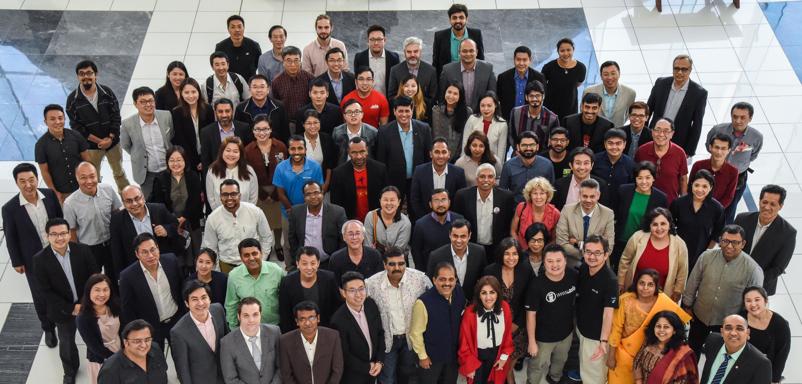
What is APAC Space?
“Space” for APAC Community Members
“Practice Ground” to facilitate community discussion -> Participate in ICANN
Community-led

Slide 6
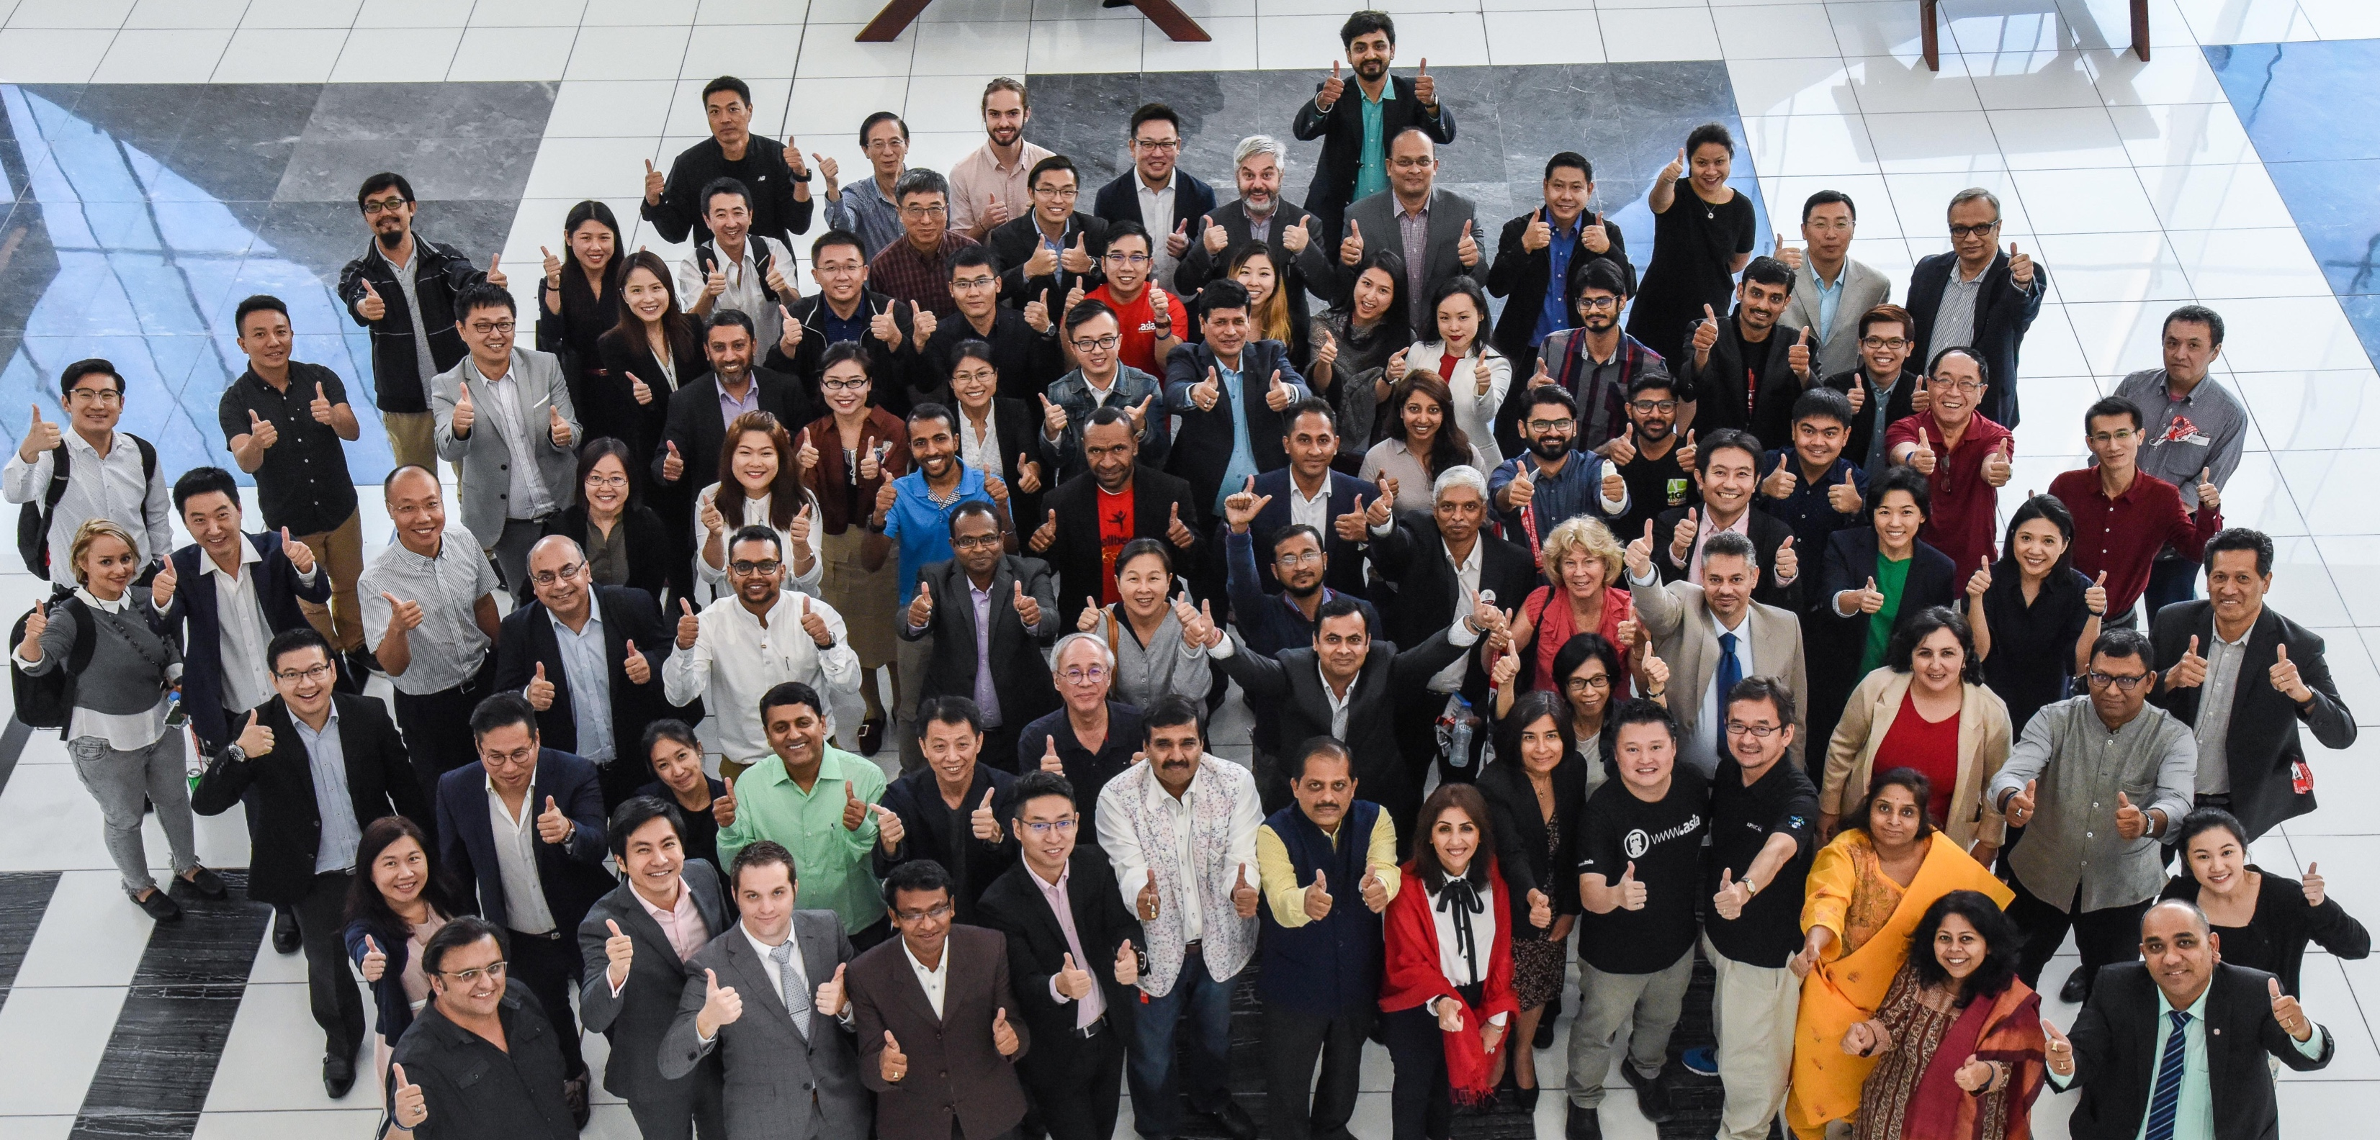
What is APAC Space?
Focus areas:
  DNS industry topics
  ICANN Policy Development Processes, and
  ICANN Reviews

Slide 7
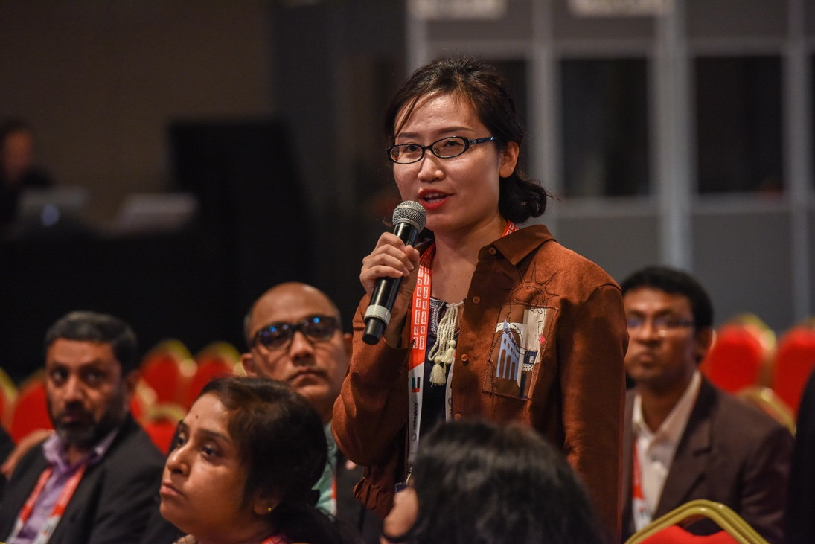

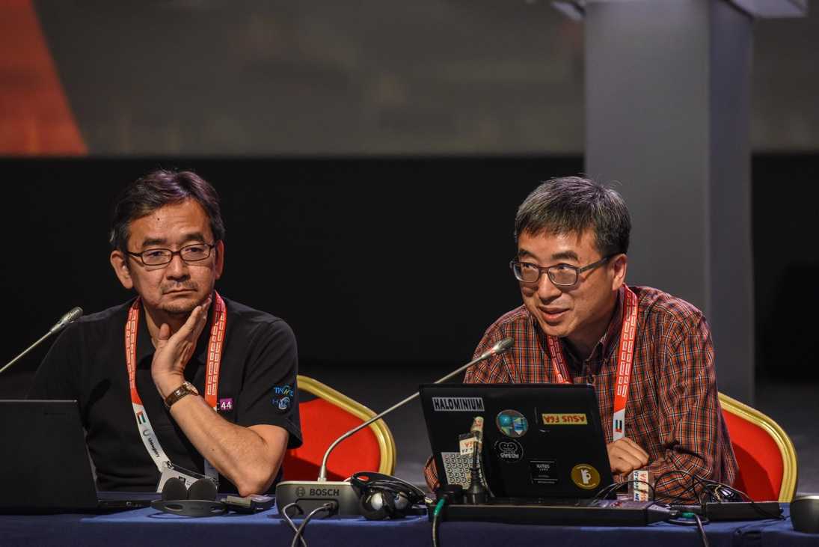
What is APAC Space?
How is it conducted?
Bi-monthly web conference and face-to-face at ICANN meetings
Presentation on topic, followed by community discussion
Community mailing list: discuss@apacspace.asia
  Facilitates setting of agenda
  Raise discussion issues
Community wiki page: https://community.icann.org/display/GSEAPAC/APAC+Space

Slide 8


APAC Space
  14 March 2018, Wednesday
  09:00 – 10:30 (local time)
  Discussion Topics (mailing list)
    ICANN Accountability Indicators
    Introduction to ICANN Reviews
    Registration Directory Service – WHOIS 2 Review
    Others
      e.g., Root Zone KSK Rollover, emerging technology such as Decentralized ID including Blockchain, security and stability, data privacy & protection
APAC Social
  14 March 2018, Wednesday
  17:30 (local time)
  Canapés and drinks provided

Slide 9

Q&A / Community Discussion
Edmon Chung
APAC Space
Community Facilitator

Slide 10
Engage with ICANN
Subscribe to discuss@apacspace.asia

