Slide 1
Universal Acceptance (UA) of Domain Names and Email Addresses
Naela Sarras / NARALO UA Day / 15 May 2024

Slide 2
We Live in a Multilingual World!
Globally, language usage is diverse. English comes third in terms of native speakers around the world, after Mandarin and Spanish. English represents 57% of the total written content online and the percentage is decreasing.
Language | Native Speakers
Mandarin | 1300 million
Spanish | 475 million
English | 373 million
Arabic | 362 million
Hindi | 344 million
Bengali | 234 million
Portuguese | 232 million
Russian | 154 million
Japanese | 125 million
Source: https://w3techs.com/technologies/history_overview/content_language.
Source: https://www.babbel.com/en/magazine/the-10-most-spoken-languages-in-the-world

Slide 3
Multilingualism, A Key To Digital Inclusion
A linguistically diverse Internet significantly contributes toward a knowledge-based society by bridging the digital divide
Therefore, linguistic diversity online was a key principle in WSIS Geneva Declaration in 2003, leading to a commitment “towards multilingualization of the Internet” in the WSIS Tunis Agenda in 2005. This included a specific ask for the following:
  Advance the introduction of multilingualism in domain names and email addresses by implementing programs and strengthening cooperation for their global deployment

Slide 4
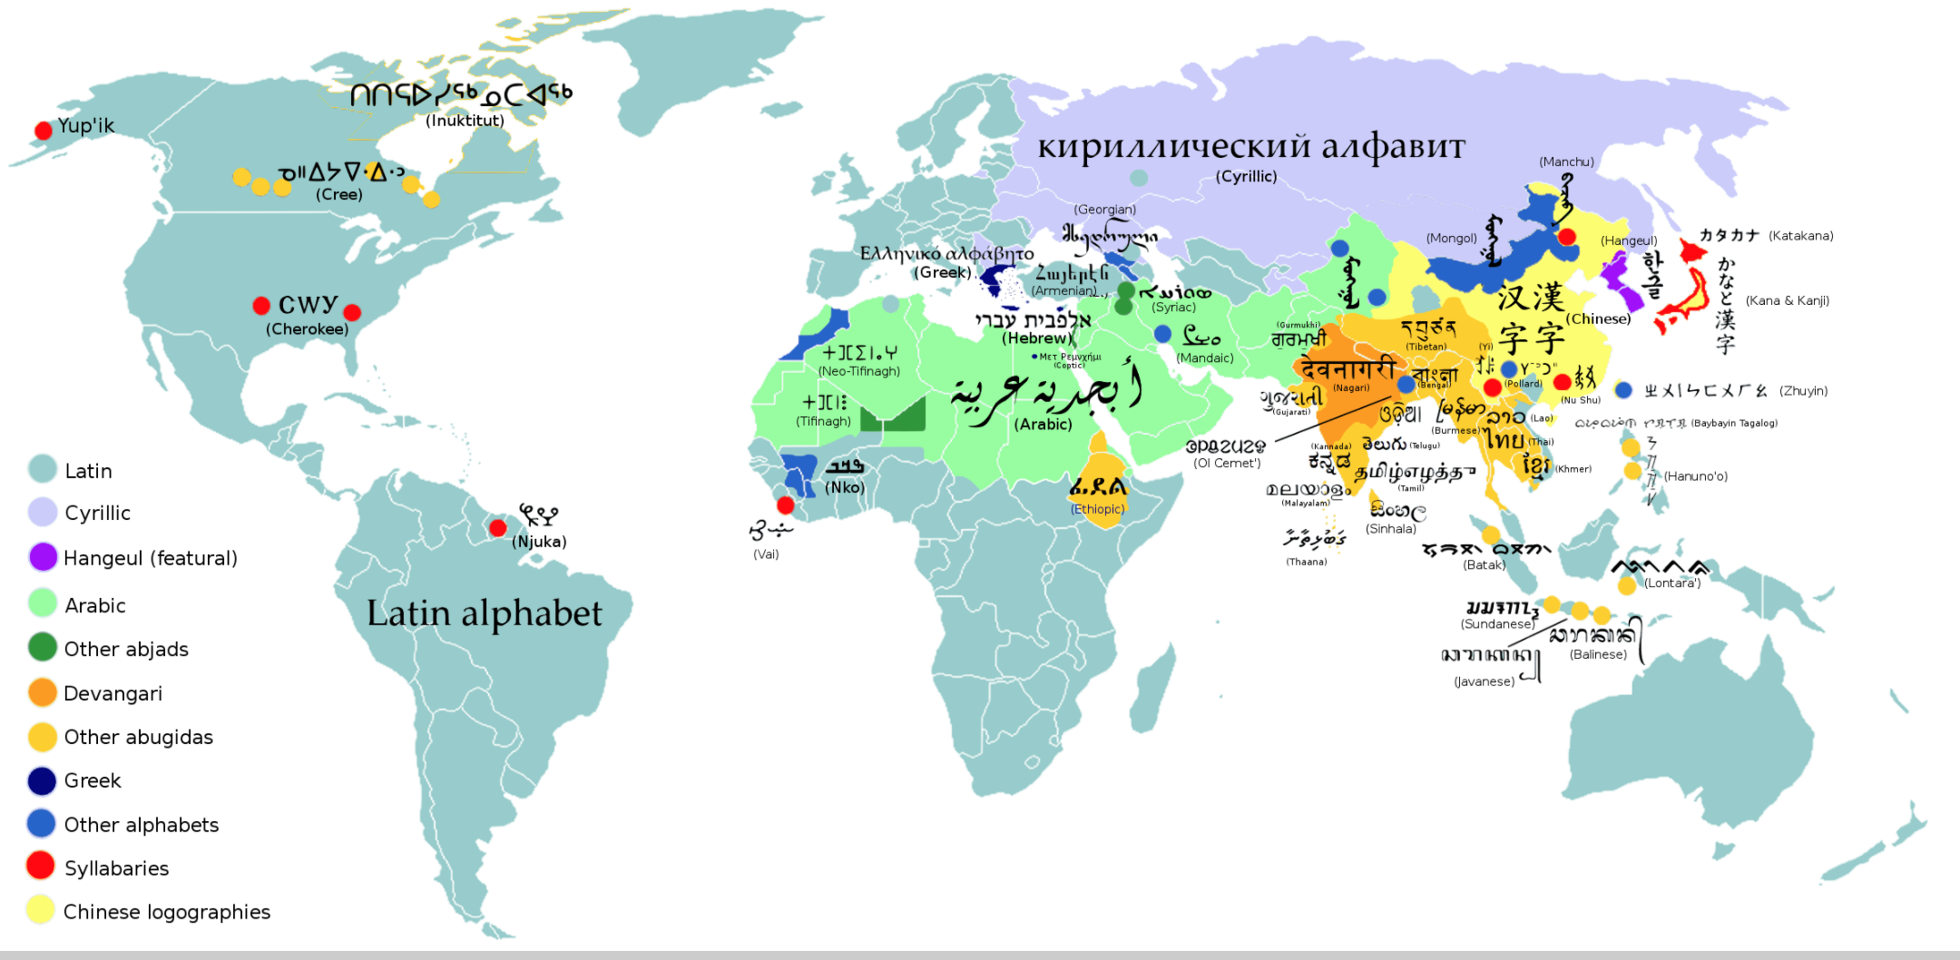
Multilingualism, A Key To Digital Inclusion
UNESCO, in its multilingualism and universal access to cyberspace 2003 recommendations, asked to alleviate language barriers on the Internet by access to content, capacity-building, national policies, and collaborative research and development on and local adaptation of technology with extensive multilingual capabilities
Source: https://en.wikipedia.org/wiki/List_of_writing_systems.

Slide 5
The Domain Name System (DNS) and ICANN
A domain name is a unique name that forms the basis of the uniform resource locators (URLs) that people use to find resources on the Internet (e.g., web pages, email servers, images, and videos)
The domain name itself identifies a specific address on the Internet that belongs to an entity such as a company, organization, institution, or individual
For example, the domain name: wikipedia.org is used to point to the address: 208.80.154.224
Collectively, the domain names and the Internet Protocol (IP) addresses help us navigate the Internet
The Internet Corporation for Assigned Names and Numbers (ICANN) helps coordinate and support these unique identifiers across the world. ICANN's mission is to help ensure a stable, secure, and unified global Internet.

Slide 6
Evolution of Top-Level Domains (TLDs) and the DNS
In the past, top-level domains (TLDs) have mostly been two or three letters long formed with Latin characters a-z (e.g., .com, .org)
The evolution of the DNS has allowed for newer and longer TLDs. There are now around 1,200 new generic gTLDs that represent brands, communities, and geographies (e.g., .photography, .london).
These new TLDs also include Internationalized Domain Names (IDNs), which allow for domain names in local languages and scripts such as “.例子” and “مثال.“ (“example” written in Chinese and Arabic)
  Other labels within a domain name can also be internationalized, allowing for a domain name to be in a local language and script completely. IDNs are separate from online content, which can also be multilingual.
The next round of gTLDs will continue to expand the DNS and give new opportunities to the next billion people waiting for access to a more multilingual and inclusive Internet in their language or script

Slide 7
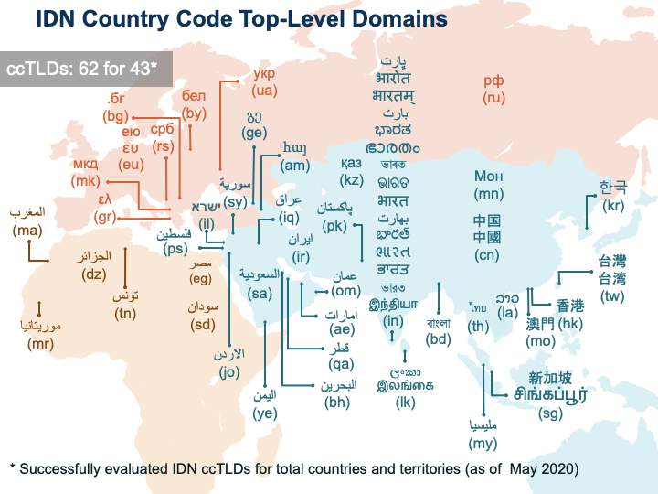
IDN Country Code Top-Level Domains (ccTLDs)

Slide 8
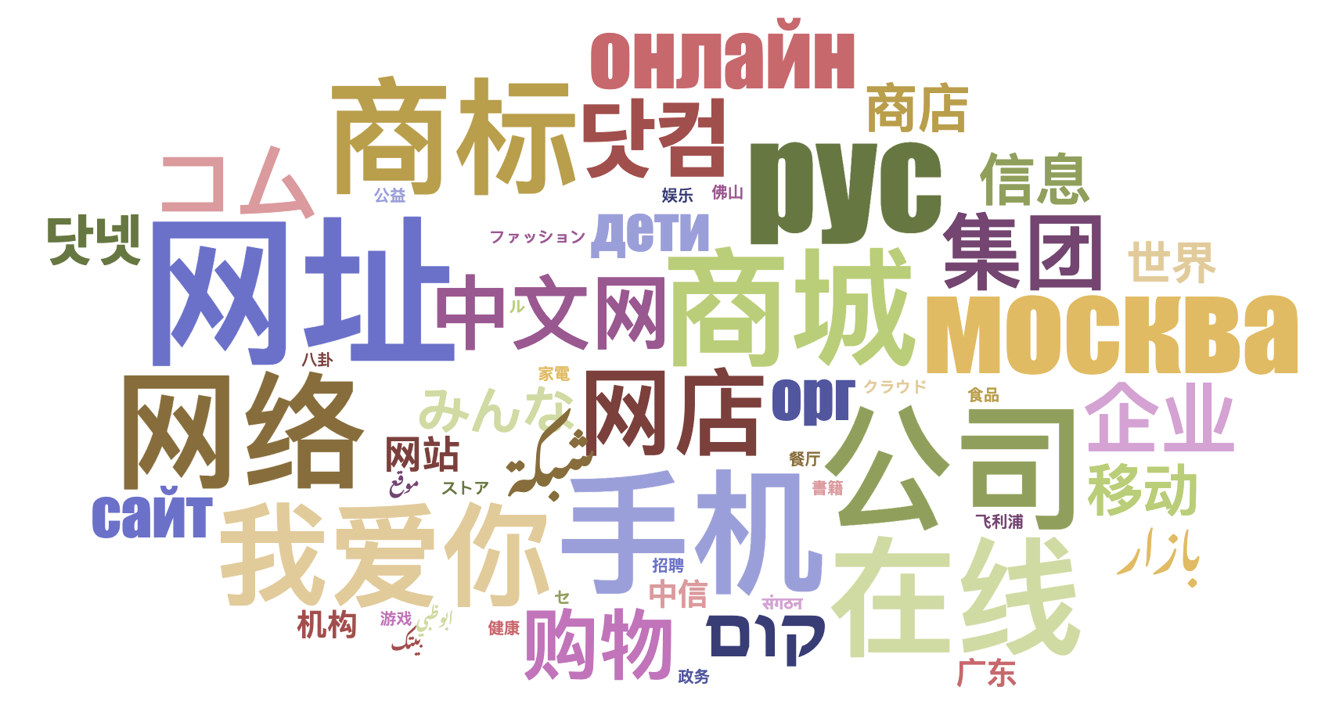
IDN Generic TLDs (gTLDs)
90 IDN gTLDs are delegated.

Slide 9
Evolution of Email Addresses
Initially, email addresses were also not available in local languages and scripts
Email Address Internationalization (EAI) addresses this limitation and allows for having email addresses in local languages and scripts
Internationalized email addresses are not related to the text in the body of the email, which is managed through the Multipurpose Internet Mail Extensions (MIME)

Slide 10
Examples of IDNs
համընդհանուր-ընկալում-թեստ.հայ
ଯୁନିଭରସାଲ-ଏକସେପ୍ଟନ୍ସ-ଟେଷ୍ଟ.ଭାରତ
უნივერსალური-თავსობადობის-ტესტი.გე
다국어도메인이용환경테스트.한국
സാർവത്രിക-സ്വീകാര്യതാ-പരിശോധന.ഭാരതം
تجربة-القبول-الشامل.موريتانيا
Armenian
Oriya
Georgian
Korean
Malayalam
Arabic

Slide 11
Examples of Internationalized Email
Էլփոստ-թեստ@համընդհանուր-ընկալում-թեստ.հայ
电子邮件测试@普遍适用测试.我爱你
ईमेल-परीक्षण@सार्वभौमिक-स्वीकृति-परीक्षण.संगठन
تجربة-بريد-الكتروني@تجربة-القبول-الشامل.موريتانيا
ηλεκτρονικό-μήνυμα-δοκιμή@καθολική-αποδοχή-δοκιμή.ευ
மின்னஞ்சல்-சோதனை@பொது-ஏற்பு-சோதனை.சிங்கப்பூர்
Armenian
Chinese
Devanagari
Arabic
Greek
Tamil

Slide 12
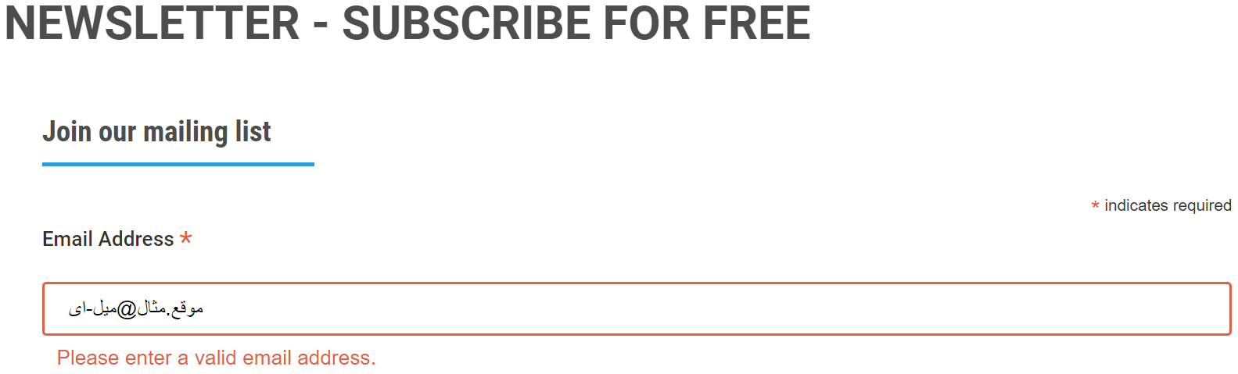
The Challenge
IDN TLDs allow for multilingual domain names and email addresses for communities to register and use, allowing for more digital inclusion.
But, there are issues in their acceptance, e.g., a valid email is rejected by a form on a website and is incorrectly displayed from left-to-right instead of right-to-left:

Slide 13
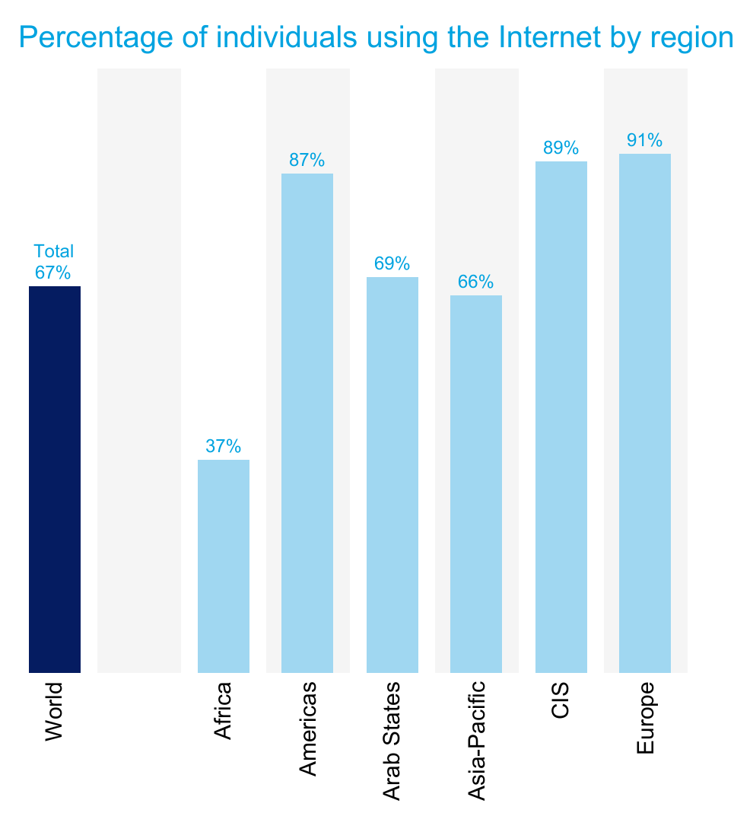
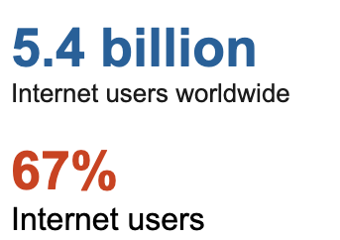
Digital Inclusion, an Opportunity
Remaining one-third of the world population, ~2.6 billion people, still aren’t online; primarily from Asia and Africa.
Many of those already online, and most of those who will be coming online, communicate in their native languages.
Source: https://www.itu.int/itu-d/reports/statistics/2023/10/10/ff23-internet-use/

Slide 14
Multilingualism Online, A Continued Challenge
Due to the need for multilingual internet and the continued gaps in the technology (among other factors), WSIS+10 Outcome Documents noted the continued need for supporting multilingualism on the Internet
As part of the priority areas to be addressed in the implementation of WSIS Beyond 2015, the report specifically asks for:
  Working towards multilingualization of Information and Communication Technologies (ICTs,) including email and native capability for international domain names (IDN), so that all members of the community are able to participate in online life
  Supporting and encouraging stakeholders, in their respective roles and responsibilities, to work together for technical evolution of the ICTs with a vision of a linguistically diverse digital world

Slide 15
What is Universal Acceptance (UA)?
While the DNS has evolved, the checks used by many software applications to validate domain names and email addresses remain outdated
In addition, not all online portals are primed for the opening of a user account with a related email address, leaving many people unable to navigate the Internet using their language and online identity of choice
Considered a technical compliance best practice, UA solves these issues by ensuring all valid domain names and email addresses, regardless of script, language or character length, can be used equally by all Internet-enabled applications, devices, and systems

Slide 16
UA Goal and Impact
Goal
All valid domain names and email addresses work in all software applications.
Impact
Promote consumer choice, improve competition, and provide broader access to end users.

Slide 17
Examples of Categories Affected by UA
Domain Names that may not work in applications:
  ASCII: example.sky
  ASCII: example.engineering
  Unicode: คน.ไทย
Internationalized email addresses (EAI) that may not work in applications:
  Unicode: marc@société.org
  Unicode: 测试@example.com
  Unicode: ईमेल@उदाहरण.भारत
  Unicode: ای-میل@ مثال.موقع (written right-to-left, RTL)
ASCII is based on letters A-Z, a-z, digits 0-9 and hyphen.
Unicode supports characters of global languages and scripts.

Slide 18





Making Applications UA-Ready
Support all valid domain names and email addresses:
Accept: The user can input characters from their local script into a text field
Validate: The software accepts the characters and recognizes them as valid
Process: The system performs operations with the characters
Store: The database can store the text without breaking or corrupting
Display: When fetched from the database, the information is correctly shown
Accept
Validate
Process
Store
Display

Slide 19
Why Does UA Matter?
Achieving UA ensures every person has the ability to navigate and communicate on the Internet using their chosen domain name and email address that best aligns with their interests, business, culture, language, and script.
UA can also help:
Support a diverse and multilingual Internet
Enable greater competition, innovation, and consumer choice
Create business opportunities
Offer career advantages for developers and system administrators
Assist governments and policymakers in reaching their citizens

Slide 20
A Call to Action
International Telecommunication Union (ITU) Plenipotentiary Resolution 133 (Revision Bucharest 2022) focuses on the Role of administrations of Member States in the management of internationalized (multilingual) domain names:
  Emphasizes
    IDNs contribute to sustainable development through the promotion of greater Internet accessibility and use in local languages
    The need to continue to implement technical solutions to enhance the implementation of IDNs
  Recognizes
    The role played by governments, technical communities and other stakeholders in advancing multilingualism, including the introduction of internationalized domain names
    The importance of community engagement and information-sharing to get a better understanding of existing challenges and to support solutions, particularly in developing countries

Slide 21
A Call to Action
International Telecommunication Union (ITU) Plenipotentiary Resolution 133 (Revision Bucharest 2022) focuses on the Role of administrations of Member States in the management of internationalized (multilingual) domain names:
  Invites Member States and Sector Members
    To consider how to further promote the adoption of Universal Acceptance in respect of IDNs and to collaborate and coordinate with relevant organizations and stakeholders in enabling the use of IDNs in the Internet

Slide 22
Working Towards UA-Readiness
The ICANN community organized to promote UA-readiness globally, including the Universal Acceptance Steering Group (UASG).
ICANN and its community work to achieve UA-readiness by:
  Organizing outreach to raise awareness on UA issues
  Conducting detailed studies to identify technical gaps
  Determining solutions to address the technical gaps
  Submitting bug reports in the relevant tools, systems, and applications
  Conducting technical training on the solutions for supporting UA-readiness
  Developing curricular recommendations for IT programs
More info at https://icann.org/ua

Slide 23
What Is Your Role: Business
Many businesses are leaving money on the table by not updating their systems to be UA-ready, which has the potential to unlock billions in revenue from untapped customers.
A UASG study, conducted in 2017, found that the Universal Acceptance of Internet domain names is a $9.8+ billion opportunity, which is a conservative estimate.
Businesses that are UA-ready will be best positioned to reach growing global audiences and maximize revenue potential from the current Internet population, as well as the next billion.
Organize internally and assess if your business’ systems are compliant with UA standards
Update your own IT systems to be UA-ready
Encourage your collaborators to participate and promote local UA-related discussions
Create UA awareness with partner organizations and companies, aiming to update their systems to current globally-inclusive standards

Slide 24
What Is Your Role: Government
Based on ITU Resolution 133 on IDN management and UNESCO recommendations on multilingualism and cyberspace:
Collaborate for development and deployment of IDNs
Promote capacity building, information-sharing and the exchange of best practices among all stakeholders for IDN implementation
Consider how to further promote the adoption of Universal Acceptance in respect to IDNs
Being UA-ready can assist governments and policymakers in reaching their citizens:
Evaluate the possibility of including UA requirements in government procurements
Reach out to government departments involved in e-government services for citizens and ask them to incorporate UA practices to provide digital inclusivity
Coordinate with your national ccTLD managers and ICANN Governmental Advisory Committee (GAC) delegates to participate in and strengthen UA-related actions

Slide 25
What Is Your Role: Civil Society
Encourage your community to attend local and regional UA-related events; help coordinate and promote them
Make your own systems UA-ready for broader digital inclusion
Promote research on inclusion and access that reinforces the principles of UA
Create UA awareness with partner organizations and companies to update their systems to current globally-inclusive standards

Slide 26
What Is Your Role: Academia
Upgrade email systems to support EAI
Update IT curricula to include teaching and learning of UA and software internationalization related concepts
  See draft guidelines and detailed materials for integrating IDN and UA concepts in IT curriculum
Train faculty and students to adopt UA practices in software development
Create awareness of UA issues and solutions in the local technical community

Slide 27
What Is Your Role: Technical Community
Carry out training and educational activities that allow software developers and project managers to address UA-related issues
Test and address UA-related issues in your own products and services
Report bugs related to UA in other products and services

Slide 28
What Is Your Role: DNS Industry
Assess UA-related gaps in customer-facing systems
Upgrade customer facing systems to support UA
  For registries and registrars, UA Roadmap for Domain Name Registry and Registrar Systems is available as a guide
  Training materials available for hosting providers and Internet service providers
Create awareness of UA with your business stakeholders and encourage them to upgrade their systems as well
Make sure a registrant has services available for all the steps needed, from registering a domain name to hosting websites as well as creating and managing mailboxes using the domain name
  If a registrant can register a domain name, but cannot host it, then it will hinder adoption

Slide 29
What is Your Role: Domain Holder/Registrant
Check with your Internet Service Provider (ISP) hosting your website and email to see if their services are UA-ready
Check with your website and email admin if your website and email is UA ready. If it is not, consider taking the initiative to update it and make it UA-ready
Create UA awareness with your ISP, web developers and email admin, and ask them to update their systems to be UA-ready. Refer them to FY23 UA Readiness report for further information. You may consider using the template letter or alternatively log the issue

Slide 30
New gTLD Program: Next Round
New opportunities to obtain a new generic top-level domain (gTLD), including Internationalized Domain Names (IDNs), are on the horizon
The application window for the next round is expected to open in Q2 2026
The next expansion of the Domain Name System (DNS) will enable people and organizations to manage their presence and identity on the Internet
Domain names in various languages and scripts will help build online digital inclusivity
An Applicant Support Program (ASP) will benefit applicants in underserved regions and emerging markets
  Includes financial and non-financial support for qualified applicants
Learn more: https://newgtlds.icann.org/en/next-round

Slide 31
Get Involved with UA!
For more information on UA, email info@uasg.tech or UAProgram@icann.org
Access all UASG documents and presentations at: https://uasg.tech
Access details of ongoing work from ICANN community wiki pages: https://community.icann.org/display/TUA
Subscribe to the UA discussion list at: https://uasg.tech/subscribe
Register to participate in UA working groups here
Follow the UASG on social media and use the hashtag #Internet4All:
Universal Acceptance Steering Group info & recent developments: www.uasg.tech
      X (formerly Twitter): @UASGTech
LinkedIn: https://www.linkedin.com/company/uasgtech/
Facebook: https://www.facebook.com/uasgtech/

Slide 32
Engage with ICANN – Fellowship and NextGen Programs
The goal of the ICANN Fellowship Program is to strengthen the diversity of the multistakeholder model by fostering opportunities for individuals from underserved and underrepresented communities to become active participants in the ICANN community
  Apply to the ICANN Fellowship to get involved
The ICANN organization is looking for the next generation of individuals who are interested in becoming actively engaged in their regional communities and in shaping the future of global Internet policy. Important work is happening every day at ICANN
  Apply to the ICANN NextGen Program to get involved

