Slide 1



DNS Abuse From a .bw Perspective
Presented By: Angela Matlapeng
.bw ccTLD
Your Gateway to the World!
DNS Abuse from a .bw Perspective | JUNE 2022

Slide 2

Agenda
Abuse of and via the DNS
What types of DNS Abuse do we record?
Prevention & Mitigation
Q & A
Your Gateway to the World!
DNS Abuse from a .bw Perspective | JUNE 2022

Slide 3
Why are we concerned with DNS Abuse?
  Security and Stability of the DNS are paramount parts of the value proposition of .bw domains.
Identifiable
Affordable
Safe, STABLE, and Secure
Timely
Fair
Trusted
Your Gateway to the World!
DNS Abuse from a .bw Perspective | JUNE 2022

Slide 4

Abuse of vs Abuse via the DNS
Abuse of the DNS: Malicious activities that disrupts or cripples the DNS infrastructure (exploited).
Abuse via the DNS: Malicious activities causing DNS to operate in an unintended manner (misused).
We will focus more on the latter: that is, the DNS is resolving and serving names as should, but the domain itself is HARMFUL!
Your Gateway to the World!
DNS Abuse from a .bw Perspective | JUNE 2022

Slide 5

What types of DNS Abuse do we record?
Your Gateway to the World!
DNS Abuse from a .bw Perspective | JUNE 2022

Slide 6
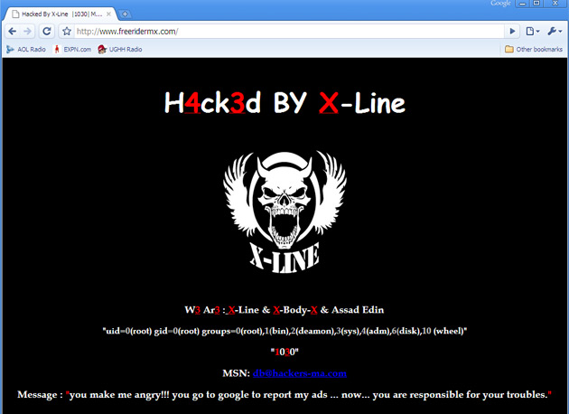
Abuse of the DNS | Abuse via the DNS
Includes but not limited to: DOS/Ddos Spoofing & Poisoning Hijacking & MITM Attacks DNS Tunneling Ransomware Unauthorized access & Host file modifications …and many more. Some Useful Actions/Tips: Have a BC/DR Playbook & perform drills CVE lookout and regular patching Monitoring e.g., IPS/IDS, Honeypot Increase bandwidth and load balancing Deploy DNSSec, TSIG, & SSL Certs Implement anycast services (PCH, AfriNIC, Slaves) | Includes but not limited to: Botnets/C &C Malware Distribution Phishing & Scamming Typo-squatting and homoglyphs Defacements
Your Gateway to the World!
DNS Abuse from a .bw Perspective | JUNE 2022

Slide 7

Prevention & Mitigation
Your Gateway to the World!
DNS Abuse from a .bw Perspective | JUNE 2022

Slide 8
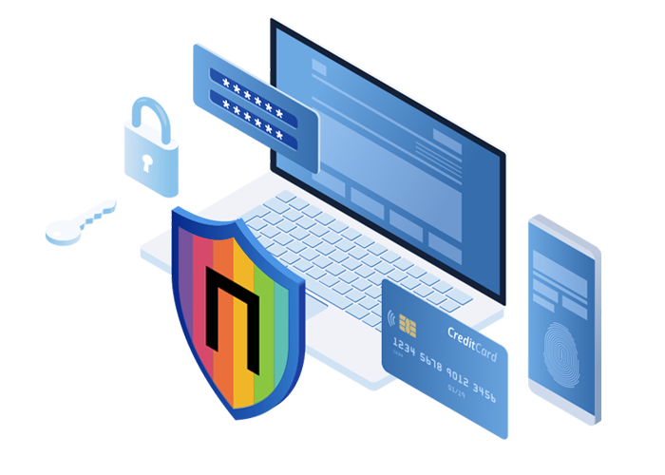
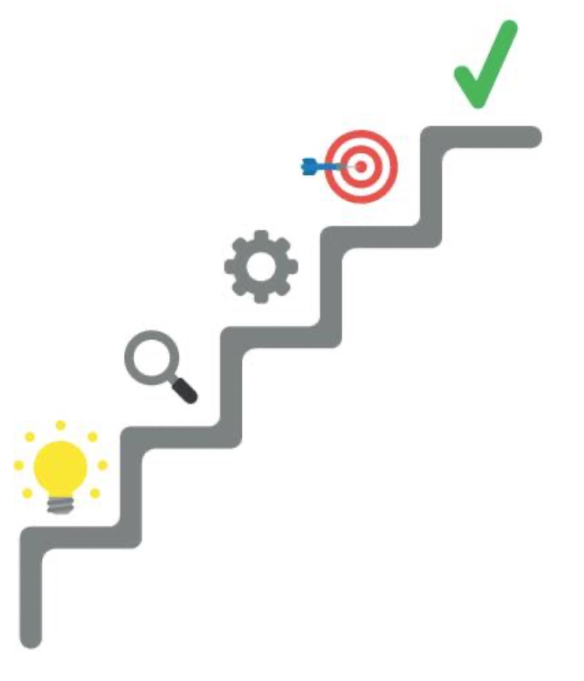
Prevention through Policies:
  Registrar Accreditation Agreement (RAA): Outlines responsibilities of Registrars securing services and the Registry’s authority/power.
  Acceptable Use Policies (AUP): Speaks to DNS abuse against IP and DNS infrastructure, deception, data theft via DNS, hacking, cracking etc.
  Registration Agreement (RA): Stipulates core registration data, accuracy of the registration data, and obligation to keep it updated.
  All give rights to takedowns and removal of zone data from Registry as well as other actions to curb abuse including random compliance checks.
  We use Commercial and OSINT tools for active Takedown against phishing and web shells., impersonation, brand infringement, etc.
  Prevent
  Identify & Notify
  Remediate & Mitigate
  Learn
  Capacitate and carry out awareness
  Tools include: Netcraft, urlhaul, phish.io, VirusTotal, Shodan, zone-h, dns dumpster, ssl labs, hardenize, goPhish, and many more can be found at https://osintframework.com
Your Gateway to the World!
DNS Abuse from a .bw Perspective | JUNE 2022
Notes:
AUP
Section 1 speaks to abuse against intellectual property (homo, domain squatting, etc.)
Section 2.6 of the Acceptable Use Policy speaks to disruption, deception and data theft via the DNS.
Section 2.7 speaks to inappropriate and abusive communication, publication or distribution (web content)
Section 3 references unsolicited email communications.
Section 5 prohibits Users from tempering with security of DNS including monitoring, probing, hacking, cracking, etc.
Section 8 & 10 outlines enforcement and the right to remove content.

Slide 9


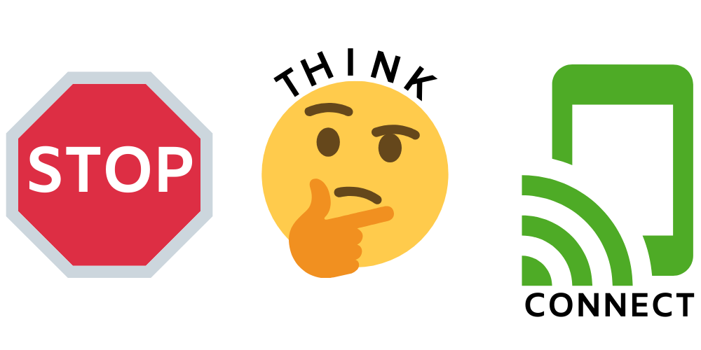
Consider this…
  Change the Narrative: Humans are NO LONGER the weakest link in Security. They are the SOLUTION!
Your Gateway to the World!
DNS Abuse from a .bw Perspective | JUNE 2022

Slide 10
Questions/Comments?
Your Gateway to the World!
DNS Abuse from a .bw Perspective | JUNE 2022

Slide 11
Ms. Angela Matlapeng
.bw ccTLD
https://nic.net.bw
matlapeng@bocra.org.bw
info@bocra.org.bw
Your Gateway to the World!
DNS Abuse from a .bw Perspective | JUNE 2022

