Slide 1
Dealing with DNS Abuse – why, what, how
Maša Drofenik
Registry .si (ARNES)
ICANN74, 16. June 2022

Slide 2

operates within public institution Academic and Research Network of Slovenia since 1992
our mission: to provide stable, secure, uninterrupted and reliable operations of .si on the internet
223 .si domains have been suspended since 2020 due to inaccurate registration data
148,200
.si domains registered
98
registrars

Slide 3
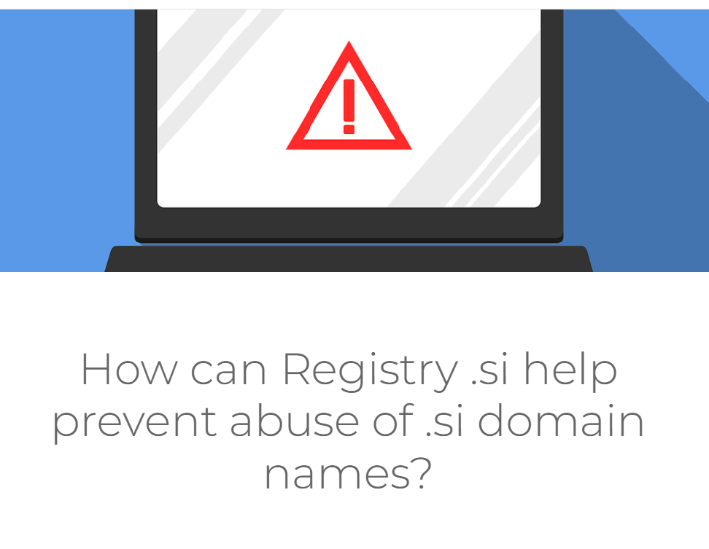
https://www.register.si/en/columns/how-can-registry-si-help-prevent-abuse-of-si-domain-names/
Monitoring and assessing the legality of online content is not the responsibility of the Registry .si and is not one of its tasks.

Slide 4





Preventing DNS Abuse under .si
accurate registration data (manually or machine-based verification by keywords etc.)
dealing with complaints from different rightsholders
close cooperation with national cert and our registrars (phishing, malware, fake web shops)
raising awareness and establishing good relations with lawmakers and national authorities (e.g. Market Inspectorate)
use our communication channels to warn end-users against online criminal activities

