Slide 1
ICANN Grant Program
Policy Team Meeting
Presenters:
Shayna Robinson - Grant Program Department
Wednesday 6 December 2023

Slide 2
Agenda
Background on the ICANN Grant Program
Making A Difference
Grant Program Implementation Progress
First Grant Cycle
Our Ask of You
Q&A

Slide 3
Background on the ICANN Grant Program

Slide 4
Background on the ICANN Grant Program
The ICANN community formed a Cross Community Working Group on Auction Proceeds (CCWG-AP) in January 2017 to develop a proposal for how proceeds from Auctions of Last Resort for new gTLDs should be distributed.
In September 2020, the CCWG-AP submitted its Final Report of 12 recommendations and related guidance to the ICANN Board for review and consideration.
The ICANN Board adopted the CCWG’s recommendations in June 2022. The Board directed ICANN org to produce a Preliminary Design and Implementation Plan for the Grant Program within 120 days which was completed in October 2022.
Since then, work has been ongoing to design the program and to establish the resources needed for its implementation.

Slide 5
Making A Difference

Slide 6
Making A Difference
The ICANN Grant Program represents a significant milestone in ICANN's ongoing efforts to nurture a robust and inclusive Internet ecosystem.
By funding projects that encourage, facilitate, and support ICANN's mission and its vision of a single, open, and globally interoperable Internet, ICANN has the exceptional opportunity to:
  Make a difference in the Internet ecosystem,
  Positively impact people across the globe in furtherance of ICANN’s mission.
Grantmaking can be a catalyzing force for change.

Slide 7
Making A Difference
The types of initiatives that the Grant Program will fund include those that support the ICANN mission by:
  Benefiting the development, distribution, evolution, and projects that support the Internet’s unique identifier systems.
  Providing capacity development for underserved populations.
  Advancing developments, innovation, and open standards for the benefit of the Internet community.
  Contributing to diversity, participation, and inclusion across stakeholder communities and geographic regions.

Slide 8
Grant Program Implementation Progress

Slide 9
Operational Readiness Update
Grant Program Department Recruitment:
The program will be managed by a dedicated ICANN department whose staffing is complete.
External Expertise and Support:
Aspects of the program will benefit from external vendors with a proven track record of expertise in the grant-making field to (i) support some eligibility checks, (ii) establish and manage the Independent Application Assessment Panel, and (iii) provide the management platform for the applications and grants.
ICANN conducted a Request for Information (RFI) in April and May 2023 and the results provided confidence that the market can offer these services. A Request for Proposals (RFP) ran from 5 June till 7 July 2023. ICANN is in the final phase of selecting the vendor(s).

Slide 10
Update on Recommendation 7
Board approved the new approach to Recommendation 7 at ICANN78:
  Using the applicant Terms and Conditions to bar applicants in the Grant Program from using ICANN’s accountability mechanisms on individual application decisions.
  Removing the prior dependency on amendment of the Fundamental Bylaws.
  Request for Reconsideration currently with the BAMC.

Slide 11
First Grant Cycle
Key Elements & Timeline

Slide 12
First Cycle Key Elements
For the first cycle, USD 10 million available for distribution.
Grant awards will range between USD 50,000 up to USD 500,000.
Maximum duration of projects is 24 months.
Disbursement of grant in installments with first installment after the signature of the grant agreement and following installments after the submission and approval of regular grantee reports.
**Key elements may be subject to change in future cycles.

Slide 13
Applicant Eligibility
Applicants must:
  Be entities that are charitable in nature:
    U.S. 501(c)(3)
    Non-U.S. equivalent of 501(c)(3)
      an equivalency determination must be made by a qualified tax practitioner
  Meet all applicable U.S. trade laws and regulations and must not be the subject of any U.S. sanctions
  Meet all applicable standards for reputation and background checks

Slide 14
Activities Eligibility
Activities must be consistent with and within ICANN’s mission “to ensure the stable and secure operation of the Internet's unique identifier systems” as described in Section 1.1 of ICANN Bylaws.
Non-eligible activities include (non-exhaustive list):
  Any political or lobbying activity, including activities to influence legislation and/or the outcome of any specific public election, or to carry on, directly or indirectly, any voter registration drive
  Any activity that may lead to private benefit of individuals
  Any unlawful activity according to the country where the applicant is based and/or where the project is developed
  Any activity already supported with funding from ICANN.

Slide 15
Work in Progress
Applicant Guide to be published in January.
Specific themes and work areas from program objectives.
Assessment criteria and rubric used by independent panelists to assess applications based on:
  Clarity and relevance,
  Quality and effectiveness,
  Soundness and feasibility,
  Appropriate resources,
  Competency and expertise of the applicant.
Eligible and ineligible expenses that can be included in the project budget.

Slide 16
Timeline for the First Cycle Launch
First cycle of the ICANN Grant Program open for applications in late Q1 of 2024.
  Awareness campaign to start at the time the applicant guide is published.
Call for applications open for 60 calendar days.
Evaluation of the applications (admissibility – eligibility – panel assessment) is expected to last five months.
Grant agreement negotiations with selected applicants will start after the Board approves the proposed slate of successful applications.

Slide 17
Our Ask of You

Slide 18
Spreading the Word
Plug the Grant Program in your meetings and events.
  Comms Toolkit forthcoming
Invite us to speak at your engagements.
  Virtual or in-person
Share our contact information with key stakeholders.
  Especially in underserved/underrepresented regions
Encourage organizations to apply even if you or they are unsure.
  Don’t make any promises, but offer support for proposal ideas
Share feedback with us about what you are hearing in the community.

Slide 19
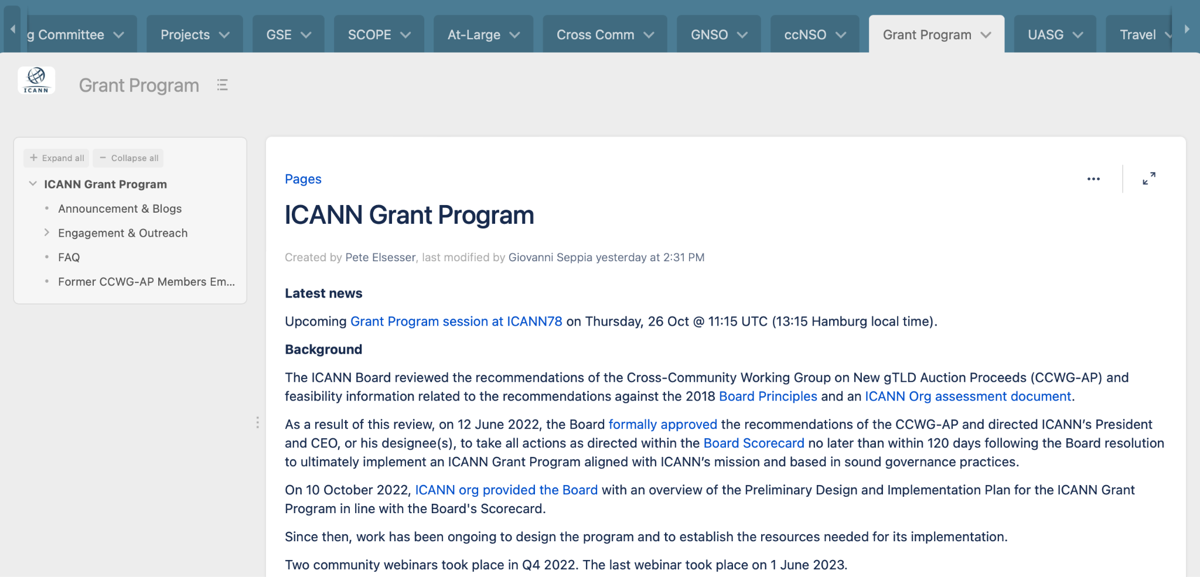
For More Updates, Stay Tuned at:
To learn more about this program and its implementation progress,
visit the dedicated wiki space:
https://community.icann.org/display/GP/ICANN+Grant+Program

Slide 20
Q&A

