Slide 1
Joint SSR-RT/DSSA meeting
DSSA Progress Update
Dakar – October 2011

Slide 2
Goals for today
Update you on our progress
Raise awareness
Solicit your input
Look for opportunities
Identify overlaps/conflicts

Slide 3
Charter: Background
At their meetings during the ICANN Brussels meeting the At-Large Advisory Committee (ALAC), the Country Code Names Supporting Organization (ccNSO), the Generic Names Supporting Organization (GNSO), the Governmental Advisory Committee (GAC), and the Number Resource Organization (NROs) acknowledged the need for a better understanding of the security and stability of the global domain name system (DNS). This is considered to be of common interest to the participating Supporting Organisations (SOs), Advisory Committees (ACs) and others, and should be preferably undertaken in a collaborative effort.

Slide 4
SSR Scope
Note: this is purely a Mikey invention that hasn’t been reviewed by anybody
I’m not sure if all of this is in-scope for the SSR team, but I imagine much of it is…
Incident response
  Provide initial response to an incident
  Communicate incidents
  Conduct impact assessments
  Detect security events (through monitoring, advisories, reports of suspicious activity, etc.)
  Provide incident resolution and countermeasures
  Conduct investigations
Compliance Monitoring
  Measure progress and compliance in the following areas;
    incident response
    practices
    technology
    management
    risk-management
Security Management
  Overall management and direction
  Security strategy and alignment within overall IT strategy
  Program management
  Security metrics
  Policy
  Guidelines and standards
Operational Practices
  Training and awareness
  Certification and accreditation
  Legal and regulatory compliance
  Securing external contractors
  Rewards and sanctions
  Acceptable use
  Business continuity
Risk Management
  Developing and maintaining an inventory of systems (determining contents, owner, maintainer, location, etc.)
  Mapping information and systems into security categories
  Conducting assessments of systems
  Analyzing risks and identifying mitigation/repair actions
Technical Practices
  Electronic mail security
  Network security
  Operating system security
  Data security
  Application security
  Security for public servers
  Wireless network security
  Personal computers and electronic devices
Technology management
  Routers
  Vulnerability assessment systems
  Configuration management systems
  Patch management systems
  Firewall systems
  Backup & recovery
  Intrusion detection and log-analysis systems
  Wireless access points

Slide 5
DSSA Scope
Note: this is purely a Mikey invention that hasn’t been reviewed by anybody
Incident response
  Provide initial response to an incident
  Communicate incidents
  Conduct impact assessments
  Detect security events (through monitoring, advisories, reports of suspicious activity, etc.)
  Provide incident resolution and countermeasures
  Conduct investigations
Compliance Monitoring
  Measure progress and compliance in the following areas;
    incident response
    practices
    technology
    management
    risk-management
Security Management
  Overall management and direction
  Security strategy and alignment within overall IT strategy
  Program management
  Security metrics
  Policy
  Guidelines and standards
Operational Practices
  Training and awareness
  Certification and accreditation
  Legal and regulatory compliance
  Securing external contractors
  Rewards and sanctions
  Acceptable use
  Business continuity
Risk Management
  Developing and maintaining an inventory of systems (determining contents, owner, maintainer, location, etc.)
  Mapping information and systems into security categories
  Conducting assessments of systems
  Analyzing risks and identifying mitigation/repair actions
Technical Practices
  Electronic mail security
  Network security
  Operating system security
  Data security
  Application security
  Security for public servers
  Wireless network security
  Personal computers and electronic devices
Technology management
  Routers
  Vulnerability assessment systems
  Configuration management systems
  Patch management systems
  Firewall systems
  Backup & recovery
  Intrusion detection and log-analysis systems
  Wireless access points
Our scope is much narrower – more of a deep dive into this one area, only for DNS and TLDs

Slide 6
Risk management process
Note: this is purely a Mikey invention that hasn’t been reviewed by anybody
Risk Assessment
Assess
Identify
Threats
Analyze
Controls
Analyze
Impact
DSSA
Inventory and
Characterize
Systems
Identify
Vulnerabilities
Determine
Likelihood
Determine
Risk
Risk Planning
Mitigate
Assume the
risk
Avoid the
risk
Limit the
risk
Transfer the
risk
Compliance and activity monitoring
Monitor

Slide 7
Goals and Objectives
Note: this is from the DSSA Kick-Off deck – reviewed and approved
Report to respective participating SO’s and AC’s on:
  Actual level, frequency and severity of threats to the DNS
  Current efforts and activities to mitigate these threats to the DNS
  Gaps (if any) in the current response to DNS issues
  Possible additional risk mitigation activities that would assist in closing those gaps (if considered feasible and appropriate by the WG)

Slide 8
Approach and status
Launch
Identify Threats & Vulnerabilities
We are here – about 70% complete with this phase of the work
Analyze
Threats & Vulnerabilities
Report

Slide 9
Activity since Singapore
Identify Threats
The working group has:
  Developed lists of vulnerabilities and threats (with definitions)
  Made preliminary choices about which threats are in/out of scope for analysis
  Developed preliminary criteria and mechanisms for segregating sensitive information
Remaining work in this phase
  Solicit additional lists/definitions from other experts and interested parties
  Arrive at a final (prioritized) list of threats and vulnerabilities

Slide 10
Brainstorming and refining
“I'm sorry this letter is so long, I didn't have time to make it shorter.”
― George Bernard Shaw, Pascal, Goethe, Wilde, Cicero, DSSA

Slide 11
Scope
From our charter, “the working group should focus on "The actual level, frequency and severity of threats to the DNS.... The DSSA‐WG should limit its activities to considering issues at the root and top level domains within the framework of ICANN’s coordinating role in managing Internet naming and numbering resources as stated in its Mission and in its Bylaws.”
The WG refined this to add “we are not to look at every threat having to do with, or taking place via, the DNS, or that impacts some party using the DNS. We are concerned with “the” DNS, i.e. threats to the system itself, and relevant to ICANN’s role.”

Slide 12
Threats to underlying infrastructure
(Draft – for discussion only)
In scope
  System failure (e.g. hardware/software failures, etc.)
  Governmental interventions (e.g. seizure, blocking, etc.)
  Physical events (e.g. natural disasters, etc.)
  Fragmentation of the root (e.g. alternate roots, root scaling, etc.)
Under discussion (your thoughts?)
  Business failure
Out of scope
  Depletion of IPv4 address pool
  Rationale:
    The concerns (routing table growth and route fragmentation) will happen anyway
    The DNS is not a heavy consumer of IP addresses, thus depletion is unlikely to have a significant impact

Slide 13
Threats – direct attacks
(Draft – for discussion only)
In scope
  DDOS – distributed denial of service
  Packet interception
  Recursive vs authoritative nameserver attacks (e.g. using vulnerable recursive DNS servers as reflectors to attack TLD DNS servers)
  Data poisoning attacks
Under discussion (your thoughts?)
  IDN attacks (lookalike characters for standard exploitation techniques – awaiting results of the Variants project)
  Malicious or unintentional alteration of DNS configuration information
Out of scope
  Footprinting
  Authenticated denial of domain name
  Malicious or unintentional alteration of contact information
  Rationale:
    These are behaviors or, in some cases, threat vectors
    These are focused/limited threats, not likely to cause widespread instability

Slide 14
Threats – indirect attacks
(Draft – for discussion only)
In scope
  Email server-hopping under IPv6 (causing collateral damage due to load)
Out of scope
  Registration abuse – front-running
  Registration abuse – cybersquatting
  Registration directory service abuse – harvesting registration data for spam
  Registration directory service abuse – harvesting personal contact information from domain name registration records
  Rationale:
    These are problems at the 2nd level, not a threat to the DNS
    In some instances these are policy issues that do not threaten the DNS
    In some cases the IETF is discussing the issue and we will monitor that discussion (harvesting registration data for spam)

Slide 15
Vulnerabilities
(Draft – for discussion only)
Operational issues
  Infrastructure vulnerabilities (e.g. single point of failure, DNS software vulnerabilities, insufficient SLA’s etc.)
  Business and technical process vulnerabilities (e.g. orphaned glue records, lock-outs, TLD redelegation, etc.)
Registry failure and continuity
Managerial choices/issues
  Not following best practices (e.g. measures to detect/prevent unauthorized changes, etc.)
  Gaps in continuity planning (e.g. responsibilities, actions, documentation, etc.)
  Inadequate funding/resources (for infrastructure, training, staff, etc.)
  Lack of visibility/understanding by decision-makers

Slide 16
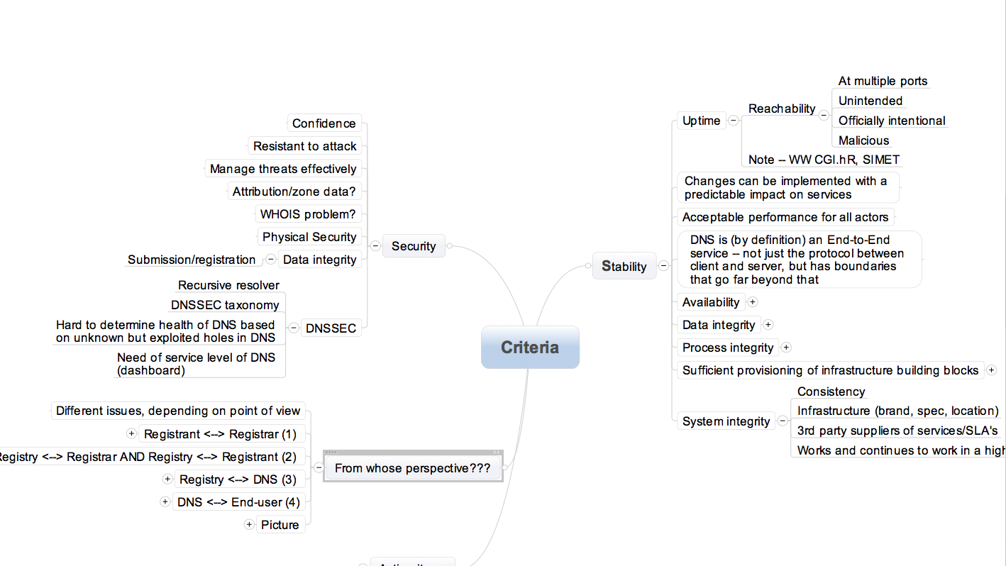
Criteria
(Note: this is very-early draft)

Slide 17
Questions?
This “scoping” work is well along, but not complete. We are interested in your thoughts

