Slide 1
DSSA Update
Costa Rica – March, 2012

Slide 2
Goals for today
Update you on our progress
Raise awareness
Solicit your input

Slide 3
Goals and Objectives
Report to respective participating SO’s and AC’s on:
  Actual level, frequency and severity of threats to the DNS
  Current efforts and activities to mitigate these threats to the DNS
  Gaps (if any) in the current response to DNS issues
  Possible additional risk mitigation activities that would assist in closing those gaps (if considered feasible and appropriate by the WG)

Slide 4
Where we are…
Approach and status
Launch
Identify Threats & Vulnerabilities
Analyze
Threats & Vulnerabilities
We are here – just getting started with this phase of the work
Report
We are hoping to have a substantial portion of this done by Prague

Slide 5
Methodology – NIST 800-30
Rationale
The DSSA realized that using a predefined methodology would save time and improve our work product
We selected NIST 800-30 after reviewing several dozen alternatives
The reasons we selected this one include:
  It’s available at no cost
  It’s being actively supported and maintained
  It’s widely known and supported in the community
  It’s likely to be consistent with the needs of other parts of ICANN (and thus our pioneering may produce something that can be “repurposed” elsewhere in the organization)
  It’s available in English

Slide 6
Methodology – NIST 800-30
Risk Management Hierarchy
The methodology presumes a tiered approach to the work
DSSA is chartered to look at the broadest, most general tier
However we feel it may be useful to pursue one or two deeper, narrower analyses of specific threats once our “survey” work is complete

Slide 7
Where we’re going
Analysis phase – based on NIST methods
Assess threat sources and events
Threat sources – broad range of impact, high capability, strong intent, targeting the DNS?
Threat events – relevant to the DNS?
Assess vulnerabilities and predisposing conditions
Vulnerabilities – severe?
Predisposing conditions – pervasive?
Determine likelihood
High likelihood that a threat-event will be initiated?
High likelihood that a threat-event will result in an adverse impact?
Determine level of impact
Broad harm/consequence from a threat-event – operations, assets, individuals, other organizations, world?
Severe impact of a threat-event?
Determine risk
Given all of the above – what are the high-risk scenarios?

Slide 8
Activity since Singapore
The working group has:
  Developed a protocol for handling confidential information
  Selected a methodology to structure the remaining work
  Begun the detailed analysis of the risk assessment

Slide 9
Architecture

Slide 10
Non-adversarial threat events
(Question: relevance to “the DNS”)
NATE-10 | Disrupts a "major" zone file (.COM/.NET/.UK/.DE etc.)
NATE-20 | Disrupts a "lesser" zone file (that is not outsourced to a major provider)
NATE-30 | Root zone -- is published incorrectly
NATE-40 | Root zone -- is not published
NATE-50 | Disrupts the IANA zone file
NATE-60 | Disrupts DNSSEC from a "Major" DNSSEC provider
NATE-70 | Disrupts DNSSEC for a TLD zone
NATE-80 | Disrupts Critical DNS support files
NATE-90 | Disrupts provisioning systems between registries and registrars (the result being that registrars can't add/change/delete zones from the TLD)
Scale: Table E-4 -- Relevance to the organization
10 -- Confirmed -- Seen by the organization
8 -- Expected -- Seen by the organization's peers or partners
5 -- Anticipated -- Reported by a trusted source
3 -- Predicted -- Predicted by a trusted source
1 -- Possible -- Described by a somewhat credible source
0 -- N/A -- Not currently applicable

Slide 11
Non-adversarial threat sources
(Question: what is the range of impact?)
NATS - 10 | Configuration errors by privaleged users
NATS - 20 | Business failure of a key provider
NATS - 30 | Nation state -- interventions with accidental or unintended consequences
NATS - 40 | Key storage, processing or network hardware failure
NATS - 50 | Key networking or operating-system software failure
NATS - 60 | General-purpose application software failure
NATS - 70 | Mission-specific software failure (WHOIS, EPP/RPP, Billing)
NATS - 80 | Root scaling
NATS - 90 | Natural disaster (flood, tsunami, earthquake
NATS - 100 | Widespread telecommunications infrastructure failure
NATS - 110 | Widespread power infrastructure failure
Scale: Table D-6 -- Range of impact
10 -- sweeping, involving almost all of the cyber resources of the DNS
8 -- extensive, involving most of the cyber resources of the DNS
5 --wide-ranging, involving a significant portion of the cyber resources of the DNS
3 --limited, involving some of the cyber resources of the DNS
1 -- minimal, involving few if any of the cyber resources of the DNS

Slide 12
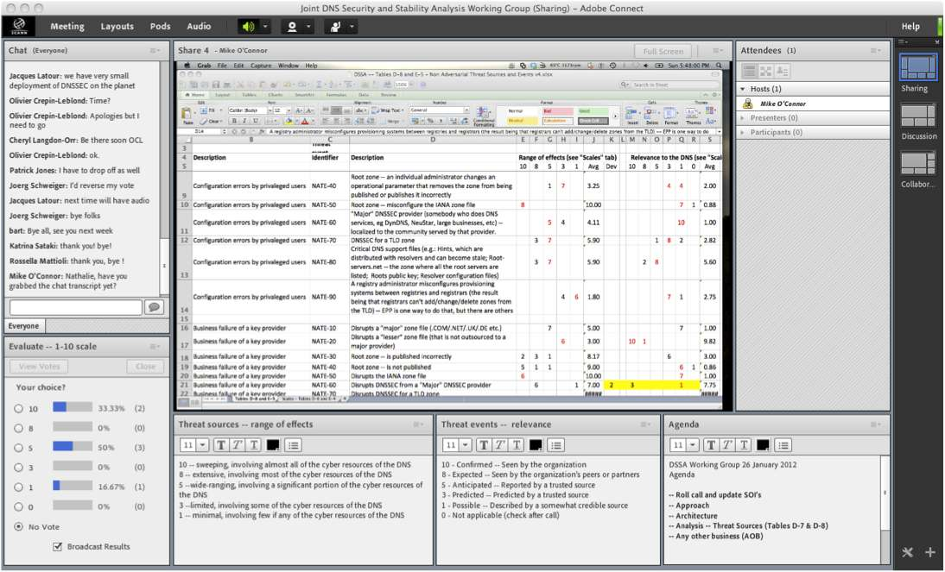
How we work
(design credit -- CLO)
Live chat
Participants
Shared document
Voting
Definitions
Agenda

Slide 13
Questions?

Slide 14
Charter: Background
At their meetings during the ICANN Brussels meeting the At-Large Advisory Committee (ALAC), the Country Code Names Supporting Organization (ccNSO), the Generic Names Supporting Organization (GNSO), the Governmental Advisory Committee (GAC), and the Number Resource Organization (NROs) acknowledged the need for a better understanding of the security and stability of the global domain name system (DNS). This is considered to be of common interest to the participating Supporting Organisations (SOs), Advisory Committees (ACs) and others, and should be preferably undertaken in a collaborative effort.

Slide 15
Methodology – NIST 800-30
Adversarial Risk Model
world
An example of the model – risks from “adversarial” events (which differs from “non-adversarial” threats such as errors, accidents, etc.)
    Benefits:
    Consistent terminology
    Shared model
    Structured work
    Sample deliverables

Slide 16
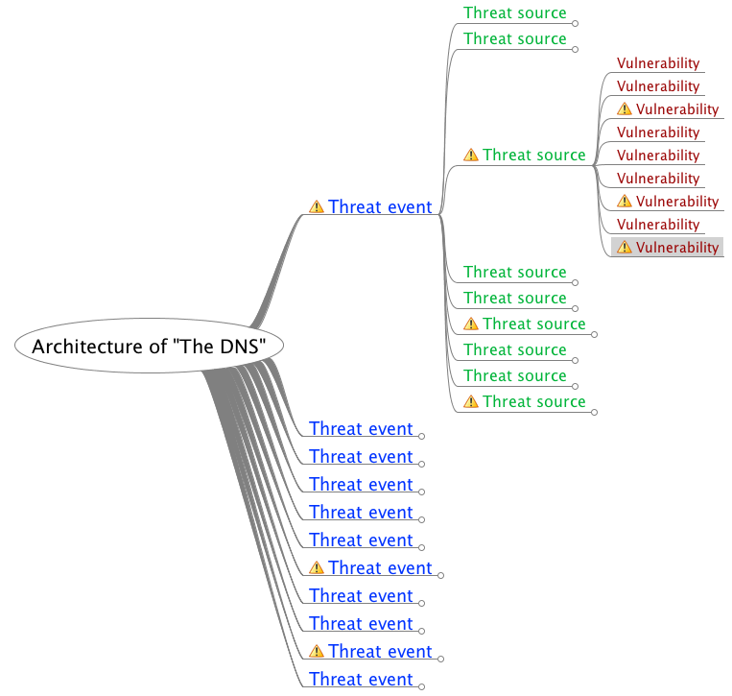
Problem: the evaluation per NIST methodology does not scale
It’s all about choices
Threat tree could easily grow to over 1000 permutations
Prune the tree along the way, in order to focus on the highest risks
Leave a framework that can be used to address:
  New things
  Changes
  Greater detail

Slide 17
Possible solution: re-sequence the work
Start with consequences
Evaluate the severity
Concentrate on the most severe (e.g. loss of trust in DNS)
Evaluate only those branches of the threat tree that lead to those outcomes
Start with consequences…
Assess threat sources and events
Threat sources – broad range of impact, high capability, strong intent, targeting the DNS?
Threat events – relevant to the DNS?
Assess vulnerabilities and predisposing conditions
Vulnerabilities – severe?
Predisposing conditions – pervasive?
Determine likelihood
High likelihood that a threat-event will be initiated?
High likelihood that a threat-event will result in an adverse impact?
Determine level of impact
Broad harm/consequence from a threat-event – operations, assets, individuals, other organizations, world?
Severe impact of a threat-event?
Determine risk
Given all of the above – what are the high-risk scenarios?

Slide 18
Confidential information
Note: Sensitivity, attribution and release to public are determined by info-provider | Sensitive |  | Not sensitive
Not attributed to source (transmitted through trusted 3rd party or summaries of Type 1 developed by sub-group) | Type 2: Distributed to sub-groups only. (Info-providers determine ultimate distribution) | Info-provider authorizes release | Type 3: Distributed to DSSA and public (“sanitized” info from sub-groups and other non-attributed information)
Attributed to source | Type 1: Distributed to sub-groups only (under NDA, most-protected) | Confidential info must never pass through this path. This is the exposure of information we’re trying to prevent. | Type 4: Distributed to DSSA and public

