Slide 1

  ICANN78 – Hamburg
  AGM - 21-26 October 2023
  Multilingual READOUT
  (by EURALO)
    Tuesday 7 November 2023
    18:00-20:00 UTC - 19:00-21:00 CEST
Interpretation: English, Español, Русский

Slide 2


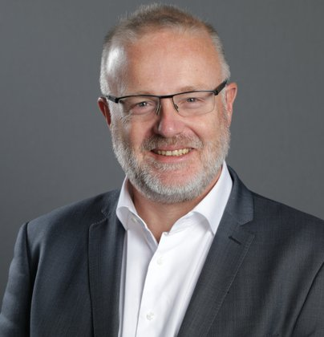
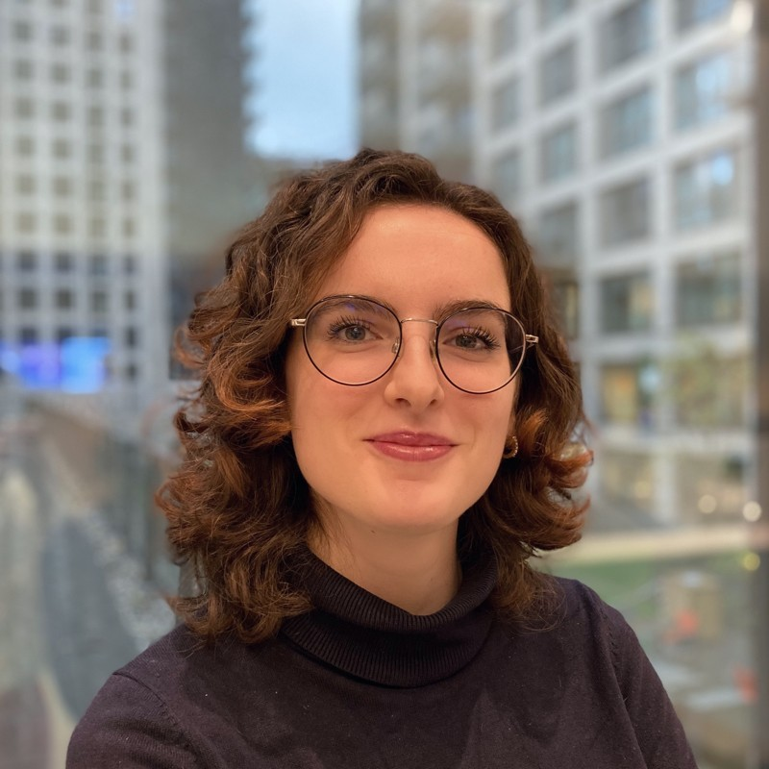
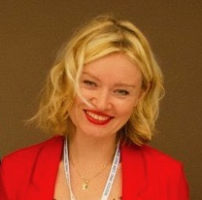
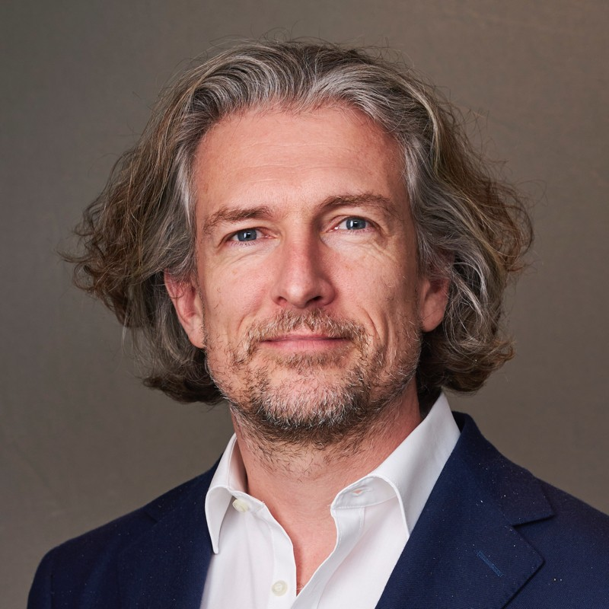
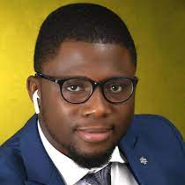
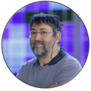
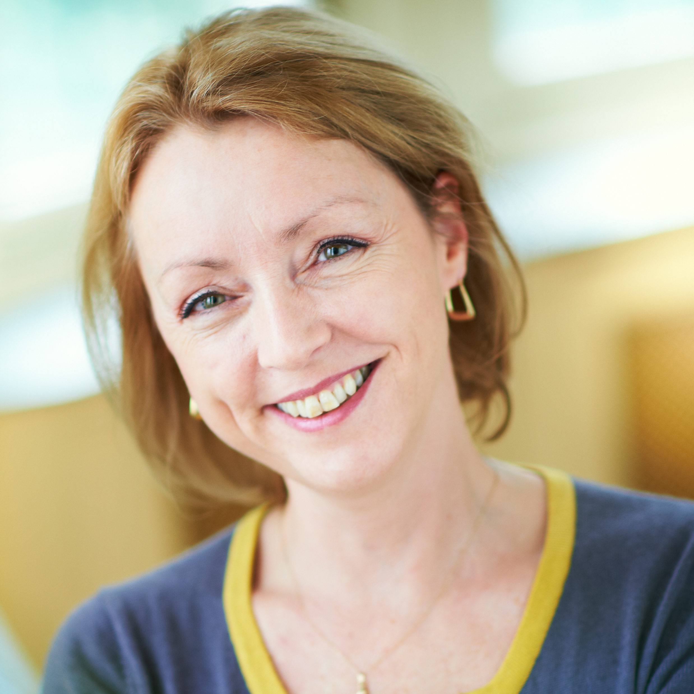

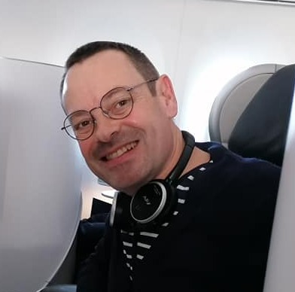
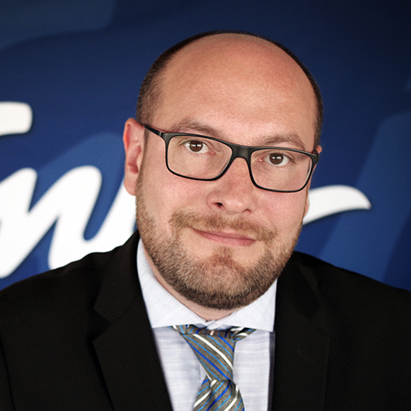
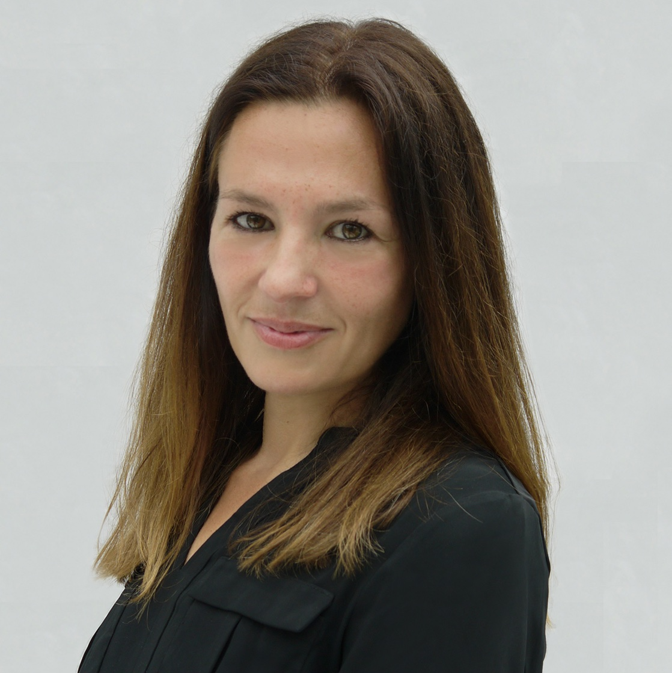
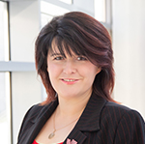
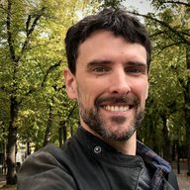
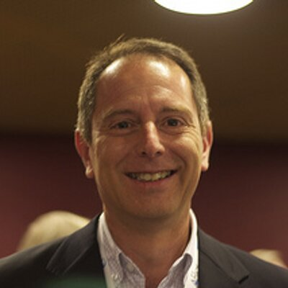
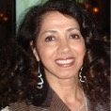
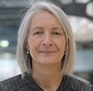
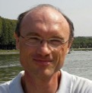
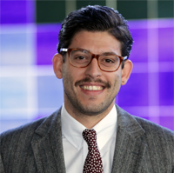
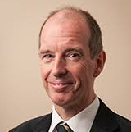

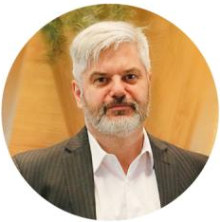
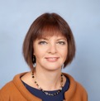
Tuesday 7 Nov 2023
19:00-21:00 CEST
18:00-20:00 UTC
EURALO
BOARD
NextGen
EURALO
{
{
}
}
{
}
{
}
{
}
{
}
{
}
{
Moderator
Sébastien Bachollet
BOARD
NPOC
BC
ASO
19:30-20:00 UTC
Welcome - SBT (2’)
Exchange with the participants (14’)
Xavier Calvez - ICANN SVP, Planning and
Chief Financial Officer (10’)
Next steps – Sébastien B. (4’)
READOUT (by EURALO)
ccNSO
GSE-Eu
BOARD
18:00 - 19:30 UTC
180 s
BOARD
EURALO
EURALO
Interpretation: English, Español, Français, Русский
RIPE-NCC
GNSO
REGISTER HERE
INSCRIVEZ-VOUS ICI
REGISTRAR AQUÍ
ЗАРЕГИСТРИРУЙТЕСЬ ЗДЕСЬ
Zoom registration
https://vu.fr/qACJ
SSAC/ALAC
GAC
GNSO
ccNSO

