Slide 1

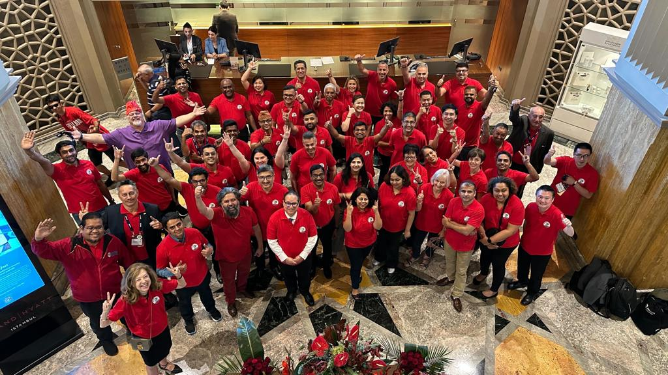
12-13TH SEPTEMBER 2023
GRAND HYATT, ISTANBUL, TURKEY
APRALO
GENERAL ASSEMBLY
12 SESSIONS
46 IN PERSON PARTICIPANTS
22 REMOTE PARTICIPANTS
2 DAYS
NETWORKING
COLLABORATION
INTERACTION
FEEDBACK
MEETING
#1 APRALO COMMUNITY

Slide 2
Welcome and Introduction to the General Assembly
Moderator: Amrita Choudhury, APRALO Chair
Welcome and a brief overview on what to expect in the next two days
At-Large Tracks
  Policy advice development
  Outreach and engagement
  Operational issues.
Productive discussions
Sharing insights & experience
Shape the future direction

Slide 3
Interaction with the ICANN Board
Moderator: Maureen Hilyard, ALAC Member
Get updated on the vision and objectives before the ICANN Board
Areas of focus
Expectations from At Large/ APRALO end user community
Guest Board Members:
  León Sánchez
  Edmon Chung
  Maarten Botterman
Updates on latest developments
Valuable insights
ICANN Board’s strategic directions

Slide 4
Summary of Key Policy and Policy Advice Issues for APRALO
Moderator: Justine Chew, ALAC Liaison to the GNSO and incoming ALAC Member
Continued discussion with ICANN Board.
Summarizing the policy and policy advice issues of importance to APRALO based on the discussion

Slide 5
Interaction with the Global Stakeholder Engagement (GSE) APAC and Middle East Teams
Moderator: Satish Babu, ALAC Member
What GSE does?
How GSE works with APRALO?
Who are the GSE team members?
Leads:
  Jia-Rong Low,VP, Stakeholder Engagement and Managing Director - Asia Pacific
  Baher Esmat, VP, Stakeholder Engagement - Middle East and Managing Director Middle East and Africa
  Savenaca (Save) Vocea, VP, Stakeholder Engagement - Oceania
Partnering APRALO
  Relationships – help us with your networks
  Speak/participate at GSE-led events
  Support your events
  Outreach and Engagement (O&E) Plan

Slide 6
At-Large Loop and Campaign Book
Moderator: Jonathan Zuck, ALAC Chair
At-Large Structures and its activities
Meeting/Seminar: Out of the box
Engagement: Mobilization and Activation
End User Interests
  Identify and Amplify
  With feedback
ICANN – ALAC
  AFRALO, APRALO, EURALO, LACRALO, NURALO
  ALS
Identify
  Think Real Hard!
  Debate, get Feedback
  General consensus
Amplify
  Get the word out
  UA Day success model
Campaign Book
Outreach vs Engagement
  Mobilize and Activate

Slide 7
Introduction to the APRALO Rules of Procedures (ROP)
Moderator: Cheryl Langdon-Orr
Current Version: 2014
Unaffiliated Individual Member, Roles, Election Process, Membership Status, New Membership Tyes, Code of Conduct
Expectations from ALSes
  Report to the ALAC
  Redistribute or support to distribute targeted ICANN Updates
  Refer ICANN and At-Large on ALS internet presence
  ALS to evaluate contributions on specific issues
  2-4 ALS representatives (office bearers)
  Know your members
  Participate in IG
  Vote
Proposed amendments on Membership
  Concept of Individual Member
Election Process
  Member in good standing
  Nominations
  Voting by nominated representatives

Slide 8
APRALO General Assembly Plenary
Moderator: Amrita Choudhury, APRALO Chair
Resolution on Rules of Procedure with 2023 edits
  Annual General Meeting
2023 edits
ICANN Legal review
Call for participants to contribute
Resolved to adopt Rules of Procedure
APRALO AGM

Slide 9
Discussion on the New gTLD Round & Opportunities
Moderators: Cheryl Landdon-Orr and Justine Chew
Participants were divided into 3 groups:
Discussions on 3 different questions and gathered input on communication tools and strategies that APRALO should look upto.
Communication modalities effective and efficient for:
ICANN’s upcoming Next Round for New gTLDs,ASP
Any unique opportunities for Regional Communities of Interest and Business,
Solicit feedback from local communities and Internet end users on ICANNs new gTLD
Propose 3 to 5 essential, and possibly unique, messages that could be included in APAC specifically focussed outreach efforts.
Propose 3 to 5 important areas of interest that could be highlighted in APAC specifically focussed community engagement efforts
In your local community
In your sub-region
APAC wide

Slide 10
Capacity Building on Effectiveness related to the Campaign
Moderators: Aris Ignacio and Jonathan Zuck
Participants were divided into 3 groups:
Fishbowl session
Suggest what would best facilitate effectiveness in a Regionally, Sub-Regionally, Nationally or Community of Interest(s) focussed Outreach and Engagement Campaign(s).
What resourcing might be required to achieve this for:
Regional efforts
Sub-Regional activities
National and Local programs
and/or
for Communities of Interest(s)

Slide 11
Outreach & Engagement Planning
Moderator: Jia Rong Low and Amrita Choudhury
ICANN Strategic Plan and Regional Plans by Jia Rong Low
Review of draft FY24 O&E Plan by Amrita Choudhury
Sub Regional Breakout Discussions and Wrap-up
ICANN’s 5 years strategic plan for year 2021-2025
Vision, Mission and Strategic Objective
APAC Regional plan for Fiscal Year 2021-2025
Firm up activities and targeted outcomes under the O&E plan for the FY24 .
Discuss how ICANN GSE and regional teams can partner/support APRALO
Sharing by each breakout group
Wrap-Up and Summary

Slide 12
Key Takeaways & Final Comments
Moderator: Gunela Astbrink
Opportunity for Participants to Share their experience
Carrying forward the learnings
Vote of Thanks to APRALO Leadership, ICANN org Team, TECH support

