Slide 1
2012 – 2015 ICANN
Strategic Plan Development Update
23 October 2011

Slide 2

Agenda
Steps in Strategic Plan process
Emerging themes
Strategic objectives – focus on security
Metrics review

Slide 3
Steps in Strategic Plan process
  Process began with community exchange in Singapore
  Received community Input on formulation of the plan in July
  Held internal brainstorm sessions, reviewed and updated strategic metrics
  SO/AC consultations
  Posted draft 2012-2015 Strategic Plan for 45 day public comment period

Slide 4
  2012-2015 Draft Strategic plan posted
    Clean version of the draft plan:
    http://www.icann.org/en/strategic-plan/draft-strategic-plan-2012-2015-clean-03oct11-en.pdf
    Redline version, which reflects changes made from the 2011-2014 Strategic Plan, can be found at:
    http://www.icann.org/en/strategic-plan/draft-strategic-plan-2012-2015-redline-03oct11-en.pdf

Slide 5
2012-2015 Strategic Plan - Next Steps
6 Month Development Process
Jun 2011
Dec 2011
20 - 24 June
41st Meeting Singapore
23 - 28 Oct
42nd Meeting,
Dakar
29 Jul -29 Aug – Input for formulation of Plan
Jul - Sept – Draft 2012-2015 Strategic Plan
3 Oct -17 Nov – Draft Plan Public Comment (45 day)
Nov – Update Draft Plan
22 Nov – Plan Board review
Dec – Board Meeting

Slide 6
Emerging themes 1
New gTLD Program is raising awareness and profile of ICANN around the globe
DNS Stability & Security message moves beyond DNS to include IP addresses and parameters
Law Enforcement is engaging more with ICANN community
Provide for effective and constructive early participation of the GAC in the policy development process

Slide 7
Emerging themes 2
Better define principles for internationalization to steer decisions and expansion
Engage new stakeholders into the multi-stakeholder model
Increase focus on Whois database policy and procedures
Better enterprise-wide processes and systems
Continue to evolve ICANN meetings

Slide 8
Questions
What are the key challenges facing ICANN over the next 3 years in accomplishing this objective?
What are the actions or strategies we (large ICANN community) can consider in response to these challenges?

Slide 9
ICANN Strategic - One of the Four Strategic Focus Areas
DNS stability and security .
Approved version
2011-2014
Updated, for discussion
2012-2015
Maintain & drive DNS uptime
Enhance DNS risk management
Broad DNSSEC adoption
Enhanced international DNS cooperation
Improved DNS resiliency
Maintain & drive DNS availability
Enhance risk management & resiliency of the DNS, IP addresses & parameters
Promote Broad DNSSEC adoption
Enhance international DNS cooperation
Improve response to DNS security incidents

Slide 10
ICANN Strategic - One of the Four Strategic Focus Areas
Consumer choice, competition and innovation.
Approved version
2011-2014
Updated, for discussion
2012-2015
Maintain single authoritative root
Increased TLD options in more languages
New gTLDs including IDNs
Lower registration abuse
Increased industry competition
Maintain single authoritative root
Increase TLD options in more languages
Rollout new gTLDs including IDNs
Lower registration abuse
Increase industry competition

Slide 11
ICANN Strategic - One of the Four Strategic Focus Areas
Core operations including IANA
Approved version
2011-2014
Updated, for discussion
2012-2015
Flawless IANA operations
Long-term IANA functions responsibility
Resilient L-Root operations
Continual improvements (TQM)
Internationalization
Flawless IANA operations
Continue long-term IANA functions responsibility
Resilient L-Root operations
Continual improvements (EFQM)
Internationalization
ICANN meeting evolution

Slide 12
ICANN Strategic - One of the Four Strategic Focus Areas
A healthy Internet ecosystem.
Approved version
2011-2014
Updated, for discussion
2012-2015
Strive to be an exemplary international multi-stakeholder organization
Increase stakeholder diversity and cross-stakeholder work
World-class accountability and transparency (ATRT actions)
Enhance trust in ICANN’s stewardship
Act in global public interest
Ease of global participation
Continuing role in internet governance
Stakeholder diversity
World-class accountability and transparency
Enhanced trust in ICANN’s stewardship
Act in global public interest
Cross-stakeholder work

Slide 13
Development of Metrics
Objectives: Broad, general areas of review. These generally reflect the end goals based on the mission of a function.
Criteria: Specific areas of accomplishment that satisfy major divisions of responsibility within a function.
Measures: Metrics designed to drive improvement and characterize progress made under each criteria. These are specific goals based on individual expected work outputs.
Notes:
The establishment of performance goals can best be specified when defined within three primary levels:

Slide 14
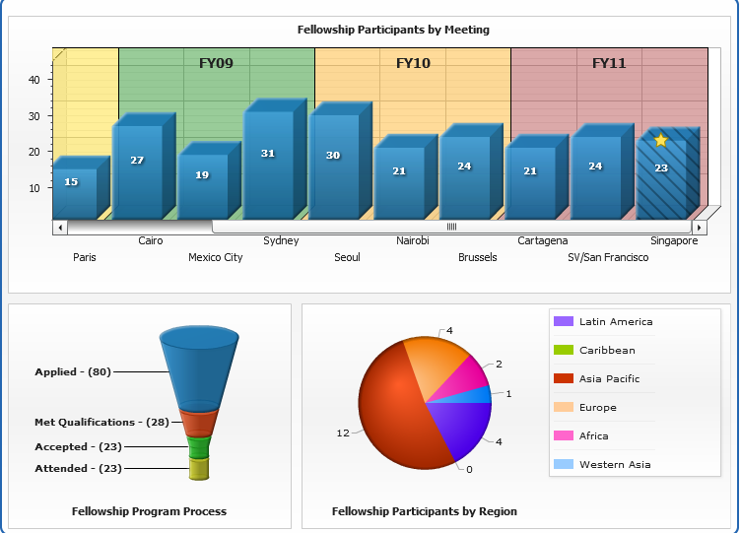
Example Metric 1- Number and trend of ICANN Fellowships and the related increase and participation in ICANN processes

Slide 15
Example Metrics 2 - DNS Stability and Security
Contract enforcement of TLD uptime SLAs
Number of DNSSEC TLD signings and broadly adopted by end of plan period
Number of IPv6 awareness raising engagements in which ICANN participates
Appropriate percentage of the ICANN budget dedicated to DNS stability, security and resiliency
Notes:
Metrics - DNS Stability and Security
100% L-Root availability
Initiate community development of key performance indicators for measuring “100% DNS availability”
Contract enforcement of TLD uptime service level agreements
Number of global business continuity exercises
Measure of progress toward certification for a global business continuity standard
Number of DNSSEC TLD signings and broadly adopted by end of plan period
Number of IPv6 awareness raising engagements in which ICANN participates
Initiate an Internet number resource certification security effort and collaborate with the community on implementation within the plan period
Define metrics to ensure that appropriate percentage of the ICANN budget is dedicated to DNS stability, security and resiliency

Slide 16
Example Metrics 3 - Competition, consumer trust & choice
Launch of the new gTLD program and timely processing of applications
Measure effectiveness of Rights Protection Mechanisms in New gTLD Program
Launch and timely progress of the Whois program enhancements, especially to address internationalized data
IDNA 2008 protocol adoption
Notes:
Metrics - Competition, consumer trust & consumer choice
Launch of the new gTLD program and timely processing of applications
Number of IDN ccTLDs delegated annually
New gTLDs and IDN Fast Track: Implementation of measures of success that align with ICANN core vales and original program objectives
Measure effectiveness of Rights Protection Mechanisms in New gTLD Program
Describe the priorities of the regional education program and report progress
Build, publish and execute a contractual compliance regime for addressing the new expanded TLD space
Launch and timely progress of the Whois program enhancements, especially to address internationalized data
Document and publish IDN guidelines in 2012
Address the domain names that are not compliant with IDNA 2008 protocol
Addresses GNSO RySG comment on Internationalization opportunity

Slide 17
Example Metrics 4 - Core Operations including IANA
EFQM assessment demonstrating improvement over time
RPKI deployment within the period of the plan
2011 implementation of a new ICANN finance information technology system
Develop and publish additional metrics and reporting of contractual compliance performance
Notes:
Metrics - Core Operations including IANA
Meet or exceed IANA contract service level agreement performance
2011 award of the IANA follow-on contract or replacement
EFQM assessment demonstrating improvement over time
RPKI deployment within the period of the plan
100% L-root uptime
Organizational Effectiveness Program Benchmarks, Metrics and Results
Definition of global stakeholder service level metrics
2011 implementation of a new ICANN finance information technology system
Develop and publish additional metrics and reporting of contractual compliance performance

Slide 18
Example Metrics 5 - A healthy Internet governance eco-system
Timely completion of the Affirmation Reviews
Formalized cross-stakeholder participation process in the multi-stakeholder model
Number and trend of ICANN Fellowships and the related increase and participation in ICANN processes
Effective process for ALAC feedback to Board
Notes:
Metrics - A healthy Internet eco- system
Timely completion of the Affirmation Reviews
Timely Board determination and action to implement Affirmation of Commitments reviews recommendations
Continuation of a single authoritative root
Formalized cross-stakeholder participation process in the multi-stakeholder model
Improved ICANN Board of Directors feedback methodology
Number of international Internet governance events with constructive ICANN participation
Number and trend of ICANN Fellowships and the related increase and participation in ICANN processes
Global and skill set diversity of the ICANN Board of directors meet the Bylaws requirements
Addresses ALAC comment for better feedback from Board on action/no action from SO/AC recommendations

Slide 19
Thank You

Slide 20
Questions

Slide 21
Strategic Plan 2012-2015: Four Strategic Focus Areas Supporting…
One World. One Internet.
DNS stability and security
Competition, consumer trust & consumer choice
Core operations including IANA
A healthy Internet governance
eco-system
Maintain & drive DNS availability
Enhance risk management & resiliency of the DNS, IP addresses & parameters
Promote broad DNSSEC adoption
Enhance international DNS cooperation
Improve responses to DNS security incidents
Maintain single authoritative root
Increase TLD options in more languages
Rollout new gTLDs including IDNs
Lower registration abuse
Increase industry competition
Flawless IANA operations
Continue long-term IANA functions responsibility
Resilient L-Root operations
Continual improvements (EFQM)
Internationalization
ICANN meeting evolution
Strive to be an exemplary international multi-stakeholder organization
Increase stakeholder diversity and cross-stakeholder work
World-class accountability and transparency (ATRT actions)
Act in global public interest
Enhance trust in ICANN’s stewardship
Ease of global participation
Strategic Objectives
Promote DNSSEC training and adoption
Facilitate work on DNS, IP address & parameter security
Implement best practices for DNS business continuity planning
Facilitate IPv6 adoption
Explore Internet Number Resource Certification
Facilitate Whois evolution
Expand Internationalized Domain Name (IDNs)
Implement new gTLDs & measure impact
Whois program improvements
Improve policy development processes
Enhance registrant protection
Implement rights protection mechanisms
Expand stakeholders
Define internationalization principles
Continue IANA infrastructure upgrade
Publish reports on IANA services
Monitor performance of root zone management
IANA excellence (EFQM)
OEI - Organizational Effectiveness Initiative
Improve Enterprise Systems
Complete Affirmation of Commitments & organizational reviews
Retain & support existing community while attracting new & diverse community members
Build global support for single authoritative root
Enhance cooperation in Internet Governance
Increase technical community communication & collaboration
Strategic Projects
Local DNSSEC adoption
IDN variant management
Facilitate new DNS risk management working group & initiate study
Develop standards for DNS, & IP address protocol
Promote IPv6 deployment
Facilitate law enforcement engagement
Strengthen regional presence
Engage with Staff on performance
Increase participation on key committees
Expand engagement within technical community
Increase multi-stakeholder participation
Onboarding of participants
Increase contributions to international forums
Review SOs and ACs
Promote continuing education/orientation in ICANN programs
Continue Root Zone Management
Promote IDNA protocol implementation
Facilitate new gTLD & IDN rollout
Support Registrar Accreditation Agreement amendments
Expand inclusion & orientation of new stakeholders
Community Work
Enhance business continuity & risk management
Increase collaboration with RIRs & technical groups
Promote DNSSEC operations & education
Facilitate IPv4 & IPv6 engagement
Advance cooperative capability building in developing countries
Increase business outreach
Improve compliance
Enhance SO & AC support work
Expand contracted party customer service
Enhance global outreach
Support IDN ccTLD Fast Track
Facilitate new gTLD & IDN TLD implementation
Expand ICANN regional footprint
IANA request processing
Root zone DNSSEC operations
Facilitate Board support
Enhance security and contingency operations
Continue L-Root operations
Improve enterprise systems/processes/controls
Improve staff training, retention and engagement
Expand Thought leadership
Widen international engagement
Strengthen corporate, government & other stakeholder partnerships
Continue to improve decision impact analysis & reporting
Enhance communications, accessibility & participation via improved tools
Enhance multi-lingual strategy
Staff Work
Multi-stakeholder – Collaborative – International – Transparent - Accountable

