Slide 1

AFRALO General Assembly
Accra, Ghana
24-25 July 2023
New gTLD Applicant Support Program
Moh. Tijani BEN JEMAA / Sarah Kiden
24 July 2023

Slide 2
Applicant Support Program
Genesis
New generic Top-Level Domain (gTLD) 2012 Round
Application fee = US$ 185 000 as per the Applicant Guidebook
To cover the cost of the new gTLD program development
Big concern of parts of the community ▶︎ large protest
Several panels
Written proposals
Moh. Tijani BEN JEMAA / Sarah Kiden
24 July 2023
24 – 25 July 2023
2
Notes:
five point ten to the power twenty eight

Slide 3
Applicant Support Program
Genesis
Board Resolution 20 (Nairobi – 12 March 2010)
Stakeholders to develop a sustainable approach to providing support to applicants requiring assistance in applying for and operating new gTLDs.
Joint Applicant Support (JAS) Working Group
Worked during about 18 months
One call a week, and then two
2 milestone reports & a final report (September 2011)
Moh. Tijani BEN JEMAA / Sarah Kiden
24 July 2023
24 – 25 July 2023
3
Notes:
five point ten to the power twenty eight

Slide 4
Applicant Support Program
Genesis
The most opponent people to any support joined the WG
Pushed to make it so tough by always alarming the group that the program will be gamed
Managed to put more and more barriers.
Applicant Support Program “ASP”
Financial Support
Non Financial Support
Moh. Tijani BEN JEMAA / Sarah Kiden
24 July 2023
24 – 25 July 2023
4
Notes:
five point ten to the power twenty eight

Slide 5
Applicant Support Program
Genesis
Financial support
Reduction of the application fee by around 75% (USD 47,OOO)
Installment payment of the application fee
Deferring of the upfront costs of the required “continuity instrument”
The possible creation of a development fund
Moh. Tijani BEN JEMAA / Sarah Kiden
24 July 2023
24 – 25 July 2023
5
Notes:
five point ten to the power twenty eight

Slide 6
Applicant Support Program
Genesis
Non Financial Support
Assistance with the preparation of gTLD applications
Facilitation of IPv6 compliance
Consulting and education regarding DNSSEC implementation
Outreach & education efforts regarding the New gTLD Program
Logistical, translation and technical support
Establishment of Registry Service Providers in regions where none or few exist
Moh. Tijani BEN JEMAA / Sarah Kiden
24 July 2023
24 – 25 July 2023
6
Notes:
five point ten to the power twenty eight

Slide 7
Applicant Support Program
Genesis
Eligibility Criteria
Service to the public interest
Financial need
Financial capability
Moh. Tijani BEN JEMAA / Sarah Kiden
24 July 2023
24 – 25 July 2023
7
Notes:
five point ten to the power twenty eight

Slide 8
Applicant Support Program
Genesis
Support Application Review Panel (SARP)
Composed of Volunteers of ICANN Community and outside experts
Knowledge of the existing new gTLD processes, potential gaming patterns and the general needs and capabilities of Support Candidates from developing economies
Board allocates 2 million US$ for the applicant support program
More than enough to support up to 14 applicants
Moh. Tijani BEN JEMAA / Sarah Kiden
24 July 2023
24 – 25 July 2023
8
Notes:
five point ten to the power twenty eight

Slide 9
Applicant Support Program
Genesis
Result
Only 3 new gTLD applicants applied for support
The SARP accepted only one application and dropped 2
The accepted application for support was dropped by the Community Evaluation Panel
Final result: None of the applicants was supported
Moh. Tijani BEN JEMAA / Sarah Kiden
24 July 2023
24 – 25 July 2023
9
Notes:
five point ten to the power twenty eight

Slide 10
Applicant Support Program
Genesis
Why ???
Barriers put by the Applicant Support Program
No Outreach for the new gTLD program in the underserved areas
No outreach for the Applicant Support Program
Leaders of ICANN didn’t believe that the underserved communities should have access to the new gTLD program
Moh. Tijani BEN JEMAA / Sarah Kiden
24 July 2023
24 – 25 July 2023
10
Notes:
five point ten to the power twenty eight

Slide 11
Applicant Support Program
This was for the 2012 round
For the upcoming round, I give the floor to Sarah who was on the group working on the applicant support.
Moh. Tijani BEN JEMAA / Sarah Kiden
24 July 2023
24 – 25 July 2023
11
Notes:
five point ten to the power twenty eight

Slide 12
GNSO Guidance Process (GGP) Background
GNSO Council approved GGP Initiation Request to perform work on Applicant Support (25 August 2022)
The Working Group was assigned 6 tasks
The Working Group began its work in November 2022 (20+ WG and leadership calls as of 22 July 2023)
Moh. Tijani BEN JEMAA / Sarah Kiden
24 July 2023
24 – 25 July 2023
12
Notes:
five point ten to the power twenty eight

Slide 13
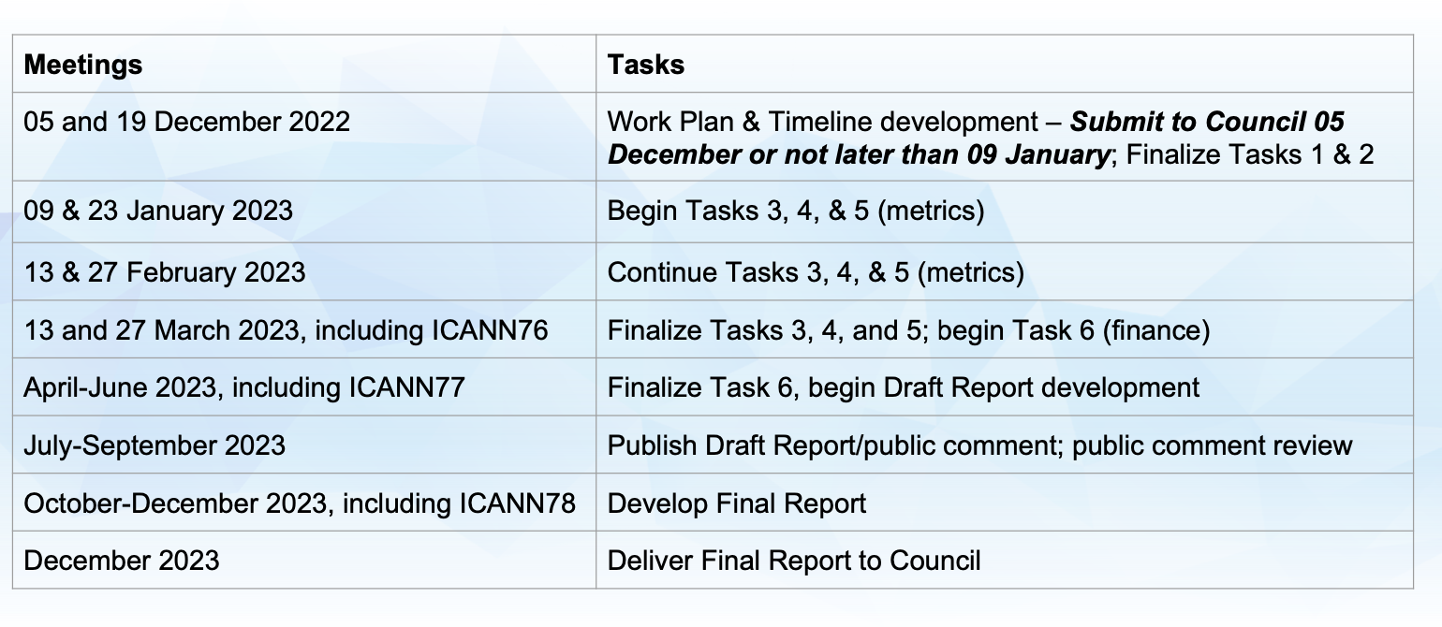
GGP Workplan and Timeline
Moh. Tijani BEN JEMAA / Sarah Kiden
24 July 2023
24 – 25 July 2023
13
Notes:
five point ten to the power twenty eight

Slide 14
GNSO Guidance Process (GGP) Tasks
Task 1: Review 2011 Final Report of JAS
Task 2: Work with ICANN Org Staff and identify experts to aid in tasks 3, 4 and 5
Task 3: Analyze and prioritize metrics in Implementation Guidance 17.9
Task 4: Identify other appropriate metrics
Task 5: Consider and suggest impact of outreach, education, business case development and application evaluation
Task 6: Recommend methodology for allocating financial support in event of inadequate funding
Moh. Tijani BEN JEMAA / Sarah Kiden
24 July 2023
24 – 25 July 2023
14
Notes:
five point ten to the power twenty eight

Slide 15
GGP Preliminary Guidance Recommendations
Increase awareness of the Applicant Support Program of the next round of gTLD applications
Pro bono services and ICANN-provided information and services
Resources necessary to achieve goals based on the GGP Recommendations Guidance Report
Make ASP materials and process timely and accessible
Percentage of successful gTLD applicants to be supported applicants
Moh. Tijani BEN JEMAA / Sarah Kiden
24 July 2023
24 – 25 July 2023
15
Notes:
five point ten to the power twenty eight

Slide 16
GGP Preliminary Guidance Recommendations
Investigate extent of business operation as registry operators after 3 years
In the scenario of inadequate funding, reduce fees equally across qualified applicants (but ICANN Org should make effort to provide additional funding)
To mitigate risk, designate a minimum level of support for each applicant
Develop flexible, predictable, and responsive ASP and communicate results of evaluation process
Moh. Tijani BEN JEMAA / Sarah Kiden
24 July 2023
24 – 25 July 2023
16
Notes:
five point ten to the power twenty eight

Slide 17
Public Comment
Call for Public Comment
GNSO Guidance Process (GGP) for Applicant Support Guidance Recommendation Draft Report
Timeframe: Open for 40 days until August 2023
Moh. Tijani BEN JEMAA / Sarah Kiden
24 July 2023
24 – 25 July 2023
17
Notes:
five point ten to the power twenty eight

Slide 18
Resources
GNSO Guidance Process (GGP) for Applicant Support Guidance Recommendation Draft Report 2023
Final report of the New gTLD Subsequent PDP WG (Applicant Support starting on page 71)
Joint Working Group Applicant Support 2011 Final Report
2016 Policy Implementation Review Report (PIRR) [Chapter 6 Applicant Support]
Applicant Guidebook
New gTLD FAQ
Moh. Tijani BEN JEMAA / Sarah Kiden
24 July 2023
24 – 25 July 2023
18
Notes:
five point ten to the power twenty eight

Slide 19
AFRALO General Assembly
Accra, Ghana
Applicant Support Program
Thank you for your Attention
tijani.benjemaa@topnet.tn
skiden@gmail.com
Moh. Tijani BEN JEMAA / Sarah Kiden
24 July 2023

