Slide 1

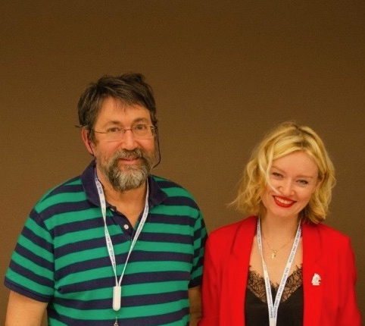

EURALO Board
2023 Road Map
Update 14th February 2023
by SBT

Slide 2

EURALO Board 2023 Road Map
EURALO 14th February 2023 – 18:00 - 19:00 UTC
EURALO Board Meeting Agenda
Welcome (2’)
EURALO Newsletters (2’)
EURALO ALSs (5’)
EURALO individual association GA (Roberto – 5’)
EURALO O&E 2023 Road Map (4’)
  Discretionary founding and CROP FY2023
EURALO & ICANN Meetings - Calendar Q1 & Q2 (3’)
  EURALO meetings
  ICANN meetings
ICANN76 meeting (2’)
ICANN meetings & ReadOut (by EURALO) (3’)
UA Day – 28 March 2023 (4’)
RT2023-1 (Tuesday 28 February 2023) (3’)
EURALO Issues (8’)
  ABR
  NomCom23
  EROR TF
  EURALO Elections
EURALO Board members
Q&A - AOB (10’)
AGENDA

Slide 3


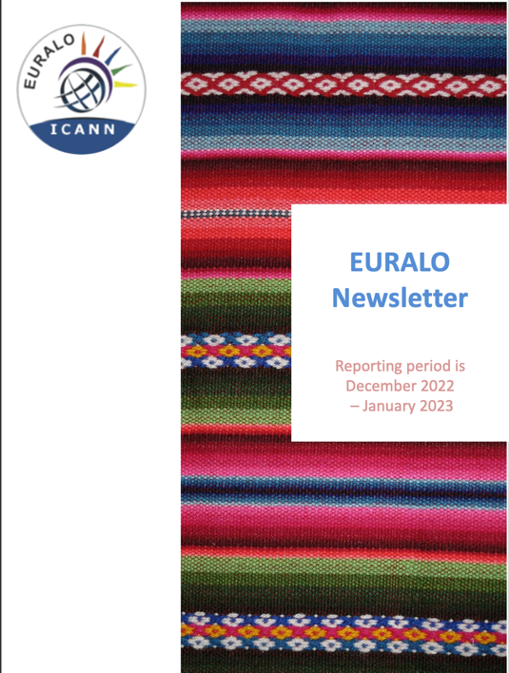
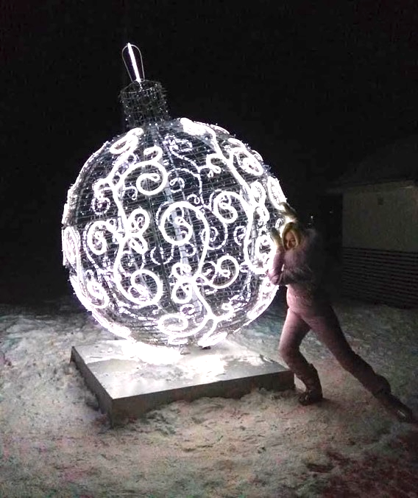
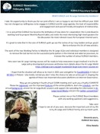








EURALO 2021/2022/2023 Road Map
EURALO Newsletters

Slide 4
EURALO 2023 Road Map
To be updated
EURALO ALSes
EURALO ALSes to be decertified
  Slovenian Consumers Association Acronym: Breda Kutin
  Internet Support Foundation Acronym (?)
  Communica-CH – Wolf Ludwig
  Wikimedia Osterreich
Possible new ALSes
  Poland – Joanna
To follow
  Dot HIV
  ISOC Wallonia (Christopher Wilkinson)
Setup a meeting
  GSE Europe – Adam Peake
  ISOC Europe – Nick Hyrka / David Frautschy
  EURALO – SBT-OCL-NFA and Staff GGR
ALS

Slide 5
EURALO 2023 Road Map
EURALO Individuals’ Association
  https://individualusers.org/about/
  https://individualusers.org/2023-elections/
EIA

Slide 6
EURALO 2023 Road Map
EURALO O&E 2023
  EURALO Regional FY23 Outreach and Engagement Strategic Plan
    https://community.icann.org/pages/editscaffold.action?pageId=222265419
  Implementation
    ALSes mobilization
    Individual (EU)RALO members mobilization
  CROP
    RIPE86 - 22 - 26 May 2023 – Rotterdam (1 Slot)
      https://ripe86.ripe.net/
    EuroDIG - 19 – 21 June 2023 – Tampere (2 Slots)
      https://www.eurodig.org/
  Discretionary funding
    Expositions et Atelier de l’Avenir Numérique à Varzy, France le 25 février 2023 (500$)
      https://www.isoc.fr/aan-varzy-fevrier2023/
    ISOC Norway, invites you to an evening workshop on 2. March 2023 (400$)
      https://isoc.no/news/evening-workshop-icann-and-current-challenges-on-the-internet/
O&E

Slide 7
EURALO 2023 Road Map
EURALO Meetings 2023
Thursday 12th January 2023 - 19:00-20:00 UTC: EURALO LT
Tuesday 17th January 2023 - 18:00-19:00 UTC: EURALO Board
Tuesday 24th January 2023 - 18:00-19:30 UTC: EURALO Members Monthly Meeting (MMM1)
Tuesday 31st January 2023 - 18:00-19:00 UTC: EURALO LT
Tuesday 7th February 2023 - 18:00-19:00 UTC: EURALO LT
Tuesday 14th February 2023 - 18:00-19:30 UTC: EURALO Board
Tuesday 21st February 2023 - 18:00-19:30 UTC: EURALO Round-Table (RT1-2023)
Tuesday 28th February 2023 - 18:00-19:30 UTC: EURALO Members Monthly Meeting (MMM2)
Tuesday 7th March 2023: ICANN76 (pre)
Tuesday 14th March 2023: ICANN76
Tuesday 21st March 2023: ICANN76 (post)
Tuesday 28th March 2023 - 17:00-19:00 UTC: RO-ICANN76 by EURALO (EN, ES, FR and RU)
Q1

Slide 8


Plenary Session
Looking Toward WSIS+20: How Can We Improve the Multistakeholder Model [of Internet Governance] for the Future?
Description
  The 2025 review of World Summit on the Information Society (WSIS) implementation is a critical opportunity to reaffirm support for multistakeholder governance of the Internet. This plenary topic would propose to discuss how to ensure participation from the technical community in the overall WSIS+20 review process, and how such technical participation might reflect the importance of multistakeholder governance for the Internet, [and also seek improvements to that model to deliver for people across the world]
Wednesday, 15 March, 10:30-12:00 (local time)
2023

Slide 9

ICANN meetings & EURALO readouts
ICANN76 – Cancun – Community Forum
  11-16 March 2023
  ICANN76 Readout by EURALO (EN, ES, FR and RU)
    Tuesday 28th March 2023 - 17:00-19:00 UTC
ICANN77 – Washington D.C. – Policy Forum
  12-15 June 2023
  ICANN77 Readout by EURALO (EN, ES, FR and RU)
    Tuesday 27th June 2023 - 17:00-19:00 UTC
ICANN78 – Hamburg – Annual General Meeting (25th)
  21-26 October 2023
  ICANN78 Readout by EURALO (EN, ES, FR and RU)
    Tuesday 7th November 2023 - 18:00-20:00 UTC
2023

Slide 10
Multilingual Readout ICANN76 (by EURALO)
Speakers
Danko Jevtovic – Vice Chair ICANN Board
Hervé Clement – Chair - ASO Address Council
Nigel Hickson – UK Rep GAC
Nicolas Caballero (LAC) – Chair GAC
Sebastien Ducos RySG – Chair - GNSO Council
Philippe Fouquart – ISP - GNSO
Pari Esfandiari – EURALO
Irina Daniela – ccNSO council member
Natalia Filina - EURALO
Katrina Sataki – ICANN Board
Maarten Botterman –ICANN Board
Christopher Mondini – VP, Stakeholder Engagement & Managing Director, Europe ICANN Org
Pierre Bonis – ccNSO
Chris Buckridge – Advisor RIPE NCC
Joanna Kulesza, ALAC Vice-Chair
Olivier Crepin-Leblond, Chair ISOC UK – Past Chair of ALAC & EURALO
Marie Pattullo – Commercial and Business Users (BC) – GNSO Council
Fellow
Xavier Calvez
ICANN SVP, Planning and Chief Financial Officer
U&A rep

Slide 11
EURALO 2023 Road Map
EURALO & UA Day – 28 March 2023
  https://uasg.tech/ua-day/
UA

Slide 12



Monthly RoundTable 1-23 (by EURALO)
Tuesday 21st February 2023
18:00-19:30 UTC - 19:00-20:30 CET
ZOOM REGISTRATION required
DNS4EU
Presentation of the project by the consortium
Various stakeholders are invited
to explain their
  Position regarding the European Commission project (RFP)
  Possible involvement
  Consequences on European End Users
The European Commission plans to onboard 100 million people to a new EU-based DNS internet infrastructure. The DNS4EU will be developed by international consortium led by Czech company Whalebone
https://www.whalebone.io/dns4eu
Agenda
Organization: At-Large staff
Welcome & Moderator: Pari Esfandiari (5’)
Introduction: Chris Mondini, ICANN Org VP Europe (5’)
Speakers (10’ each)
  Robert Šefr, CTO Whalebone
  Lise Fuhr, Director General Etno
  Chris Buckridge, Advisor to the RIPE NCC Managing Director
  Center for Democracy & technology or Article 19
  Alain Durand, ICANN Org - Principal Technologist
Q&A, moderated by Pari Esfandiari (20’)
Conclusion by Chris Mondini (5’)
Next steps: Sébastien Bachollet (5’)
Languages supported English, Français, Español, Русский

Slide 13
EURALO 2023 Road Map
EURALO Meetings 2023
Tuesday 4th April 2023 - 17:00-20:00 UTC: LT
Tuesday 11th April 2023 - 17:00-19:00 UTC: EURALO Board
Tuesday 18th April 2023 - 17:00-19:30 UTC: EURALO Members Monthly Meeting (MMM3)
Tuesday 25th April 2023 - 17:00-19:00 UTC: LT
Tuesday 2nd May 2023 - 17:00-19:00 UTC: EURALO LT
Tuesday 9th May 2023 - 187:00-19:00 UTC: EURALO Board
Tuesday 16th May 2023 - 17:00-19:00 UTC: EURALO Round-Table (RT2-2023)
Tuesday 23rd May 2023 - 17:00-19:00 UTC: EURALO Members Monthly Meeting (MMM4)
Tuesday 6th June 2023 - 17:00-19:00 UTC: ICANN77 (pre)
Tuesday 13th June 2023 - 17:00-19:00 UTC: ICANN77
Tuesday 20th June 2023 - 17:00-19:00 UTC: ICANN77 (post) + EURODIG
Tuesday 27th June 2023 - 17:00-19:00 UTC: RO-ICANN77 by EURALO (EN, ES, FR and RU)
Tuesday 7th November 2023 - 18:00-20:00 UTC: RO-ICANN78 by EURALO (EN, ES, FR and RU)
Q2

Slide 14
EURALO Issues
EURALO Board 2023
At-Large Additional Budget Request
NomCom – Yrjö Länsipuro
  The deadline to submit applications is 23 March 2023 at 23:59 Coordinated Universal Time (UTC).
EURALO Operation Rules Taskforce (EROR TF)
EURALO Elections (https://community.icann.org/pages/viewpage.action?pageId=186781605)
  ALAC Voting Delegates to the NomCom
  ALAC member (by EURALO)
  ALAC Selection Timetable for 2022 ALAC Members
    17 April 2023 - Announcement of call for nominations and Nominee's Statement
    17 April – 28 April 2023 - Nomination period (nominations accepted for 10 working days).
    5 May 2023 - Deadline for nomination acceptances
    9 May 2023 - 12 May 2023- Calls with the candidates if desired by the RALOs.
    15 May - 19 May 2023 - Elections (If required, elections will begin no later than one week after the deadline for nomination acceptances and end no later than two weeks after that deadline).
    2022 AGM [ ICANN78] - Newly elected ALAC Members and RALOs Leaders shall be seated at the end of the 2023 AGM following the close of the Board Meeting on 26 September 2023

Slide 15
EURALO Board 2023 Road Map
EURALO 14th February 2023 – 18:00 - 19:00 UTC
EURALO Board Meeting Agenda
Welcome (2’)
EURALO Newsletters (2’)
EURALO ALSs (5’)
EURALO individual association GA (Roberto – 5’)
EURALO O&E 2023 Road Map (4’)
  Discretionary founding and CROP FY2023
EURALO & ICANN Meetings - Calendar Q1 & Q2 (3’)
  EURALO meetings
  ICANN meetings
ICANN76 meeting (2’)
ICANN meetings & ReadOut (by EURALO) (3’)
UA Day – 28 March 2023 (4’)
RT2023-1 (Tuesday 28 February 2023) (3’)
EURALO Issues (8’)
  ABR
  NomCom23
  EROR TF
  EURALO Elections
EURALO Board members
Q&A - AOB (10’)
AGENDA

Slide 16


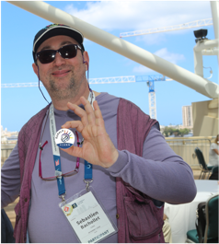

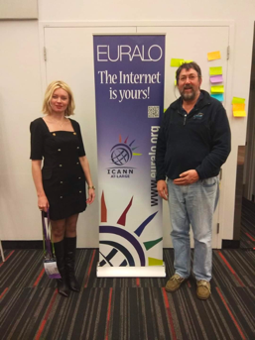
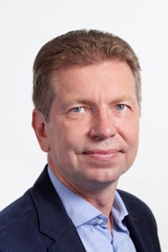


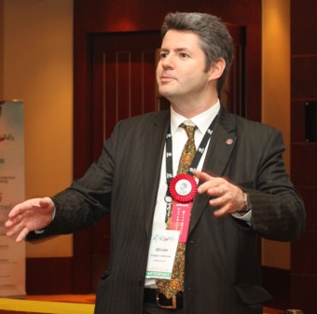
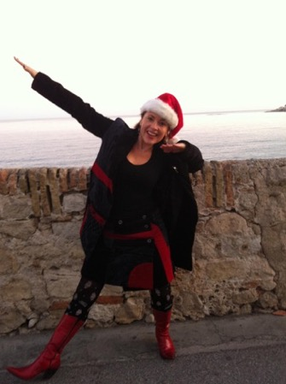


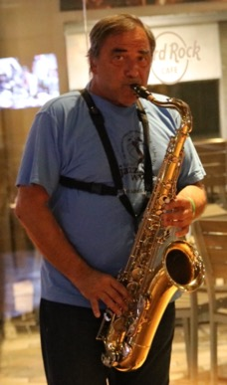
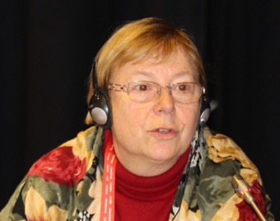



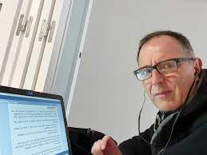
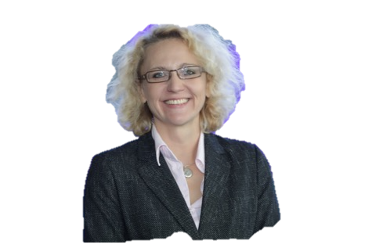





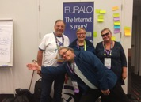



EURALO 2023

