Slide 1
APNIC Policy Development Capacity Building
Adam Gosling
Internet Policy Development Consultant
Tuesday, 12 August 2014

Slide 2
Agenda
About APNIC
  Mission and Vision
Policy Ecosystem
  NRO, ASO, and ICANN
  Global Policy Development
  National Internet Registries (NIRs)
APNIC PDP
  Role of Policy in APNIC Operations
  Policy Development Process
APNIC Policies
    Goals
    Review of APNIC Policies
    Current Proposals

Slide 3
What is APNIC?
One of 5 Regional Internet Registries (RIRs)
APNIC covers the Asia Pacific region
All RIRs are non-profit, membership-based organizations

Slide 4
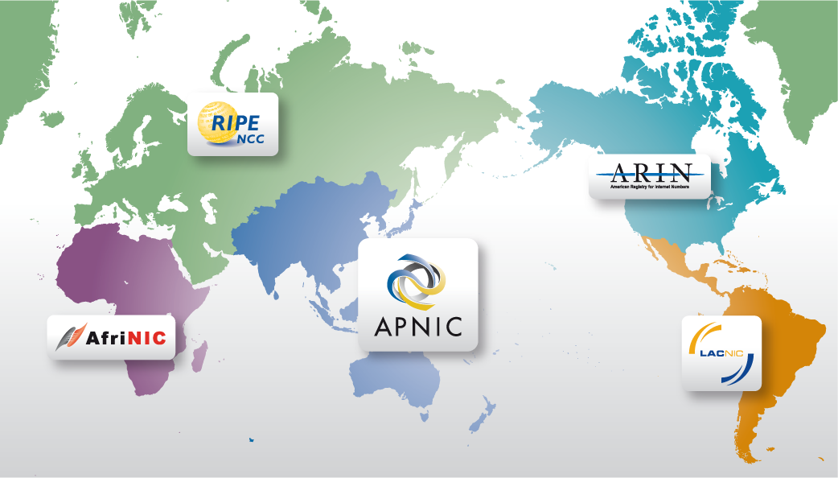
Where are the RIR Regions?
Notes:
4

Slide 5
APNIC vs. APNIC Secretariat
APNIC is a community of Internet numeric resource stakeholders in the Asia Pacific region
The APNIC Secretariat is the organization that manages those resources and provides a range of services to that community
  The Secretariat serves the stakeholders, resource holders, and APNIC membership that constitute the Asia Pacific community
  APNIC also has responsibilities to serve the global community of Internet stakeholders
  In turn, the NIRs each have a Secretariat and a community of users

Slide 6
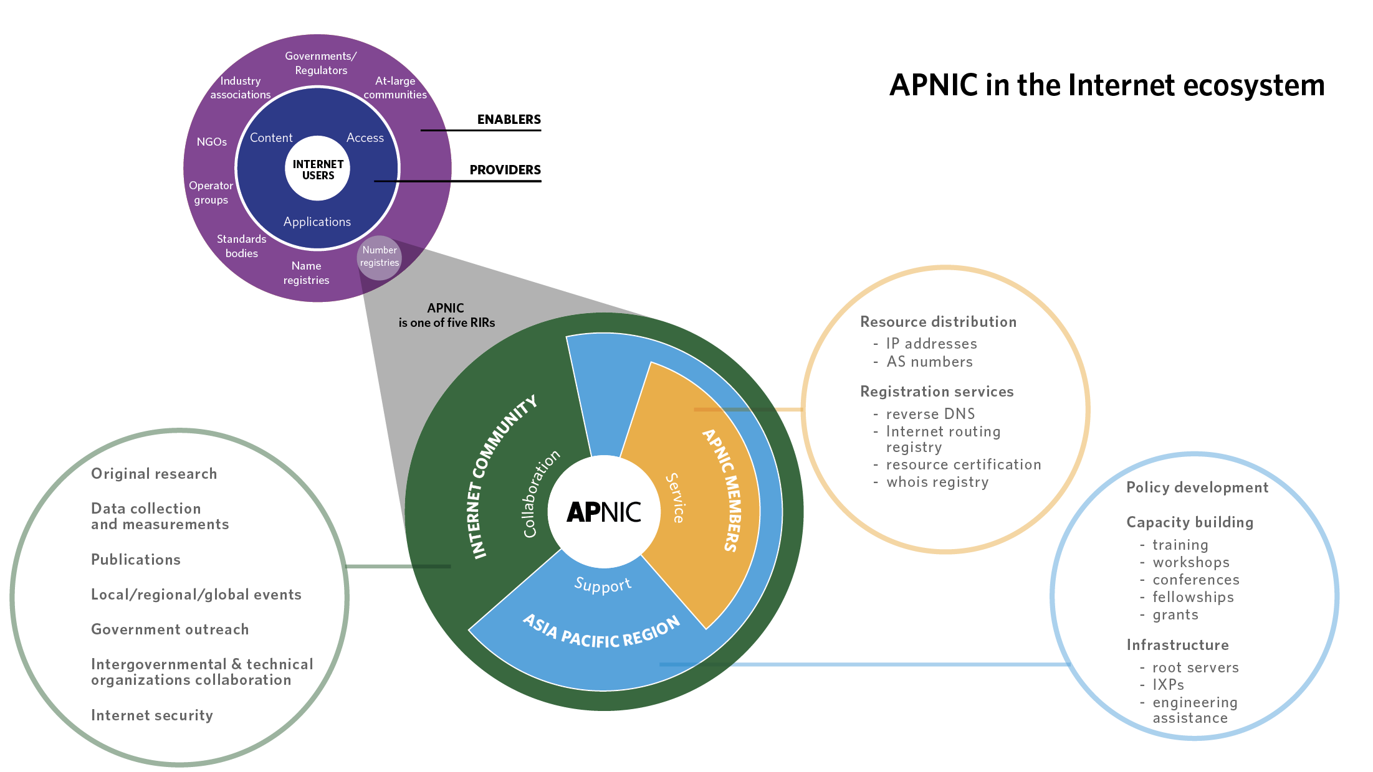

Slide 7
APNIC’s Mission
Function as the RIR for the Asia Pacific, in the service of the community of Members and others
Provide Internet registry services to the highest possible standards of trust, neutrality, and accuracy
Provide information, training, and supporting services to assist the community in building and managing the Internet
Support critical Internet infrastructure to assist in creating and maintaining a robust Internet environment
Provide leadership and advocacy in support of its vision and the community
Facilitate regional Internet development as needed throughout the APNIC community

Slide 8
Overview
APNIC’s Vision:
“A global, open, stable, and secure Internet that serves the entire Asia Pacific community”
Serving APNIC Members
Supporting Internet development in the Asia Pacific region
Collaborating with the Internet community

Slide 9
Serving APNIC Members
“Function as the RIR for the Asia Pacific, in the service of the community of Members and others”
“Provide Internet registry services to the highest possible standards of trust, neutrality, and accuracy”
IPv6 delegations
IPv4 delegations
ASN delegations
Transfers Ipv4 / ASNs
Services
  Whois
  Reverse DNS
  Routing Registry
  RPKI

Slide 10
Supporting Internet Development in the Asia Pacific Region
“Provide information, training, and supporting services to assist the community in building and managing the Internet”
“Support critical Internet infrastructure to assist in creating and maintaining a robust Internet environment”
“Facilitate regional Internet development as needed throughout the APNIC community”
Policy development
IPv6 support
Training
APNIC Events
Infrastructure capacity building
Information Society Innovation Fund (ISIF Asia)

Slide 11
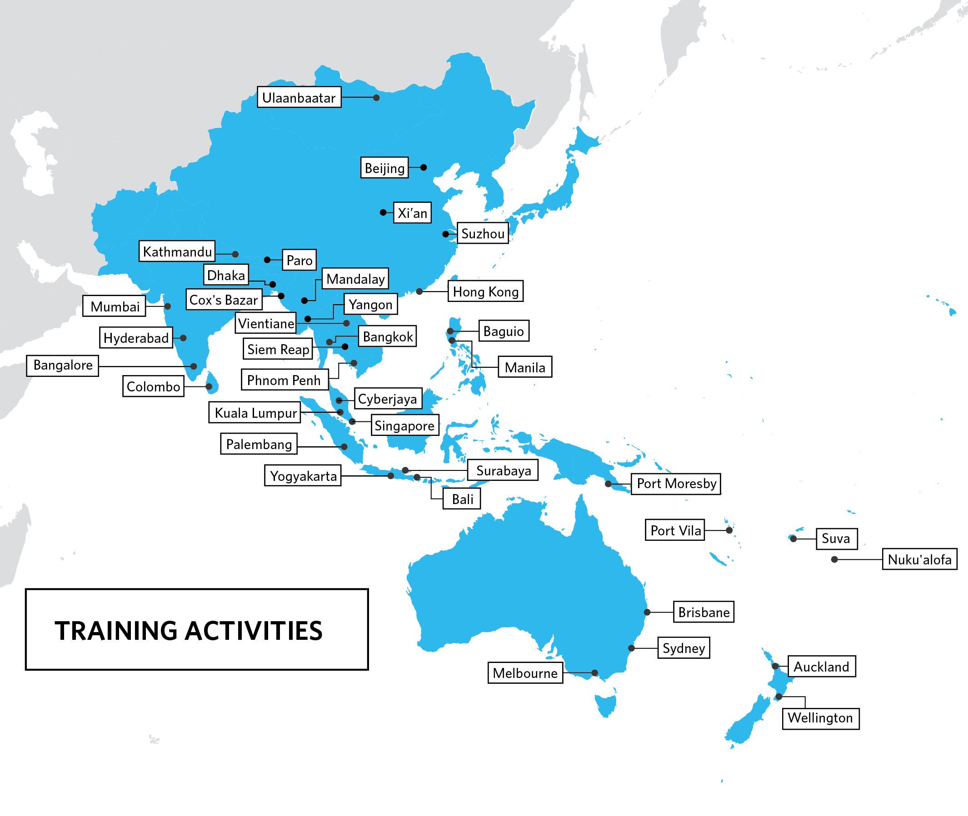
Training
IPv6
Continuing focus on IPv6 deployment
Hands-on
Extensive exercises in virtual and physical training labs
eLearning
Every Wednesday is IPv6 day; 179 hours training provided in 2013

Slide 12

Infrastructure Capacity Building
IXP Workshop held in Bangkok, Thailand - working towards establishing the country’s first IXP
Provided training and equipment to help establish the Vanuatu IXP
Helped establish an I-Root server instance in Port Vila, Vanuatu
APNIC supported the establishment of bdNOG and BTNOG, new network operators groups in Bangladesh and Bhutan

Slide 13
ISIF and Seed Alliance
ISIF Asia
Small grants and awards
Seed Alliance
Joint project of ISIF (APNIC), Frida (LACNIC), FIRE (AFRINIC)
AUD 1.3m over 3 years (IDRC, Canada)
So far, AUD 1.2m to 38 projects in 17 economies
2014 Call for Grants: 11 projects selected for implementation in 2014
AUD 1.5m over 3 years (Sida, Sweden)
2014 ISIF Asia Awards: 93 applications received; 34 passed pre-screening; 18 passed for full review

Slide 14
Collaborating with the Internet Community
“Provide leadership and advocacy in support of APNIC’s vision and the community”
APNIC Labs
Strategic Engagement
Internet cooperation

Slide 15
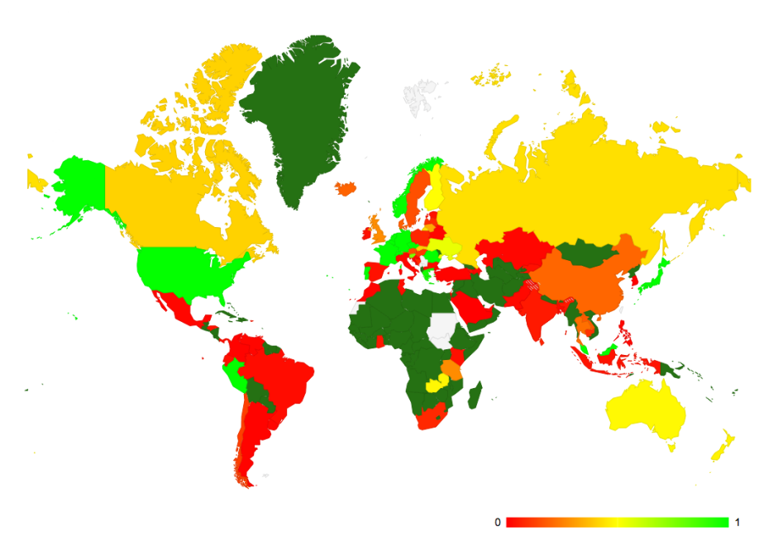
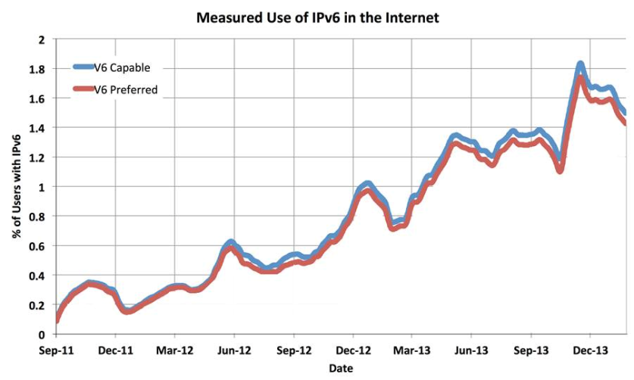
APNIC Labs
Measurement activities
  IPv6 readiness by economy and ISP; IPv6 performance
  Repurposed IPv6 measurement for DNSSEC validation by economy and ISP
  Tracking growth of routing table in IPv4 and IPv6
  RPKI use across the Internet
Long-term investigation exercise into evolving nature of dark traffic in both IPv4 and IPv6
Internet number resource reporting and analysis
labs.apnic.net
blabs.apnic.net

Slide 16
Strategic Engagement
Technical community
Governmental
IGF
NOGs, NIR OPMs, I*, CERTs, ISOC Chapters, PACINET, PICISOC, PTC, PITA
APEC-TEL 47 and 48, ITU WTPF, APT, WSIS+10, ITU Connect Asia Pacific Summit, ITU Telecom World 2013, APEC TEL 49, NETmundial
National IGFs (Nethui, auIGF), APrIGF
Bali IGF - significant support given for fundraising and logistics

Slide 17
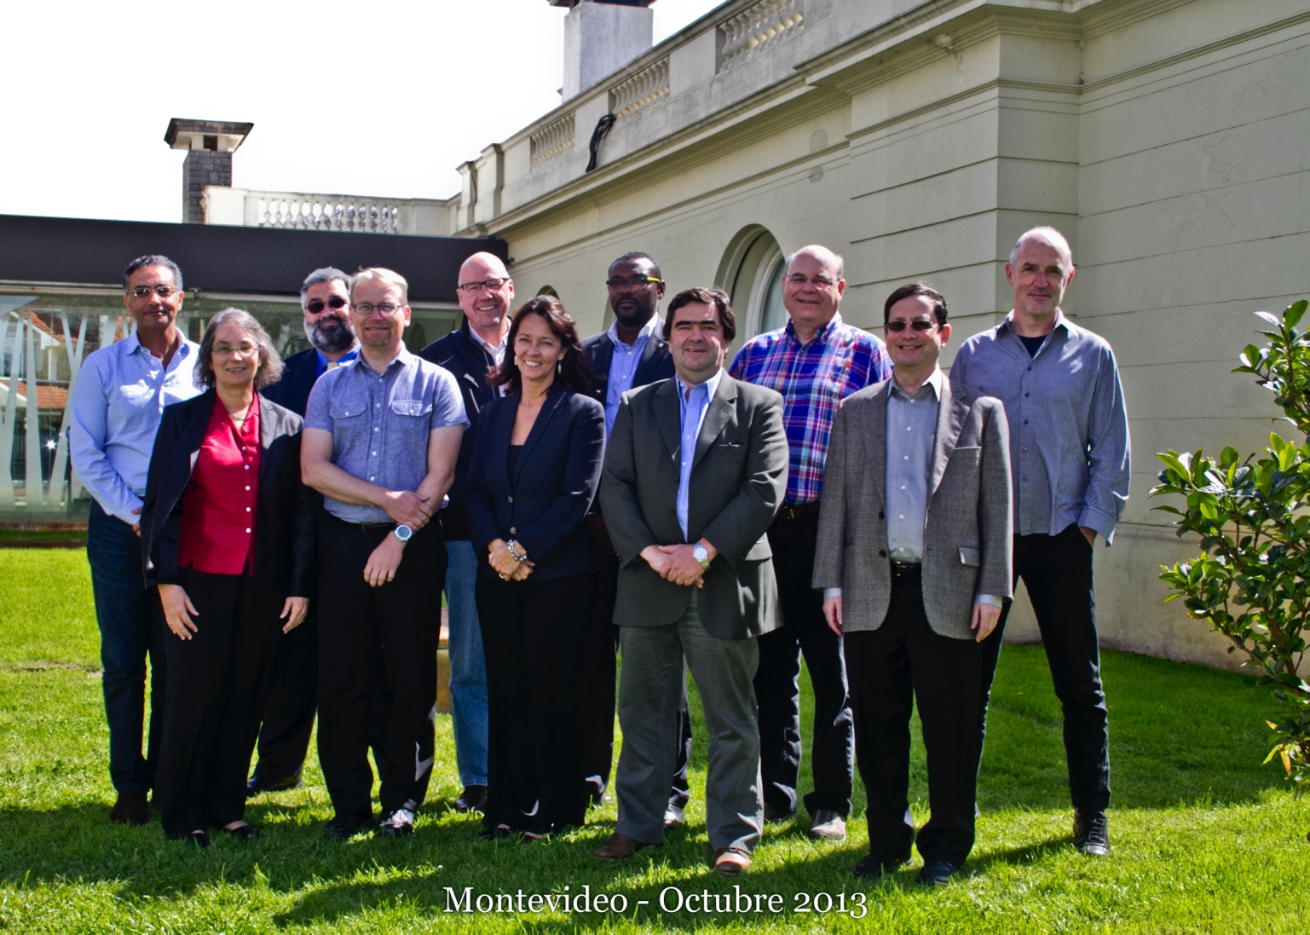
IANA Oversight Transition
October 2013: Internet’s technical organizations signed Montevideo Statement calling for globalization of ICANN and IANA functions
January 2014: APNIC EC endorsed statement
March 2014: US Government announced IANA functions will be transferred to global Internet community
Open community discussion process on IANA transition underway
Paul Wilson and Adiel Akplogan selected as NRO representatives on IANA Oversight Transition Coordination Group
For resources and to join the discussion on the APNIC mailing list:
www.apnic.net/ianaxfer

Slide 18
Policy Ecosystem

Slide 19
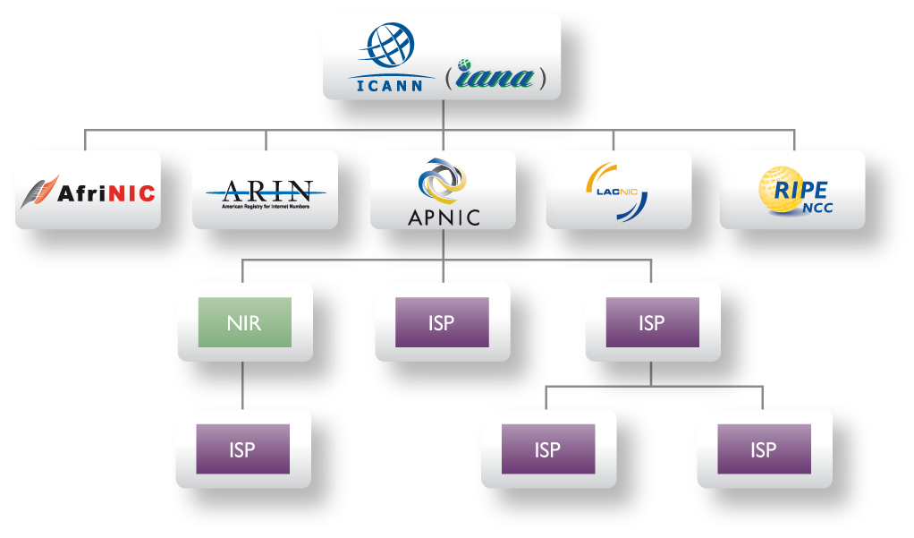
Hierarchy of resource distribution
NRO
Notes:
19

Slide 20
Policy EcoSystem
Introduction to Policy EcoSystem
  ICANN / IANA / ASO
  RIRs / NRO
  NIRs
Global Policies are:
  “Internet number resource policies that have the agreement of all RIRs according to their policy development processes and ICANN, and require specific actions or outcomes on the part of IANA or any other external ICANN-related body in order to be implemented”.
Global Policy development
  NRO Number Council & ASO Address Council
  Global policies must reach consensus in all RIRs before ratification by IANA

Slide 21
NRO NC / ASO AC
Number Resource Organization Number Council performs the function of the Address Supporting Organization Address Council
  http://www.nro.net/about-the-nro/the-nro-number-council
Each RIR has three representatives on the Council
  Two elected by the community
  One appointed by the RIR
    http://www.apnic.net/community/participate/elections/nro-elections/nro-election-process

Slide 22
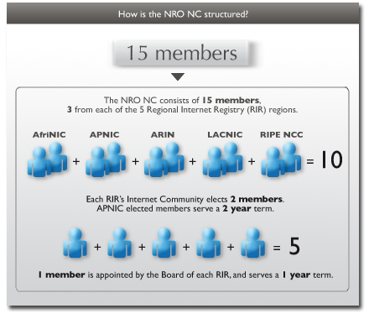
NRO NC / ASO AC

Slide 23
IANA Policies – Global Policies
ICANN Address Supporting Organization (ASO) MoU - Attachment A (Global Policy Development Process)
  http://www.icann.org/en/aso/aso-mou-attachmentA-29oct04.htm
Board's Review Procedures for Global Internet Number Resource Policies Forwarded for Ratification by the ASO Address Council in Accordance with the ASO MoU
  https://www.icann.org/resources/pages/review-procedures-2012-02-25-en
ICANN Addressing Policy Page
  https://www.icann.org/resources/pages/global-addressing-2012-02-25-en

Slide 24
Global Addressing Policies
Global Policy for Allocation of IPv6 Address Space
  https://www.icann.org/en/news/in-focus/global-addressing/allocation-ipv6-rirs
Internet Assigned Numbers Authority (IANA) Policy for Allocation of ASN Blocks to Regional Internet Registries
  https://www.icann.org/resources/pages/global-policy-asn-blocks-2010-09-21-en
Global Policy for Post Exhaustion IPv4 Allocation Mechanisms by the IANA
  https://www.icann.org/en/news/in-focus/global-addressing/allocation-ipv4-post-exhaustion

Slide 25
National Internet Registry Policies
NIRs must comply with Global and Regional Policies
NIRs may implement additional local policies, provided these do not conflict with regional or global policies
Substantial policy changes should be brought to the APNIC community for approval

Slide 26
APNIC
Policy Development Process

Slide 27
References
APNIC Policy Development Process
  www.apnic.net/policy/policy-development
SIG Guidelines
  www.apnic.net/sigs/sig-guidelines.pdf
Mailing list archive
  mailman.apnic.net/mailing-lists/sig-policy
Mailing list subscription
  mailman.apnic.net/mailman/listinfo/sig-policy

Slide 28
Why Have Policies?
Community-developed policies allow the people who use the resources control how the resources are managed
Policy allows the community to ensure The Goals of Internet Number Resource Management are met in the Asia Pacific region
Role of Policy in APNIC Operations
  Resource Policies dictate how resources are managed
  Guide the operations of Registration Services
  Guide the operations of Member Services
Policies are inputs into
  Software development
  Communications
Policies dictate how Policies are developed

Slide 29
Who sets Policy?
These are not Secretariat policies
  They are policies decided by the community
The Secretariat only supports the community
  Secretariat staff are expected to refrain from publicly voicing opinions on policy matters

Slide 30
APNIC’s Role in PDP
The process is supported by APNIC
  Mailing list, SIG meetings, documentation
  SIG Chair support, reports, editorial help
  Proposals format, publish, editorial support
  Implementation analysis
APNIC invests resources to ensure openness, participation
  Remote Participation via online chat
  Webcasting of Policy SIG
  New Consensus tool

Slide 31
Policy SIG Charter
Develop policies and procedures which relate to the management and use of Internet address resources by APNIC, NIRs and ISPs within the Asia Pacific region
Mailing list
  sig-policy@apnic.net
Web address
  http://www.apnic.net/policy-sig

Slide 32
Policy Principals
APNIC Policy Development is:
  Open
  Transparent
  Bottom Up

Slide 33
Open
Anyone can propose policies
Everyone can discuss policy proposals
Adoption is based on community consensus
  Consensus is judged by Chairs based on participation from stakeholders
  Stakeholders are viewed as individuals
    Don’t need to be APNIC Members
    Each valued equally – any individual’s opinion has the same weight as any other individual regardless of affiliation

Slide 34
Transparent
APNIC publicly documents all policy discussions and decisions
  Mailing list - http://mailman.apnic.net/mailing-lists/sig-policy/index.shtml
  Meeting archive - http://meetings.apnic.net/
  APNIC Website - http://www.apnic.net/community/policy/proposals
  EC Minutes - http://www.apnic.net/about-APNIC/organization/structure/apnic-executive-council/ec-minutes

Slide 35
Bottom Up
The Policy Development Process (PDP) and the policies that are the outcome of the PDP are all determined by the community they serve
    http://www.apnic.net/publications/media-library/documents/policy-development/development-process
This is mandated by ICANN
  clearly document defined procedures for the development of resource management policies
  procedures must be open and transparent, be accessible to all interested parties, and ensure fair representation of all constituencies
  at least one annual policy development meeting that is open and accessible to all interested parties.
  maintain public archived mailing lists to discuss policy development

Slide 36
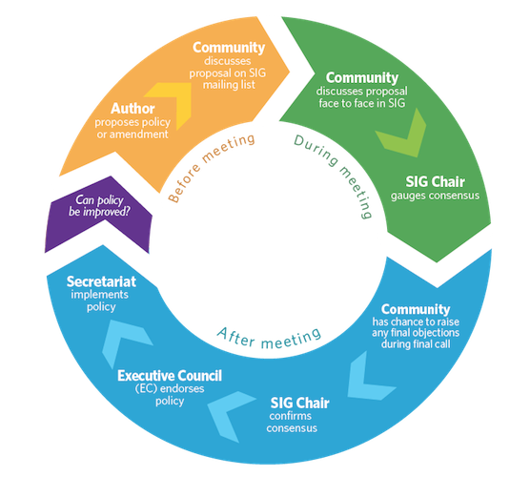
APNIC PDP

Slide 37
Steps to Implementation
Proposal submission
Mailing list discussion before meeting
Consensus at Policy SIG Meeting
Consensus at the AMM
Comment Period to confirm consensus
  Now 4 – 8 weeks
EC endorsement
Editorial Comment period
Implementation

Slide 38
Participation is the cornerstone
To operate effectively and meet the needs of the community. Community members need to
  Participate by proposing policy changes
  Participate by following and contributing to policy discussions on mailing lists
  Where possible, attend Policy SIG sessions (Open Policy Meetings) at APNIC Conferences
    Or participate via webcasting and online chat

Slide 39
Consensus Decision Making
Consensus = “general agreement” taking into consideration comments on the mailing list and at the meeting.
Show of hands is a way of “broadly gauging opinion”
Comments via Remote Participation are welcome
Example definitions from Tao of IETF:
  a very large majority of those who care must agree
  strongly held objections must be debated until most people are satisfied that these objections are wrong

Slide 40
Consensus Decision Making
Minor Objections
  some problems may occur for some members of the group
Major Objections
  major problems will occur for parts of the community
Participants should “work together” to resolve

Slide 41
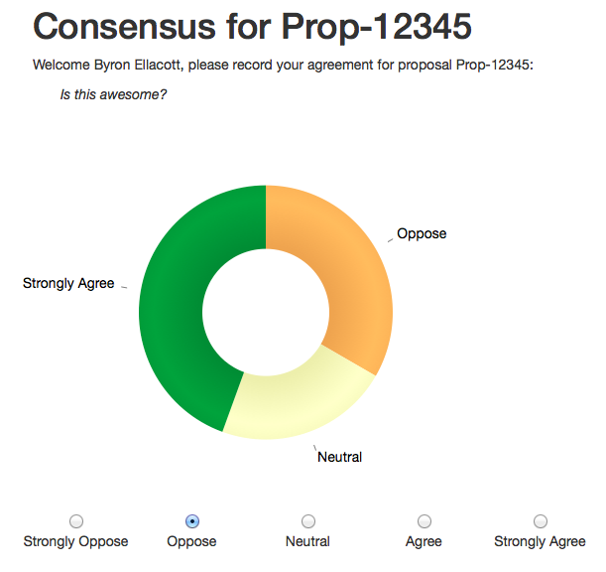
Pilot of Electronic Consensus tool

Slide 42
Who’s Who?
APNIC Policy SIG Chairs
Andy Linton - APNIC Policy SIG Chair
Masato Yamanishi - APNIC Policy SIG Co-Chair
NRO NC / ASO AC
Aftab Siddiqui
Naresh Ajwani (seat up for election at APNIC 38)
Tomohiro Fujisaki

Slide 43
APNIC Policies

Slide 44
References
Resource Policies
  http://www.apnic.net/community/policy/current
Corporate Documents & Guidelines
  http://www.apnic.net/publications/media-library/documents

Slide 45
Internet Resource Management Goals
Uniqueness
  Public IP addresses must be globally unique
Registration
  Ensure uniqueness
  Facilitate trouble shooting
Aggregation
  Limit routing table growth
  Support provider-based routing
No guarantee of contiguous delegations
Conservation
  Efficient use of resources
  Based on demonstrated need
Fairness
Minimized Overhead
Conflict of goals

Slide 46
APNIC Policies
In addition to Bylaws, Member Agreements and other corporate documents, and guidelines
PDP Policies
  Policy development process
  Document editorial policy
Resource Policies
  Policy environment for Internet number resource distribution in the Asia Pacific
  Policies for IPv4 address space management in the Asia Pacific region
  IPv6 address allocation and assignment policy
  Experimental allocations policy
  Policies for Autonomous System number management in the Asia Pacific region
  APNIC transfer, merger, acquisition, and takeover policy
  Policies for historical Internet resources in the APNIC Whois Database
NIR Policies
  Operational policies for NIRs in the APNIC region
  Criteria for the recognition of NIRs in the APNIC region

Slide 47
Implemented Proposals
prop-109 - Allocate 1.0.0.0/24 and 1.1.1.0/24 to APNIC Labs as Research Prefixes
prop-108 - Suggested changes to the APNIC Policy Development Process
prop-107 - AS number transfer policy proposal
prop-105 - Distribution of returned IPv4 address (Modification of prop-088)
prop-104 - Clarifying demonstrated needs requirement in IPv4 transfer policy
prop-102 - Sparse allocation guidelines for IPv6 resource allocations
prop-101 - Removing multihoming requirement for IPv6 portable assignments
prop-097 - Global policy for post exhaustion IPv4 allocation mechanisms by the IANA
prop-096 - Maintaining demonstrated needs requirement in transfer policy after the final /8 phase
prop-095 - Inter-RIR IPv4 address transfer proposal
prop-094 - Removing renumbering requirement from final /8 policy
prop-093 - Reducing the minimum delegation size for the final /8 policy
prop-088 - Distribution of IPv4 addresses once the final /8 period starts
prop-083 - Alternative criteria for subsequent IPv6 allocations
prop-082 - Removing aggregation criteria for IPv6 initial allocations
prop-080 - Removal of IPv4 prefix exchange policy
prop-079 - Abuse contact information

Slide 48
Policy Proposals at APNIC 38
prop-111v003: Request-based expansion of IPv6 default allocation size
  Proposal did not reach consensus at the Open Policy Meeting during APNIC 37 and was returned to the author for further development
Allows for larger IPv6 allocations
  Organizations that meet the initial allocation criteria can receive up to /29 by providing utilization information of the whole address space.
  Existing IPv6 address space holders able to request extension of each of these allocations up to a /29 without meeting the utilization rate for subsequent allocation by explaining how the whole address space will be used.

Slide 49
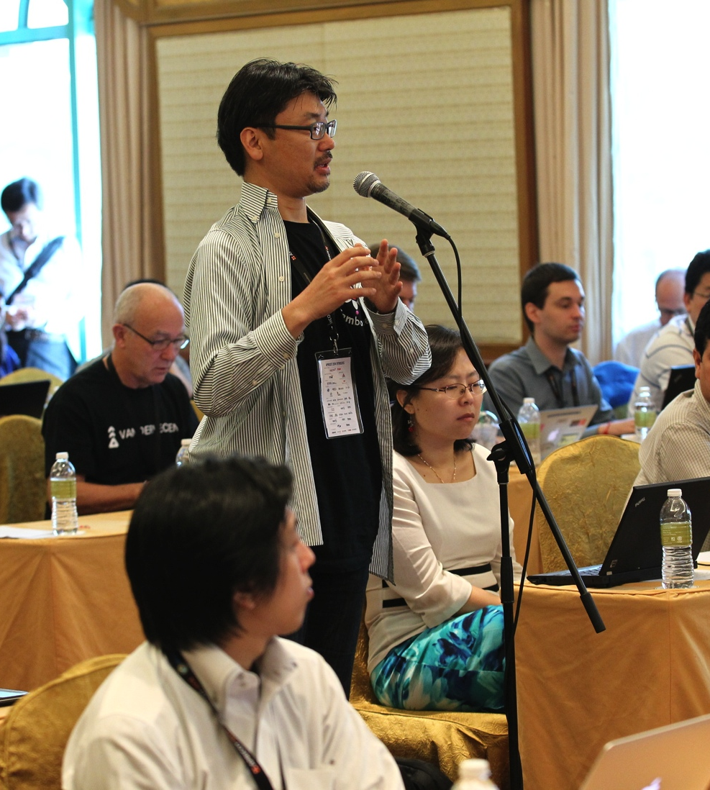
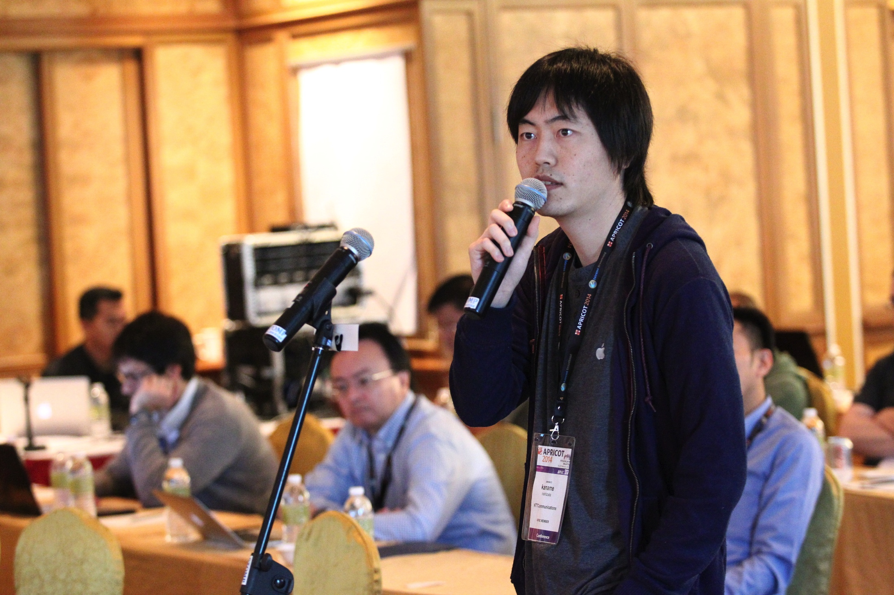
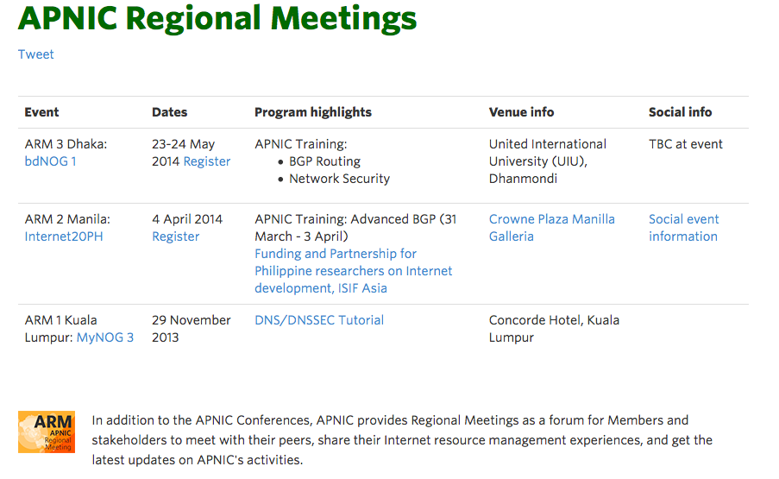
APNIC Regional Meetings (ARM)
Free one-day events
  Laos (TBC)
  PacNOG (Dec)
No part in policy process
Updates:
  http://www.apnic.net/community/participate/apnic-regional-meetings

Slide 50


Upcoming APNIC Conferences
APNIC 38: Brisbane, Australia, 9-19 Sep 2014
APRICOT 2015: Fukuoka, Japan, 24 Feb-6 Mar 2015

Slide 51





THANK YOU
www.facebook.com/APNIC
www.twitter.com/apnic
www.youtube.com/apnicmultimedia
www.flickr.com/apnic
www.weibo.com/APNICrir

