Slide 1
Introduction to
Universal Acceptance (UA)
Seda Akbulut
UA Program Manager
AFRALO Webinar II
17 November 2022

Slide 2
Agenda
What is Universal Acceptance (UA)?
Why Does UA Matter? Why is it Important in Africa?
Make Your Systems UA-ready
Role of Community in Achieving UA
UA Training and Outreach
UA Day

Slide 3
Meaningful and Broader Access
If you talk to a man in a language he understands, that goes to his head.
If you talk to him in his own language, that goes to his heart.
Nelson Mandela
Universal Acceptance (UA) means that everyone globally should be able to access and communicate on the Internet using the domain name of their choice regardless of language or length.

Slide 4
Universal Acceptance of Domain Names and Email
Goal
All domain names and email addresses work in all software applications regardless of script, language, or character length.
пример.рф
site.example
名称@网站.域名
Internationalized Domain Names
(IDN)
New gTLDs
Email Address Internationalization
(EAI)

Slide 5
Universal Acceptance Enables Digital Inclusivity
*Consumer Choice *Digital Inclusivity *Multilingual Internet
There are now more than 1,200 active gTLDs, as well as country code top-level domains (ccTLDs) that are available in different scripts and that may be longer than three characters. These new TLDs represent cultures, brands, geographies, and special interests (e.g., .ไทย, .AFRICA, .SPORT).
The majority of the world does not speak English as a first language.
There are billions of people who prefer to read and write in Arabic, Ethiopic, Chinese, Cyrillic, or other scripts.
There are five billion Internet users around the world.
At least one billion more are expected to come online by 2023. Through Universal Acceptance (UA), they can experience the full benefits of the Internet.

Slide 6






Categories Affected and UA-Readiness
Domain Names:
  New short top-level domain names: example.sky
  New long top-level domain names: example.engineering
  Internationalized Domain Name (IDN): คน.ไทย
Internationalized email addresses (EAI):
  ASCII@ASCII (new and long TLD) ekrem@misal.istanbul
  ASCII@IDN marc@société.org
  Unicode@ASCII 测试@example.com
  Unicode@IDN ईमेल@उदाहरण.भारत
  Unicode@IDN; right to left scripts ای-میل@ مثال.موقع
Key Principles of UA Readiness
Accept
Validate
Process
Store
Display

Slide 7
ICANN’s Universal Acceptance Program
Support UA Steering Group (UASG) uasg.tech
  Tech, EAI, Comms, Measurement Working Groups
  UA Local Initiatives, UA Ambassadors
Outreach and Trainings
  UA remediation and training programs are conducted around the world.
  Case studies, e.g., Supporting a Culturally and Linguistically Diverse Internet Through EAI – How Coremail and THNIC Made it a Reality
IDN and UA Steering Committee of ICANN
  Plans and coordinates cross-functional work on IDNs and UA

Slide 8
Why Does UA Matter?

Slide 9
UA Provides Business Opportunities
* Competitive Advantage * 9.8+ Billion Opportunity * Reduce Technical Debt
* Social Responsibility * Serve Local/Global Audiences
Potential to unlock billions in revenue from untapped customers.
A UASG study, conducted in 2017, found that the Universal Acceptance of domain names is a $9.8+ billion opportunity, which is a conservative estimate.
UA-ready systems will have a first-mover advantage and the potential to capture new increasing revenue streams.
The investment to update systems is far outweighed by the revenue potential from becoming UA-ready.

Slide 10
UA Delivers Career Opportunities
* Competitive Differentiator * Skill Development * Global User Experience
UA is the new competitive differentiator every developer should have in their skill set.
Becoming proficient in UA does not require learning a new category of coding, but rather builds upon existing skill sets to expand systems to recognize and support URLs and email addresses in all character lengths and supported scripts.

Slide 11
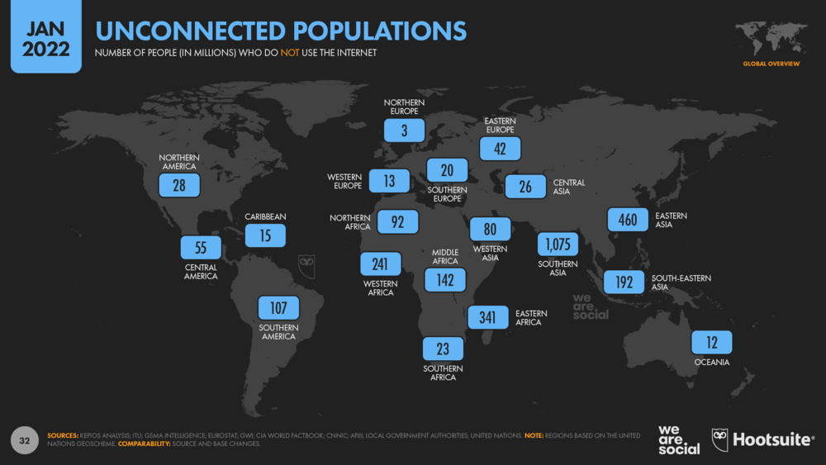
Why is UA Important for Africa?
Around 1.2 billion people, ~77% of whom do not use the Internet.
Main scripts being used in Africa: Latin (English, French), Ethiopic, Arabic.

Slide 12
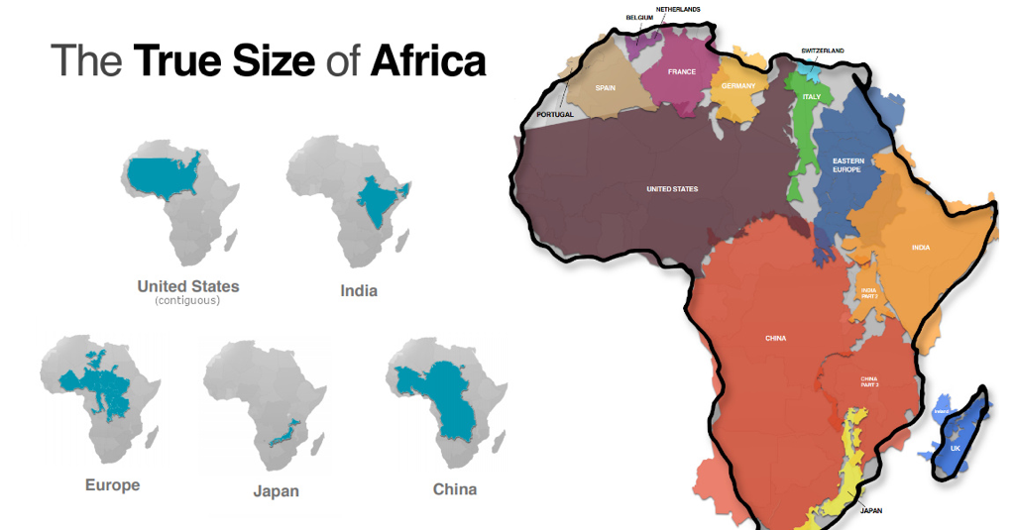
Potential Growth in Africa
Africa is the youngest and fastest-growing continent. It is expected that Africa’s population will double by 2050.
By 2050, Nigeria's population is expected to double, overtaking the USA.
Here’s a useful graphic to help put the true size of Africa in perspective:
(Courtesy: The Visual Capitalist).

Slide 13
Make Your Systems UA-Ready

Slide 14
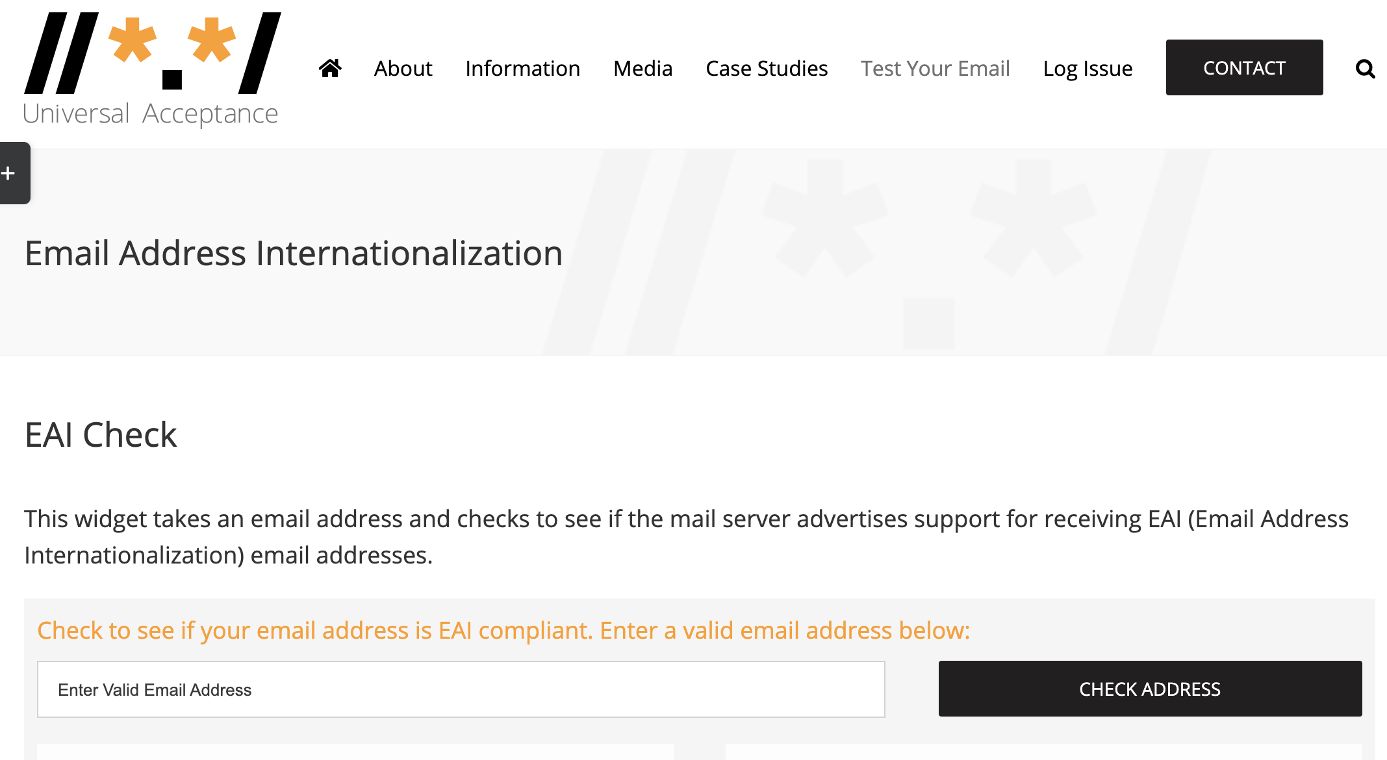
Make Your Systems UA-Ready
UA-readiness requires a considerable effort by all of us! Start with testing your own systems and email addresses with below resources.
  UASG 004: Test Cases for UA Readiness Evaluation
  UASG 026: UA-Readiness Framework
Is your email server globally inclusive?
https://uasg.tech/eai-check/

Slide 15
Programming Languages Solutions
Functional minimal running prototypes with the libraries and programming languages were developed as example code and best practice for developers to follow in their work.
Two different Minimal Viable Products (MVPs) were developed, each making use of a different main library: one for domain names using IDNA-related libraries, and the other one for EAI-related libraries.
Code samples that support UA are public and free for any developers on GitHub. https://github.com/icann/ua-code-samples
Non-UA-ready libraries are being reported on via public bug trackers and support is provided while addressing UA shortcomings.
Programming languages | Java | JavaScript | Python3
Libraries | commons-validator | nodemailer | idna
 | guava | idna-uts46 | email-validator
 | Icu | validator | smtplib
 | jakartamail

Slide 16
Email Address Acceptance by Global Websites
UASG039

Slide 17
EAI Support Across Email Servers
A total of 2,506,329 IP addresses tested from 35,521,173 mail servers on gTLDs.
EAI Support Survey Tool code available for ccTLDs:
https://github.com/icann/eai-survey-tool.

Slide 18
Role of Community in Achieving UA

Slide 19
Role of Community in Achieving UA
UA requires a joint effort by all of us! So, what can be done next?
ALSes can work with GSE and UA Ambassadors to ensure that their domain names, and online platforms are compliant with Universal Acceptance.
ALSes can conduct awareness activities at the local level (ICANN GSE/IDN and UA teams and the UA Ambassadors are ready to help).
UA reforms are needed in governments, academia, domain name industry, and technology organizations, etc.
Developers should update their systems by deploying UA-ready tools and UA-ready code samples.
TLD registries, registrars, resellers, and local domain name organizations should review their systems to become UA-ready (see UA Roadmap).
End users should demand more UA-ready systems and report non-UA ready systems and applications (report issues at https://uasg.tech/global-support-center/).
UASG and ICANN continue to undertake:
  Gap analysis of social media, browsers, programming languages, EAI Tools, etc.
  Remediation efforts like engaging technology forums (e.g. Github) and bug reporting.
  Training and outreach through local initiatives and ambassadors.
2) The ICANN community can help address UA-readiness and lead by example:
Raise awareness of the technical problems within the community.
Upgrade and use UA ready systems as a community to create the necessary demand, e.g. upgrade email servers, use email in local languages.
Advocate more broadly to support UA in their systems (e.g. in e-govt. services; the private sector organizations, etc.).
Such activities can be done in collaboration with UA Local Initiative and UA Ambassadors.

Slide 20
Universal Acceptance Local Initiatives
  Objective: To interact with local stakeholders to promote UA-readiness through:
  Local community outreach and engagement
  Technical training
  Active Local Initiatives
  China
  Commonwealth of Independent States and Eastern Europe (CIS-EE):
  Armenia, Belarus, Georgia, Latvia, Russia, Serbia, Ukraine
  India
  Sri Lanka
  Thailand
  Help us establish new UA Local Initiatives in Africa!
  UA Ambassadors in Africa:
  Abdalmonem Galila – Egypt
  Malick Alassane - Benin
  Mark Elkins – South Africa
  Abdulkarim Oloyede - Nigeria
  Please contact us at info@uasg.tech if you are interested in starting a Local Initiative in your country or region, or to become UA Ambassador.

Slide 21
UA Training Programs

Slide 22
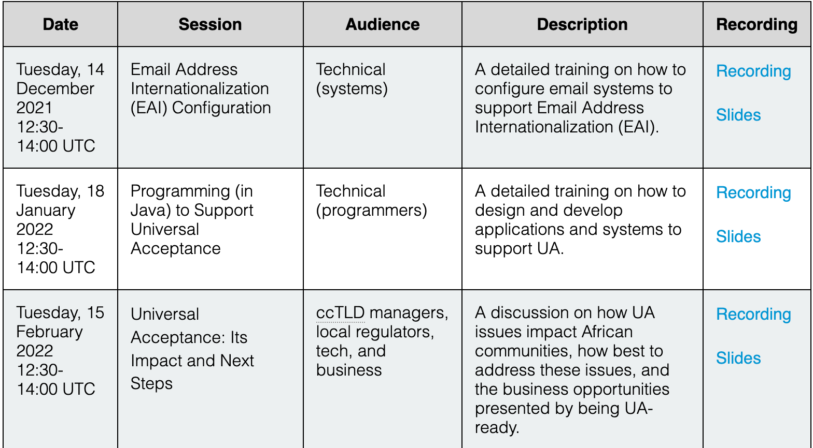
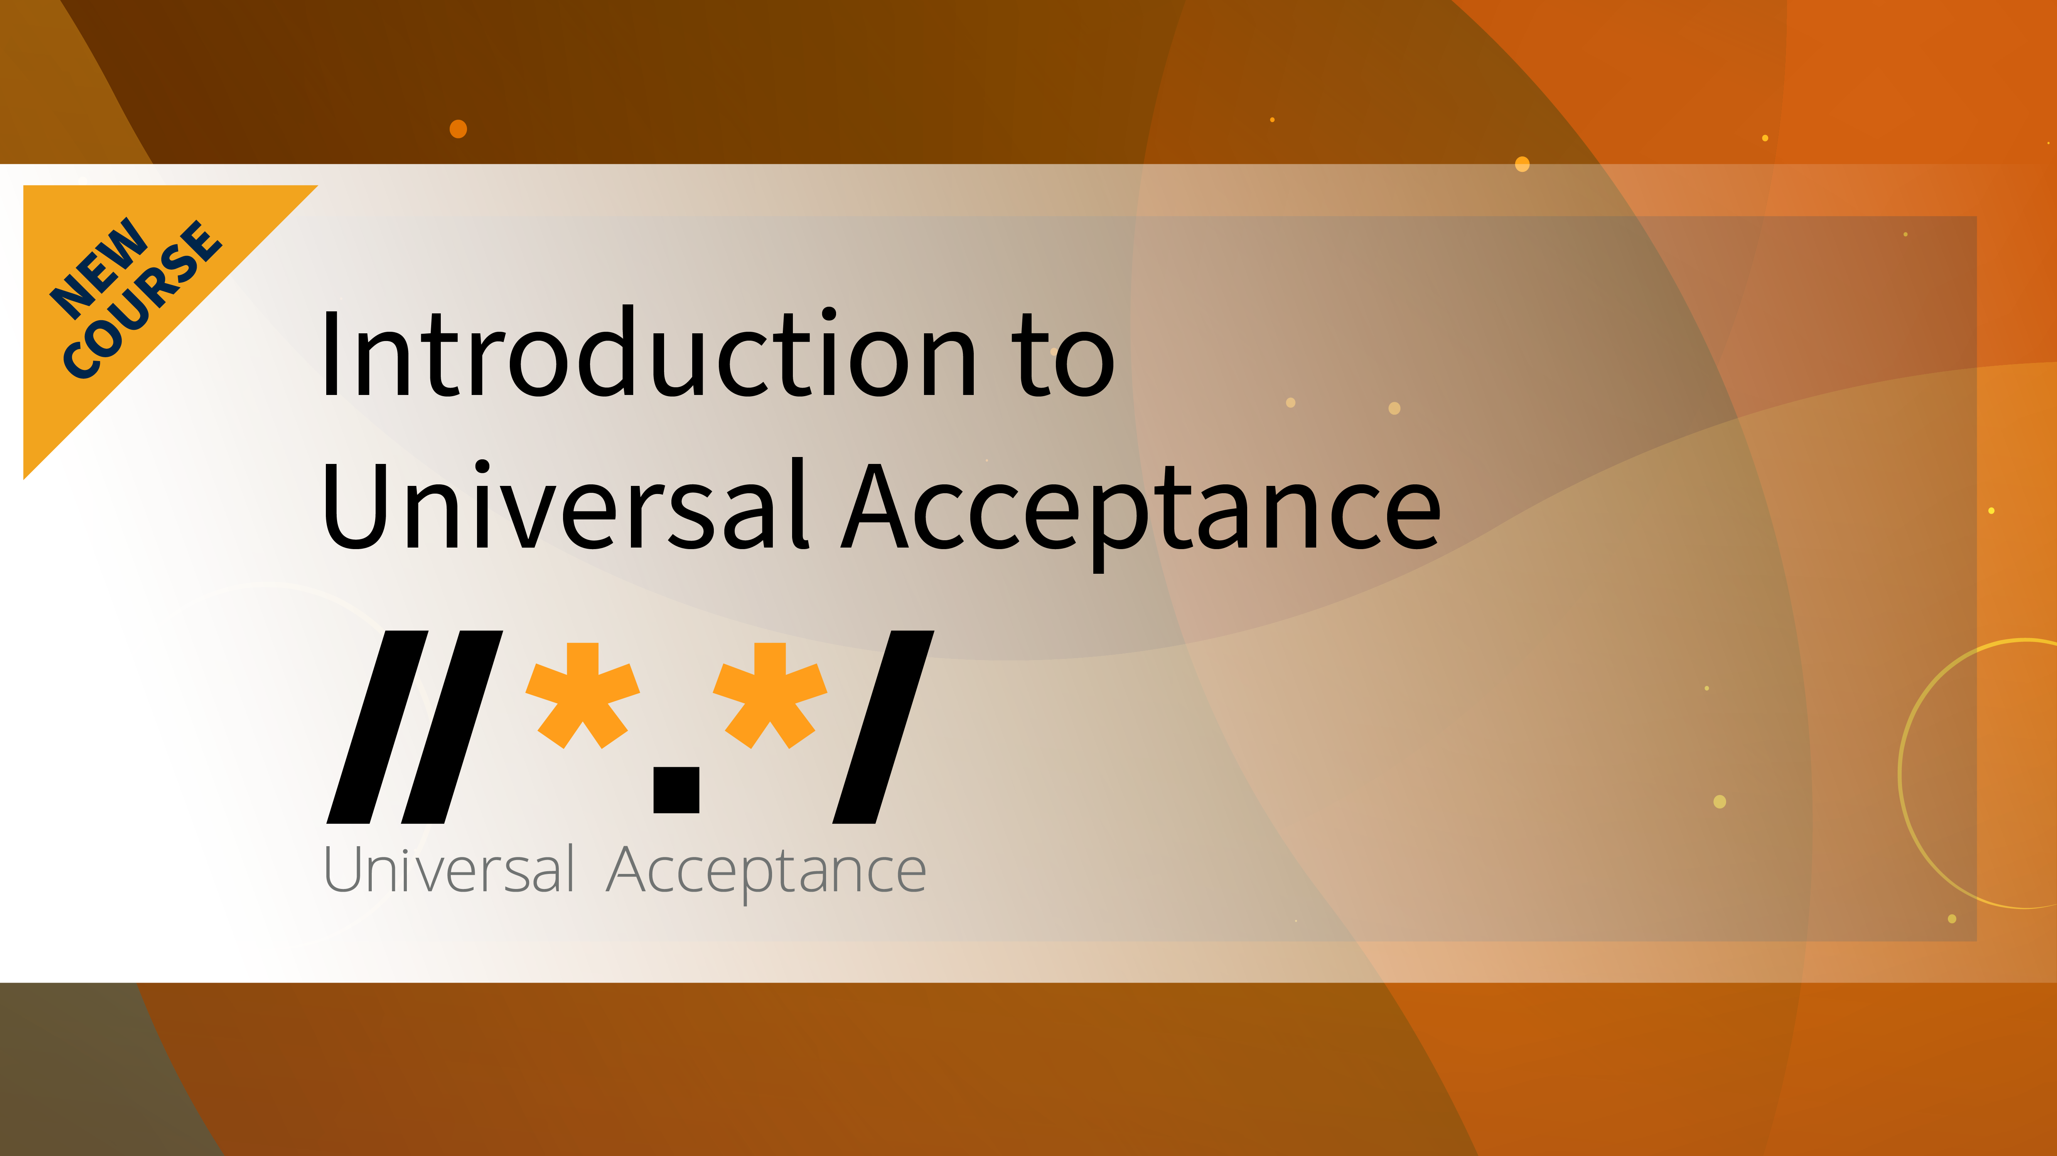
Universal Acceptance Training Programs
All UA training programs are available on https://www.icann.org/ua-training-en
ICANN Learn - Universal Acceptance Course (basics of UA)
UA Technical Training Programs (Java, Python, Email Server for EAI support)
Regional Training Programs about UA (combination of basics and technical)
Let us know if you would like to volunteer as a UA technical trainer: info@uasg.tech

Slide 23
Technical Engagement
Technical Education and Awareness to the Developers’ Network
One of the major challenges for UA adoption is a lack of awareness among software developers developing and deploying end user applications and services.
The decisions software developers will make at the microlevel make a big difference for UA support
No | Question | Forum
1 | non-latin email address validation | Stackoverflow
2 | Validating email addresses using jQuery and regex | Stackoverflow
3 | Properly validating e-mail addresses | Reddit
4 | Is my new gTLD causing it to get filtered as spam? | Serverfault
Two blog posts were written by a developer on important aspects of UA:
  Universal Acceptance of Domain Names and E-mail Addresses - What is the issue?
  What is the ultimate goal of the Domain Name and Email ID Validation?

Slide 24
Planning for Universal Acceptance (UA) Day

Slide 25
Objectives of UA Day
In order to mobilize the technical community to become UA-ready, UA Day aims to rally local, national, regional, and global organizations to create a “buzz” around adopting UA.
Share UA challenges and current gaps in UA technology.
Drive change towards the UA-readiness of all software, systems, and devices.
Motivate technical and government decision makers towards UA adoption.
Create awareness of UA-related issues in the technical community.
Create awareness of UA solutions in the technical community.
Rally language communities together around UA, and towards enabling policies to promote UA adoption.
Celebrate the achievements of UA so far.

Slide 26
UA Day Strategy
UA Day will be a unique event, planned at three levels to conduct outreach to industry and academia, run hackathons, and more.
Local, national events
  To be organized by UA Local Initiatives, UA Ambassadors and other community stakeholders, e.g., ALSes, ISOC chapters, etc.
Local and regional events
  To be organized in each geographic region with technology industry and community stakeholders, e.g., RALOs, regional business associations.
Local, regional and global events
  To be organized every year starting in 2023, with technology industries and other global stakeholders.

Slide 27
UA Day Planning
In developing the plans around UA Day, the UASG seeks support, commitments or proposals for holding UA Day events from the following:
  ICANN SOs/ACs
  GAC members, who can work with their respective governments.
  Other global organizations to promote UA, e.g., ALSes and ISOC chapters.
Decentralized planning
  The UASG is developing a framework with materials and guidelines for stakeholders to organize UA Day sessions.
  UASG will give organizations the flexibility on how to organize the sessions within this framework.

Slide 28
Potential Organizations to be Involved in UA Day
To organize UA Day events, the UASG will reach out to:
Supporting Organizations and Advisory Committees (SO/ACs)
Regional organizations, RALOs, and ALSes
ISOC Chapters
Academia
Language communities
Government departments
Global technology organizations, industry bodies
Telecommunication/ICT regulators, mobile phone operating systems
International organizations (e.g., UNESCO, etc.)
Relevant open-source communities
Standards bodies (e.g., Unicode,W3C,WHATWG,etc.)
Registries, registrars, resellers, ISPs
Email service providers

Slide 29
Outreach Package for UA Day
The UASG will develop and distribute the following outreach and training materials to collaborating organizations for UA Day events. These would cover both general messaging and technical training.
Outreach materials:
  Half-hour event
  One-hour event
  Two-hour event
  A quarter day event
  A half day event
Technical training materials:
  A full-day event
  A two-day event

Slide 30
Be a Part of UA Day
Contribute to UA Day events globally!
More information on how to submit event proposals will be made public in the coming weeks. Stay tuned!
A UA Day Proposal Template will be published on uasg.tech with further details on how to organize UA Day events.

Slide 31
Get Involved!
For more information on UA, email info@uasg.tech or UAProgram@icann.org and visit www.icann.org/ua
Access all UASG documents and presentations at: https://uasg.tech
Access details of ongoing work from wiki pages: https://community.icann.org/display/TUA
Register to participate or listen in the UA discussion list at: https://uasg.tech/subscribe
Register to participate in UA working groups https://uasg.tech/join/.
Follow UASG on social media:
  Twitter: @UASGTech
  LinkedIn: https://www.linkedin.com/company/uasgtech/
  Facebook: https://www.facebook.com/uasgtech/

Slide 32
Engage with ICANN – Thank You and Questions

