Slide 1

LAC DIGITAL – Comms Support
Graphic for social media efforts
Calendar event added to the engagement calendar on icann.org: https://features.icann.org/event/large/lac-digital-2022-lacralo
Newsletter story (May issue) distributed on 16 May 2022 to 1623 subscribers in English, Spanish, and Portuguese.
Social media posts in English and Spanish via Twitter, Facebook and LinkedIn.
  Support from GDS and UASG for the 18 May panel on Universal Acceptance (UA) and Internationalized Domain Names (IDNs).

Slide 2
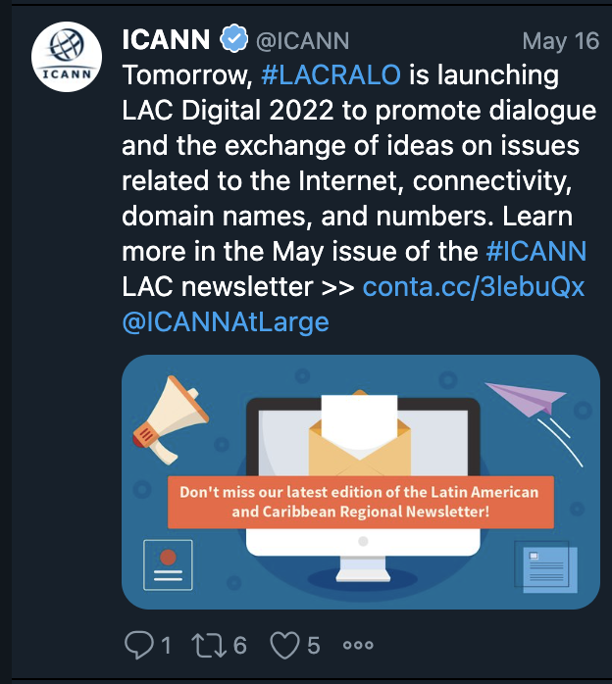
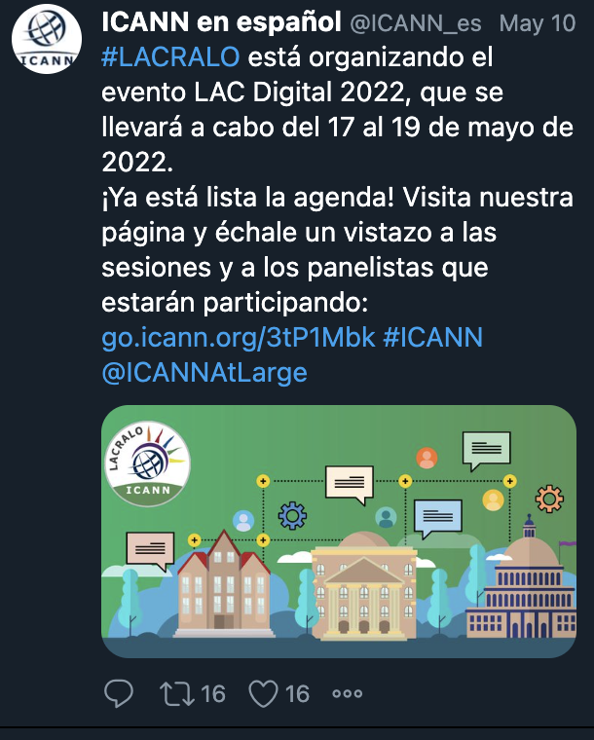
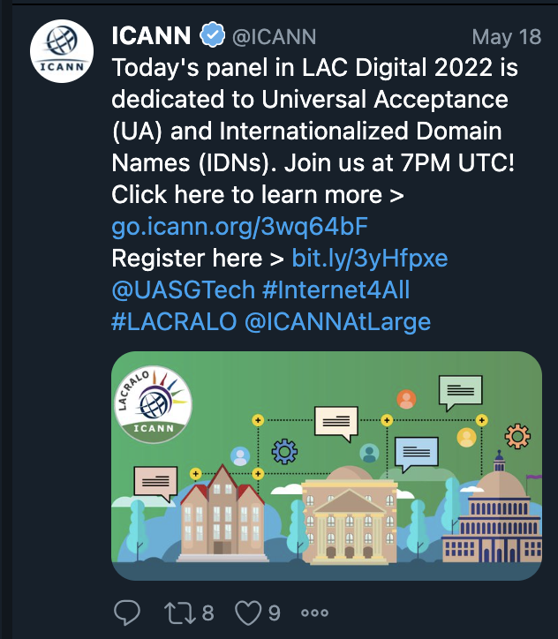
Twitter metrics
9 posts in English and Spanish:
  Spanish: 24 RTs, 29 Likes
  English: 29 RTs, 36 Likes

