Slide 1

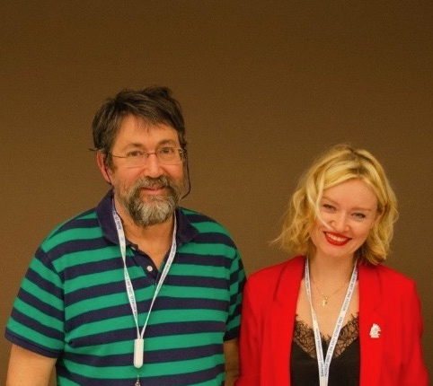

EURALO
2022 Road Map
Update 25 January 2022

Slide 2

EURALO 2022 Road Map
Updated by Sébastien on the 15th January 2022
EURALO General Assembly
  2022
EURALO monthly Newsletter
EURALO ALSs
EURALO O&E 2022 Road Map
  Discretionary founding and CROP FY2022
EURALO & ICANN Meetings
  EURALO Board (& TF) meetings
  Monthly RoundTables (by EURALO)
  ICANN meetings
  ICANN73 & 74 EURALO readouts
EURALO ABR
  Accepted FY2022
  Proposals FY2023
EURALO Board members
AOB (2 min)
AGENDA

Slide 3
European Regional
At-Large Organization
Face to Face
General Assembly
Training
ICANN 74 - Policy Forum - The Hague
13 - 16 June 2022

Slide 4
EURALO 2022 Road Map
EURALO GA 2022
EURALO GA 2022 Face to face
  Along with ICANN74 – The Hague – Policy Forum – 13-16 June 2022
  If ICANN74 is not going F2F
    GA F2F along with EURODIG22 – 20-22 June 2022 Trieste
    GA F2F (small regional meeting) in one European country – in FY22
    Keep the budget for FY23 (OK)
  Program
    Agenda
    Training (proposal by Joanna K and Natalia F)
GA2022

Slide 5
EURALO 2022 Road Map
EURALO Virtual GA 2022 Agenda
DRAFTGA22
Tuesday, 14 June 2022 - 14:00 - 17:00 UTC - 16:00 - 19:00 CET
Standing issues - 16:00-16:15 CET
  Staff opening
  Welcome to the Group and Guests
  Sébastien Bachollet – EURALO Chair
  Confirmation of attending members, proxies and apologies
  Gisella Gruber, ICANN Org
    Confirmation of the Assembly Quorum - Articles 11.7 - 11.22.1
  Adoption of the proposed Agenda - Sébastien Bachollet
  Action Items from the last 2021 Virtual General - Sébastien Bachollet

Slide 6
EURALO 2022 Road Map
EURALO Virtual GA 2022 Agenda
DRAFTGA22
Tuesday, 14 June 2022
14:00 - 17:00 UTC - 16:00 - 19:00 CET
B. Agenda Items for Discussion (105 minutes) - 19:15-21:00 CET
  B01. Presentation of the EURALO 2020-2021 Annual Report Sébastien Bachollet
  B02. ALS Mobilization Report and consequences for EURALO
  Yrjö Länsipuro
  B03. RALO Individual members Mobilization Report and consequences for EURALO - Roberto Gaetano
  B04. EURALO ALS engagement Task Force
  Yrjö Länsipuro and Natalia Filina
  B05. EURALO's FY22 Outreach Strategy and monthly report
  Natalia Filina and Adam Peake
  B06. Consolidated Policy Working Group (CPWG) activity summary and EURALO participation – Olivier Crépin-Leblond (Co-Chair CPWG)
  B07. Operations, Finance and Budget Working Group (OFB-WG) activity summary and EURALO participation
  Ricardo Holmquist (Past-Chair OFB-WG)
  B08. At-Large Capacity Building Working Group (CB-WG) activity summary and EURALO participation & ALAC
  Joanna Kulesza (Co-chair CB-WG) & ALAC (Vice-Chair) by EURALO 2020 - 2022 AGMs
  B09. ALAC Member – Matthias Markus Hudobnik by EURALO 2019 - 2023 AGMs
  B10. ALAC Member – Pari Esfandiari by Nominating Committee 2020 - 2022 AGMs
  B11. Discussion with all the participants Sébastien Bachollet
  B12. Adoption of the EURALO 2020-2021 Annual Report - Sébastien Bachollet
  B13. Result of the EURALO Board (2022-2025) elections - Sébastien Bachollet
  B14. EURALO F2F General Assembly - June 2022, IANN74 The Hague
  B15. AOB - Sébastien Bachollet
To be updated

Slide 7
EURALO 2022 Road Map
EURALO Virtual GA 2022 Training
ICANN74 – The Hague – Policy Forum – 13-16 June 2022
Breakfast - 05:30-07:00 UTC - 07:30-09:00 CET (14-15-16 June 2022)
Lunch – 10:00-11:30 UTC - 12:00-13:30 CET (13-15-16-17 June 2022)
Program to be designed
  Session 1: ICANN BOARD 101
    Intro by the Board Chair and the CEO
    Exchange with Board members (2) and EURALO ALS Rep (4) by table
  Session 2: ICANN finances 101
    Intro by CFO AND Chair of the BFC
    Exchange with BFC members or ICANN Finance staff (2) and EURALO ALS Rep (4) by table
  Session 3: GNSO 101 and main topics under discussion
    Intro by the GNSO Chair and the ALAC liaison
    Exchange with GNSO members (2) and EURALO ALS Rep (4) by table
  Session 4: ICANN 101
    Intro by the OCL and the SBT
    Exchange with GNSO members (2) and EURALO ALS Rep (4) by table
  Session 5: At-Large 101
    Intro by the ALAC Chair and RALO Chairs
    Exchange with ALAC members& RALO Chairs (2) and EURALO ALS Rep (4) by table
DRAFTGA22

Slide 8
EURALO 2022 Road Map
EURALO Virtual GA 2022
Euralo Social Event
DRAFTGA22
Wednesday, 15 June 2022 – 16:00 - 18:00 UTC - 18:00 - 20:00 CET
TBD

Slide 9
EURALO 2022 Road Map
EURALO Virtual GA 2022
Euralo Policy session
DRAFTGA22
?, ? June 2022 – 1?:00 - ?:00 UTC/CET
TBD
  Possible topic(s) ?
    Various laws in preparation and/or discussion in the European Union (NIS2…)
  Moderator
    Joanna
  Possible Speakers
    Introduction: Gorän Marby
    Lucien Castex
    Elena Plexida
    European Commission
    …

Slide 10
EURALO 2022 Road Map
EURALO Virtual GA 2022
Open diner
DRAFTGA22
Tuesday, 14 June 2022 – 18:00 - 21:00 UTC - 20:00 - 23:00 CET
For EURALO members and invites
Expenses to be taken care by each participants
ICANN to offer ?
TBD

Slide 11


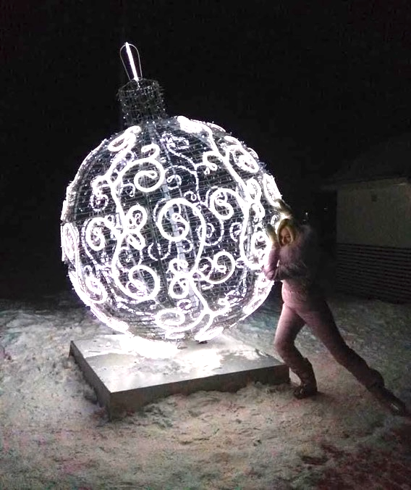
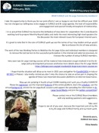


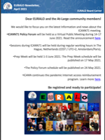
EURALO 2021/2022 Road Map
EURALO Newsletters

Slide 12
EURALO 2022 Road Map
EURALO ALSes
EURALO ALSes to be decertified
  Slovenian Consumers Association Acronym: Breda Kutin
  Internet Support Foundation Acronym (?)
  Communica-CH – Wolf Ludwig
  Wikimedia Osterreich
Possible new ALSes
  ISOC Poland
  Poland – Joanna
To follow
  Dot HIV
  ISOC Wallonia (Christopher Wilkinson)
Setup a meeting
  GSE Europe – Adam Peake
  ISOC Europe – Nick Hyrka
  EURALO – SBT-OCL-NFA and Staff GGR
ALS

Slide 13
EURALO 2022 Road Map
EURALO O&E 2022
EURALO O&E 2022
  Road Map
  Implementation
    ALSes mobilization
    Individual (EU)RALO members mobilization
  CROP
  Discretionary funding
O&E

Slide 14

EURALO Regional FY22 Outreach and Engagement Strategic Plan
designed mainly not to attract new participants to the EURALO activities, but also to identify ways and tools to mobilize our internal community members.
1. The "fatigue" of the virtual mode of work and virtual meetings.
Solution:
new formats of interaction.
the plan of work for upcoming 6 months.
Explanation of the benefits and privileges of being part of the EURALO and At-Large.
f2f meetings on the local level.
2. Difficulties of understanding the At-Large function, work, processes and our power for people outside the ICANN bubble.
Solution: an interesting and simple explanation of complex things in all communication channels
3. Attracting new people, including Youth:
Solution:
Interaction with YOUTH organizations, showcase of EURALO/At-Large, inviting ambassadors to the dialogue.
6. Active participation in ICANN and IG events.
Solution:
With ICANN support and opportunity to use the CROP.
Maintaining a calendar of major events (announcement for 3 months ahead) to attract attention, prepare members for participation.
Recommendations related the actual list of events.
Reports of EURALO members about the visiting and participating IG events.
4. Working with existing members - involving not just "viewers", but participants in activities and work.
Solution:
«Welcome package».
Greeting and self-presentation of new members (Individuals and new ALSes via leaders).
PR of our existing members who actively participate in the ICANN work and support the development of the IG agenda.
Expertise table (professional area of EURALO and At-Large members).
5. Receiving feedback from community members and external participants of the ICANN and IG agenda.
Solution:
Surveys, newsletter distribution and an invitation to contribute by feedback, sending the news and updates as a valuable content for our resources.

Slide 15
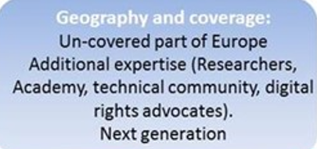
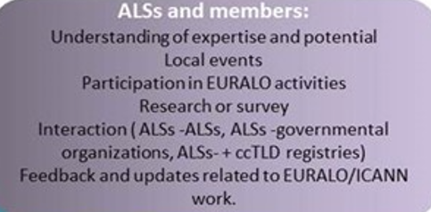
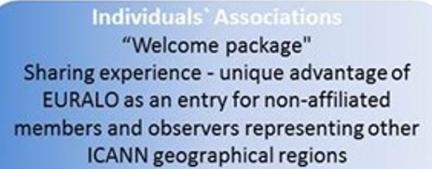
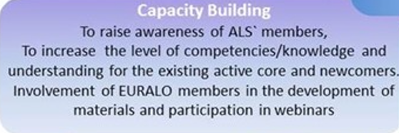
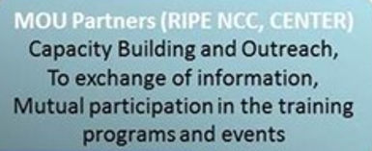
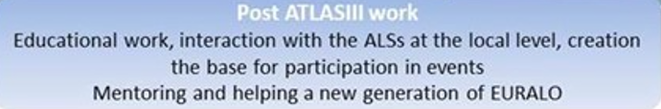
EURALO Regional FY22 Outreach and Engagement Strategic Plan
Parts of EURALO Regional FY21 Outreach and Engagement Strategic Plan used in FY22.

Slide 16
EURALO 2022 Road Map
EURALO Meetings 2022
Friday 14th January 2022: LT
Tuesday 18th January 2022: No call
Tuesday 25th January 2022 18:00-19:30 UTC: Board
Tuesday 1st February 2022 18:00-19:30 UTC: MRT1-22 (EN, ES, FR and RU)
Tuesday 8th February 2022 18:00-19:30 UTC: LT
Tuesday 15th February 2022 18:00-19:30 UTC: Board
Tuesday 22nd February 2022 18:00-19:30 UTC: MRT2-22 (EN, ES, FR and RU)
Tuesday 1st March 2022 18:00-19:30 UTC: LT
Tuesday 8th March 2022: ICANN73
Tuesday 15th March 2022 18:00-19:30 UTC: Board
Tuesday 22nd March 2022 18:00-20:00 UTC: RO-ICANN73 by EURALO (EN, ES, FR and RU)
Tuesday 29th March 2022 17:00-18:30 UTC: LT
Q1

Slide 17
EURALO 2022 Road Map
EURALO Meetings 2022
Tuesday 5th April 2022 17:00-18:30 UTC: LT
Tuesday 12th or 19th April 2022 17:00-18:30 UTC: Board
Tuesday 26th April 2022 17:00-18:30 UTC: MRT3-22 (EN, ES, FR and RU)
Tuesday 3rd May 2022 17:00-18:30 UTC: LT
Tuesday 10th May 2022 17:00-18:30 UTC: LT
Tuesday 17th May 2022 17:00-18:30 UTC: Board
Tuesday 24th May 2022 17:00-18:30 UTC: MRT4-22 (EN, ES, FR and RU)
Tuesday 31st May 2022 17:00-18:30 UTC: LT
Tuesday 7th June 2022: Final preparation of EURALO and ICANN74
Tuesday 14th June 2022 14:00 - 17:00 UTC - 16:00 - 19:00 CET: EURALO GA ICANN74
Tuesday 21st June 2022: EURODIG
Tuesday 28th June 2022 17:00-19:00 UTC: RO-ICANN74 by EURALO (EN, ES, FR and RU)
Q2

Slide 18
EURALO 2021
ICANN Meetings 2022 & 2023
ICANN73 – San Juan – vCommunity Forum
  7-10 March 2022
ICANN74 – The Hague – Policy Forum
  13-16 June 2022
ICANN75 – Kuala Lumpur – Annual General Meeting (24th)
  17-22 September 2022
ICANN76 – Cancun – Community Forum
  11-16 March 2023
ICANN77 – ? – Policy Forum
  12-15 June 2023
ICANN78 – ? – Annual General Meeting (25th)
  21-26 September 2023

Slide 19

ICANN meetings & EURALO readouts
ICANN73 – San Juan – vCommunity Forum
  7-10 March 2022
    ICANN73 Readouts by EURALO (EN, ES, FR and RU)
    Tuesday 22nd March 2022 18:00-20:00 UTC
ICANN74 – The Hague – Policy Forum
  13-16 June 2022
    ICANN74 Readouts by EURALO (EN, ES, FR and RU)
    Tuesday 28th June 2022 17:00-19:00 UTC
Q1&2

Slide 20
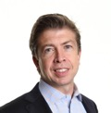
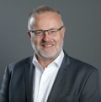
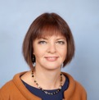
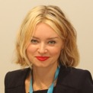
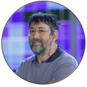
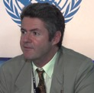
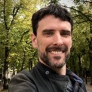
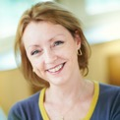
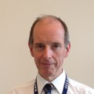
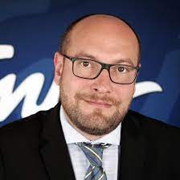
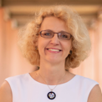

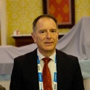
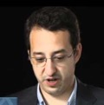
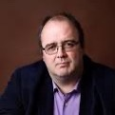
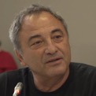
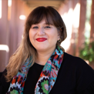
ICANN73 – READOUT
(by EURALO) Tuesday, 22 March 2022
Interpretation
English
Français
Español
Русский
Moderators
VP-Eu
BOARD
ccNSO
Sébastien Natalia
Bachollet Filina
EURALO
ASO
To be updated
{
}
{
}
{
}
{
}
{
}
{
}
{
19:00-20:00 UTC
Introduction by the moderators (5’)
Exchange with the participants (50’)
Conclusion by Xavier Calvez
ICANN SVP, Planning and
Chief Financial Officer (5’)
BC
GAC
18:00 - 19:00 UTC
180 s
ccNSO
ALAC
EURALO
RySG
REGISTER HERE
INSCRIVEZ-VOUS ICI
REGISTRAR AQUÍ
ЗАРЕГИСТРИРУЙТЕСЬ ЗДЕСЬ
RrSG
Zoom registration:
https://tinyurl.com/bejpjh2b
NCSG
EURALO

Slide 21
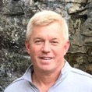
Monthly RoundTables (by EURALO)
2022
Tuesday 1st February 2022 18:00-19:30 UTC - 19:00-20:30 CET
  Monthly RoundTable 1-22 (by EURALO)
Tuesday 22nd February 2022 18:00-19:30 UTC - 19:00-20:30 CET
  Monthly RoundTable 2-22 (by EURALO)
  Equipping backbone networks with high-performance and secure DNS resolution infrastructures - Works
Tuesday 26th April 2022 17:00-18:30 UTC - 19:00-20:30 CET
  Monthly RoundTable 3-22 (by EURALO)
  Brian Cute – Director of Capacity & Resilience, Global Cyber Alliance
  https://www.globalcyberalliance.org/
Tuesday 24th May 2022 17:00-18:30 UTC - 19:00-20:30 CET
  Monthly RoundTable 4-22 (by EURALO)
Agenda
  Topic(s) ?
  Moderator
  Possible Speakers
  Languages (EN, ES, FR and RU)
Q1&2
Notes:
Chiffrement vs régulation des communications électroniques
14h15 Enjeux du chiffrement dans l'espace de régulation français et européen
par Lucien Castex,
Lucien Castex est représentant de l’Afnic pour les affaires publiques. Il a pour principales missions de représenter l'Afnic en France et à l’international, notamment dans le champ des politiques publiques liées au développement de l’internet et du numérique et de structurer les activités partenariales. Il est également chercheur à l’Université Sorbonne-Nouvelle - Paris 3 et enseigne le droit et les politiques du numérique.
A propos de la présentation
Le cadre juridique du chiffrement se situe au carrefour de débats juridiques, politiques et techniques en France comme en Europe interrogeant l’équilibre entre protection des droits et libertés, innovation et sécurité. Régulation d’internet, interception de sécurité, sanction du refus de remise d’une clef de chiffrement ou accès exceptionnel, cette présentation reviendra sur le cadre juridique du chiffrement à l’aune de ses enjeux politiques et sociaux.

Slide 22
Monthly RoundTable 1-22 (by EURALO)
Tuesday 1st February 2022
19:00 - 20:30 CEST
18:00 - 19:30 UTC
Languages supported: English, Français, Español, Русский

Slide 23

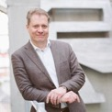
Monthly RoundTable 1-22 (by EURALO)
Tuesday 1st February 2022
18:00-19:30 UTC - 19:00-20:30 CET
ZOOM REGISTRATION required
Agenda
Organization: At-Large staff
Welcome
Sebastien Bachollet, EURALO Chair, (18:00 - 18:05) (5 mins)
Moderator & Introduction
Olivier Crépin-Leblond, (18:05 - 18:10) (5 mins)
RIPE NCC in 2022 – Relation with ICANN – Situation of other RIR
  RIPE NCC - Chris Buckridge (18:10 - 18:30) (20 mins)
  Q&A, moderated by Olivier Crépin-Leblond (18:30 - 18:45) (15 mins)
Presentation and demonstration of https://www.istrust.org/
  Internet SOCiety Belgium - Frederic Taes (18:45 - 19:05) (20 mins)
  Q&A, moderated by Olivier Crépin-Leblond (19:05 - 19:20) (15 mins)
Conclusion by the moderator (19:20 - 19:25) (5 mins)
Next steps: Sébastien Bachollet (19:25 - 19:30) (5 mins)
Languages supported
English, Français, Español, Русский
Notes:
Chiffrement vs régulation des communications électroniques
14h15 Enjeux du chiffrement dans l'espace de régulation français et européen
par Lucien Castex,
Lucien Castex est représentant de l’Afnic pour les affaires publiques. Il a pour principales missions de représenter l'Afnic en France et à l’international, notamment dans le champ des politiques publiques liées au développement de l’internet et du numérique et de structurer les activités partenariales. Il est également chercheur à l’Université Sorbonne-Nouvelle - Paris 3 et enseigne le droit et les politiques du numérique.
A propos de la présentation
Le cadre juridique du chiffrement se situe au carrefour de débats juridiques, politiques et techniques en France comme en Europe interrogeant l’équilibre entre protection des droits et libertés, innovation et sécurité. Régulation d’internet, interception de sécurité, sanction du refus de remise d’une clef de chiffrement ou accès exceptionnel, cette présentation reviendra sur le cadre juridique du chiffrement à l’aune de ses enjeux politiques et sociaux.

Slide 24

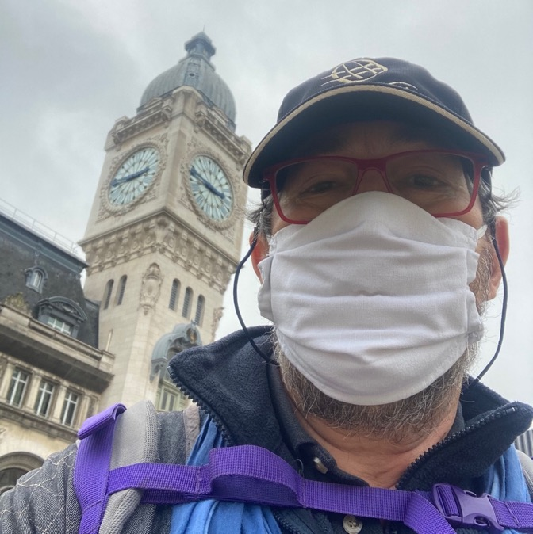
Monthly RoundTable 1-22 (by EURALO)
Welcome
Sébastien Bachollet
Chair of EURALO
(European At-Large regional organization – ICANN)
https://atlarge.icann.org/alses/euralo
ATRT3 and ws2 shepherd
Member of the Board of AFNIC (.fr)
www.afnic.fr
Honorary Chair – Internet Society France
www.isoc.fr

Slide 25
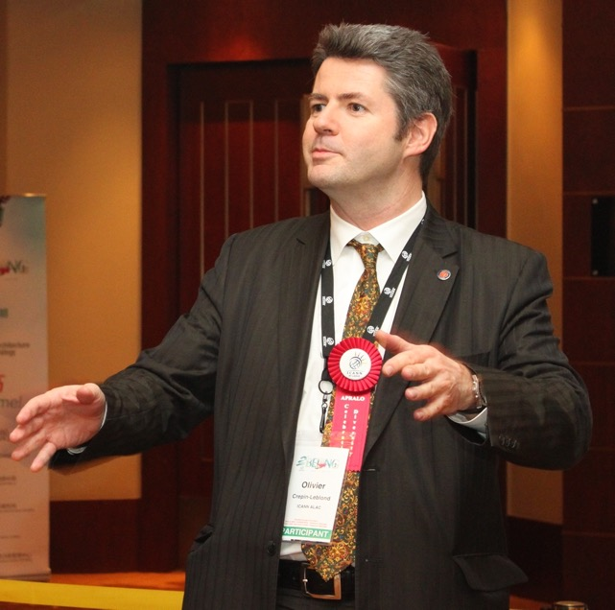

Monthly RoundTable 1-22 (by EURALO)
Moderator
Olivier Crépin-Leblond, Former EURALO Chair
  Co-Chair of the At-Large Consolidated Policy WG
  Chair of the ICANN Engagement Group on Internet Governance

Slide 26

Monthly RoundTable 1-22 (by EURALO)
RIPE NCC
Chris Buckridge
  Advisor to the RIPE NCC Managing Director on issues of Global Strategic Engagement
  Strategic specialist, adept at establishing and maintaining an organization's position of influence, trust and expertise in policy and governance discussions
  Experienced manager of a multicultural, globally distributed team of subject matter experts
  Expert in development and implementation of wide-ranging communication and stakeholder engagement strategies
  More than 15 years working in the global Internet industry (RIPE NCC since 2006)

Slide 27

Monthly RoundTable 1-22 (by EURALO)
Internet SOCiety Belgium
Frederic Taes
  Internet SOCiety Belgium, Chair (2019…)
  Internet Society Chapters AC Steering Committee 2022 – Europe
  Information Security Office Manager Europe in a big retail group
  Supporter of diversity to bring innovation (gender, age, disability, origin, language…) – Internet One World
  Battled against a law to lower end-to-end encryption in 2021
  Want a safe Internet for everyone

Slide 28
EURALO ABR Proposals FY2022
Board approval
At-Large FY22 Additional Budget Request Implementation Workspace
https://community.icann.org/display/atlarge/At-Large+FY22+Additional+Budget+Request+Implementation+Workspace
Protecting the Internet’s Unique Identifier System in an Age of Disinformation
  Joanna Kulesza
  15,000$
Diversity in ICANN Leadership bodies
  Sébastien Bachollet
  15,000$
Support participation of individual users in EURALO
  Roberto Gaetano
  7,500$
    https://community.icann.org/display/atlarge/At-Large+FY22+Budget+Development+Workspace

Slide 29
EURALO ABR Proposals FY2023
EURALO Board approval
At-Large FY23 Additional Budget Request Implementation Workspace
https://community.icann.org/display/atlarge/At-Large+FY23+Budget+Development+Workspace

Slide 30
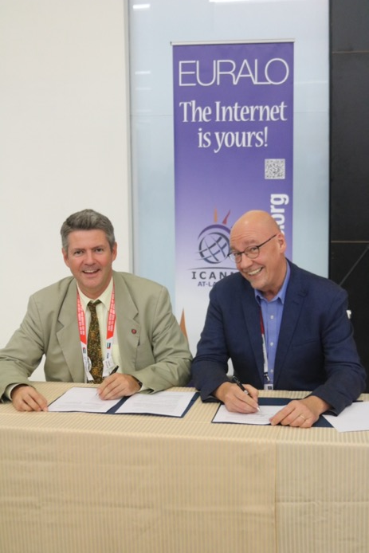
MOU
RIPE
Centr

Slide 31
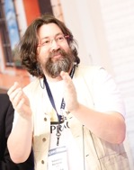



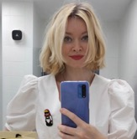
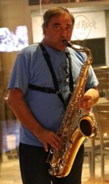

EURALO Board 2022
Member responsibilities
Sébastien Bachollet, Chair (2019-2023)
  ATRT3 and ws2 shepherd
  New gTLDs Auction Proceeds (ccwg) member
  At-Large Operations, Finance and Budget Working Group (OFBWG)
  EURALO Operating Rules Taskforce (EROR TF) Co-Chair
  EURALO GA Prep (EGAP)
  ABR 2022
Natalia Filina, Secretariat (2019-2023)
  ALAC Subcommittee on Outreach & Engagement Co-chair
    Coordination of the Regional O&E Leaders
    National and Global IGF Activities
    RALO General Assemblies
    O&E Strategy Development
    At-Large Capacity Building Webinars WG
  EURALO GA Prep (EGAP)
Olivier Crépin-Leblond, Former Chair
  Co-Chair of the At-Large Consolidated Policy WG
  Chair of the ICANN Engagement Group on Internet Governance
  EURALO GA Prep (EGAP)
Roberto Gaetano
  Chair of Internet Individual Users Association
  Chair of the Individual Members Implementation
  EURALO GA Prep (EGAP)
  ABR 2022

Slide 32
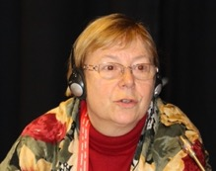
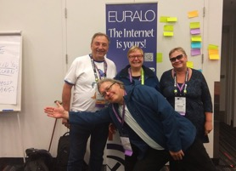

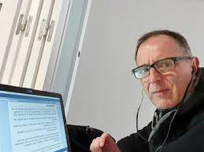

EURALO Board 2022
Member responsibilities
EURALO Board (2022-2023)
Anne-Marie Joly-Bachollet
  ALAC Subcommittee on Appointee Selection member AASC (Euralo representative)
  ALAC Subcommittee on Outreach and Engagement
  Atlas III Ambassador
  EURALO GA Prep (EGAP)
Lutz Donnerhacke
  EURALO Operating Rules Taskforce (EROR TF) Co-Chair
  Atlas III Ambassador
Ricardo Holmquist
  At-Large Operations, Finance and Budget Working Group (OFBWG)
  ALAC Subcommittee on Finance and Budget

Slide 33
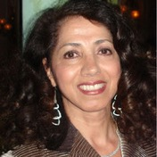

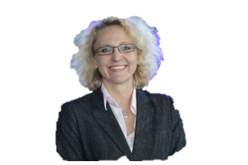
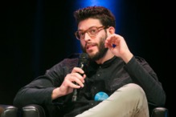
EURALO Board 2022
Member responsibilities
ALAC
Pari Esfandiari
    Selected by NomCom – 2020-2022
Joanna Kulesza
    Selected by NomCom – 2018-2020
    Selected by EURALO – 2020-2022
  ALAC - GAC liaison – 2021-2022
  ALAC Vice-Chair Outreach and Engagement
  Co-Chair Capacity Building Working Group
  ALAC Subcommittee on Appointee Selection member
  EURALO GA Prep (EGAP)
  ABR 2022
Matthias Hudobnik
    Selected by EURALO – 2019-2023
  ALAC Subcommittee on Finance and Budget
  EURALO GA Prep (EGAP)

Slide 34
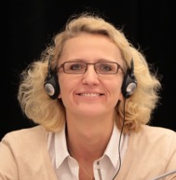
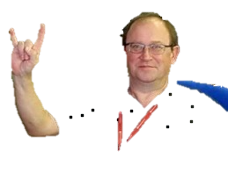


EURALO Board Nov 2021
Member responsibilities
ALAC Liaisons
Joanna Kulesza, to GAC
Andrei Kolesnikov, to SSAC
NomCom
Yrjö Länsipuro
  NomCom Delegate, European Region (2022)
  EURALO Task Force on At-Large Structure (ALS) engagement
Involvement of other people
Sandra Hoferichter
  ICANN’s Leadership Training Program, where EURALO contributed substantially to its creation
Oksana Prykhodko
  Member of ICANN ccPDP4 IDN Working Group

Slide 35

EURALO 2022
ICANN Task Forces & WG
ICANN Engagement Group on Internet Governance
  Olivier Crépin-Leblond, Chair
ATRT3 & WS2
  Sébastien Bachollet (Shepherd)
ICANN Academy Cross-Community Committee
  Sandra Hoferichter (Chair)
NomCom 2022
  Yrjö Länsipuro, European Region

Slide 36


EURALO 2022
At-Large/ALAC Task Forces & WG – Policy
Consolidated Policy Working Group (CPWG)
  Olivier Crépin-Leblond, Co-Chair
  Sébastien Bachollet
  Pari Esfandiari
  Lutz Donnerhacke
  Roberto Gaetano
  Ephraim Percy Kenyanito
  Betty Fausta
  Anne-Marie Joly-Bachollet
  Natalia Filina
  Yrjö Länsipuro
  Steinar Grotterod
Transfer Policy Review
  Steinar Grotterod
  Lutz Donnerhacke
Curative Rights for IGOs
  Yrjö Länsipuro
Universal acceptance

Slide 37
EURALO 2022
At-Large/ALAC Task Forces & WG – Operations
At-Large Review Implementation Working Group (ARIWG)
    Bastiaan Gosling ALAC-EU (TBUp)
    Joanna Kulesza
    Olivier Crépin-Leblond
    Yrjö Länsipuro
    Sébastien Bachollet
  Metrics
    Joanna Kulesza
Appointee Selection Subcommittee (AASC)
  Joanna Kulesza
  Anne-Marie Joly-Bachollet
Finance and Budget Subcommittee (FBSC)
  Matthias Hudobnik
  Ricardo Holmquist
At-Large Operations, Finance and Budget Working Group (OFB-WG)
  ALAC Subcommittee on Finance and Budget members +
  Joanna Kulesza
  Sébastien Bachollet (as ws2 and ATRT3 shepherd)
ALAC-ccNSO Coordination Working Group
ALAC - GAC Coordination Working Group
  Joanna Kulesza (Chair)
Prioritisation Working Group
  Sebastien Bachollet

Slide 38
EURALO Board Nov 2021
ALAC Task Forces & WG – O&E
Outreach and Engagement Subcommittee
      Natalia Filina (Vice-Chair and Manager of the Regional Liaisons)
  Capacity Building Working Group
      Joanna Kulesza (co-chair)
      Natalia Filina
      Desara Dushi
      Ephraim Percy Kenyanito
      Mariam Tsiklauri
      Neli Odishvili
      Ricarda Wagner
    ICANN Learn Policy Development Course Team
      Desara Dushi
      Joanna Kulesza (Lead)
    ICANN At-Large Onboarding Slide Deck Team
      Joanna Kulesza (Obs)
    Webinars Team
      Natalia Filina
      Joanna Kulesza (Obs)

Slide 39
EURALO Board Nov 2021
ALAC Task Forces & WG – O&E
ALAC Subcommittee Outreach and Engagement
      Natalia Filina (Vice-Chair and Manager of the Regional Liaisons)
  Social Media Working Group
    Natalia Filina (Regional Vice-Chair)
    Olivier Crépin-Leblond (Ralo Lead)
    Matthias Hudobnik
Real Time Transcription (RTT) Project
Technology Taskforce (to be updated)
    Olivier Crepin-Leblond
    Sebastien Bachollet
    Lutz Donnerhacke
    Stuart Clark
    Mikhail Medrish
    Fotjon Kosta
    Dina Solveig Jalkanen

Slide 40
EURALO Board Nov 2021
EURALO Task Forces & WG
EURALO Task Force on At-Large Structure (ALS) engagement
Yrjö Länsipuro, Chair
Natalia Filina (O&E WG liaison)
Sébastien Bachollet
Olivier Crépin-Leblond
Jordi Iparraguirre
Matthias Hudobnik
Oksana Prykhodko
Eric Schweighofer (?)
Nenad Marinkovic
Anne-Marie Joly-Bachollet
Olawale Bakare
Annette Muehlberg
Sandra Hoferichter
EURALO Operation Rules Taskforce (EROR TF)
Sébastien Bachollet, co-Chair
Lutz Donnerhacke, co-Chair
Anne-Marie Joly-Bachollet
Ricardo Holmquist
Joanna Kulesza
Matthias Hudobnik
Pari Esfandiari
Yrjö Länsipuro
Andrei Kolesnikov
Olivier Crépin-Leblond
Roberto Gaetano
Natalia Filina
Olivier Passek
EURALO Monthly RoundTable
?
EURALO GA Prep (EGAP)
Olivier Crépin-Leblond
Natalia Filina
Roberto Gaetano
Matthias Hudobnik
Anne-Marie Joly-Bachollet

Slide 41


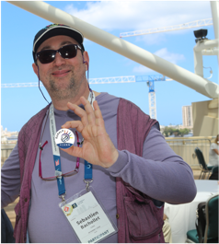

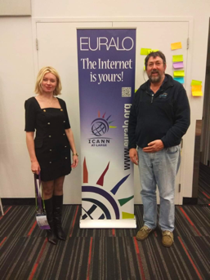




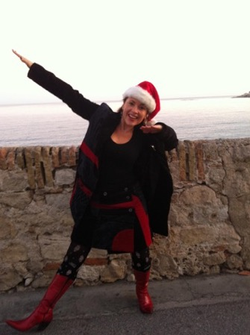


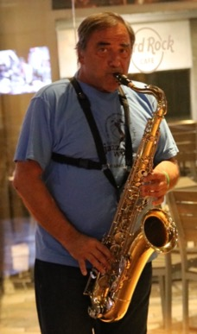



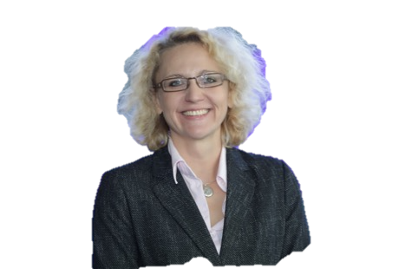

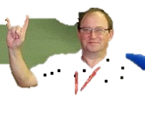




EURALO 2022

Slide 42

EURALO Board Nov 2021
ICANN Task Forces & WG Archive
GNSO Cross Community Working Group on New gTLD Auction Proceeds
  Sébastien Bachollet (member)
  Natalia Filina
  Wale Bakare
GNSO Expedited Policy Development Process (EPDP) Phase II
  Bastiaan Gosling (To be replaced?)
GNSO New gTLD Subsequent Procedures PDP
  Christopher Wilkinson
GNSO Work Track 5: Geographic Names at the Top-Level
  Christopher Wilkinson
  Erich Schweighofer
  Ricardo Holmquist
  Yrjö Länsipuro
NomCom 2021
  Sébastien Bachollet, European Region
IDN (Internationalized Domain Names) Policy Working Group
  Olivier Crépin-Leblond
  Jean-Jacques Subrenat
  Roberto Gaetano
  Lutz Donnerhacke
Archives

Slide 43
EURALO Board Nov 2021
At-Large/ALAC Task Forces & WG – Operations Archive
  ALS Mobilization Working Party
    Yrjö Länsipuro
      Bastiaan Gosling
      Natalia Filina
      Roberto Gaetano
  Unaffiliated Individuals Working Party
    Roberto Gaetano (Chair)
      Yrjö Länsipuro
      Natalia Filina
      Matthias Hudobnik
      Clément Genty
      Sébastien Bachollet (Ex-officio)
      Narine Khachataryan
Archives

