Slide 1
ICANN73 Production Planning Call #1
16 December 2021

Slide 2
Agenda
Welcome
ICANN73 Block Schedule
ICANN73 Plenary Topic Proposals
  Introduction by each proposing group’s representative followed by discussion of community priorities and possible agreements
Production Timeline / Next Steps
AOB

Slide 3
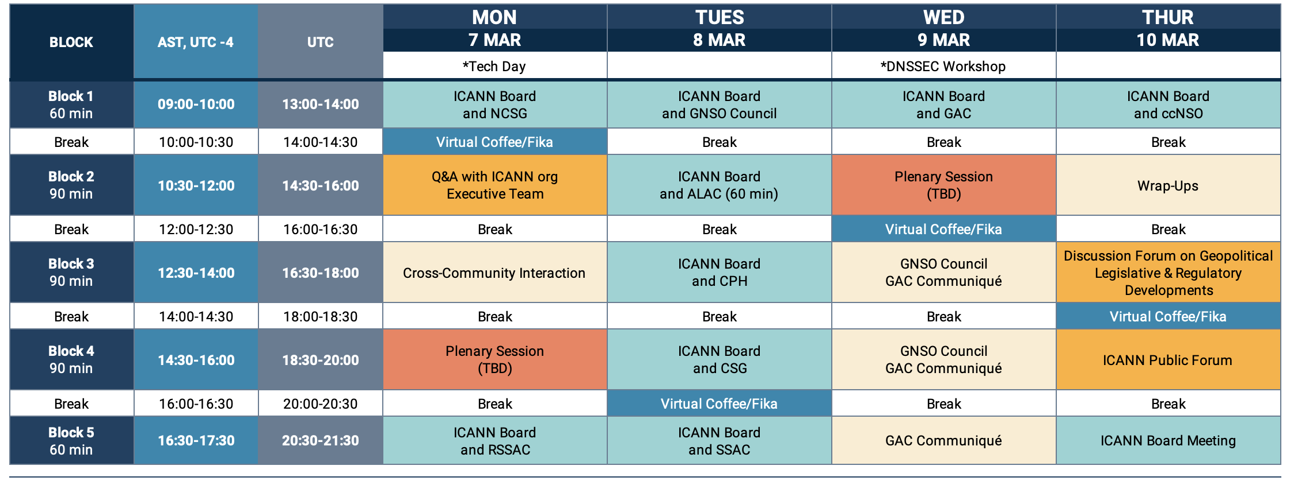

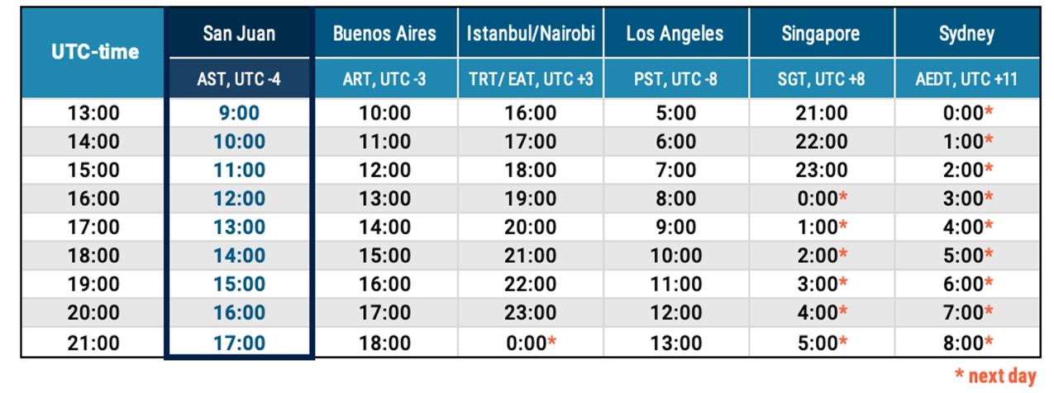
ICANN73 Community Forum Block Schedule
Revised Dates: 7-10 March 2022
2 slots for Plenary Topics
Proposed times for Joint Sessions with the Board

Slide 4
Agenda
Welcome
ICANN73 Block Schedule
ICANN73 Plenary Topic Proposals
  Introduction by each proposing group’s representative followed by discussion of community priorities and possible agreements
Production Timeline / Next Steps
AOB

Slide 5

ICANN73 Plenary Topic Proposals
1. Moving Forward with the Global Public Interest Framework (carried over from ICANN72)
ALAC (Contact: Marita Moll)
The ICANN FY22 operating plans (community engagement and services) include the following activity: "Community to decide whether the proposed public interest framework can be used to demonstrate how specific recommendations, advice and public comments are in the global public interest"*. At ICANN, the global public interest is tied to its mission and central to primary governance documents. The challenge has been in operationalizing this commitment. In 2019, the Board and the community began a discussion on developing a tool designed to formally incorporate the public interest into Board decision making. In the interests of addressing the activity proposed in the plan, this session will provide more information and seek feedback about the public interest framework and how it is evolving It would also consider how such a tool should be used by the community in their activities/initiatives to further ICANN's mission. What has changed since the last public update on this in ICANN66? https://www.icann.org/en/system/files/files/draft-op-financial-fy22-26-opplan-fy22-2020-en.pdf (p.280) Speakers Confirmed Avri Doria - Board shepherd for an update on the current status of the framework: what is it; how does it work; how can communities participate. Moderator: Marita Moll (ALAC)

Slide 6
ICANN73 Plenary Topic Proposals
2. Reflections From the Pandemic So Far — Impacts of Covid-19 on the Work of ICANN
GAC (Contact: Anna Goulden)
The session, rather than specifically looking at the effects of the pandemic on the ICANN Community, would essentially be an opportunity to discuss how the pandemic has affected key ICANN work initiatives, such as growth in gTLD & IDNs, and ICANN Compliance, as well as operational matters (e.g., the diversity of ICANN participation, etc.). Rationale/Desired Outcomes A better understanding of the impacts of the pandemic on ICANN and the overall DNS market - Community discussion of potential strategies for how to respond to the experience and take learnings forward into the future in a positive way. Speakers TBC Open to suggestions - a main priority should be that the speakers reflect a range of perspectives and community groups within ICANN

Slide 7
ICANN73 Plenary Topic Proposals
3. Evolving the DNS Abuse Conversation: Maliciously Registered versus Compromised Domains
GNSO RySG (Contact: Samantha Demetriou)
Most discussions relating to DNS Abuse, to date, have not distinguished between malicious and compromised domains. However, any nuanced approach to DNS Abuse mitigation must account for both malicious registrations, where a domain is registered with malicious intent, and as such the registrant is likely complicit, and compromised domains, which are registered by a registrant for a non-abusive purpose but are later compromised by malicious third-party actors in order to engage in DNS Abuse, typically without the registrant’s knowledge or consent registrant. Thus, the registrant is considered a victim alongside others potentially affected; and suspending the entire domain name is typically not the appropriate remediation. Compromised domains account for a significant portion of DNS Abuse. As the DNS matures, and we welcome more established web presences of all types of genuine registrants, individuals and businesses alike, both large and small, we must seek to protect them. Efforts to effectively combat DNS Abuse should seek to do no harm to genuine registrants, who are not directly to blame for abuse occurring in connection to their domain. The potential for disproportionate harm in treating compromised domain the same as maliciously registered domains is high. A more nuanced approach is required to address compromised names. This session will explore the differentiation between maliciously registered and compromised domains in DNS Abuse; specifically, we will discuss the impacts of the DNS Abuse itself on end-users and registrants, and strategies to effectively mitigate DNS Abuse when dealing with both malicious and compromised domains. Speakers Confirmed Moderator: Graeme Bunton, DNS Abuse Institute | Presenter: Maciej Korczynski, University of Grenoble Panelists: Lori Schulman, IPC | Chris Lewis Evans, PSWG | Alan Woods, RySG | Reg Levy, RrSG | Possible Brand Registrar Rep and additional Registry Operator

Slide 8
ICANN73 Plenary Topic Proposals
4. 10-Year Anniversary of the New gTLD Program: a Conversation with the Operators
GNSO RySG (Contact: Samantha Demetriou)
2022 marks the 10th anniversary of the opening of the application window for new gTLDs. ICANN73 provides an excellent opportunity to reflect on some of the benefits that new gTLDs have brought, innovative business models and practices that new gTLDs have successfully adopted, as well as explore some of the challenges encountered by new gTLD applicants and operators. Rationale/Desired Outcomes In 2012, the introduction of new gTLDS was heralded as the single biggest change to the domain name landscape, intended to enhance competition, innovation, and consumer choice. The aim of this session is to take stock, as we reach the 10th anniversary of the program launch, including: How is innovation occurring through TLDs | What are the barriers to innovation, which might be lowered through new contractual provisions or procedures in order to encourage innovation | How are consumers benefiting fromTLDs that provide new products and choices? | Bearing in mind ICANN Org’s focus on the role that new gTLDs in scripts other than ASCII can play in getting underserved regions online, how are IDN TLDs currently playing a role in competition, innovation and consumer choice, and what are the barriers to and challenges of IDN TLDs Speakers TBC from a range of new gTLDs, including: Validated / restricted eligibility, dotBrand, geoTLD, OpenTLD, Niche/market TLD, IDN, [A TLD operator who has terminated their RA - not sure how easy it will be to get this, but it might be of interest to hear from someone who has given up their TLD, particularly the reasons for doing so]

Slide 9
Agenda
Welcome
ICANN73 Block Schedule
ICANN73 Plenary Topic Proposals
  Introduction by each proposing group’s representative followed by discussion of community priorities and possible agreements
Production Timeline / Next Steps
AOB

Slide 10
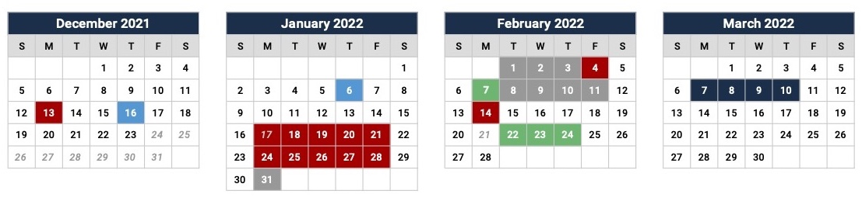
ICANN73 Schedule Production Timeline
Schedule Closed (No Further Changes)
4 Feb
Plenary Topics Due
Session Request Deadline
13 Dec
28 Jan
Prep Week Schedule Posted
Community Planning Call 1
Community Planning Call 2
7 Feb
ICANN73 Schedule Posted
16 Dec
6 Jan
14 Feb
15-day (DPOP) Deadline
2021
Nov
Dec
2022
Feb
Mar
2022
0%
Today
0%
Plenary Topic Proposals
16 d
Mon 22 Nov - Mon 13 Dec
0%
Session Request Submissions Period
10 d
Mon 17 Jan - Fri 28 Jan
0%
Allocations; Conflict Resolution
5 d
Mon 31 Jan - Fri 4 Feb
0%
Website Build
5 d
Mon 7 Feb - Fri 11 Feb
0%
3 d
Tue 22 Feb - Thu 24 Feb
Prep Week
4 d
ICANN73 Community Forum

