Slide 1



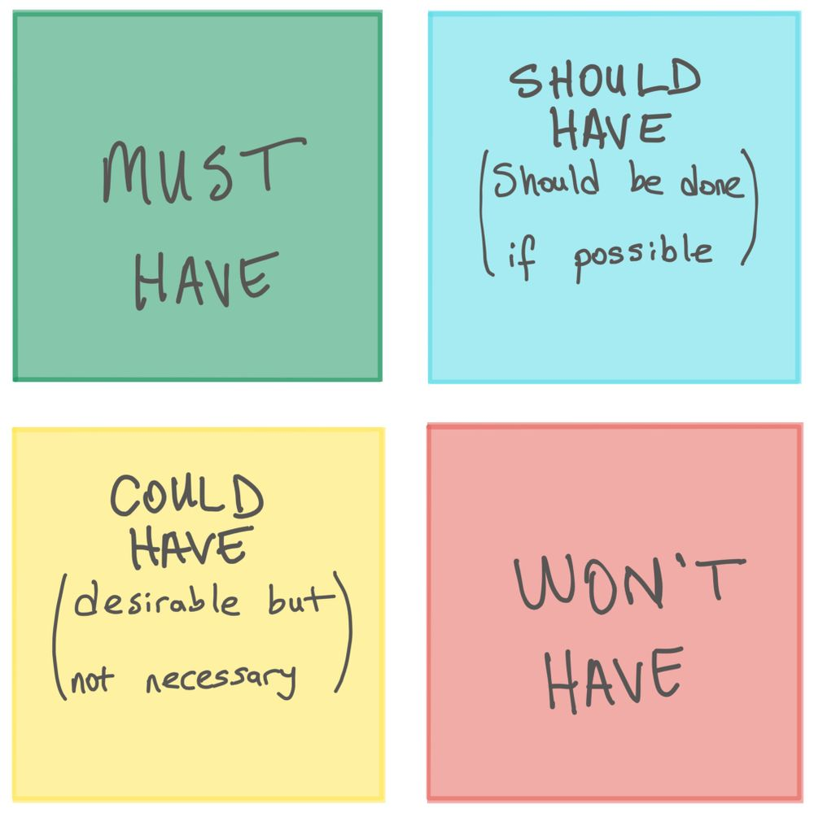
Prioritization
Consider Resources
This Photo by Unknown Author is licensed under CC BY

