Slide 1

EURALO
Road Map
Board 05 October 2021

Slide 2

EURALO 2021/2022 Road Map
Updated by Sébastien on the 14th September 2021
Welcome and roll call - Staff (2 min)
IA (2 min)
EURALO General Assembly (2 min)
  2021
  2022
EURALO monthly Newsletter (2 min)
EURALO O&E 2021/2022 Road Map (2 min)
  Discretionary founding and CROP FY2022
EURALO & ICANN Meetings (45 min)
  EURALO Board (& TF) meetings
  Monthly RoundTables (by EURALO)
  ICANN72 EURALO lead Policy sessions
  ICANN72 EURALO readouts
  Next ICANN meetings
EURALO ABR Proposals FY2022 (5 min)
EURALO Elections (5 min)
EURALO Board members (1 min)
AOB (2 min)
AGENDA

Slide 3
EURALO 2021/2022 Road Map
EURALO GA 2021 & 2022
EURALO GA 2021
  Virtual 14 December 2021
  EGAP re-started the work for the preparation?
    Next meeting October??
EURALO GA 2022
  Face to face
    Along with ICANN74 – The Hague – Policy Forum
      13-16 June 2022
      Training
GAs

Slide 4
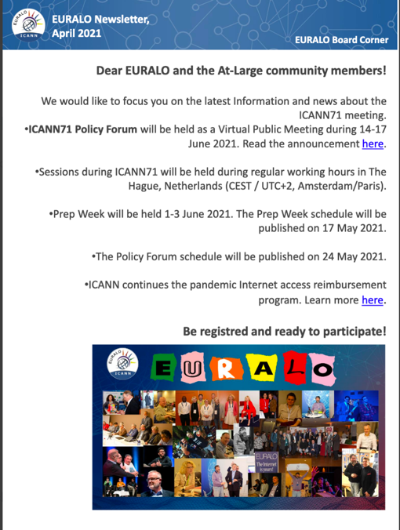
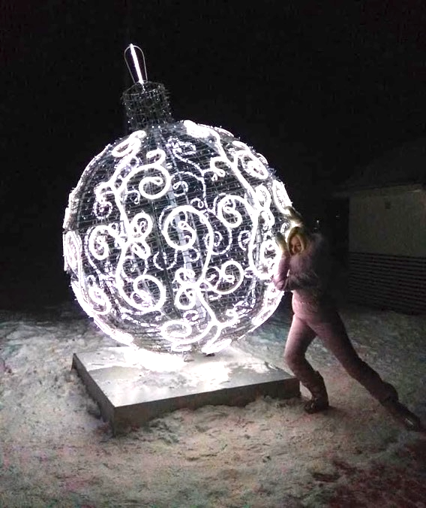

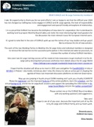
EURALO 2021/2022 Road Map
EURALO Monthly Newsletter

Slide 5
EURALO 2021/2022 Road Map
EURALO O&E 2021 & 2022
EURALO O&E 2021/2022
  Road Map
  FY22 Regional Strategy Plan
  At-Large Outreach Activities at the 2021 IGF in Katowice
  Implementation
    ALSes mobilization
    Individual (EU)RALO members mobilization
  CROP
  Discretionary founding
O&E

Slide 6
EURALO 2021/2022 Road Map
EURALO Meetings 2021 & 2022
Tuesday 5 October 2021 18:00-19:30 UTC: Board
???: EGAP
ICANN72 – Seattle – Virtual
Pre-ICANN meeting – 12-14 October 2021
At-Large / ALAC meetings - 18-22 October 2021
  Policy session involving EURALO Leaders
    Tuesday 19 October 2021 – 17:00-18:30 UTC
    At-Large Policy Session 2: Tackling DNS Abuse – Joanna Kulesza
    Wednesday 20 October 2021 – 17:00-18:00 & 18:30-19:00 UTC
    At-Large Policy Session 3: ICANN Accountability and Transparency and the ICANN Reviews (part 1&2)
ICANN Annual General Meeting (23rd) – 25-28 October 2021
Q4

Slide 7
EURALO 2021/2022 Road Map
EURALO Meetings 2021 & 2022
Tuesday 9 November 2021 18:00-19:30 UTC: ICANN72 Readout (EN, ES, FR and RU)
Tuesday 16 November 2021 18:00-19:30 UTC
  Monthly RoundTable 8 (by EURALO): (EN, ES, FR and RU)
  Encryption challenges in the French and European regulatory space – Lucien Castex
Tuesday 23 November 2021 18:00-19:30 UTC: LT + EGAP
Tuesday 30 November 2021 18:00-19:30 UTC: Board - Preparation of EURALO vAG
Tuesday 7 December 2021: IGF Poland
Tuesday 14 December 2021: EURALO vAG (including Elections) (EN, ES, FR and RU)
Tuesday 21 December 2021: New EURALO Board
Bye-bye 2021 next meeting in 2022
Q4

Slide 8
Monthly RoundTable 8 (by EURALO)
2021
Tuesday 16 November 2021 - 18:00-19:30 UTC
Monthly RoundTable 8 (by EURALO)
Encryption challenges in the French and European regulatory space
Moderator:
  Possible Speakers:
    Lucien Castex
Notes:
Chiffrement vs régulation des communications électroniques
14h15 Enjeux du chiffrement dans l'espace de régulation français et européen
par Lucien Castex,
Lucien Castex est représentant de l’Afnic pour les affaires publiques. Il a pour principales missions de représenter l'Afnic en France et à l’international, notamment dans le champ des politiques publiques liées au développement de l’internet et du numérique et de structurer les activités partenariales. Il est également chercheur à l’Université Sorbonne-Nouvelle - Paris 3 et enseigne le droit et les politiques du numérique.
A propos de la présentation
Le cadre juridique du chiffrement se situe au carrefour de débats juridiques, politiques et techniques en France comme en Europe interrogeant l’équilibre entre protection des droits et libertés, innovation et sécurité. Régulation d’internet, interception de sécurité, sanction du refus de remise d’une clef de chiffrement ou accès exceptionnel, cette présentation reviendra sur le cadre juridique du chiffrement à l’aune de ses enjeux politiques et sociaux.

Slide 9
ICANN72
At-Large policy session
ICANN accountability and transparency and the reviews
Tackling DNS Abuse

Slide 10
ICANN72
At-Large policy session 2
Proposal by JKA
Moderator Joanna Kulesza
Tackling DNS Abuse
This proposal aims to bridge the widening gap between policy development around activity considered abusive to the Domain Name System (DNS Abuse) and relevant legal and policy measures. With the overall goal of breaking the silos, it brings together technical community, governments and business from around the globe to offer different perspectives on DNS Abuse and platform liability. Looking at automated content moderation within platforms, is asks the questions of recommendable policy solutions to best address end user needs and concerns.

Slide 11
ICANN72
At-Large policy session 3
2 hours
Proposal by SeB
Moderators SeB and ?
ICANN accountability and transparency and the reviews
From ATRT3 & From the Board
What are the point of view of the constituencies of the ICANN community?
Discussion with the participants

Slide 12
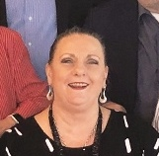
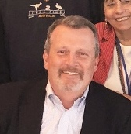

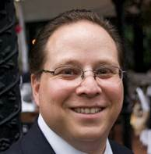

ICANN accountability and transparency and the reviews
At-Large policy session 3 - Part 1
  Co-chairs of ATRT3
  Board members

Slide 13

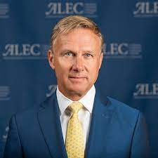
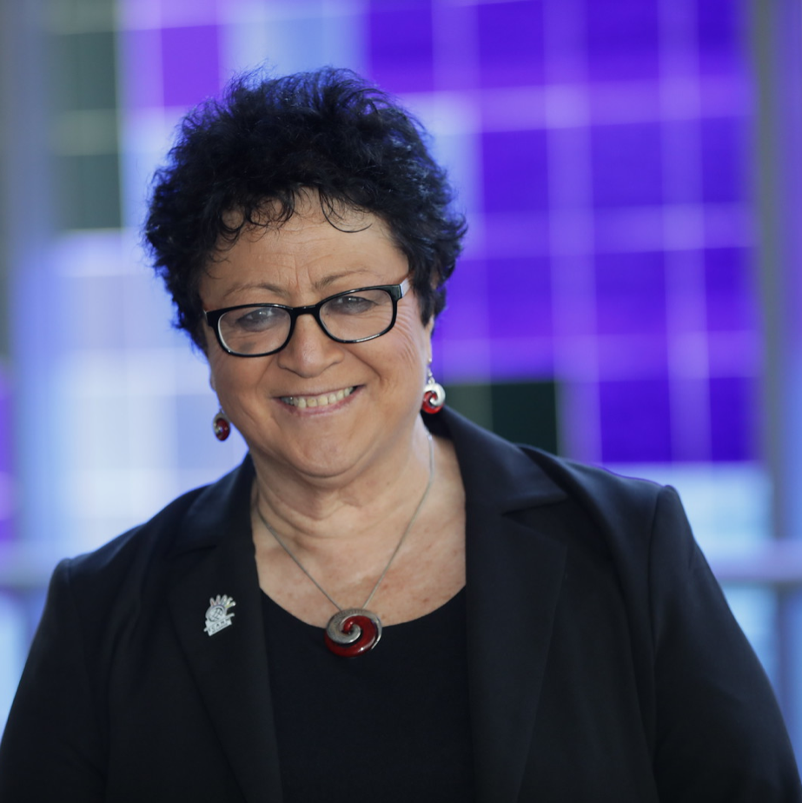


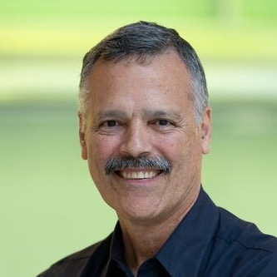
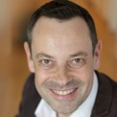
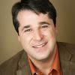
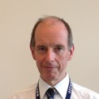
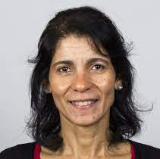
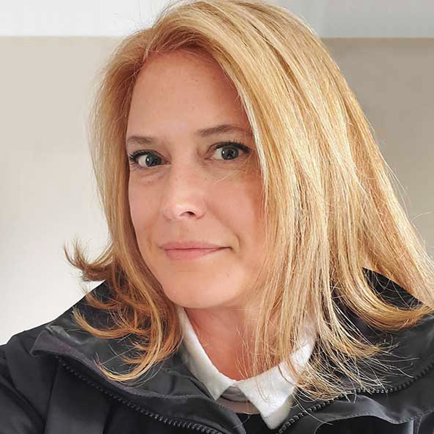

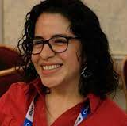
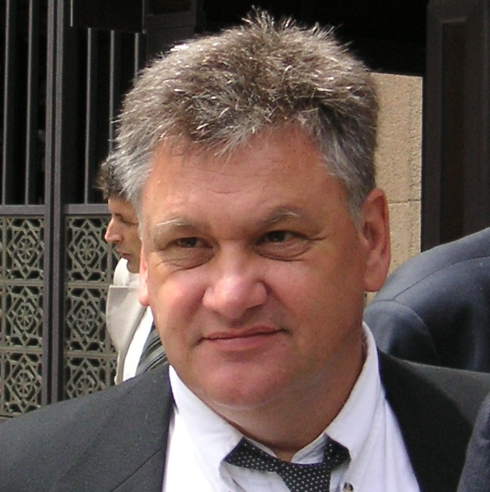
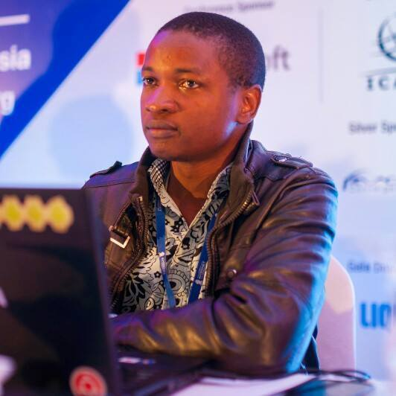
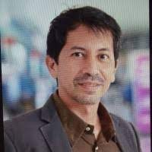
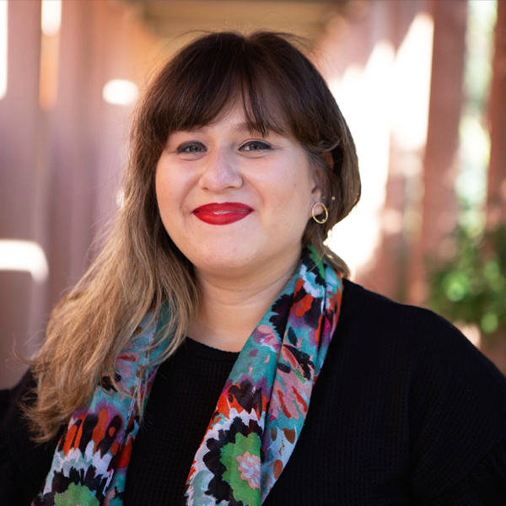
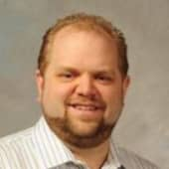
ICANN accountability and transparency and the reviews
At-Large policy session 3 - Part 1
Interpretation
English, Français, Español, Русский
Video 15’
A 3’ speech for each constituency
Total 45’
  gNSO 4 + 1
  ccNSO 1
  ASO 1
  RSSAC 1
  SSAC 1
  GAC 1
  ALAC 1
  RALO 4 (APRALO)
20 October 2021
17:00 - 18:00 UTC
180 s
CcNSO?
RSSAC
Moderators
SeB and ?
SSAC
REGISTER HERE, INSCRIVEZ-VOUS ICI, REGISTRAR AQUÍ, ЗАРЕГИСТРИРУЙТЕСЬ ЗДЕСЬ

Slide 14
ICANN accountability and transparency and the reviews
Plenary session - Part 2
Exchanges with the participants
Rooms by languages
  English with Russian
  French with Spanish
With Visio and Chat or
With tools like dashboard…?
Questions to get the temperature of the room?
Conclusion by the CEO
Total 1 hour
Moderators
SeB and ?

Slide 15


ICANN meetings & EURALO readouts
ICANN72 – Seattle – Annual General Meeting (23rd)
  23-28 October 2021
    EURALO ICANN72 Readouts
    Tuesday 9 November 2021 18:00-19:30 UTC

Slide 16
EURALO 2021
ICANN Meetings 2021 & 2022
ICANN70 – Cancun – Community Forum (Virtual)
  20-25 March 2021
ICANN71 – The Hague – Policy Forum (Virtual)
  14-17 June 2021
ICANN72 – Seattle – Annual General Meeting (23rd)
  23-28 October 2021
ICANN73 – San Juan – Community Forum
  5-10 March 2022
ICANN74 – The Hague – Policy Forum
  13-16 June 2022
ICANN75 – Kuala Lumpur – Annual General Meeting (24th)
  17-22 September 2022

Slide 17
EURALO 2022
ICANN74 – The Hague – Policy Forum - 13-16 June 2022
EURALO GA
EURALO Social Event
TBD
TBD
Chair
  Sébastien Bachollet
Members
  Yrjö Länsipuro
  Natalia Filina
  Lutz Donnerhacke
  Joanna Kulesza
  Wale Bakare
  Jonathan Zuck
  Olivier Crépin-Leblond
Chair
  Natalia Filina
Members
  Maté Mester
  Matthias Hudobnik
  Roberto Gaetano
  Jonathan Zuck
  Olivier Crépin-Leblond
  Sébastien Bachollet
Other EURALO Events?

Slide 18
EURALO 2022
-xx
EURALO Social Event
ICANN74 – The Hague – Policy Forum - 13-16 June 2021
  EURALO at ICANN74
EURALO social event
  Date: ? June 2022
  Time: TDB UTC – TBD CEST (90’)
  Duration : 90 minutes
  Format: ?
  Needs?
TF2

Slide 19
ICANN meetings &
EURALO sessions
-xx
ICANN71 – The Hague – Virtual Policy Forum - 14-17 June 2021
EURALO Policy Session
  16 June 2021 - 10:30-12:00 UTC - 12:30-14:00 CEST or 12:30-14:0 UTC - 14:30-16:00 CEST
  New gTLDs: Protection of geographical names in Europe
  Objective
    Respond to the Sub-Pro PDP on gTLDs to ensure that in the public interest European geo-names of all kinds, are not exposed to open speculative registrations allowed by ICANN.
    The session will endeavor to assess the risks of open, speculative delegations and the eventual costs to local communities and final users arising from the unregulated sale of 'premium' domains, or even the geo-TLDs themselves.
  Description
    The session will explore and report on the needs and interests of users for geographical identity, the existing scope and opportunities for legal protection, intellectual property aspects including AOC, and alpha3 codes in ISO3166 and ISO 4217, including for example, EUR.
  Introduction: Sébastien Bachollet (EURALO Chair)
  Moderator: Sandra Hoferichter (Medienstadt Leipzig e.V. & EURODIG)
  Panelists TBC
    GAC members
    Existing policy in a ccTLD
    Case study of a country that practices legal protection of geo names
    EU Commission: scope for legal protection through Applicable Local Law (c.f. GDPR)
    People involved in the .vin/.wine story
  Rapporteur
    Summary and conclusions, EURALO follow-up
      Christopher Wilkinson (ISOC Wallonia)
TBD

Slide 20
EURALO ABR Proposals FY2022
Board approval
At-Large FY22 Additional Budget Request Implementation Workspace
https://community.icann.org/display/atlarge/At-Large+FY22+Additional+Budget+Request+Implementation+Workspace
Protecting the Internet’s Unique Identifier System in an Age of Disinformation
  Joanna Kulesza
  15,000$
Diversity in ICANN Leadership bodies
  Sébastien Bachollet
  15,000$
Support participation of individual users in EURALO
  Roberto Gaetano
  7,500$
    https://community.icann.org/display/atlarge/At-Large+FY22+Budget+Development+Workspace

Slide 21
EURALO 2022
EURALO 2021
Oksana Prykhodko
  Member of ICANN ccPDP4 IDN Working Group

Slide 22
EURALO 2022
EURALO 2021 ELECTIONS
ALAC
  Matthias Hudobnik
NomCom
  Yrjö Länsipuro
EURALO Chair
  Sébastien Bachollet
EURALO Secretariat
  Natalia Filina
EURALO Board (to be organized for the EURALO GA in December 2021)
  Incumbents
    Anne-Marie Joly (France)
    Lutz Donnerhacke (Germany)
    Màté Mester (Hungary)
    Ricardo Holmquist (Spain)
    Wale Bakare (United Kingdom)

Slide 23
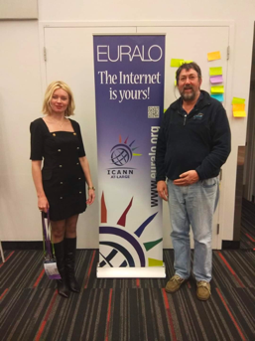

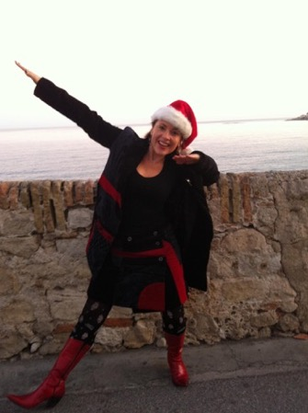









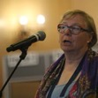
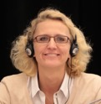



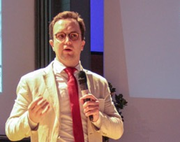


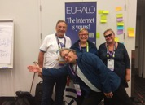





EURALO 2021

