Slide 1

OFBWG
DRAFT PTI and IANA FY23 Operating Plan and Budgets

Slide 2
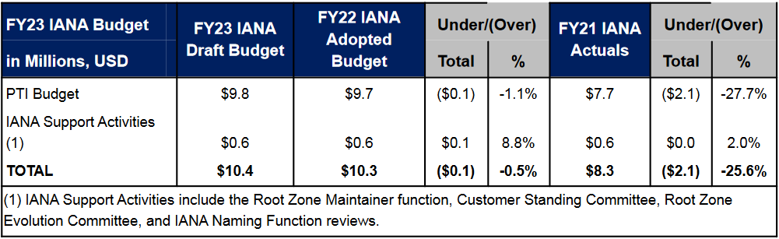
IANA Budget

Slide 3
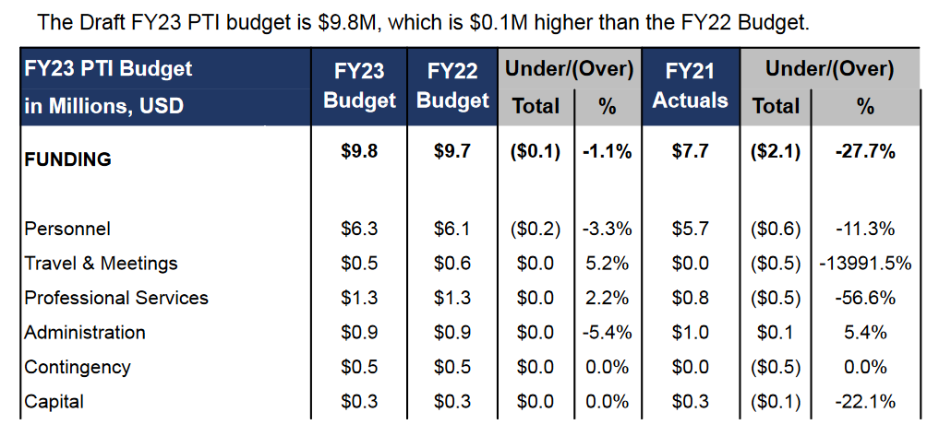
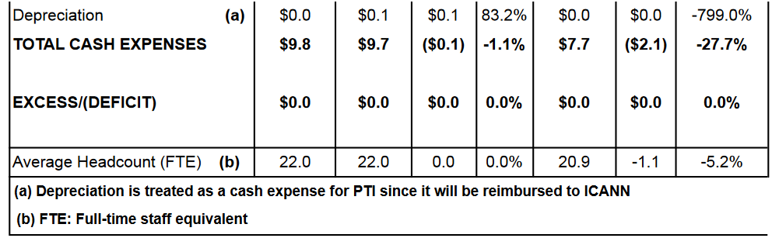
PTI Budget
Looks reasonable, just the comment for the new headcount
Not sure why it is budgeted to decrease in a
year expected to be the first one with full travel
Admin costs a bit lower, but professional svcs 60% up
Looks reasonable, just in case
FY20 and FY21 were close to 8 Million, and there is a jump to near
10 Million in FY22 and now FY23. The “only” adjust account is the
Contingency.
Hedcount goes up 1 FTE in FY22 Budget, but none for FY23

Slide 4
Draft PTI FY23 Operating Plan and Budget
DRAFT PTI FY23 Operating Plan and Budgets doubt:
  “Personnel costs are the highest expenses in the PTI Budget, so carefully planning for resources is critical. For FY23, additional headcount may be required but are not included in this budget in order to align with ICANN’s common process for approving and budgeting for new positions. A certain amount of headcount turnover and growth is budgeted each year, but new positions are not allocated to the functional activities until they are hired. This process allows the organization to strategically evaluate each new hire, controlling headcount growth and ensuring proper allocation of resources. If PTI requires additional headcount in FY23, resources will be prioritized using this budgeting and approval process.”
  It is not clear if PTI needs or not a new headcount. It is understable the careful planning, but if needed, this is the time to budget it. If it is not in this budget, at the time they will require it (9-21 months from now) they will not have the money, because it was not budgeted.

Slide 5
Draft PTI FY23 Operating Plan and Budget
DRAFT PTI and IANA FY23 Operating Plan and Budgets:
  Revised Draft Comment: ALAC appreciates the opportunity to comment of the DRAFT PTI and IANA FY23 Operating Plan and Budgets. The budget, and specially the operating plans look good, both as an improvement of PTI and IANA functions. We like to thank also the opportunity to be involved in the planning process of PTI.
  Although there is a 27% increase in the budget from the last real results (FY21), in At-Large we are glad to see that ICANN org is dedicating more resources to its core function.

Slide 6
Draft PTI FY22 Operating Plan and Budget
DRAFT PTI and IANA FY22 Operating Plan and Budgets:
  Revised Draft Comment: ALAC appreciates the opportunity to comment of the DRAFT PTI and IANA FY22 Operating Plan and Budgets. The budget, and specially the operating plans look good, both as an improvement of PTI and IANA functions, also as a transparent initiative to let the community know the Operational Improvements Activities and System Enhancements in advance.
  Although there is a 30% increase in the budget from the last real results (FY20), in At-Large we are glad to see that ICANN org is dedicating more resources to its core function.

