Slide 1
Collaboration on Universal Acceptance
Universal Acceptance Steering Group (UASG)
Meeting between the UASG and ALAC
28 September 2021

Slide 2
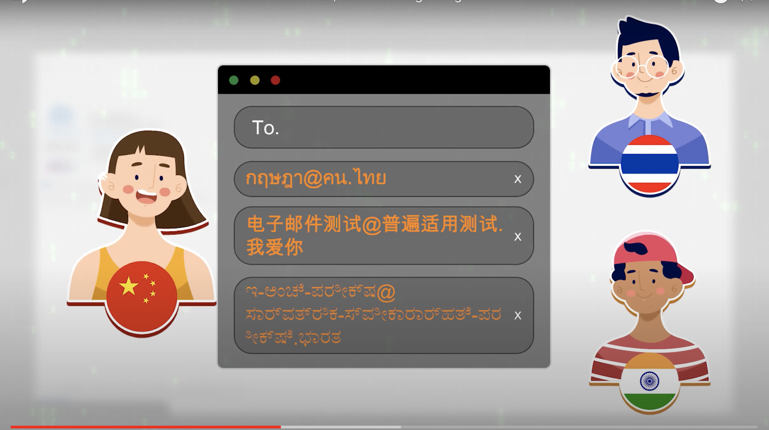
Overview
1
Universal Acceptance (UA) Strategy and Need for Collaboration – 7 mins
Ajay Data, Chair, Universal Acceptance Steering Group (UASG)
2
ALAC-UASG Collaboration Discussion – 13 mins
ALAC and UASG members

Slide 3





Universal Acceptance (UA) Refresher
Universal Acceptance (UA): All domain names and email addresses work in all software applications.
Domain names:
  Newer top-level domain names: example.sky
  Longer top-level domain names: example.international
  Internationalized Domain Names: คน.ไทย
Internationalized email addresses (EAI):
  ASCII@ASCII (new and long TLD) ekrem@misal.berlin
  ASCII@IDN marc@société.org
  Unicode@ASCII 测试@example.com
  Unicode@IDN пример@тестовая-зона.рф
  Unicode@IDN; right-to-left scripts موقع.مثال@میل-ای
Accept
Validate
Process
Store
Display

Slide 4
Why is UA Important?
The Universal Acceptance of domain names and email addresses provides:
  Registrants with a greater choice of different top-level domains that can match their interests, identities, and more.
  Global end users with better access to the Internet due to domain names and email addresses being available in local languages.
  Businesses with opportunities to grow their customer base, e.g., using domain names in local languages.
  The domain name industry with opportunities for innovation and competition.

Slide 5
Strategy for Addressing UA Technically
Prioritize technology to evaluate
Determine how to evaluate the technology
Evaluate the technology for UA-readiness
Submit a UA bug report
Develop UA compliant guidelines, code
Develop messaging and training
Conduct outreach and training for stakeholders
Follow-up on bug reports
Technology Remediation
  UA Measurement WG
  UA Technology WG
  UA Email Address Internationalization (EAI) WG
Outreach
  UA Communications WG
  UA Local Initiatives
  UA Ambassadors
See current progress outlined in the UA-Readiness Report for FY21

Slide 6
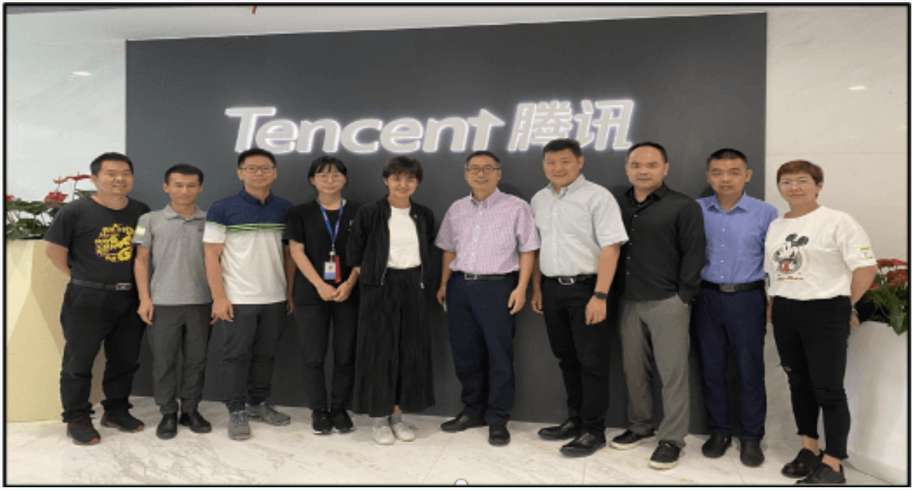
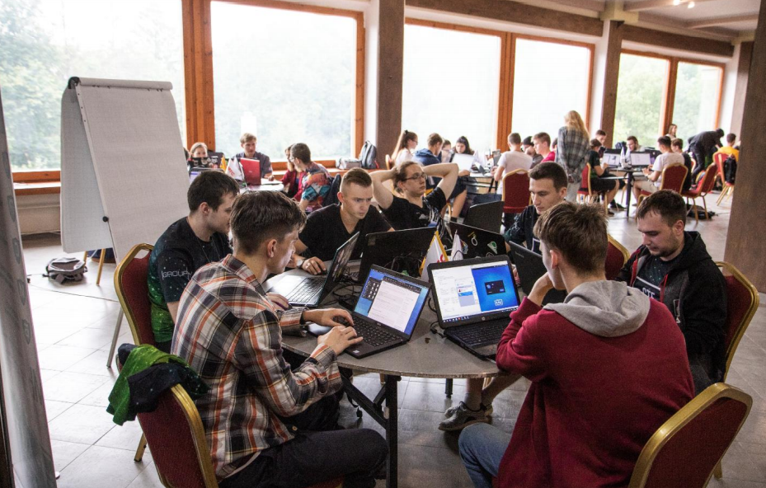
UASG Stakeholders for FY22
Technology enablers and developers
Email software and service providers, email administrators
Top-level domain registries and registrars
Academia
Government policymakers
See detailed plans in the UASG’s FY22 Action Plan

Slide 7
Need for Further Collaboration with ALAC
At-Large Advisory Committee (ALAC)
Around 80 countries have At-Large structures (ALSes), with around 40 ALSes are in each Regional At-Large Organization (RALO).
This presents a great opportunity to promote UA globally.
Collaboration
Help create awareness on the need for UA for the different RALOs and ALSes.
Encourage RALOs and ALSes to promote UA locally.
  UASG can support ALAC in developing UA materials for RALOs and ALSes.
    LACRALO’s UA Training Program is an example such collaboration.
Encourage members to adopt UA in their own systems.
Follow up with RALOs and ALSes to assess progress.
Is it possible to coordinate with ALSes and RALOs to organize an annual UA Day in collaboration with the UASG over next three years?

Slide 8
Questions for Discussion
Are the UASG’s suggestions reasonable for ALAC to adopt?
How can we convert this request into a collaborative plan that can be implemented?
How can the UASG enhance collaboration with ALAC to help promote and achieve UA-readiness?

Slide 9
Thank You!
Get involved:
  Join the UASG community email list: https://uasg.tech/subscribe
  Join a UASG working group: sign-up form
  Follow @UASGTech on social media
Contact the UASG:
  Email: info@uasg.tech
Universal Acceptance Steering Group info & recent developments: www.uasg.tech

