Slide 1

Operations, Finance and Budget Working Group (OFB-WG)
Holly Raiche - Chair

Slide 2

OFBWG - What we do
  Contributing to the coordination of annual additional budget requests (ABRs) from the ALAC and RALOs, to go into the yearly ICANN budget <- this is a task of the FBSC, by ALACs rules it must be a group formed by one ALAC member and one person designated by the RALO directive per region, chaired by the ALAC chair.
  Drafting any statement related to the ICANN budget process
  Drafting any statement regarding ICANN's operational initiatives
  Drafting any statement related to the ICANN strategic plan and processes, Support ICANN org in the strategic plan <- most of the work that we will do jointly with planning will not end in a statement.

Slide 3
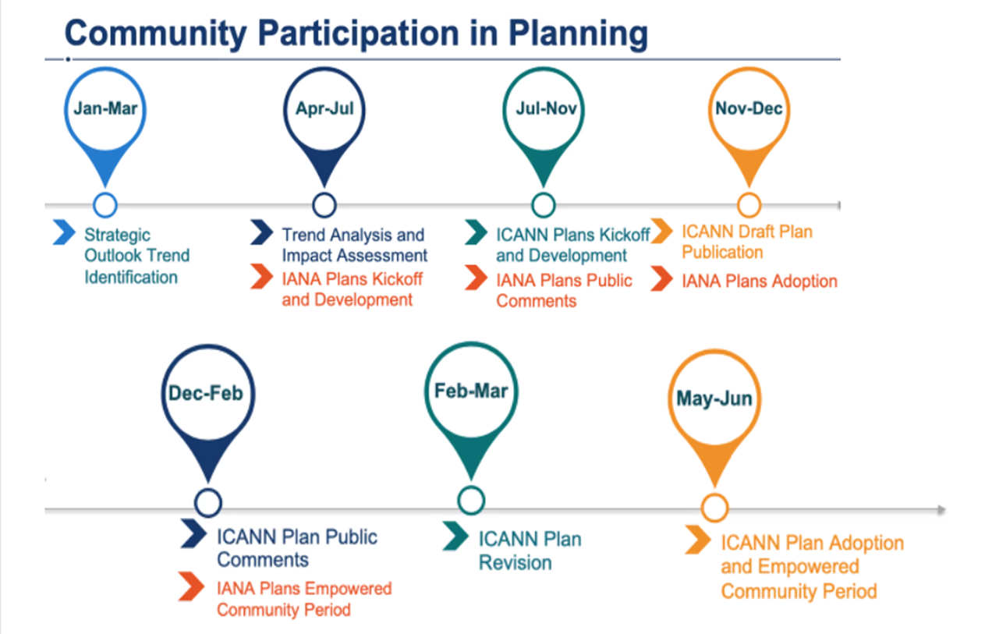
ICANN Planning Timetable

Slide 4
OFBWG - What we do
Strategic Planning
IANA & PTI Operating Plan and Budget
ICANN Operating Plan and Budget

Slide 5
OFBWG - Strategic Planning
To analyze the Operational Initiatives of the ICANN Operational Plan, and select those more relevant to ALAC/At-Large, to focus our resources. From the 15 Operating initiatives of ICANN the top 5 for At-Large are:
    Strengthen MSM - facilitate diverse and inclusive participation
    Strengthen ICANN Community’s Decision making processes
    Universal Acceptance (tied with 2)
    Planning at ICANN
    Monitor legislation, etc that may impact on ICANN’s mission
A subgroup is dedicated to thresher among the 200+ recommendations of the different reviews (Among them the ATRT3, WS2, CCTRT, SSR2 and Enhancing the Effectiveness of ICANN’s Multistakeholder Model)

Slide 6
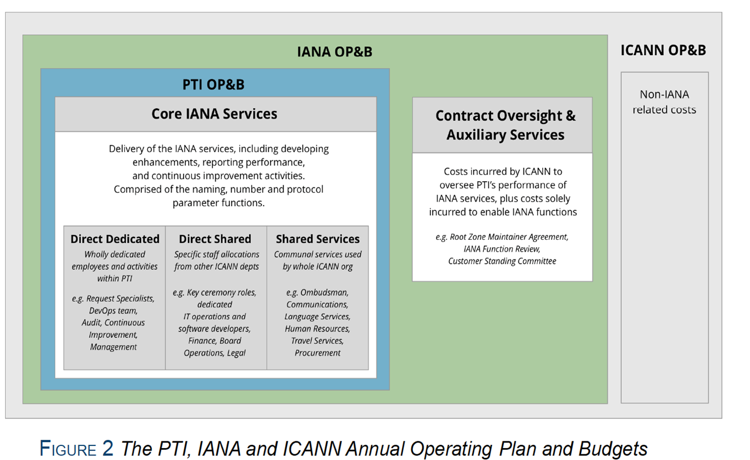
OFBWG - IANA & PTI Operating Plan and Budget
FY23 statement from ALAC is under construction

Slide 7
OFBWG – ICANN Operating Plan and Budget
FY23 is about to be released next month.
It includes a Budget for the whole org.
It also includes the operating initiatives mentioned before.
Important for At-Large:
  Incomes and expenses are consistent
  Different reserves are consistent
  Resources (money and people) is dedicated to the strategic activities, in particular the ones close to the user needs (MSM, Universal Acceptance, Strengthen ICANN Community’s Decision making processes)

Slide 8

Questions
Comments

