Slide 1

EURALO
Road Map
Board 14 September 2021

Slide 2

EURALO 2021/2022 Road Map
Updated by Sébastien on the 14th September 2021
Welcome and roll call - Staff (2 min)
IA (2 min)
EURALO General Assembly (2 min)
  2021
  2022
EURALO monthly Newsletter (2 min)
EURALO O&E 2021/2022 Road Map (2 min)
  Discretionary founding and CROP FY2022
EURALO & ICANN Meetings (45 min)
  EURALO Board (& TF) meetings
  Monthly RoundTables (by EURALO)
  ICANN72 EURALO lead Policy sessions
  ICANN72 EURALO readouts
  Next ICANN meetings
EURALO ABR Proposals FY2022 (5 min)
EURALO Elections (5 min)
EURALO Board members (1 min)
AOB (2 min)
AGENDA

Slide 3
EURALO 2021/2022 Road Map
EURALO GA 2021 & 2022
EURALO GA 2021
  Virtual 14 December 2021
  When do EGAP re-start the work for the preparation?
    September??
EURALO GA 2022
  Face to face
    Along with EuroDIG2022
      Dates? (if before end of June 2022)
    Along with ICANN74 – The Hague – Policy Forum
      13-16 June 2022
GAs

Slide 4
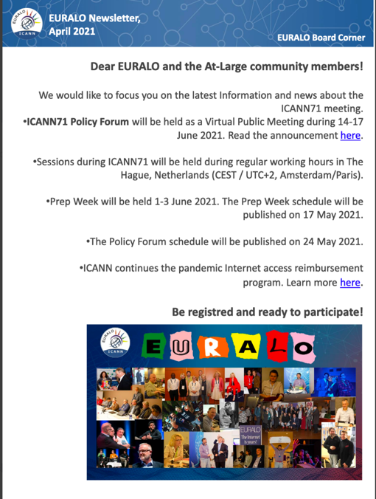
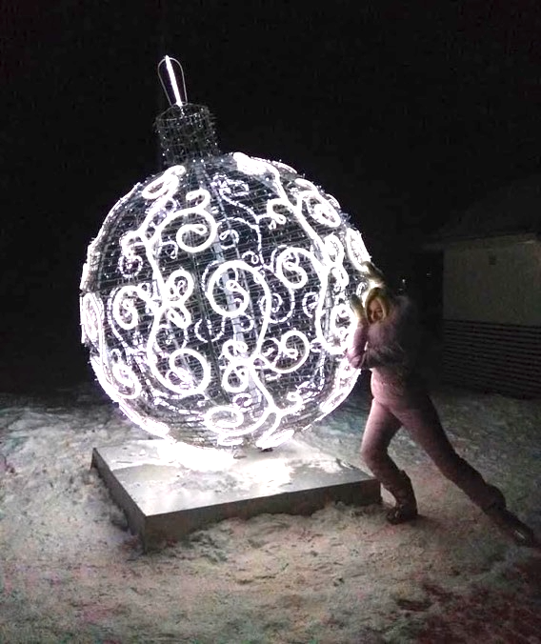

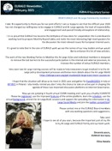
EURALO 2021/2022 Road Map
EURALO Monthly Newsletter

Slide 5
EURALO 2021/2022 Road Map
EURALO O&E 2021 & 2022
EURALO O&E 2021/2022
  Road Map
  At-Large Outreach Activities at the 2021 IGF in Katowice
  ALSes mobilization
  Individual (EU)RALO members mobilization
  CROP
  Discretionary founding
O&E

Slide 6
EURALO 2021/2022 Road Map
EURALO Meetings 2021 & 2022
Tuesday 14 September 2021 18:00-19:30 UTC: Board
Tuesday 21 September 2021 18:00-19:30 UTC
  Monthly RoundTable 7 (by EURALO):
  DNS Abuse and intermediary liability of non-hosting providers
Tuesday 28 September 2021 18:00-19:30 UTC: LT+EGAP
Tuesday 5 October 2021 18:00-19:30 UTC: Board
ICANN72 – Seattle – Annual General Meeting (23rd) - 23-28 October 2021
Pre-ICANN meeting – 12-14 October 2021
At-Large / ALAC meetings - 18-22 October 2021
  Policy session involving EURALO Leaders
    Tuesday 19 October 2021 – 17:00-18:30
    At-Large Policy Session 2: Tackling DNS Abuse – Joanna Kulesza
    Wednesday 20 October 2021 – 17:00-18:00 & 18:30-19:00
    At-Large Policy Session 3: ICANN Accountability and Transparency and the ICANN Reviews (part 1&2)
ICANN meeting – 25-28 October 2021
Q3&4

Slide 7
EURALO 2021/2022 Road Map
EURALO Meetings 2021 & 2022
Tuesday 9 November 2021 18:00-19:30 UTC: Readout?
Tuesday 16 November 2021 18:00-19:30 UTC
  Monthly RoundTable 8 (by EURALO):
  Encryption challenges in the French and European regulatory space – Lucien Castex
Tuesday 23 November 2021 18:00-19:30 UTC: LT
Tuesday 30 November 2021 18:00-19:30 UTC: Board - Preparation of EURALO vAG
Tuesday 7 December 2021: IGF Poland
Tuesday 14 December 2021: EURALO vAG (including Elections)
Tuesday 21 December 2021: New Board
Bye-bye 2021 next meeting in 2022
Q3&4

Slide 8
Monthly RoundTable 7 (by EURALO)
2021
Tuesday 21 September 2021 - 18:00-19:30 UTC
DNS Abuse and intermediary liability of non-hosting providers
  Introduction and welcome, Sebastien Bachollet, EURALO Chair (18:00 - 18:10)
  DNS Abuse and intermediary liability of non-hosting providers – where does the ICANN community fit in? (18:10 - 18:30)
  Tobias Mahler, UiO; Sebastian Felix Schwemer, Københavns Universitet
  DNS Abuse and the EC DSA package – crossing the picket fence of content control?
  Elena Plexida, VP, Government and IGO Engagement, ICANN, (18:30 - 18:45)
  Q&A, moderated by Joanna Kulesza, ALAC EURALO (18:45 - 19:15)
  Summary and wrap up, tbc, EURALO (19:25 - 19:30)

Slide 9
Monthly RoundTable 8 (by EURALO)
2021
Tuesday 16 November 2021 - 18:00-19:30 UTC
Monthly RoundTable 8 (by EURALO)
Encryption challenges in the French and European regulatory space
Moderator:
  Possible Speakers:
    Lucien Castex
Notes:
Chiffrement vs régulation des communications électroniques
14h15 Enjeux du chiffrement dans l'espace de régulation français et européen
par Lucien Castex,
Lucien Castex est représentant de l’Afnic pour les affaires publiques. Il a pour principales missions de représenter l'Afnic en France et à l’international, notamment dans le champ des politiques publiques liées au développement de l’internet et du numérique et de structurer les activités partenariales. Il est également chercheur à l’Université Sorbonne-Nouvelle - Paris 3 et enseigne le droit et les politiques du numérique.
A propos de la présentation
Le cadre juridique du chiffrement se situe au carrefour de débats juridiques, politiques et techniques en France comme en Europe interrogeant l’équilibre entre protection des droits et libertés, innovation et sécurité. Régulation d’internet, interception de sécurité, sanction du refus de remise d’une clef de chiffrement ou accès exceptionnel, cette présentation reviendra sur le cadre juridique du chiffrement à l’aune de ses enjeux politiques et sociaux.

Slide 10
ICANN72
At-Large policy session
ICANN accountability and transparency and the reviews
Tackling DNS Abuse

Slide 11
ICANN72
At-Large policy session 2
Proposal by JKA
Moderator Joanna Kulesza
Tackling DNS Abuse
This proposal aims to bridge the widening gap between policy development around activity considered abusive to the Domain Name System (DNS Abuse) and relevant legal and policy measures. With the overall goal of breaking the silos, it brings together technical community, governments and business from around the globe to offer different perspectives on DNS Abuse and platform liability. Looking at automated content moderation within platforms, is asks the questions of recommendable policy solutions to best address end user needs and concerns.

Slide 12
ICANN72
At-Large policy session 3
2 hours
Proposal by SeB
Moderators SeB and ?
ICANN accountability and transparency and the reviews
From ATRT3 & From the Board
What are the point of view of the constituencies of the ICANN community?
Discussion with the participants

Slide 13
A video to present « ICANN accountability and transparency and the reviews »
A video (15’) explaining
  ATRT3 recommendations and
  Board proposals
Including videos (3’ each) of
  Co-chairs of ATRT3
    Cheryl Langdon-Orr
    Pat Kane
  Board members
    Avri Doria
    Leon Sanchez
Ending with one or two questions
At the start of the At-Large Policy session 3
Who can help with the production of the PPT Video?

Slide 14
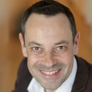

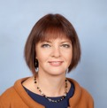
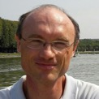
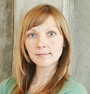



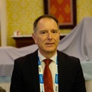
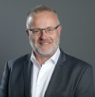

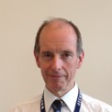
ICANN accountability and transparency and the reviews
At-Large policy session 3 - Part 1
Interpretation
English, Français, Español, Русский
Video 15’
A 3’ speech for each of constituency
Total 45’
  ASO 1
  ccNSO 1
  gNSO 4 + 1
  RSSAC 1
  SSAC 1
  GAC 1
  ALAC 1
  RALO 4
20 October 2021
17:00 - 18:00 UTC
180 s
Moderators
SeB and ?
SSAC
RSSAC
REGISTER HERE, INSCRIVEZ-VOUS ICI, REGISTRAR AQUÍ, ЗАРЕГИСТРИРУЙТЕСЬ ЗДЕСЬ
https://icann.zoom.us/meeting/register/tJYlduiqqT8pGNZT_tz_mympgdB5w9hGOX5k

Slide 15
ICANN accountability and transparency and the reviews
Plenary session - Part 2
Exchanges with the participants
Rooms by languages
  English with Russian
  French with Spanish
With Visio and Chat or
With tools like dashboard…?
Questions to get the temperature of the room?
Conclusion by the CEO
Total 1 hour
Moderators
SeB and ?

Slide 16


ICANN meetings & EURALO readouts
ICANN72 – Seattle – Annual General Meeting (23rd)
  23-28 October 2021
    EURALO ICANN72 Readouts (To be scheduled)
    Tuesday 9 November 2021 18:00-19:30 UTC

Slide 17
EURALO 2021
ICANN Meetings 2021 & 2022
ICANN70 – Cancun – Community Forum (Virtual)
  20-25 March 2021
ICANN71 – The Hague – Policy Forum (Virtual)
  14-17 June 2021
ICANN72 – Seattle – Annual General Meeting (23rd)
  23-28 October 2021
ICANN73 – San Juan – Community Forum
  5-10 March 2022
ICANN74 – The Hague – Policy Forum
  13-16 June 2022
ICANN75 – Kuala Lumpur – Annual General Meeting (24th)
  17-22 September 2022

Slide 18
EURALO 2022
ICANN74 – The Hague – Policy Forum - 13-16 June 2022
EURALO GA
EURALO Social Event
TBD
TBD
Chair
  Sébastien Bachollet
Members
  Yrjö Länsipuro
  Natalia Filina
  Lutz Donnerhacke
  Joanna Kulesza
  Wale Bakare
  Jonathan Zuck
  Olivier Crépin-Leblond
Chair
  Natalia Filina
Members
  Maté Mester
  Matthias Hudobnik
  Roberto Gaetano
  Jonathan Zuck
  Olivier Crépin-Leblond
  Sébastien Bachollet
Other EURALO Events?

Slide 19
EURALO 2022
-xx
EURALO Social Event
ICANN74 – The Hague – Policy Forum - 13-16 June 2021
  EURALO at ICANN74
EURALO social event
  Date: ? June 2022
  Time: TDB UTC – TBD CEST (90’)
  Duration : 90 minutes
  Format: ?
  Needs?
TF2

Slide 20
ICANN meetings &
EURALO sessions
-xx
ICANN71 – The Hague – Virtual Policy Forum - 14-17 June 2021
EURALO Policy Session
  16 June 2021 - 10:30-12:00 UTC - 12:30-14:00 CEST or 12:30-14:0 UTC - 14:30-16:00 CEST
  New gTLDs: Protection of geographical names in Europe
  Objective
    Respond to the Sub-Pro PDP on gTLDs to ensure that in the public interest European geo-names of all kinds, are not exposed to open speculative registrations allowed by ICANN.
    The session will endeavor to assess the risks of open, speculative delegations and the eventual costs to local communities and final users arising from the unregulated sale of 'premium' domains, or even the geo-TLDs themselves.
  Description
    The session will explore and report on the needs and interests of users for geographical identity, the existing scope and opportunities for legal protection, intellectual property aspects including AOC, and alpha3 codes in ISO3166 and ISO 4217, including for example, EUR.
  Introduction: Sébastien Bachollet (EURALO Chair)
  Moderator: Sandra Hoferichter (Medienstadt Leipzig e.V. & EURODIG)
  Panelists TBC
    GAC members
    Existing policy in a ccTLD
    Case study of a country that practices legal protection of geo names
    EU Commission: scope for legal protection through Applicable Local Law (c.f. GDPR)
    People involved in the .vin/.wine story
  Rapporteur
    Summary and conclusions, EURALO follow-up
      Christopher Wilkinson (ISOC Wallonia)
TBD

Slide 21
EURALO ABR Proposals FY2022
Board approval
At-Large FY22 Additional Budget Request Implementation Workspace
https://community.icann.org/display/atlarge/At-Large+FY22+Additional+Budget+Request+Implementation+Workspace
Protecting the Internet’s Unique Identifier System in an Age of Disinformation
  Joanna Kulesza
  15,000$
Diversity in ICANN Leadership bodies
  Sébastien Bachollet
  15,000$
Support participation of individual users in EURALO
  Roberto Gaetano
  7,500$
    https://community.icann.org/display/atlarge/At-Large+FY22+Budget+Development+Workspace

Slide 22
EURALO FY22
Additional Budget Request
Next Steps
27 July 2021

Slide 23
EURALO ABR Proposals FY2022
Proposals approved by the Board and org
At-Large FY22 Additional Budget Request Implementation Workspace
https://community.icann.org/display/atlarge/At-Large+FY22+Additional+Budget+Request+Implementation+Workspace
Protecting the Internet’s Unique Identifier System in an Age of Disinformation
  Joanna Kulesza
  15,000$
Diversity in ICANN Leadership bodies
  Sébastien Bachollet
  15,000$
Support participation of individual users in EURALO
  Roberto Gaetano
  7,500$
    https://community.icann.org/display/atlarge/At-Large+FY22+Budget+Development+Workspace

Slide 24
EURALO ABR Proposals FY2022
Diversity in ICANN Leadership Bodies
This is a recommendation for partial support.
  No travel support is approved for this request
ICANN org agrees with EURALO that enhancing diversity in ICANN community leadership bodies would benefit from additional data.
ICANN org encourages EURALO to work with the Policy Development Support function and Public Responsibility Support team to design a study about diversity in the context of the Work Stream 2 recommendations of the Cross-Community Working Group on Enhancing ICANN Accountability.
Working with ICANN org and within the limitations of the estimated support allocation, EURALO may engage either a diversity expert or a data analyst for this study as appropriate.
The study should incorporate a virtual workshop series open to the broader ICANN community. Findings from the study should be published.
EURALO is required to submit an initial report by 31 December 2021 and a final report by 30 June 2022 to abr-reports@icann.org
Ergys Ramaj, VP, Public Responsibility, will be adeed to the team

Slide 25
Enahancing Diversity in ICANN Leadership Bodies
EURALO Diversity ABR Call on 12 Aug at 17:00 UTC
Proposed agenda
  Team
    Sébastien Bachollet
    Policy Development Support function
    Public Responsibility Support team
      Ergys Ramaj, VP
      Betsy Andrews, Program Manager
    Com?
    External help
  Milestones
  Workshops (virtual)
  Diversity study design
  Data analyze
  Publications
    Initial report by 31 December 2021
    Final report by 30 June 2022

Slide 26
EURALO ABR Proposals FY2022
Protecting the Internet’s Unique Identifier System in an Age of Disinformation
This is a recommendation for partial support.
  No travel support is approved for this request.
ICANN org agrees with EURALO that it is important to identify “end user interests” in the investigation of the “impact of disinformation actors on the Internet’s unique identifier system and the response by public authorities and private actors” as it relates to geopolitical challenges to the mission of ICANN.
ICANN org encourages EURALO to work with the Policy Development Support function to develop two webinars to identify issues and explore solutions; the webinars should be open to the broader ICANN community. Working with the Language Services team, the webinars may include remote simultaneous interpretation in English, French, and Spanish.
EURALO is required to submit a report by 30 June 2022 to abr-reports@icann.org

Slide 27
EURALO ABR Proposals FY2022
Support Participation of Individual Users in EURALO
This is a recommendation for partial support.
ICANN org does not manage the EURALO website, and as such, is not in a position to assess the need for enhancements to the EURALO website, including translation of content.
ICANN org supports the engagement of EURALO individual members.
ICANN org already provides teleconference and virtual meeting support via Zoom to the ICANN community.
Please refer to Section 3.A.13 for more information about support for the “welcome package”.
Connected to the approved ABR on Community Communications Support.
For the ABR to support the Individual Users in EURALO we would like to ask Roberto for more clarity on the support that is being requested as well as offer some suggestions

Slide 28
EURALO 2022
EURALO 2021 ELECTIONS
ALAC
  Matthias Hudobnik
NomCom
  Yrjö Länsipuro
EURALO Chair
  Sébastien Bachollet (
EURALO Secretariat
  Natalia Filina
EURALO Board (to be organized for the EURALO GA in December 2021)
  Incumbents
    Anne-Marie Joly (France)
    Lutz Donnerhacke (Germany)
    Màté Mester (Hungary)
    Ricardo Holmquist (Spain)
    Wale Bakare (United Kingdom)

Slide 29
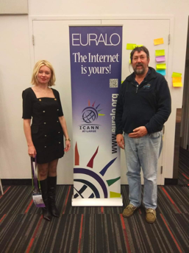

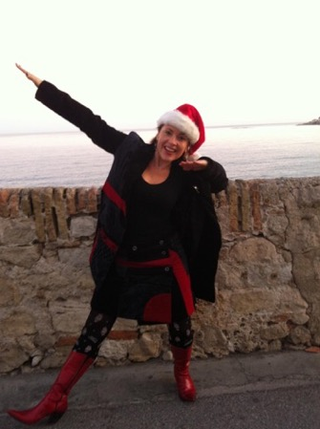









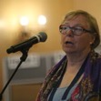
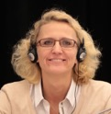



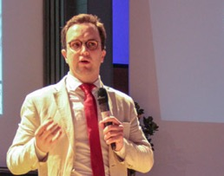

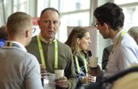
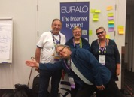





EURALO 2021

