Slide 1


ccTLDs: governance models
JUNE 2021une
ctld community webinar

Slide 2
TLDs
Top-Level Domains
ccTLDs
Country Code Top-Level Domains
gTLDs
Generic
Top-Level Domains

Slide 3
156.5 million ccTLDs
207 million gTLDs
Top 10 largest TLDs by number of reported domains contain 7 ccTLDs:
.com, .tk, .cn, .de, .net, .uk, .org, .nl, .ru, and .br
Volume 18 – issue 2 | June 2021 (source: Verisign DNIB)

Slide 4
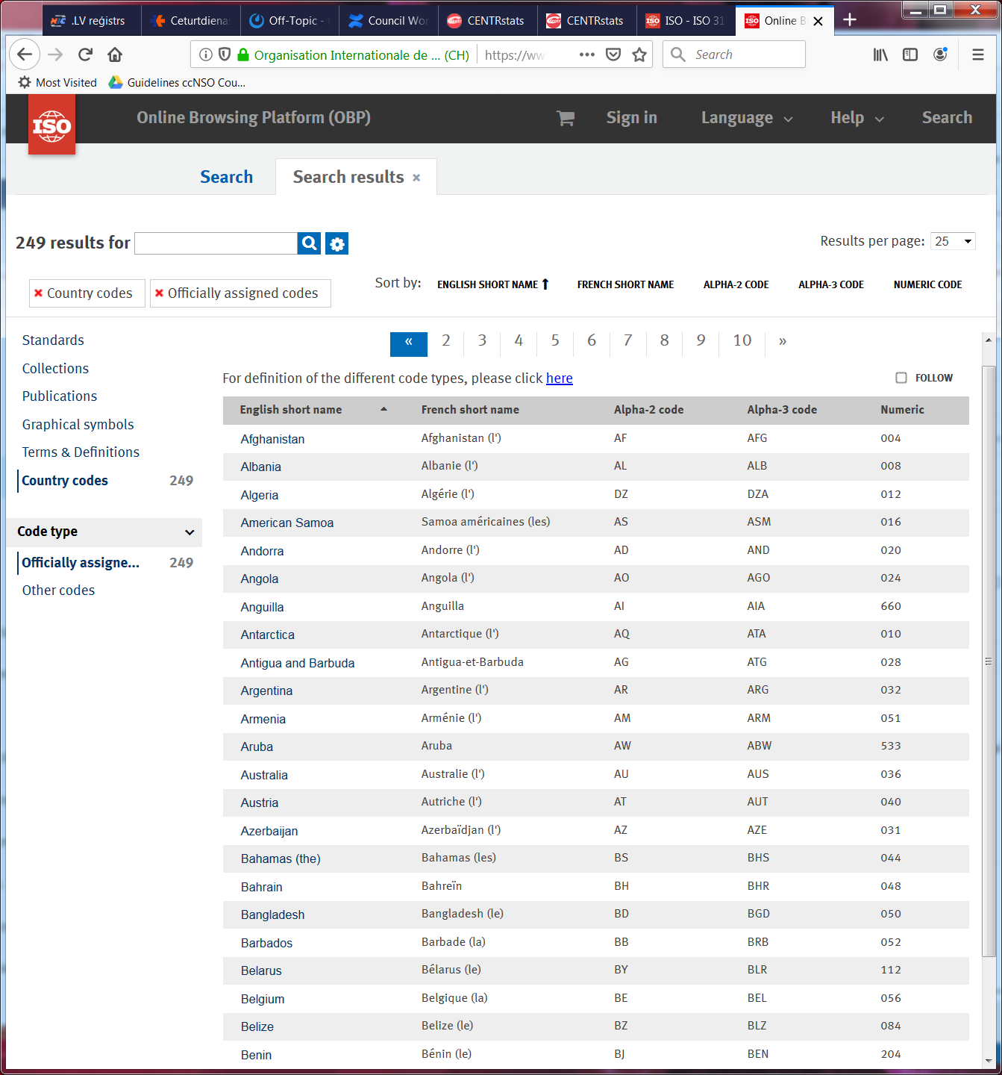
ISO 3166

Slide 5
ccTLD Manager
The organisation or entity listed in the IANA Rootzone Database under the heading ccTLD Manager

Slide 6
The ccTLD governance model is a collection of mechanisms, processes and relations of the ccTLD Manager and others, to control and operate the ccTLD.
-- ccNSO Members Meeting, ICANN69

Slide 7
4
Europe
North America
Asia/Australia/
Pacific
One size does not fit all!
Latin America/
Caribbean islands
2
Africa

Slide 8
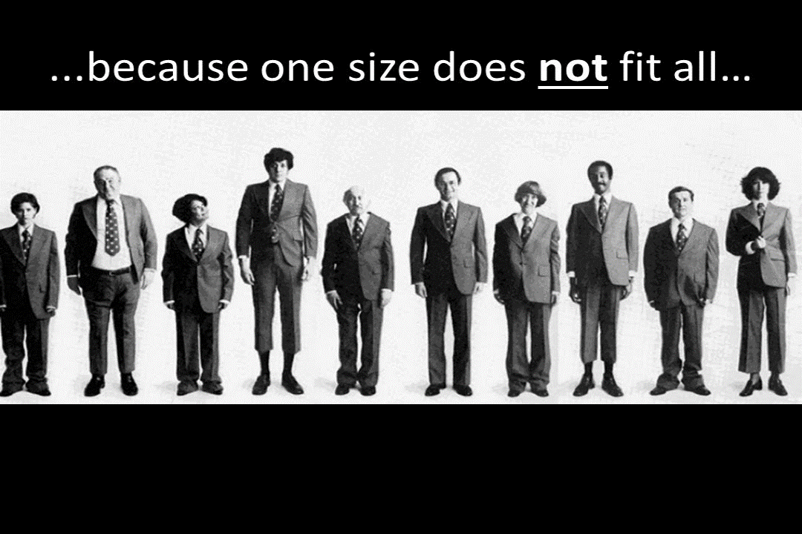

Slide 9
4
Europe
Local legal structure and laws
Local customs
Local public policy
North America
Asia/Australia/
Pacific
Latin America/
Caribbean islands
2
Africa

Slide 10
4
Europe
Local management and operation
Develop their own policy
Serve local internet community
North America
Asia/Australia/
Pacific
Latin America/
Caribbean islands
2
Africa

Slide 11
4
Europe
Registration model
Registrars, Direct registrations, Mixed
Management model
Combined policy and registration, separated policy and registration, outsources registration function
Legal structure
Not-for-profit,
for-profit,
governmental,
academic
North America
Asia/Australia/
Pacific
Latin America/
Caribbean islands
2
Africa

Slide 12
4
Europe
Legal structure
Not-for-profit,
for-profit,
governmental,
academic
North America
Asia/Australia/
Pacific
Latin America/
Caribbean islands
2
Africa

Slide 13
TECHNICAL COMPETENCY!
4
Europe
Legal structure
Not-for-profit,
for-profit,
governmental,
academic
North America
Asia/Australia/
Pacific
Latin America/
Caribbean islands
2
Africa

Slide 14
Disclaimer
The following data analysis is for informational purposes only.
It may not be accurate due to assumptions made about the legal nature of the ‘losing’ and ‘gaining’ registry. Please do not refer to these data as an authoritative source.
As different regional organisations use different models to describe the legal structure of ccTLD registries, in some cases necessary adjustments and assumptions were made. Although we believe that the data show the dominating trends in AF, AP, EU, and LAC regions, percentage of each governance models may not be accurate.

Slide 15
4
Europe
Not-for profit
Governmental
North America
Academic
Asia/Australia/
Pacific
For-profit
Latin America/
Caribbean islands
2
Africa

Slide 16
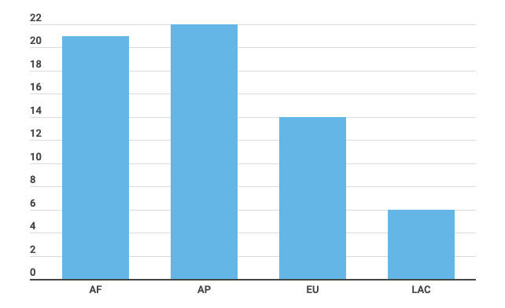
Total Number of Transfers since 2003

Slide 17
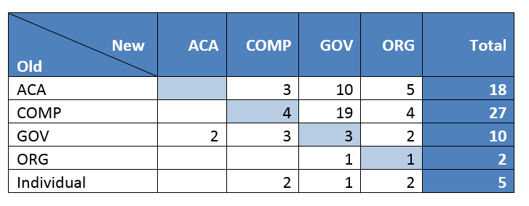
Changes to Legal Structure
ACA – academic institution, COMP – (private) company, GOV – governmental institution, ORG – not for profit organisation

Slide 18
Changes to Legal Structure
ACA – academic institution, COMP – (private) company, GOV – governmental institution, ORG – not for profit organisation

Slide 19
Changes to Legal Structure
ACA – academic institution, COMP – (private) company, GOV – governmental institution, ORG – not for profit organisation

Slide 20
Local legal structure and laws
Local customs
Local public policy
4
Europe
Local management and operation
Develop their own policy
Serve local internet community
North America
Registration model
Registrars, Direct registrations, Mixed
Management model
Combined policy and registration, separated policy and registration, outsources registration function
Legal structure
Not-for-profit,
for-profit,
governmental,
academic
Asia/Australia/
Pacific
Latin America/
Caribbean islands
2
Africa

Slide 21
Thank you!
ccnsosecretariat@icann.org

