Slide 1



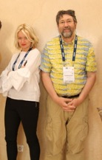
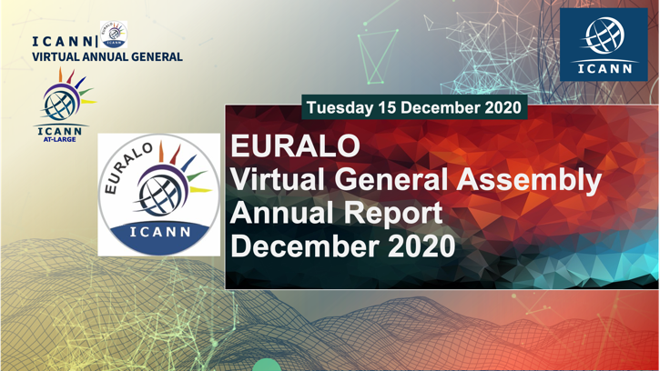
EURALO Annual Report, December 2020
Sébastien Bachollet (Chair) & Natalia Filina (Secretary)
EURALO December 2020
Dear EURALO members,
Please find the Annual report 2019-2020 of EURALO.
It was built with the Monthly Reports and the Newsletters published during this year.
Thanks to Natalia Filina for the accurate and beautiful realization and publication of those documents.
EURALO Secretariat is in excellent hands.
December 2020

Slide 2
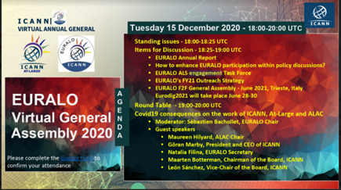
EURALO Annual Report, December 2020
EURALO Leadership
EURALO December 2020
EURALO
Sébastien Bachollet, Chair
  NomCom (ALAC/Euralo rep) 2021
  ATRT3 member and implementation shepherd
  New gTLDs Auction Proceeds (ccwg) member
  WS2 – Implementation shepherd
Natalia Filina, Secretariat
  ALAC Subcommittee on Outreach & Engagement
  Regional Vice-Chair Social Media Working Group
  At-Large Capacity Building Webinars WG
Olivier Crépin-Leblond, Former Chair
  Co-Chair of the At-Large Consolidated Policy WG
  Chair of the ICANN Engagement Group on Internet Governance
Roberto Gaetano
  Chair of Internet Individual Users Association
  Chair of the Unaffiliated Individuals Mobilization WP

Slide 3

EURALO Annual Report, December 2020
EURALO Leadership
EURALO December 2020
Pari Esfandiari
  Selected by NomCom – 2020-2022
Joanna Kulesza
  Selected by EURALO – 2020-2022
  Vice-Chair Outreach and Engagement
  Co-Chair Capacity Building Working Group
  ALAC Subcommittee on Appointee Selection member
Matthias Markus Hudobnik
  Selected by EURALO – 2019-2021
ALAC MEMBERS

Slide 4

EURALO Annual Report, December 2020
EURALO Leadership
EURALO December 2020
EURALO Board
Anne-Marie Joly-Bachollet
  ALAC Subcommittee on Appointee Selection member
Lutz Donnerhacke
  EURALO Operating Rules Taskforce (EROR TF) leader
Màté Mester
Ricardo Holmquist
  (Ex-)Chair of the At-Large Operations, Finance and Budget Working Group (OFBWG)
Wale Bakare
  Liaison to the ALAC Subcommittee on Finance and Budget (regarding ABR - Additional Budget Requests)

Slide 5
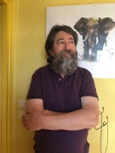
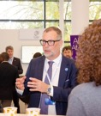
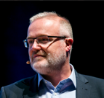
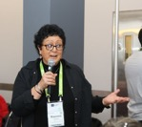


EURALO Annual Report, December 2020
EURALO Leadership
EURALO December 2020
NomCom Delegate, European Region
  Sébastien Bachollet (Starting on the 7th of December 2020)
ALAC Liaison
  Yrjö Länsipuro, to GAC
    Chair ALAC - GAC Coordination Working Group
    EURALO Task Force on At-Large Structure (ALS) engagement
  Andrei Kolesnikov, to SSAC
Other
  Sandra Hoferichter
    ICANN’s Leadership Training Program, where EURALO contributed substantially to its creation
Since our last (virtual) General Assembly (GA) in November 2019 in Berlin, the records of our regular activities on the basis of our monthly calls can be seen on EURALO’s Workspace and in our monthly reports
Round Table (EURALO vGA2020)
Covid19 consequences on the work of ICANN, At-Large and ALAC

Slide 6


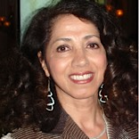

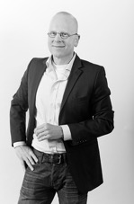
EURALO news
Pari Esfandiari new EURALO ALAC member selected by NomCom
Pari Esfandiari is the president and Co-Founder of the Global TechnoPolitics Forum, with a mission to shape the public debate and facilitate global coordination at the intersection of technology and geopolitics. She serves as Nonresident Senior Fellow at the Atlantic Council’s GeoTech Center. Her extensive international background includes leadership, advisory, and investment positions with organizations and corporations in China, Europe, the Middle East, and the United States. She is an innovative entrepreneur, sustainability and communications executive, and Internet pioneer and has worked across diverse industries ranging from FinTech and e-commerce to sustainability and smart cities. Her social enterprise was showcased by UNESCO and supported by the Google Foundation. Her article was nominated for the prestigious National Magazine Award.
She has a doctorate from Oxford Brookes University in
sustainable business and is an avid environmentalist.
“I am honored to serve at the At-Large Advisory Committee (ALAC) at
ICANN since November 2020. I knew of ICANN almost from
its beginnings. Over the years, I have eagerly followed its
evolution to this complex, scattered, multi-stakeholder,
bottom-up organization. It really could serve as a model for
our increasingly flat globalized world.
As a technology entrepreneur, I have encountered many issues that
are directly related to ICANN’s assignment of name and numbers and I am delighted with the opportunity to offer that perspective. As a policy advisor, I am well aware of digital technology’s impact on the fabric of our society, our democratic values, as well as on global geopolitics. There are huge differences in the economy, the ideological visions of the internet, and also fundamental cultural values that divide countries and influence their policies. The Regional At-Large Organization (RALO) structure within ICANN, offers the opportunity to understand these differences. Europe has shown leadership in its legislative approach, which makes me particularly proud to be part of EUROLA that represents this region. Internet governance is a complex subject where issues overlap, cut across policy areas, and even conflict.
My latest publication Data: Governance and Geopolitics (Dec. 2020) discuss these issues in detail”.
Pari Esfandiari
Bastiaan Goslings,
recently accepted a job at the Dutch Ministry of Economic Affairs and Climate as a senior policy advisor within the Directorate Digital Economy (cluster Cybersecurity and Continuity). Starting the 1st of December 2020.
Natalia Filina, EURALO Regional SMWG Vice Chair was leading the efforts to promote and engage At-Large and ICANN community during ICANN69. Report of Social Media Activities.

Slide 7
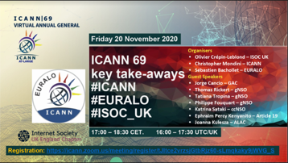
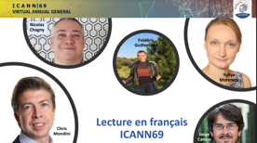
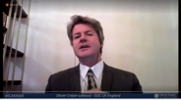


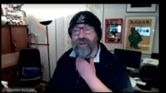
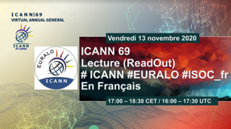
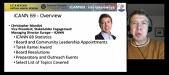

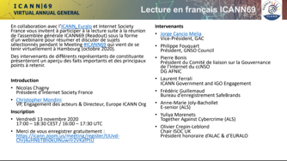

EURALO news
In November 2020
the Chair of EURALO Sebastien Bachollet successfully hosted 2 readout sessions “ICANN 69 Key Takeaways”:
in French (co-organized by ICANN, EURALO and ISOC France).
in English (co-organized by ICANN, EURALO and ISOC UK).
LIVESTREAM http://livestream.com/internetsociety/icann69takeaways

Slide 8



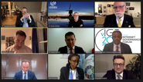
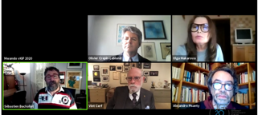
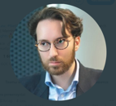
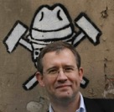

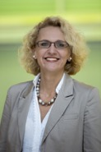

At-Large news
Fifteenth Annual Meeting of the Internet Governance Forum (IGF) hosted online by the United Nations under the overarching theme: Internet for human resilience and solidarity.
The first phase was hosted on 2-6 November and the second
one on 9-17 November. The IGF 2020 Outputs are available.
The At-Large and EURALO members took part in IGF2020 as session moderators, organizers, rapporteurs, experts, and participants of the discussions. You can find a list of sessions here.
All the IGF2020 sessions can be found in the recording on the YouTube channel https://www.youtube.com/user/igf
Multistakeholder Advisory Group
(MAG) of the IGF appointed for 2021 coming from Europe:
Lucien Castex (ISOC France, EURALO)
Adam Peake (ICANN, GSE)
Unique opportunity to participate in At-Large Capacity Building webinars.
You can find all completed 2020 CB Webinars are now on the playlist
How does multistakeholder advice development work at ICANN?
Check out our infographic to learn about the process

Slide 9
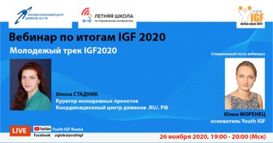
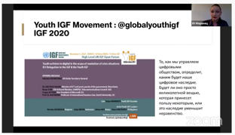
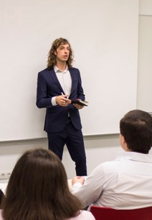
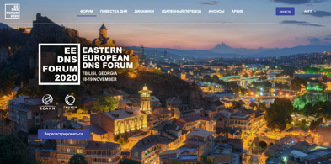
ALSs updates and European regional activities, Outreach
and Engagement work of Euralo members
On November 26, 2020 EURALO members
Filina Natalia and Yulia Morenets, founder of Youth IGF
took part in a Webinar on the results of the IGF2020 Youth track.
The webinar was organized by the coordination center of the ccTLD RU/РФ
The fifth Eastern European Domain Name System Forum (EEDNSF) online from 18-19 November 2020. Organized by ICANN in partnership with Caucasus Online.
The EEDNSF is part of ICANN’s regional outreach efforts to raise awareness about DNS-related issues; and collaborate with stakeholders through discussions on topics currently under development. The Forum bring together interested parties and experts to share experiences, and update participants on regional and global domain industry trends. This year’s program included the following key topics:
Regional focus on Internationalized Domain Names (IDNs) and Universal Acceptance (UA)
ICANN’s Identifier Technology Health Indicators (ITHI) and Health of the DNS Ecosystem
DNS Operations and Security
Business Continuity for Registries: A Regional Approach
Learn more about #ICANN’s evolving engagement and support in European regional Internet governance initiatives this year, in @becktweet
Andrea Beccalli's blog

Slide 10
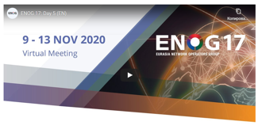
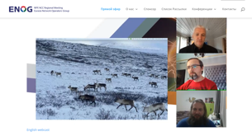
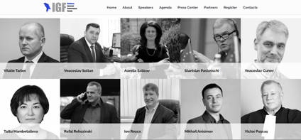
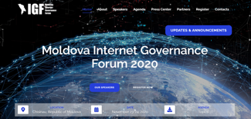

INDUSTRY and Partners` NEWS
ENOG 17 / RIPE NCC
Regional Meeting was a virtual meeting and took place from 9–13 Nov 2020
The ENOG 17 videos and slides can be found in the presentation archives
ENOG (Eurasian group of network operators) is a forum where technology experts from Eastern Europe, the Caucasus and Central Asia gather to discuss the key operational issues and share ideas on Internet development in the region
Moldova became the 88th country to launch a local IGF initiative
On November 23-24, 2020 the first national IGF was held in Chisinau
Moldova Internet Governance Forum – MIGF 2020
EuroDIG 2021 will be planned as a hybrid format, with both an on-site event in Trieste, and remote participation options.
While remote participation has been a longstanding practice, new ways to enhance this experience will build on the lessons learned in 2020.
We encourage you to participate in planning process an
help to make EuroDIG2021 successful!

Slide 11
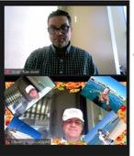
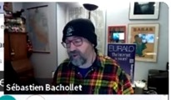
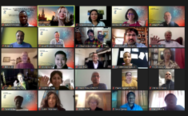
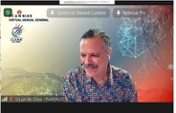
ICANN69 At-Large / EURALO news
EURALO members participate to a lot of activities during ICANN69
Even if it was only online. Thanks to all.
We would like to focus on ICANN69 At-Large sessions and topics that are important to our community, so we have prepared the following list & links
ICANN69 At-Large prep week sessions (5-8 October)
At-Large Social Media Webinar
At-Large ICANN69 Introduction Webinar
ICANN69 At-Large Community Days sessions (13-15 October)
At-Large Leadership session
At-Large Policy Session:
Recommendation Prioritization
Joint ALAC & NCSG Meeting:
ICANN and Human Rights - a way forward
The At-Large Community and DNS Abuse:
An Individual User Education Campaign
GNSO New gTLD Subsequent Procedures
ICANN At-Large: Ensuring
Community Engagement in Pandemic Times
At-Large Regional Leaders Meeting
ALAC Subcommittee on Outreach and Engagement
Dialoging into O&E

Slide 12
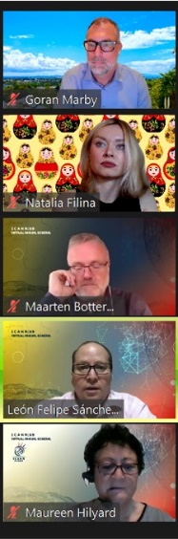
ICANN69 At-Large news
ICANN69 At-Large Plenary week sessions (19-22 October)
Joint ALAC & ICANN Board Meeting
PLENARY 1
The Domain Name Business:
Everything You Want to Know, Ask or Discuss
Coordinating the Internet unique identifiers and the interests of the Internet users
Community/Board Focus on ICANN meetings
ICANN69 Welcome Ceremony
PLENARY 2
The Domain Name System (DNS) Abuse
ALAC 2020: Achievements & Highlights
Remediating Universal Acceptance Issues
Joint ALAC & GAC Meeting
PLENARY 3
Consumer Protection Post Whois
GNSO Council Meeting
Engagement Group-Internet Governance (EG-IG) Session on
Digital Platforms and Regulation

Slide 13
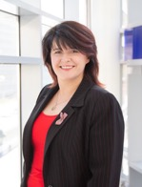
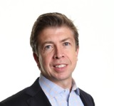
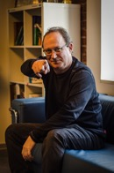
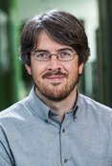
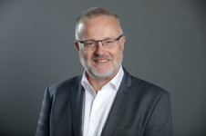
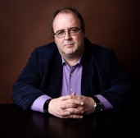
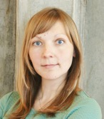
ICANN69 At-Large EURALO news
We thank EURALO Chairman Sébastien Bachollet for the excellent organization of two round tables where each speaker answered a question:
"Please point out one important topic for ICANN and its communities (in an European perspective) and explain why?”
European Perspectives on ICANN and Internet Governance –
A Stakeholder Roundtable hosted by EURALO, Part 1
Maarten Botterman – Chair of the ICANN Board
Katrina Sataki – Chair of the ccNSO
Andrei Kolesnikov – ALAC Liaison to the SSAC and SSAC Member
Tatiana Tropina – NCSG-NCUC, GNSO Council member
Chris Mondini – Vice President, Stakeholder Engagement, Europe – ICANN
Michele Neylon – GNSO Councillor; Registrars SG / CP
Jorge Cancio – Vice-Chair of the GAC
Natalia Filina – EURALO Secretary

Slide 14
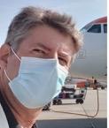
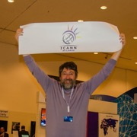
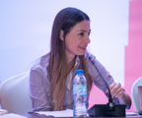
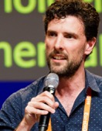
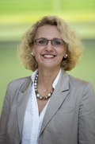
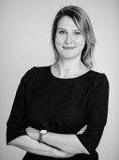
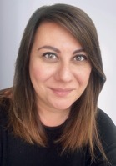
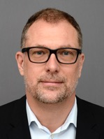
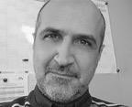

EURALO newsletter, October 2020
ICANN69 At-Large EURALO news
…And “As a European Leader of the ICANN community and participant to Internet Governance activities, can you point out one important topic for you or/and your group (in an ICANN perspective) and explain why?”
European Perspectives on ICANN and Internet Governance –
A Stakeholder Roundtable hosted by EURALO, Part 2
Olivier Crépin-Leblond – Chair of the ICANN Engagement Group on Internet Governance – At-Large - EURALO
Elena Plexida – Government and IGOs Engagement Sr Director – ICANN
Polina Malaja – Director – Centr
Ceren Ünal – Regional Policy Manager – Internet Society
Joanna Kulesza – Vice-Chair – ALAC – EURALO
Georgios Tselentis – Policy and Programme officer – Next Generation Internet and Internet Governance – European Commission
Pierre Bonis – Chair of the ccNSO Internet Governance Liaison Committee – AFNIC
Chris Buckridge – Head of External Relations – RIPE NCC
Göran Marby – President and CEO – ICANN

Slide 15









ICANN69 At-Large EURALO news
“Beyond Budapest: The UN Cybercrime Treaty and DNS Abuse“
This session looked into the progress and perspectives of the proposed UN cybercrime treaty and explores how it might impact ICANN’s mission and trying answers to these questions: How does DNS Abuse fit in with existing cybercrime frameworks, both: national and international? Can cybercrime laws be useful for fighting DNS Abuse? What are the opportunities for having the ICANN voice heard in international cybercrime discussions? Do we have opportunities for enhanced ICANN community input into this and similar processes that directly impact the effectiveness of our DNS Abuse mechanisms?
Joanna Kulezsa ALAC/EURALO
Thanks for the organization of the At-Large Policy Session
Alexander Seger
Head of the Cybercrime Division and Executive Secretary of the Cybercrime Convention Committee in Strasbourg, Council of Europe
Matthias Hudobnik
ALAC EURALO
Our Twitter competition winners

Slide 16






ALSs updates and European regional activities, Outreach
and Engagement work of Euralo members
On October 10, 2020, the Russian Association of Electronic Communications hosted a "Public debate on the Internet", where users of digital technologies discussed the most pressing issues of the "digital ecosystem".
The event is the Russian part of the international campaign
We the Internet, which includes 70 countries in 2020.
The main organization is Andrey Tscherbovich,
The lead moderator was Natalia Filina
https://runet-id.com/event/internet-debate20/
On October 28, 2020 Portulans Institute, in cooperation with UNESCO and ICANN-Europe held a panel with regional experts highlighting the progress Europe has achieved in terms of network readiness and digital transformation. In this panel, Portulans co-founders presented the 2020 Network Readiness Index results, highlighting regional data.
You can hear from global thought leaders about digital transformation and Covid-19 in Portulans’ Dialogue on Digital Transformation series.
https://portulansinstitute.org/nri-2020-digital-transformation-dialogues/
Sandra Hoferichter announced the “Guide-to-effective-participation-in-virtual-meetings” in English and German. This guide was drafted with support from the German Ministry of Economics and Energy, the host of last year’s IGF.
You can download and share widely under the creative common license CC BY-SA: German English
Virtual 12-14 May 2020

Slide 17









ALSs updates and European regional activities, Outreach
and Engagement work of Euralo members
On October 27, 2020 was held Internet Governance Forum in France
in October 2020 TaC International www.againstcybercrime.org
organized a series of webinars on cybersecurity and active involvement of young people in digital security issues 2020 https://www.facebook.com/globalyouthigf
On October 29, 2020 was held the 11th Internet Governance Forum in Ukraine
Virtual 12-14 May 2020

Slide 18






ALSs updates and European regional activities, Outreach
and Engagement work of Euralo members
On September 30, 2020 the Summer school on Internet Governance, organized by the Coordination center .RU together with St. Petersburg state University and MTUCI, finished its work. The school was attended by youth not only from Russia, but also from Kazakhstan, Belarus, Moldova and other countries. 38 people who will receive certificates of additional education from St. Petersburg state University have successfully completed Youth IGF School. Graduates of the school will be able to take part in IGF and join the upcoming educational and discussion projects of the Coordination center .RU
https://www.facebook.com/YouthIGrus
Website to find all the information about the results of the dialogue on Internet governance in South-Eastern Europe (SEEDIG) meeting
Virtual 12-14 May 2020
The latest issue of the SEEsummary covers Internet governance and digital policy developments that occurred in SEE+ in October 2020.
Industry news

Slide 19





EURALO Individual Users’ Association activities
We aim at providing a ‘home’ for individuals from all across Europe interested in engaging actively in ICANN policy development processes, as well as in the broader Internet Governance debate
This ‘home’ is also open to individuals Observers
from other regions than Europe
"Welcome package" project
Expertise spreadsheet of the EURALO members
Organization of the IGF2020 #271 sessions and
discussions on the topic "Universal Acceptance“
Organization and leadership of the
"Unaffiliated Individuals Mobilization WP"

Slide 20



EURALO news
Congratulations Olivier Crépin-Leblond Former Chair and Vice Chair of ICANN's At-Large Advisory Committee
Former EURALO Chair
Ex-officio EURALO Board member
Recipient of the 2020 Community Excellence Award*
ICANN news:
“The selection panel of representatives from ICANN Supporting Organizations and Advisory Committees recognized Crépin-Leblond's dedication to ICANN's multistakeholder model and long record of substantial contributions to the ICANN community. The panel noted his energy, enthusiasm, and willingness to engage across the diverse ICANN community contributed to his effective facilitation of community dialogues.
He has participated in a number of key ICANN policy development processes and working groups and was a member of the 2010 Nominating Committee. Long active in the Internet governance ecosystem, he is the Chair of the United Kingdom chapter of the Internet Society, a founder and Board member of the European Dialogue on Internet Governance (EuroDIG), and the current co-Chair of the Cross-Community Working Group on Internet Governance.
Crépin-Leblond is the founder of Global Information Highway, an Internet policy, services, and equipment consultancy.
ICANN Community Excellence Award Selection Panelist Margarita Valdés discusses the process for choosing the 2020 recipient
https://bit.ly/37WnRsX
Interview with Olivier Crépin-Leblond
*The Community Excellence Award honors members of the ICANN community who have invested in consensus-based solutions and contributed in a substantive way to policymaking within the ICANN ecosystem.

Slide 21






ICANN68
Congratulations to all At-Large winners of ICANN68 Social Media Working Group Twitter Competitions!!!
We thank Shreedeep Rayamajhi
(SMWG Chair ICANN68) & all members of Social Media WG and our activists for their incredible preparation and coordination of the community's work in social networks during ICANN68!
1 – Sebastien Bachollet (EURALO)
2 – Satish Babu (APRALO)
3 – Sarah Kiden (AFRALO)

Slide 22


ALSs updates and European regional activities, Outreach
and Engagement work of Euralo members
ISOC FRANCE
The Afnic Annual General Assembly held on 1 July 2020 2 elected 2 members of the Board of Trustees, one Users’ representative and one Registrars’ representative
Gandi SAS, represented by
Arnaud Franquinet, Chief Operating Officer, as Registrar
Internet Society France, represented by
Sébastien Bachollet, as User
OUR Congratulations!
INGO European Media Platform (EMP)
On June 7, 2019 the Diplomatic Academy of Ukraine hosted the presentation of “Integrating Ukraine into the European Digital Single Market: transforming impediments into the windows of opportunity” project outcomes. The event was attended by the representatives of Government Office for European and Euro-Atlantic Integration, the National Commission for the State Regulation of Communications and Informatization, the Ministry of Foreign Affairs, the State Agency on E-Governance, the Ukrainian Consumers’ Union, biggest mobile carriers and internet providers, as well as experts and civic activists. A resolution was adopted based on the roundtable discussion.
http://eump.org/media/2019/19-06-ua2dsm.pdf
EURALO is an institutional partner of EuroDIG.
EuroDIG virtual meeting June 10 – 12, 2020
Program
Virtual 12-14 May 2020

Slide 23
EURALO news
In April and May 2020 EURALO went through the 2020 At-Large Elections, Selections and Appointment process.
The separate EURALO elections page is https://community.icann.org/display/atlarge/2020+EURALO+Regional+Selections
EURALO Selection Timetable for 2020
27 April 2020 - Announcement of call for nominations and Nominee's Statement
27 April – 8 May 2020 - Nomination period (nominations accepted for 10 working days).
15 May 2020 - Deadline for nomination acceptances
18 May - 22 May 2020- Calls with the candidates if desired by the RALOs.
22 May - 29 May 2020 - Elections (If required, elections will begin no later than one week after the deadline for nomination acceptances and end no later than two weeks after that deadline).
The Interviews with candidates were undertaken during the EURALO monthly call on 19 May 2020
2020 AGM [ ICANN69 ] - Newly elected ALAC Members and RALOs Leaders shall be seated at the end of the 2020 AGM following the close of the Board Meeting on 22 October 2020.

Slide 24



ICANN/ALAC/EURALO news
The third Accountability and Transparency Review (ATRT3)
Final Report has been submitted to the ICANN Board
Five recommendations with regard to ICANN accountability and transparency
Prioritization of review and Cross-Community Working Group on Enhancing ICANN Accountability, Work Stream 2 (WS2) recommendations
Amending Specific & Organizational Reviews
Accountability and transparency relating to Strategic and Operational Plans including accountability indicators
Public input
Assessment of the implementation of ATRT2 recommendations
Members of the ATRT3 including
Euralo Chair Sébastien Bachollet
ICANN Global Newsletters for 2020
Including REGIONAL NEWSLETTER for
EUROPE, MIDDLE EAST AND AFRICA (EMEA)

Slide 25

ICANN updates
22-25 June 2020 will be held the
VIRTUAL POLICY FORUM ICANN68
Full schedule
PREP SESSIONS
Dates: 08-19 June 2020
During ICANN68, the At-Large community, including the At-Large Advisory Committee (ALAC) members, Regional At-Large Organization (RALO) leaders, and ALAC liaisons, holds 11 sessions to discuss policy issues of interest to At-Large and to individual Internet users.
The At-Large community also holds several sessions on:
DNS abuse, Public Interest Commitments (PICs) and PIC Dispute Resolution Procedure (PICDRP) improvements, new generic top-level domain (gTLD) applicants, and Universal Acceptance.
We encourage you to create your personal schedule and join ICANN68 At-Large Policy sessions

Slide 26


ALSs updates and European regional activities, Outreach
and Engagement work of Euralo members
TaC (Together against cybercrime International)
Online talk “Youth IGF Campaign against fake medicines online”
Speakers
Lousewies van der Laan
Ambassador Netherlands IGF
Former MEP & MP, Former ICANN Board
Jordi Iparraguirre
Innovation manager, EURid (.eu TLD)
Geo Van Langenhove
Legal manager, EURid (.eu TLD)
Moderators
Alexandre Bianquini do Amaral
Journalist & Filmmaker, MILEN
@Deutsche Welle Akademie
Yuliya Morenets
Founder TaC
Date: June 10, 3pm CET
Through a series of webinars, ISOC France invites you to think about today in terms of digital sovereignty, Internet governance methods, the digital education or open standards. The series of webinars will also be presented at the Internet governance Forum in France 2020.
June 9: "What is Internet Governance in the light of the Covid19 crisis?" with
Sébastien Bachollet
honorary President of ISOC France (EURALO Chair)
Olivier Crepin-Leblond
President of ISOC UK (Ex EURALO Chair)
Esther Ngom, President of ISOC Cameroon
June 16: "Digital sovereignty rethink" with
Lucien Castex
co-President of FGI France
June 23: "Shaping digital education for all" with Nicolas Chagny
President of ISOC France & CEO of WebForce3
July 1: "Promoting norms and standards discovered during the crisis and foreseeing FGI France 2020“
https://www.isoc.fr/webinaires-jour-apres/
Virtual 12-14 May 2020

Slide 27

EURALO news
EURALO Outreach Strategic plan for Fiscal Year 21
Framework
Euralo must be present in each and every country of our region and engage new people or new groups into the ICANN policy making process to strengthen the voice of Internet individual end-user.
The main goal is spreading a clear, interesting and useful information about Internet, ICANN activities, At-Large, ALAC and EURALO's role in the European regions and beyond, maintaining the current positive image, raising awareness and, as a result, growing the number and the quality active participation of European Internet individual end-user in the ICANN policy development.
All RALO`s Outreach Strategic plans for Fiscal Year 21
At-Large Regional FY21 Outreach and Engagement Strategic Plans
Euralo Outreach Strategic plan for Fiscal Year 21
https://community.icann.org/display/CRALO/EURALO+Regional+FY21+Outreach+and+Engagement+Strategic+Plan

Slide 28




ALSs updates and European regional activities, Outreach
and Engagement work of Euralo members
POLAND
Dr Joanna Kulesza organized series of virtual lectures in April for students at the University of Lodz about security in the Web with Patrick Jones, Adam Peake and about new gTLD with Gabriella Schittek
GERMANY
Cross-Pollination in Cyberspace & the Internet Governance "Spaghetti-Ball": How to Design a Global Mechanism for Digital Cooperation?
by Wolfgang Kleinwächter
ISOC Finland was the main organizer of an event
March 4th 2020 on the
Internet of Food

Slide 29







ICANN67 (vCancun)
At the end of February 2020 the Board of ICANN decided to avoid the risks of the threat of COVID19 spreading, protect the community and hold an ICANN67 meeting in a completely remote mode
ALAC MEETINGS @ICANN67
Cybersecurity and Geopolitics in a Multistakeholder Environment
In addition, a cross-community roundtable on the topic of “One World. One Internet?’ Cybersecurity and Geopolitics in a Multistakeholder Environment,” was led by Joanna Kulesza, ALAC Vice Chair for Capacity Building. During a time where the risk of the fragmentation of the Internet is increasing, states are taking more effective measures to ensure their jurisdiction over what they consider to be their part of cyberspace. It is in this context that ICANN’s global stewardship
role has grown more significant than ever. This session explored how to best justify ICANN policies in the face of global disruptive trends and to identify and present to the ICANN community a coherent, comprehensive narrative on why “One World. One Internet.” remains a valid narrative, and how to best communicate it to the different stakeholders outside ICANN.

Slide 30



ICANN67 (vCancun)
Photos from some ICANN67 participants from Europe
https://www.flickr.com/photos/icann/albums/72157713426698137
EURALO news
EURALO develops Outreach Strategic plan for Fiscal Year 21
The focus is to cover all regions of the Europe
to enhance the interaction between the EURALO ALSs and other members
A very convenient tool: the spreadsheet of expertise of ALS representatives and individuals
Your expertise is always welcome and useful
The list of expertise is a good opportunity for effective interaction & participation on highly specialized discussions and projects
It will help to analysis the EURALO potential

Slide 31



ICANN updates
ICANN announced Mikhail Anisimov joins ICANN organization as the Head of Global Stakeholder Engagement for Eastern Europe and Central Asia.
"Mikhail Anisimov is a well-known domain industry professional in Eastern Europe and Central Asia, and a long-time ICANN community member," said Sally Costerton, ICANN's Senior Vice President for Global Stakeholder Engagement. "He will continue to build on the great work of his predecessors, bringing his knowledge of Internet governance and the domain industry to our organization. I look forward to working with him to deepen ICANN's presence in the region.“
https://www.icann.org/news/announcement-2020-03-16-en
ICANN announced that The Hague, Netherlands has been selected as the location for the ICANN74 Policy Forum, to be held from 13-16 June 2022 at the World Forum The Hague.
https://www.icann.org/news/announcement-2020-03-13-en
MoU partners news
RIPE NCC
The RIPE 80 Meeting was the first ever fully virtual meeting
12-14 May 2020
Agenda was published for most sessions here: https://ripe80.ripe.net/programme/meeting-plan/
RIPE NCC
The RIPE NCC Executive Board has appointed Hans Petter Holen as the Managing Director of the RIPE NCC. Read the full announcement at: https://ripe.net/publications/news/announcements/hans-petter-holen-appointed-as-the-ripe-nccs-managing-director

Slide 32

EURALO news
The "Welcome package"
Individuals Internet Users Association
is working on of a guidebook for new community members
(Individuals or ALS members) and participants.
This Guidebook will help
To understand the place, role, purpose &
communication channels within ICANN of the
At-Large Advisory Committee, At-Large, EURALO
Individuals Internet Users Association
To find the set of required information
to learn how to start the interactions and
to get involved in the work process
To start to navigate all web
resources of ICANN and At-Large
To get to know the key people of
ICANN & IG community from Europe
To use an excellent open knowledge base
webinars, online courses, videos, infographics
and other learning resources
Interview with Chris Mondini
In February 2020,
during an ATRT3 working meeting in Brussels,
EURALO Chair Sebastien Bachollet
asked several questions to
ICANN Vice President, Stakeholder Engagement, Europe &
Managing Director for the Brussels, Belgium office, Chris Mondini.
https://community.icann.org/display/EURALO/Interview+with+EURALO+Chair+and+ICANN+GSE+VP+for+Europe

Slide 33








ALSs updates and European regional activities, Outreach
and Engagement work of Euralo members
Domain pulse 20-21 February 2020: Innsbruck, Austria.
Roberto Gaetano, Wolfgang Kleinwächter and Matthias Hudobnik
Three EURALO members participated in a panel
The next generation:
Lili Leisser, Elisabeth Schauermann and Matthias Hudobnik
Confront Internet Governance veterans
Maarten Botterman, Roberto Gaetano and Wolfgang Kleinwächter
with their ideas and concerns for a better Internet future.
Diversity in the area of Internet Governance
The importance of the young voice
- Agenda of the conference: https://domainpulse.at/dp2020/schedule
- Pictures of the conference: https://domainpulse.at/dp2020/fotogalerie
Safer Internet Day and Youth IGF Movement Russia
(Together against Cybercrime, EURALO ALS)
On February 18, 2020, at the Higher school of Economics (Moscow)
Discussion with 40 students of the E-Business course.
"Safety for kids on the Internet”
Opportunities to join the ranks of multistakeholders organizations
IGF, ISOC, ICANN, RIPE NCC…

Slide 34


.ORG
Ethos Capital Announces Accountability Initiatives to Secure a Strong Future for .ORG
https://www.keypointsabout.org/pressrelease
Video / Transcript of PIR Call (28,02,2020) with Gonzalo Camarillo
YOUTUBE: https://youtu.be/j4od1Ea0jVI (closed captions)
FULL TRANSCRIPT: https://isoc.live/bot/2020.02.28_ISOC_Chapter_Leaders_PIR_Discussion.pdf
DOWNLOAD: https://isoc.live/bot/2020.02.28_ISOC_Chapter_Leaders_PIR_Discussion.mp4
ICANN
From Jones day to PIR lawyer
https://www.icann.org/en/system/files/correspondence/levee-to-boglivi-13feb20-en.pdf
From Maarten Chair of the ICANN Board to Gonzalo Camarillo Chair, ISOC Board https://www.icann.org/en/system/files/correspondence/botterman-to-camarillo-13feb20-en.pdf
EURALO ALSs
Sale of .ORG: The Internet Society France is committed and remains vigilant and is calling to reconsider this sale by opening a broad consultation of the stakeholders
https://www.isoc.fr/vente-du-point-org/ (at the end of the page)
The ISOC Catalan Chapter regrets the ISOC Board’s decision to sell PIR
https://www.isoc.cat/isoc/pir-org-internet-society-ethos-capital-isoc-cat-point-of-view/
Other ISOC Chapters from Europe
The Swiss Chapter of ISOC has posted a statement here
https://www.isoc.ch/archives/3859
ICANN Board
Withholds Consent for a Change of Control of the Public Interest Registry (PIR)
30 April 2020 the ICANN Board made the decision to reject the proposed change of control and entity conversion request that Public Interest Registry (PIR) submitted to ICANN
https://www.icann.org/news/blog/icann-board-withholds-consent-for-a-change-of-control-of-the-public-interest-registry-pir

Slide 35


EURALO
In January 2020 was held EURALO Board Members Selection
In accordance with the rules and agreements applicable to this election
1. EURALO Board is 3-7 members, plus ex-officio, the EURALO Chair and Secretary
2. There is a maximum limit of 1 Board member per country
3. The voting takes place by secret ballot
4. The Board is selecting for a two-year term
The five EURALO Board Members selected are
Anne-Marie Joly (France)
Lutz Donnerhacke (Germany)
Màté Mester (Hungary)
Ricardo Holmquist (Spain)
Wale Bakare (United Kingdom)
Important NEWS/Appointments
CENTR
On February 12-13, 2020, the 63rd General Assembly of the Council of European national top-level domain registries (c) was held in the Slovenian capital of Ljubljana, which brought together more than 70 representatives of the national domain registries (members of CENTR). Also during the Assembly were introduced the new Vice President of ICANN in Europe, Chris Mondini. He visited the CENTR meeting to meet representatives of European national registries and talk about ICANN's plans in the European region.
https://twitter.com/CENTRnews/status/1227502700851425280
Chris Mondini
Appointed ICANN Vice President Stakeholder Engagement, Europe and Managing Director, Brussels
In his new role, Mondini will oversee ICANN org's operations in the region and will continue to lead ICANN org's Global Business Engagement initiatives worldwide. He brings an ideal mix of engagement and managerial experience to this role, along with language skills.
https://www.icann.org/news/announcement-2020-01-13-en

Slide 36


EURALO GA 2019 Berlin
EURALO GA2019, Berlin

Slide 37

Thank you, Merci, Gracias, спасибо
The next ICANN meeting taking place in Europe will be ICANN71 in The Hague, on 14-17 June 2021.
The evolving policy of ICANN and Global Stakeholder Engagement (GSE) department is that RALO General Assemblies should take place, at least for this cycle, preferably outside of an ICANN meeting.
As a result, the time/date identified for a Funded F2F EURALO General Assembly will be during EuroDIG21 in Trieste, Italy – 28-30 June 2021
Finally the Chair and Secretariat would like to thank the responsiveness of the Board and all of their help in making fast turnaround decisions. This body of 5 members plus ex-officio, has been solicited regularly.
And would like to warmly thanks Olivier Crépin-Leblond for his support to the new team.
Varzy
December 2020
Sébastien Bachollet
EURALO Chair
Moscow
December 2020
Natalia Filina
EURALO Secretariat

