Slide 1
Experiencing Indic Scripts
[An Ongoing Study with Special Thanks to ICANN]
Dr. T V Gopal
Professor
Department of Computer Science and Engineering
&
Co-Ordinator
Center for Research in Indic Technologies [CARIT]
College of Engineering, Guindy Campus
Anna University
Chennai – 600 025, INDIA
e-mail : gopal@annauniv.edu
Home Page : https://vidwan.inflibnet.ac.in/profile/57545
Note: Pantheism is the term used by Max Mueller to enshrine the faith systems in Indic
What is Indic? Please visit: https://www.annauniv.edu/CARIT/indic.php

Slide 2
Chances of a Variant [Label] becoming another Language Script

Slide 3
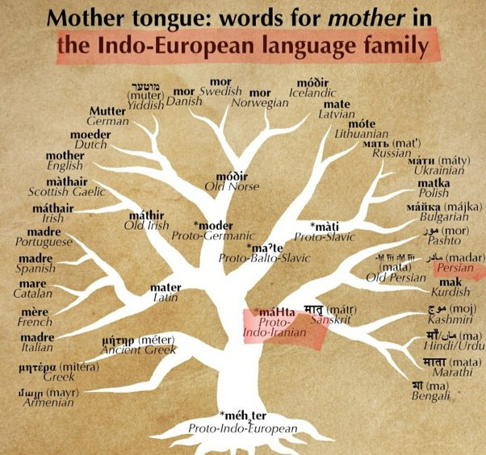

Slide 4
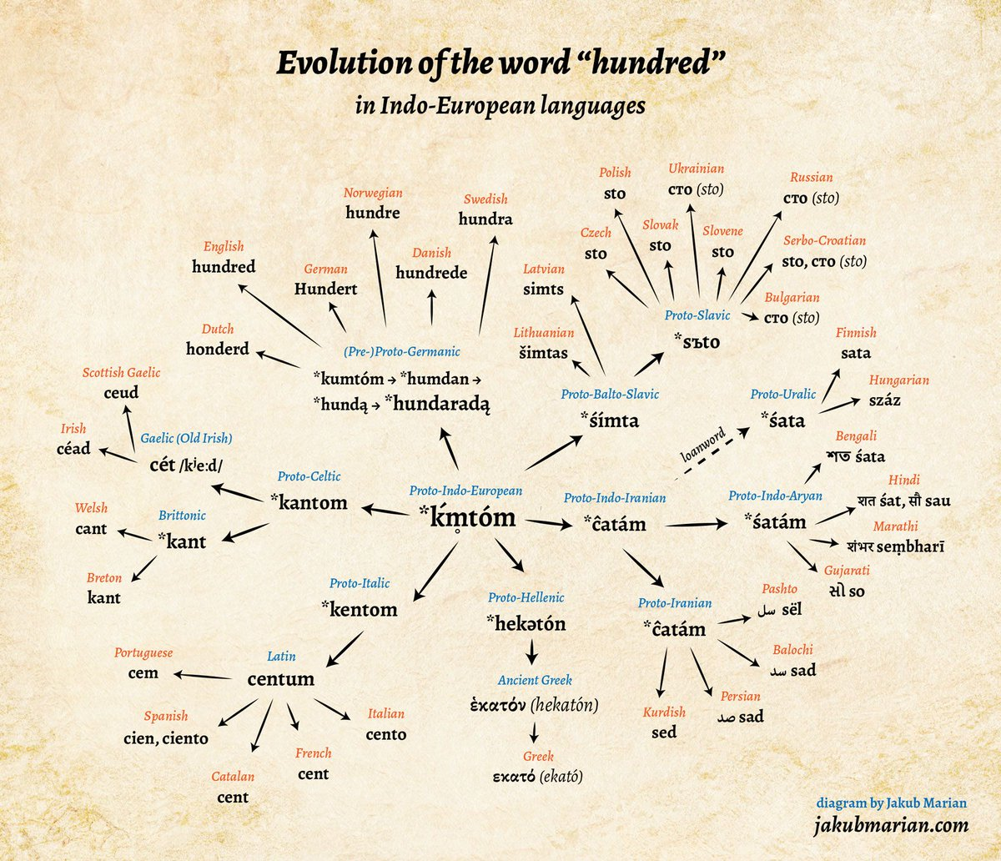

Slide 5
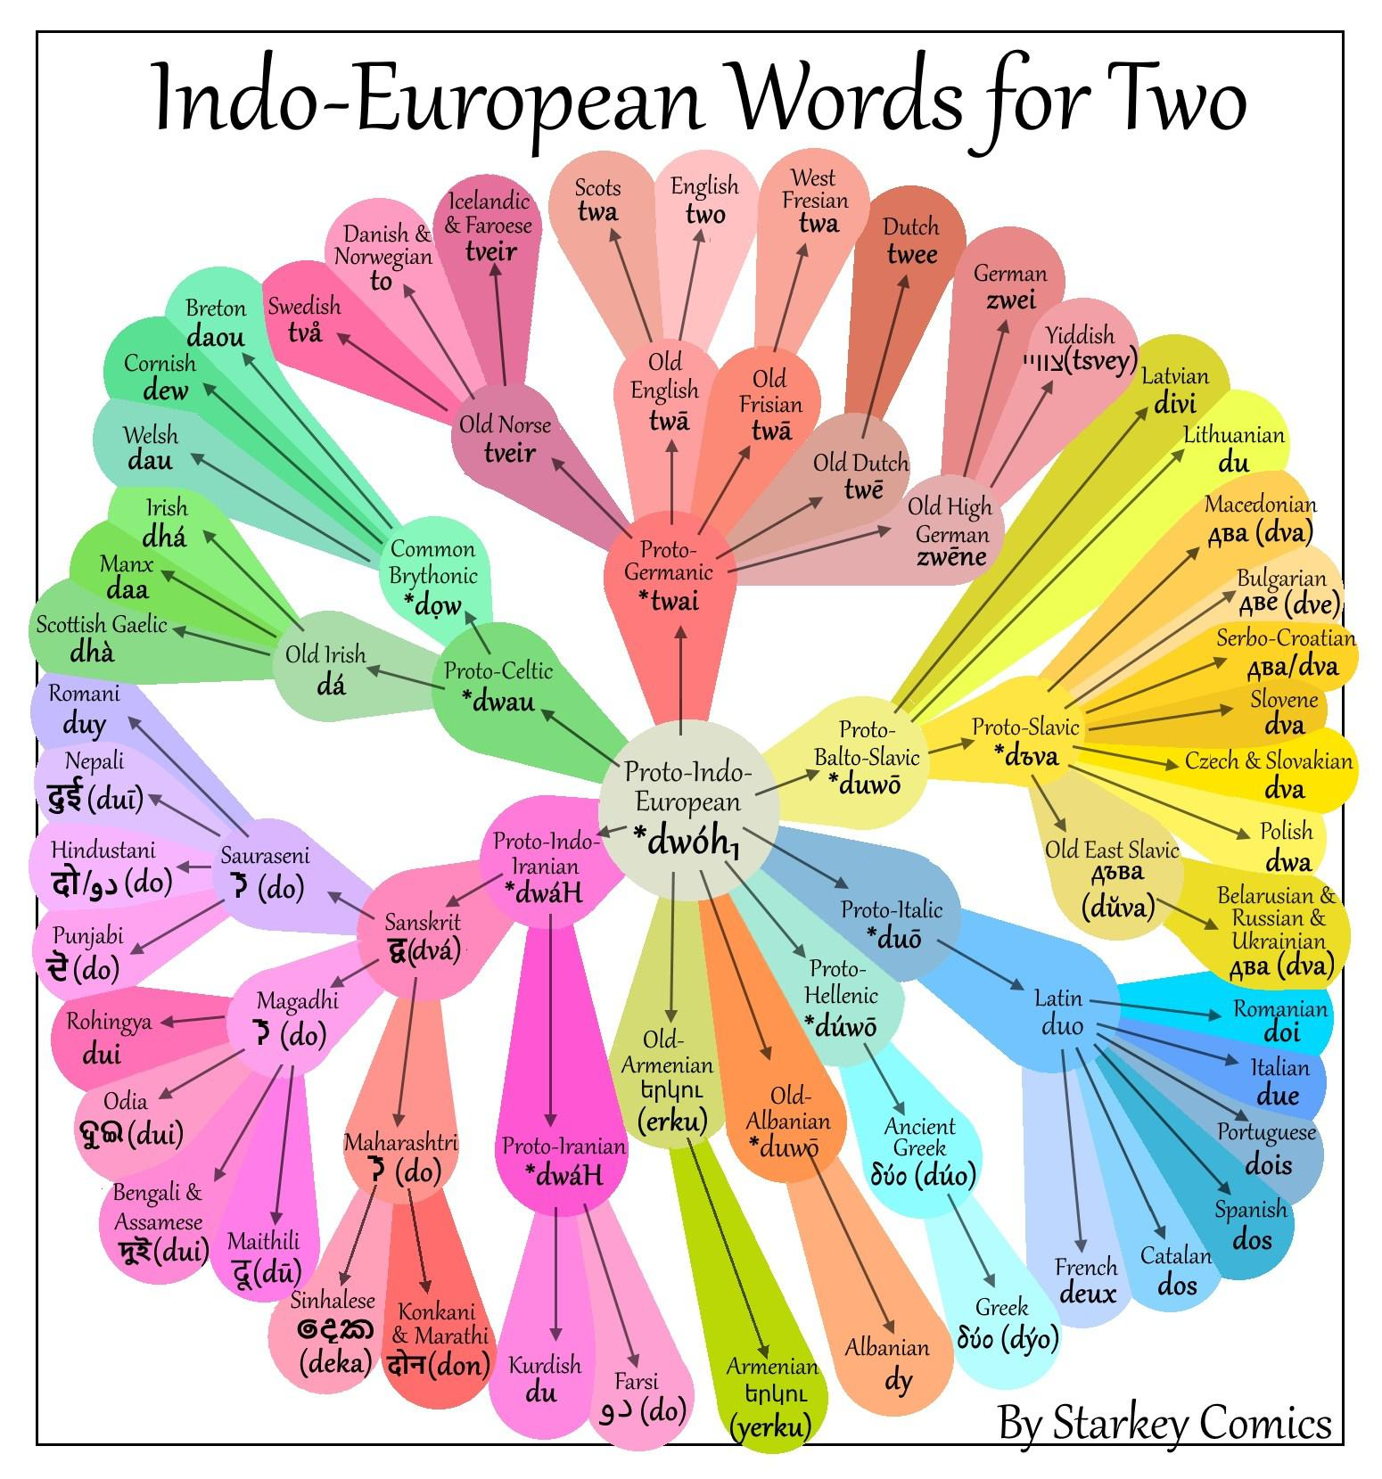

Slide 6
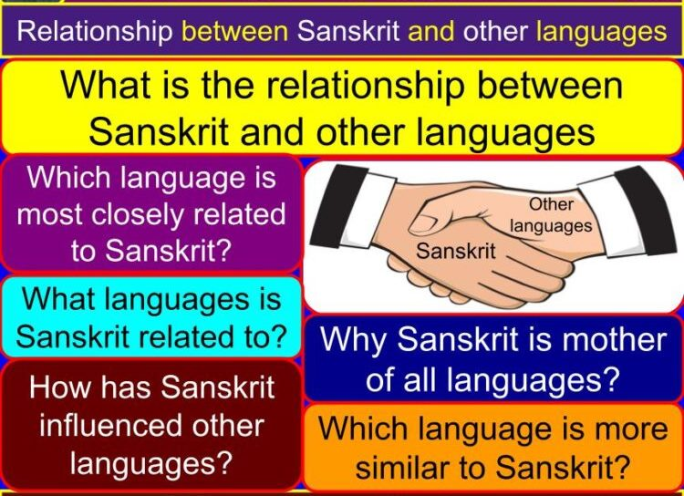

Slide 7
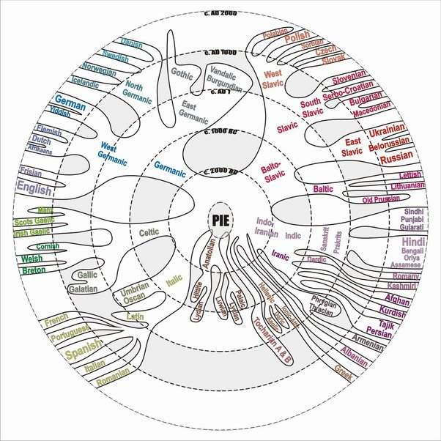
Age of Languages

Slide 8
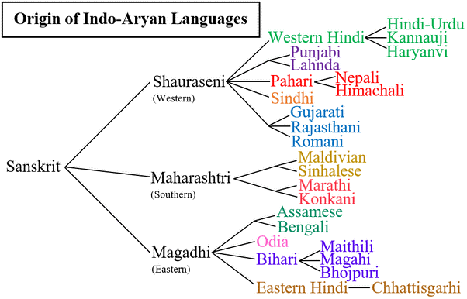

Slide 9
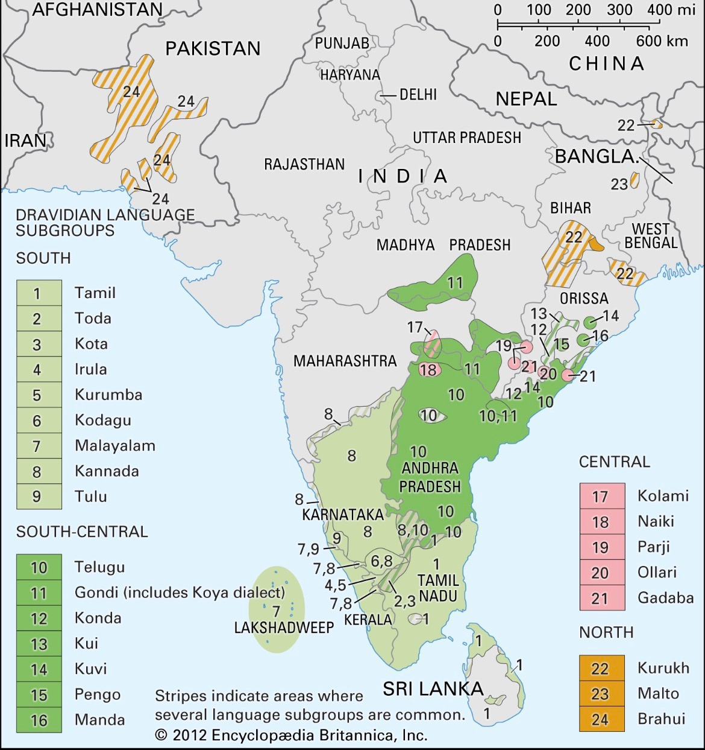

Slide 10
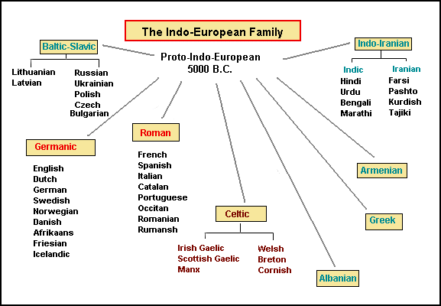

Slide 11
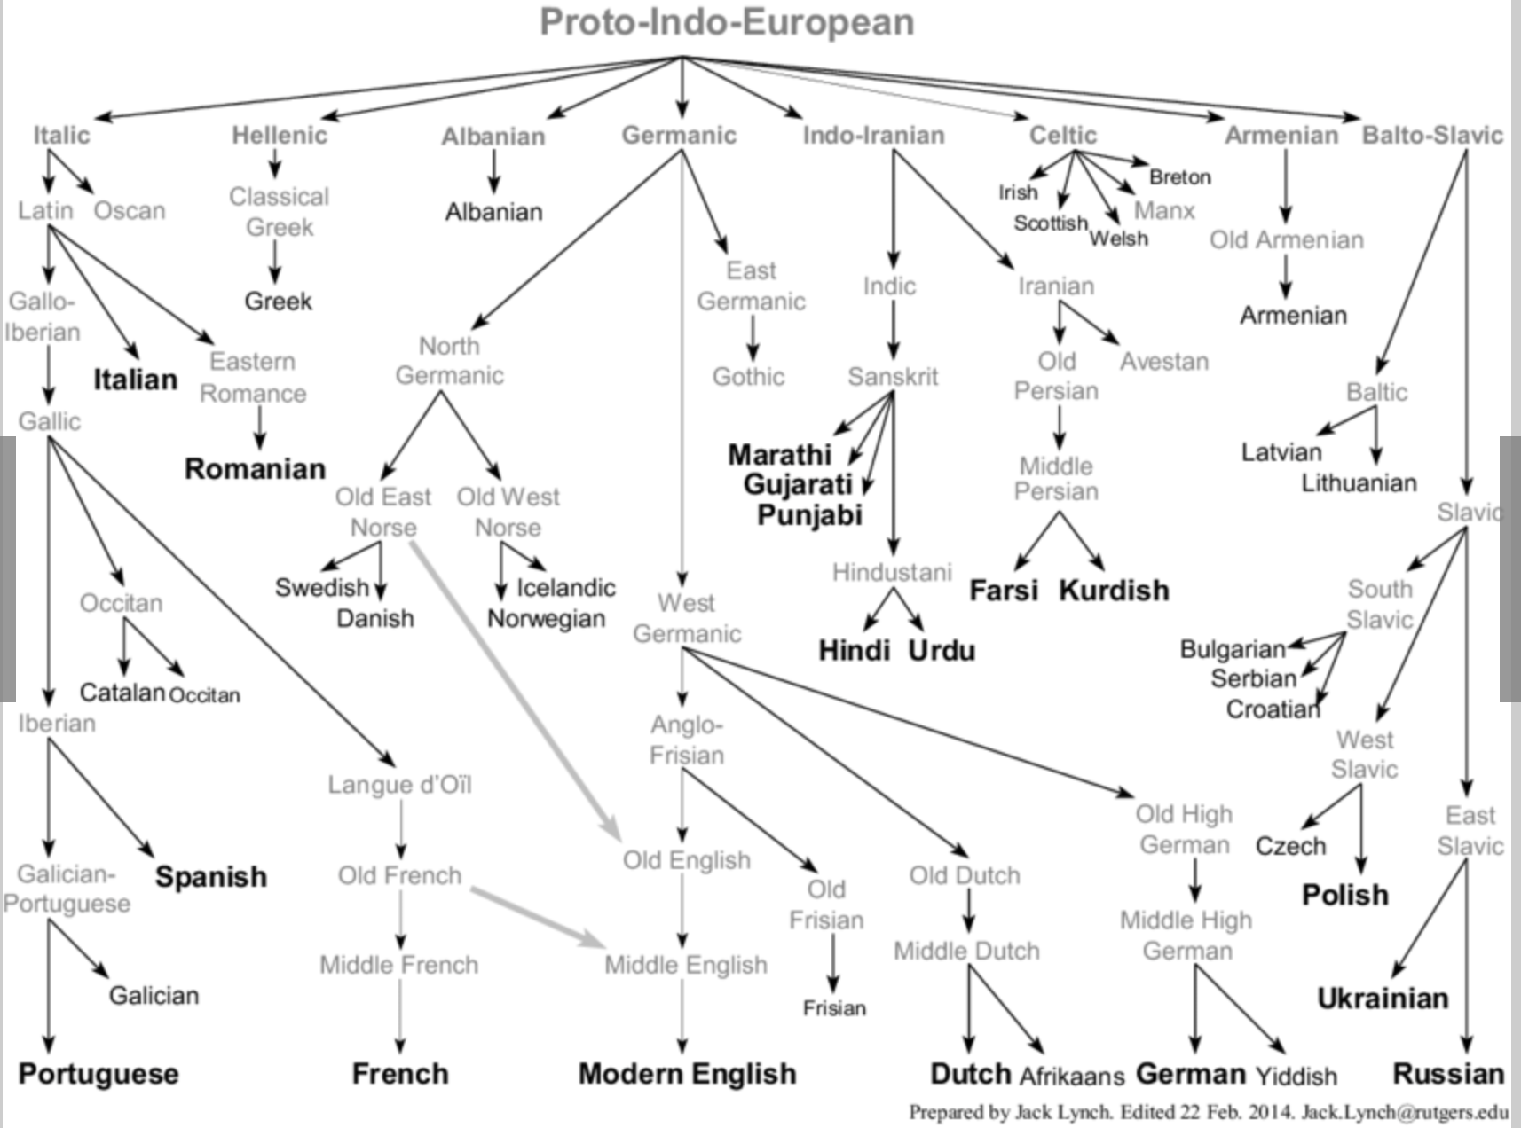

Slide 12
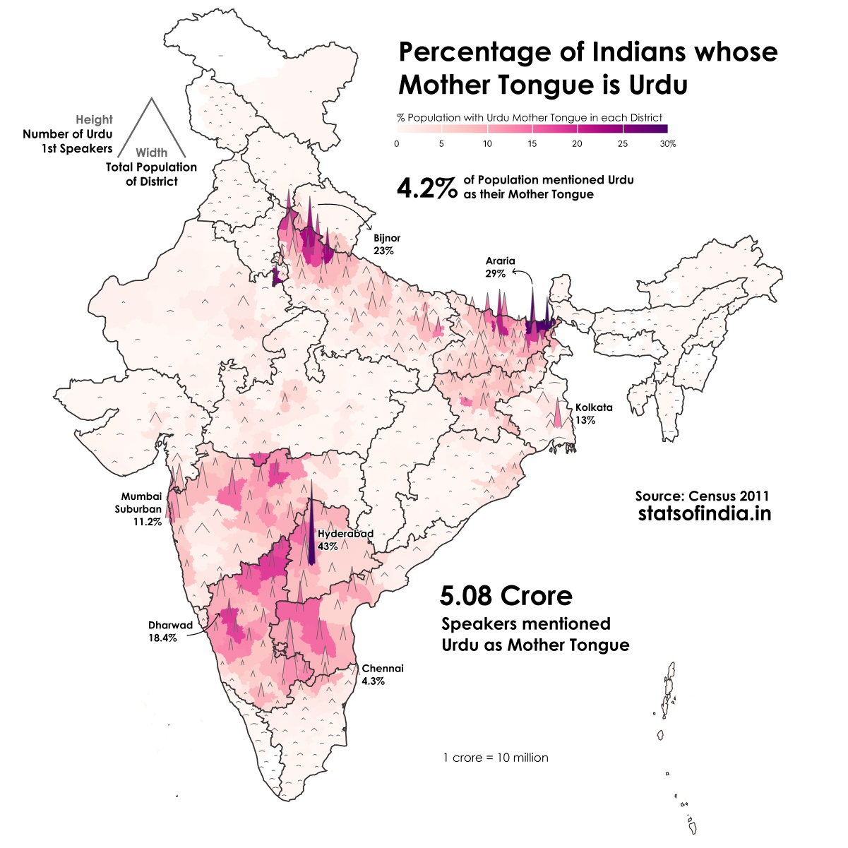
Included for Geopolitical Concerns with due regards to fellow academicians

Slide 13
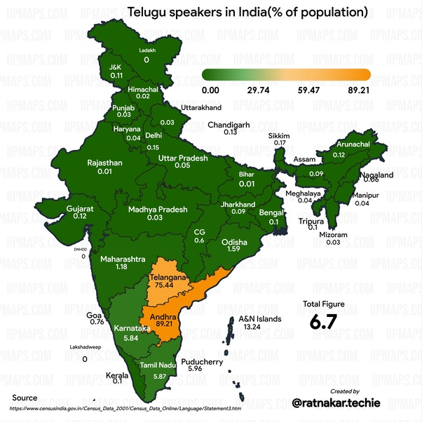
My Mother Tongue

Slide 14
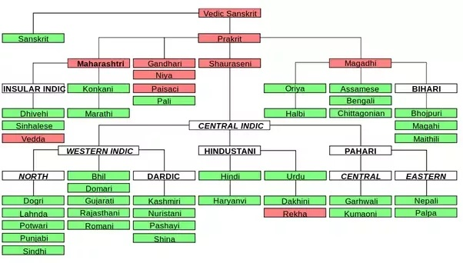
!!!
Thank
You

