Slide 1
Geonames – Etymology and Possible Impact on DNS
Dr. T V Gopal, Volunteer [APRALO] and
Professor, Department of Computer Science & Engineering
College of Engineering, Guindy Campus
Anna University, Chennai – 600 025, INDIA
E-mail: gopal@annauniv.edu ; gopal.tadepalli@gmail.com
(Mob): +91 - 9840121302
Ref: At-Large Consolidated Policy Working Group (CPWG) Single Issue Call: Jonathan Zuck on “GeoNames Survey”, Thursday, 04 June 2020 at 13:00 UTC

Slide 2
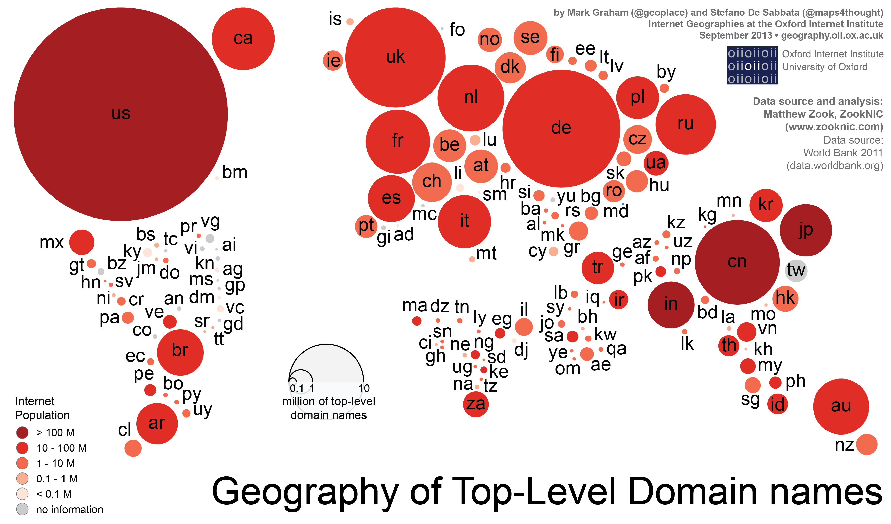
Useful to View in this manner by ICANN

Slide 3
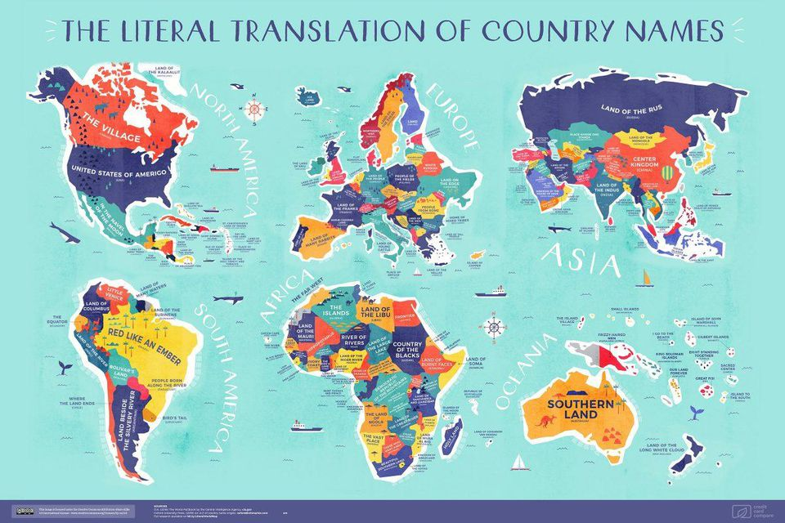

Slide 4
Etymology
Etymology - the origin of words - is a fascinating subject on its own.
Applying it geographically throws up many interesting, out-there and “intriguing” place names to ponder over, revel in and also laugh out loud.
It reveals a lot about the history of a land and its people, their suffering and success, whether they were conquered or conquerors, their origins and their lives.
It is bundle of “Tacit Knowledge” which is waiting to connect to “One World, One Net”

Slide 5
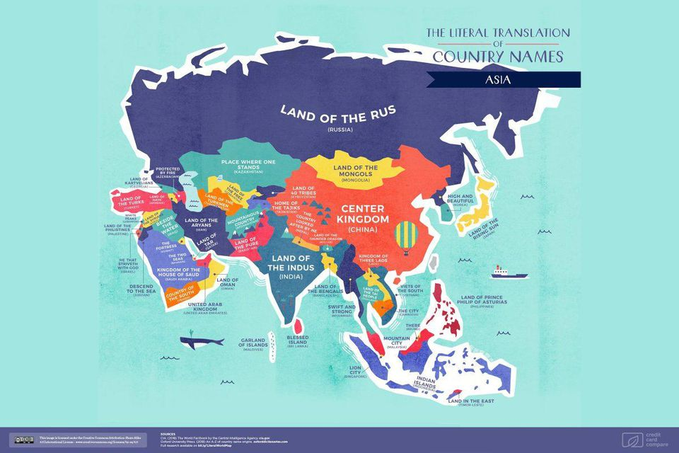

Slide 6
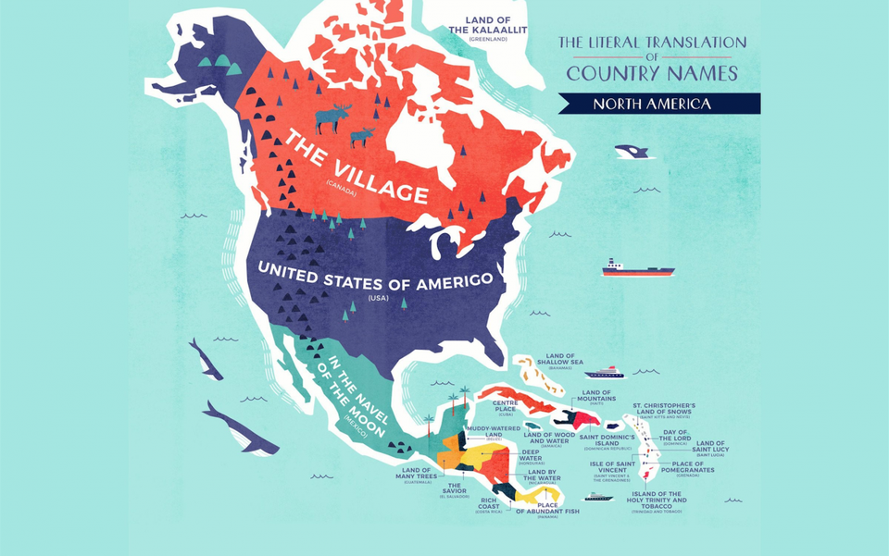

Slide 7
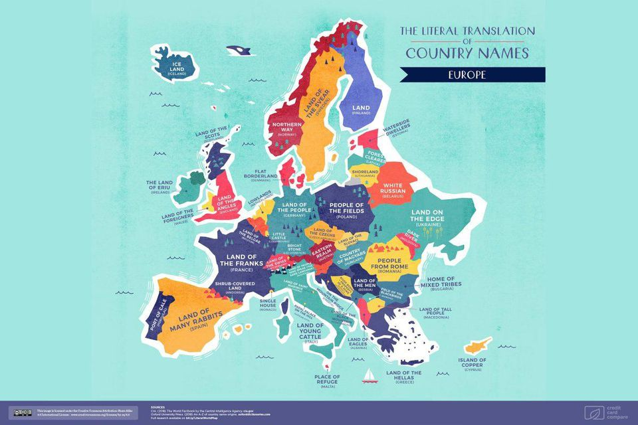

Slide 8
How does a country get its name?
Most countries in the world have been named after one of four things: an important person with some influence of the country or its history, a directional description of the country, a tribe or ethnic group, or a feature of its land.
Saint Lucia is the only sovereign state to be named after a woman.
Virgin Islands is named after Saint Ursula and the 11,000 Virgins.
https://en.wikipedia.org/wiki/List_of_country-name_etymologies
https://en.wikipedia.org/wiki/List_of_country_names_in_various_languages_(A-C)

Slide 9
ICANN Codes are Different https://en.wikipedia.org/wiki/Country_code_top-level_domain
UN Food and Agricultural Organization [FAO] - http://www.fao.org/countryprofiles/iso3list/en/
https://en.wikipedia.org/wiki/Lists_of_country_codes
International Olympic Committee [IOC] Codes:
https://en.wikipedia.org/wiki/List_of_IOC_country_codes

Slide 10
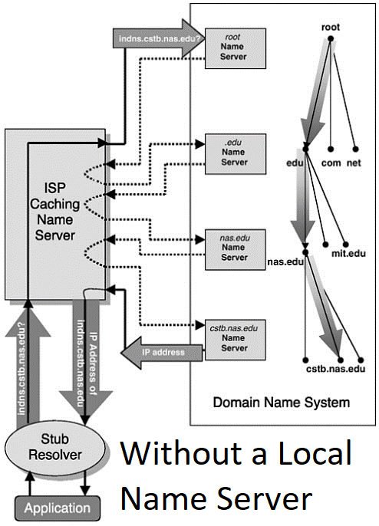
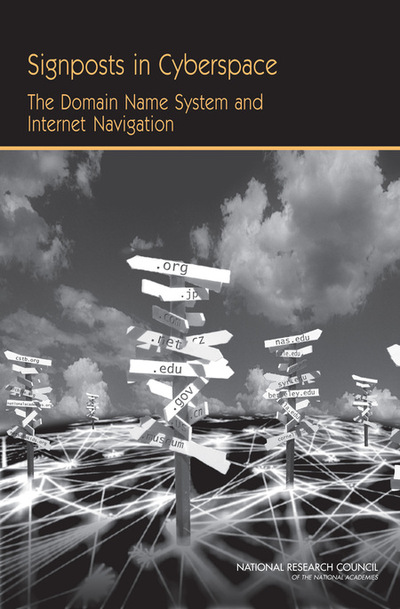

Slide 11
DNS @ Application Layer
[From Coding to Code Space]

