Slide 1



COVID-19
AND END-USER ISSUES
At-Large Capacity Building Session: DNS Abuse

Slide 2
Our speakers
Yrjö LÄNSIPURO, ALAC GAC Liason
Marita MOLL, ALAC NARALO
Moderator: Joanna KULESZA, ALAC EURALO

Slide 3
Our Objective
We want to explore whether the pandemic has impacted multistakeholder policy making and if so, how.
Does it impact how we work within ICANN?

Slide 4
The big problem
With governments taking enhanced measures to counter the pandemic (be it tracing apps or mobile surveillance), is there still space for MS decision making? Has this space changed in any way?
Has enhanced governmental control impacted IG/ICANN/end-users’ interest?
Are we in the same place that we were before the pandemic or has it impacted how we effective we are in developing policies?
Is there room for ICANN discussion on policy? Or should we just leave it governments because the crisis is so severe?

Slide 5
THE AGENDA
Welcome and introduction - Joanna Kulesza (02:00 UTC – 02:10 UTC)
Protecting individual end user interests in the time of pandemic – challenges and solutions - Yrjö LÄNSIPURO, ALAC GAC liason (02:10 UTC – 02:30 UTC)
How do governments protect individual rights in the time of the pandemic? How do ICTs fit in? - Joanna KULESZA, ALAC EURALO (02:30 UTC – 02:50 UTC)
Has COVID-19 redefined MS consensus development? Can we still make decisions bottom up when public health and security are at stake? - Marita MOLL, ALAC NARALO (02:50 UTC – 03:10 UTC)
Q&A (03:10 – 03:25)
Summary and takeaways - Joanna Kulesza (03:25 – 03:30)

Slide 6
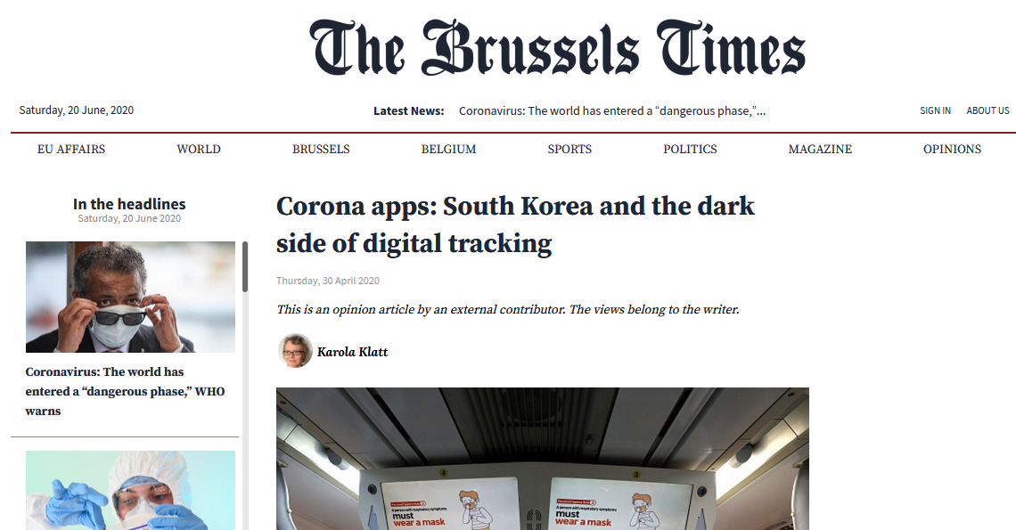
CONTEXT
Technical measures used by states

Slide 7
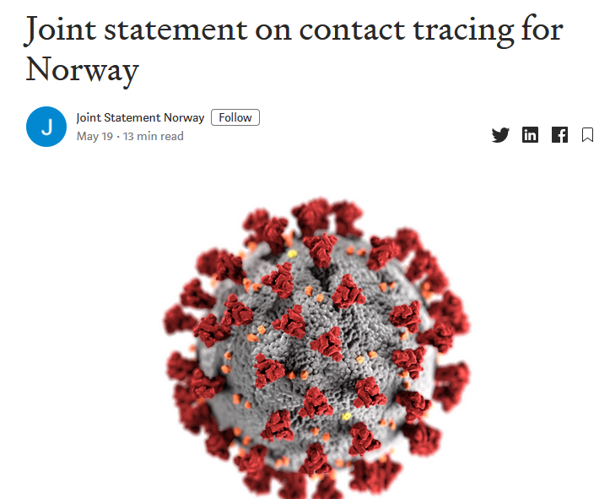
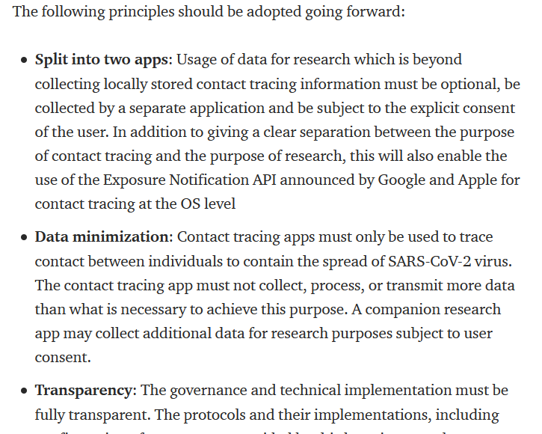
CONTEXT
Tracing apps?

Slide 8
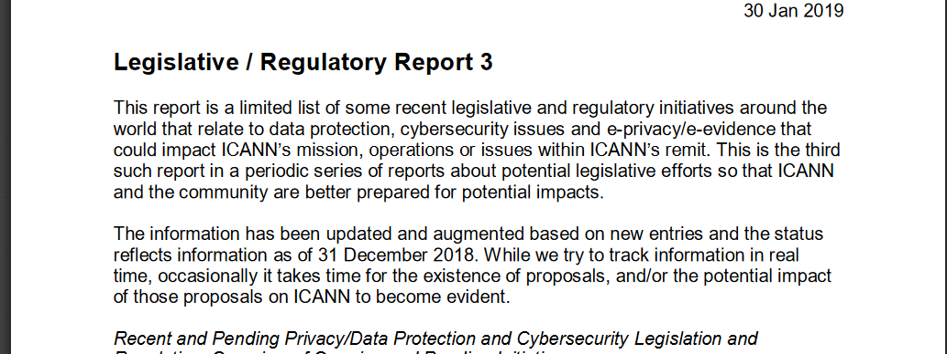
CONTEXT
ICANN monitoring relevant legislative measures

Slide 9
COVID-19
AND END-USER ISSUES
Protecting individual end user interests in the time of pandemic – challenges and solutions
Yrjö LÄNSIPURO, ALAC GAC liason

Slide 10
COVID-19
AND END-USER ISSUES
How do governments protect individual rights in the time of the pandemic? How do ICTs fit in? Joanna KULESZA, ALAC EURALO, EU’s FRA SC

Slide 11
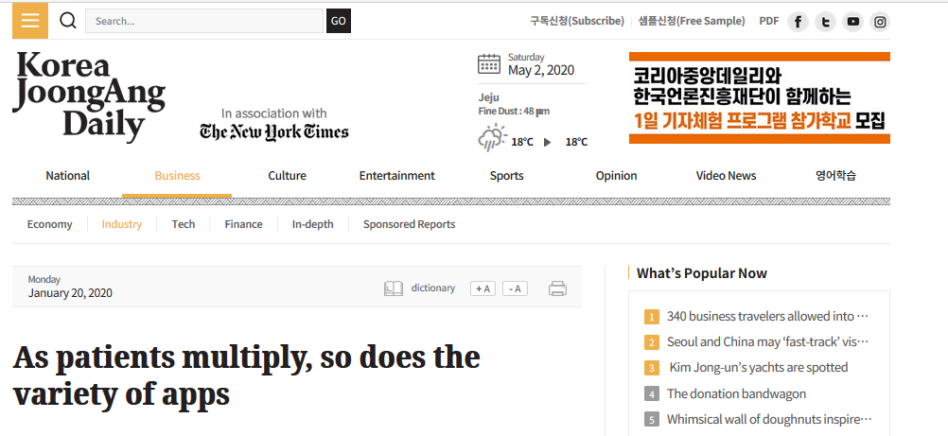
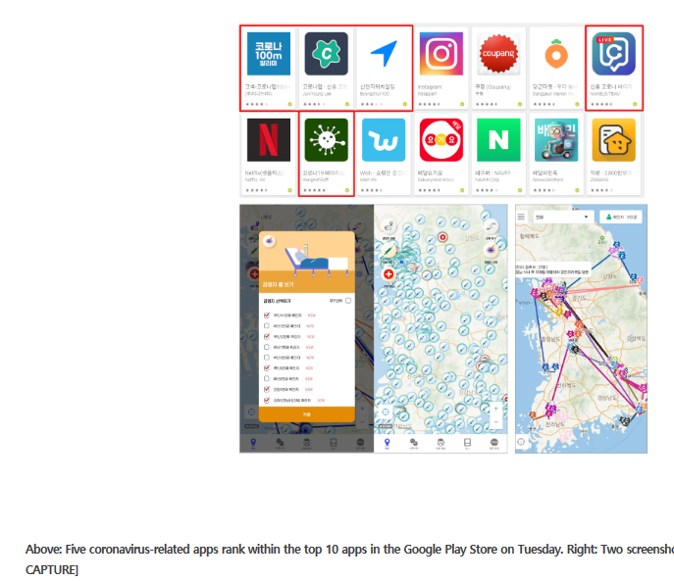

Slide 12
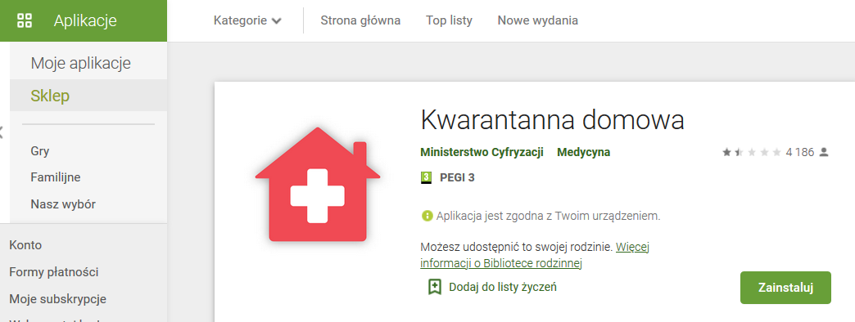
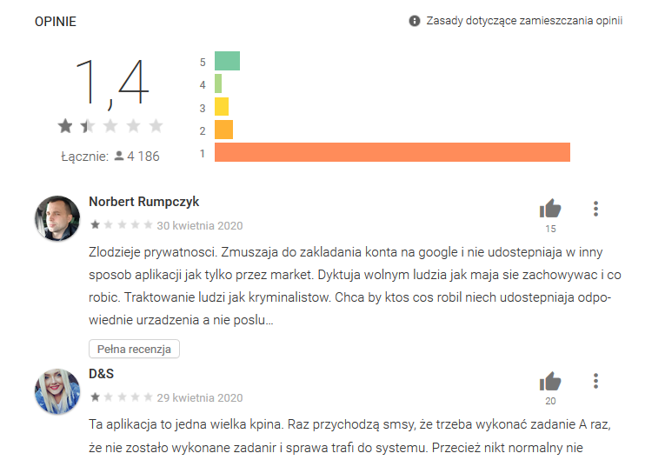

Slide 13


Slide 14
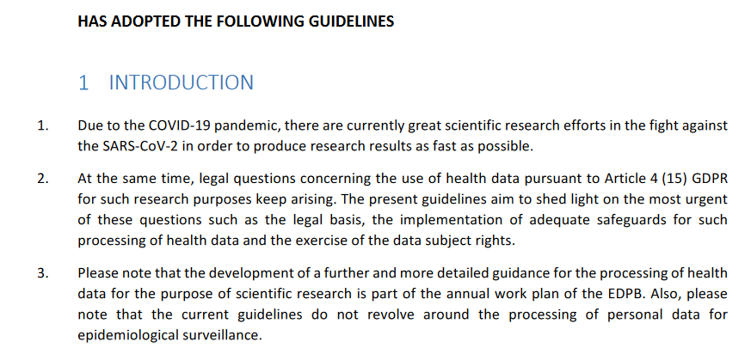

Slide 15
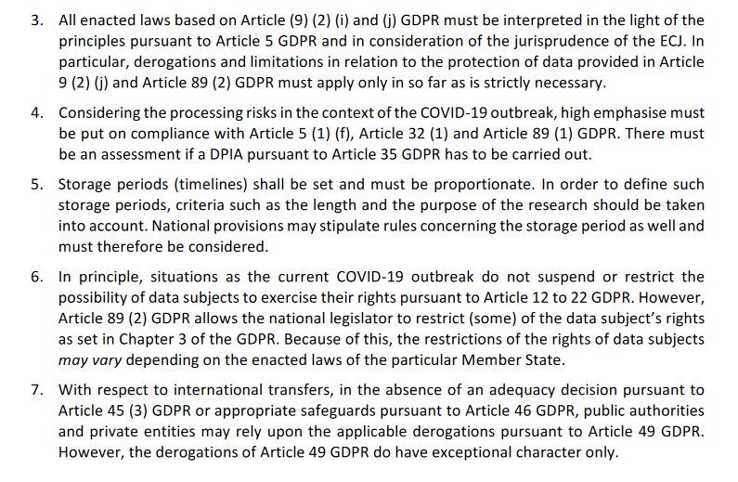

Slide 16
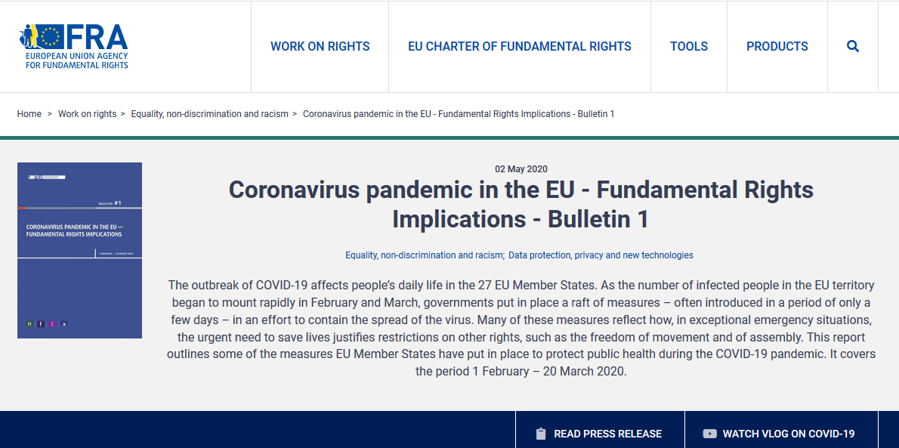

Slide 17
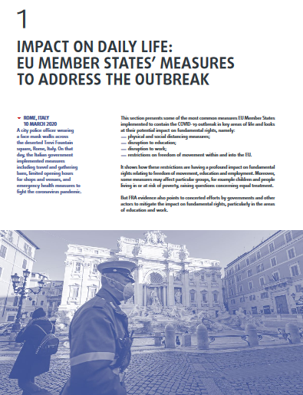
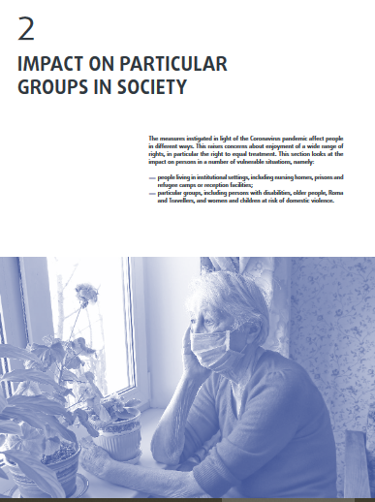
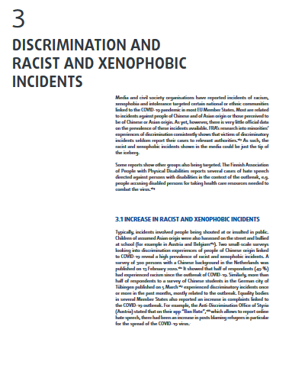
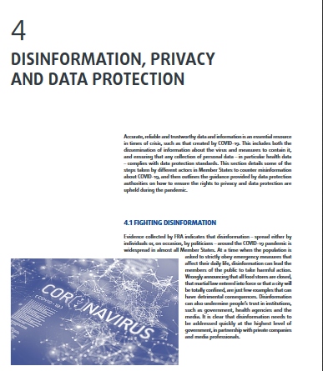
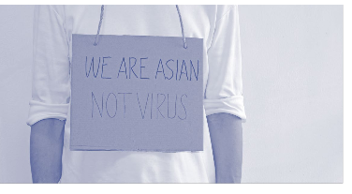

Slide 18
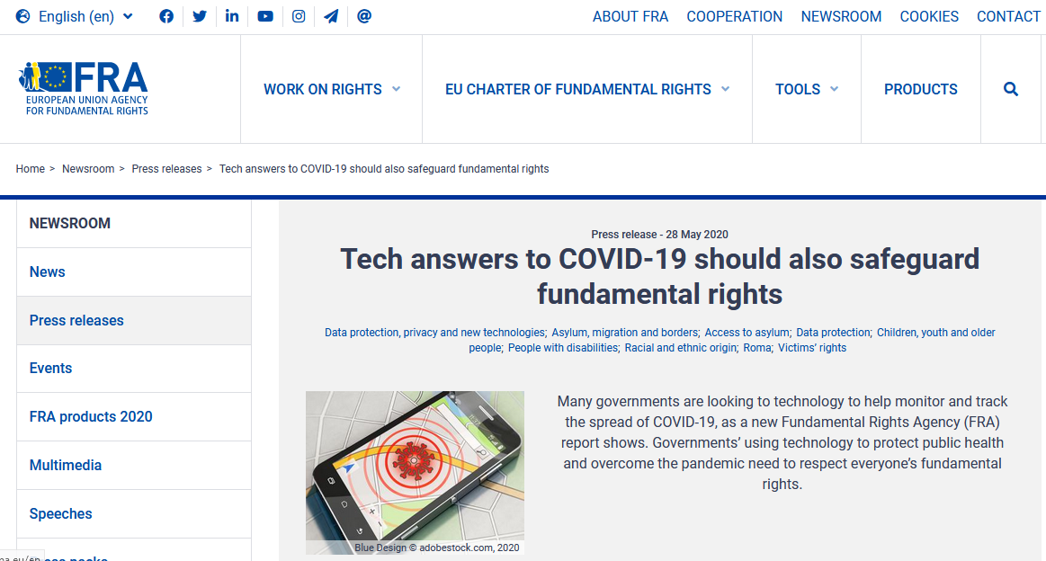

Slide 19
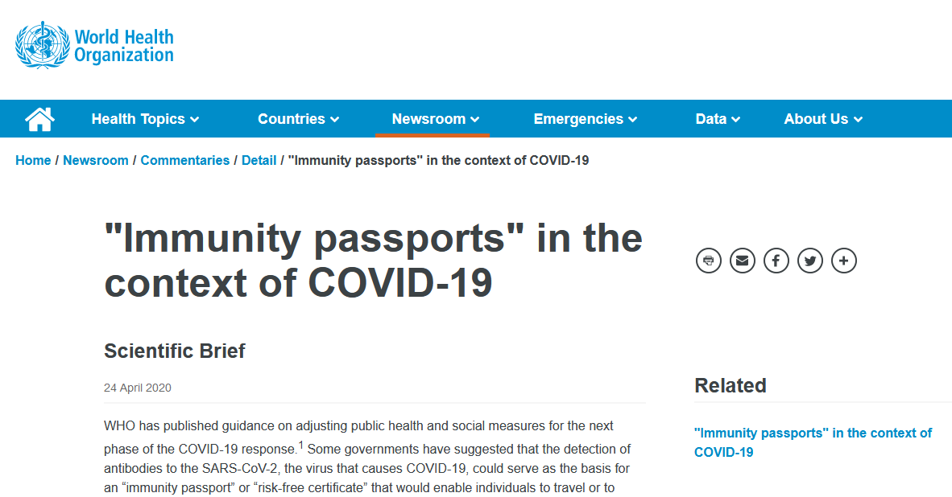

Slide 20
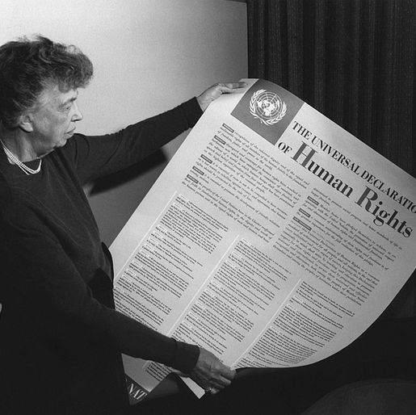
Right to education
Article 26 Universal Declaration of Human Rights
Articles 13 and 14 International Covenant on Economic, Social and Cultural Rights.
"Everyone has the right to education. Education shall be free, at least in the elementary and fundamental stages. Elementary education shall be compulsory. Technical and professional education shall be made generally available and higher education shall be equally accessible to all on the basis of merit. […] "

Slide 21
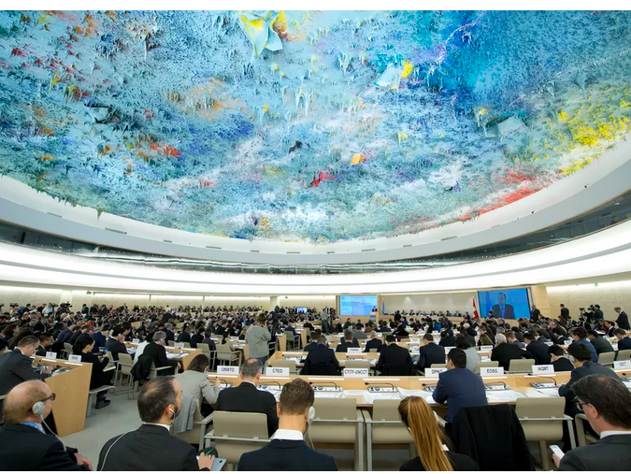
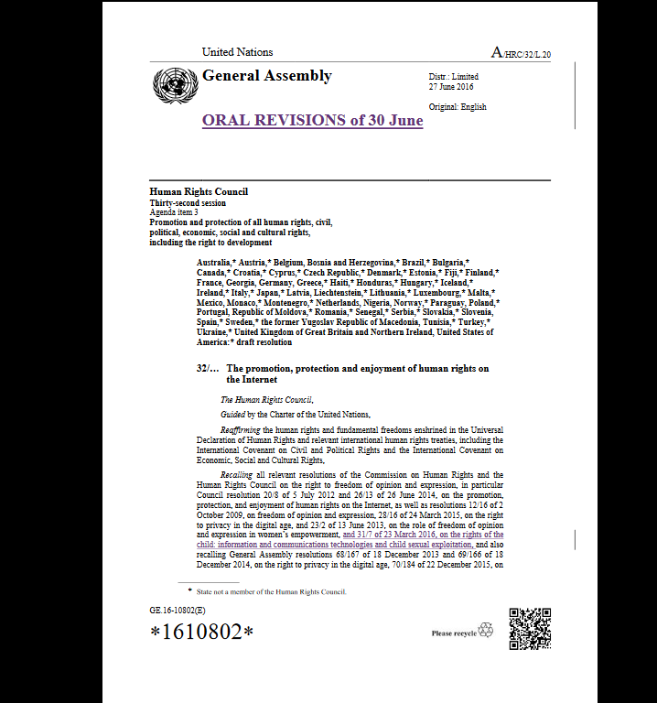
Right to Internet access

Slide 22


Slide 23
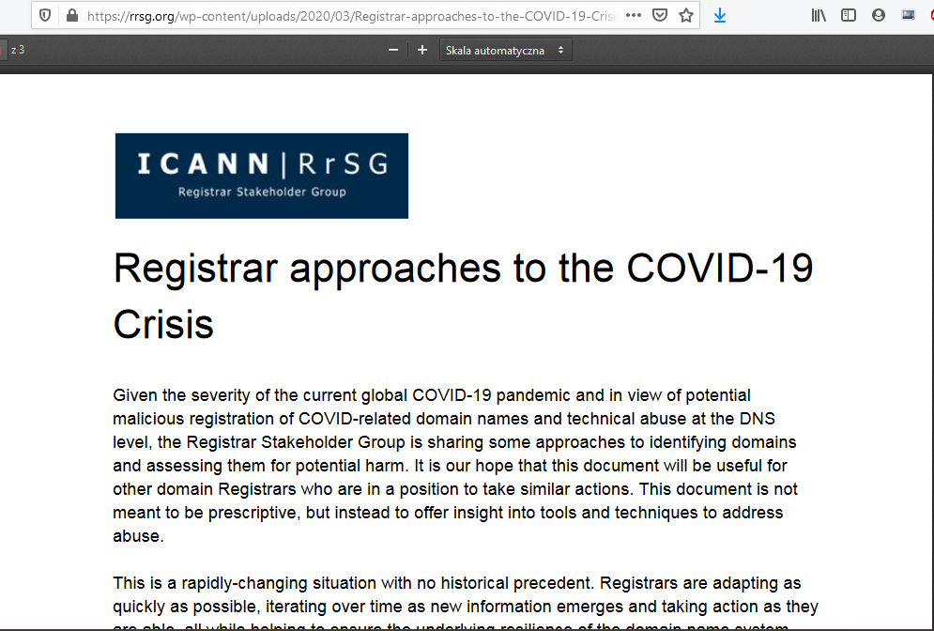
COVID-19 cures/equipment/tracing apps?

Slide 24
The big problem
With governments taking enhanced measures to counter the pandemic (be it tracing apps or mobile surveillance), is there still space for MS decision making? Has this space changed in any way?
Has enhanced governmental control impacted IG/ICANN/end-users’ interest?
Are we in the same place that we were before the pandemic or has it impacted how we effective we are in developing policies?
Is there room for ICANN discussion on policy? Or should we just leave it governments because the crisis is so severe?

Slide 25
COVID-19
AND END-USER ISSUES
Has COVID-19 redefined MS consensus development? Can we still make decisions bottom up when public health and security are at stake? - Marita MOLL, ALAC NARALO

Slide 26

THANK YOU
FOR
YOUR
ATTENTION.
At-Large Capacity Building Working Group (CBWG)

