Slide 1

Alignment and fragmentation
in global Internet governance
Milton L. Mueller, School of Public Policy, Georgia Institute of Technology

Slide 2

Polity Press, 2017

Slide 3

Fragmentation sounds bad…but what is it?
Disconnected physical links
Data localization
Content blocking
Paywalls
Geoblocking
Route hijacks
VPNs
National Internets
Language differences
The digital divide

Slide 4
Fragmentation
Alignment

Slide 5
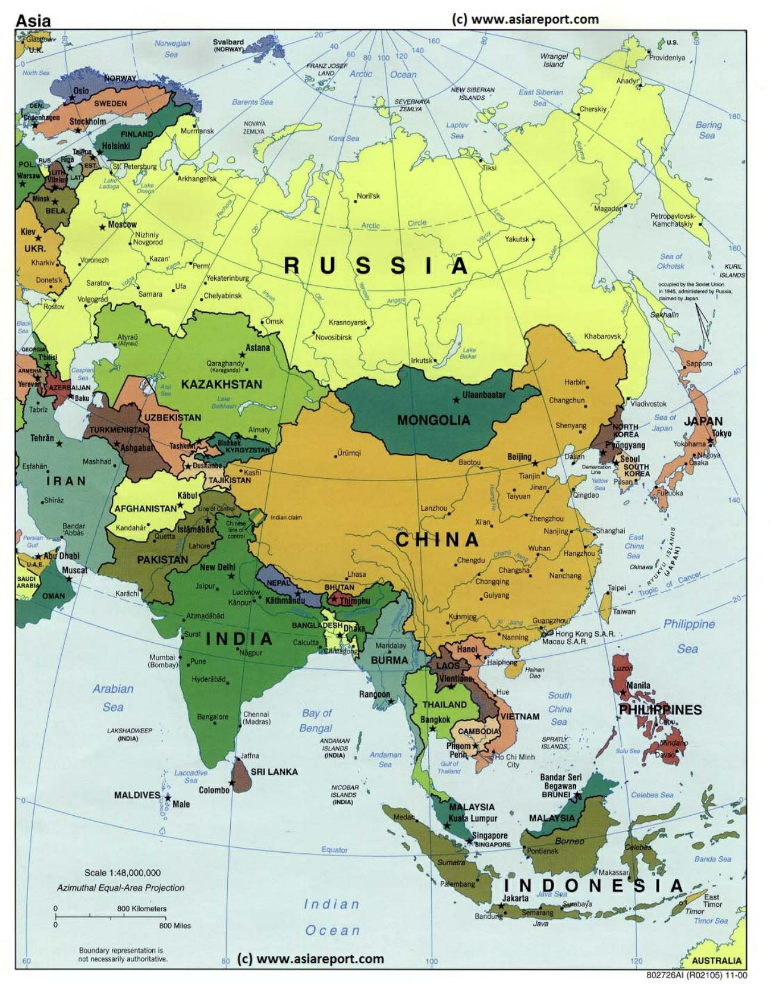
The Mismatch
The territorial fragmentation of state sovereignty

Slide 6

Alignment
The subjugation of the cyber domain to political jurisdictions

Slide 7
Methods of alignment
National securitization
  Development of cyber as military ‘domain’
  Nationalization and centralization of threat intelligence and incident response
  National technical standards, ownership, procurement
  Kill switches
Territorialization of information flows
  Content filtering
  Data localization
  Geo-blocking
Alignment of critical internet resources
  Domain names
  IP numbers

Slide 8
Linkage of cybersecurity to national security
Cyber-espionage (U.S. – China)
Cyber-sabotage (Stuxnet)
Data sovereignty (localization) policies
Export controls
Trade in telecommunication equipment (Huawei)
National encryption standards (back doors?)

Slide 9
Constraints on alignment
Global scope of the Internet
  Fait accompli globalization in names and numbers
  Default global interoperability
Economic efficiency
  Network externality
  Sharing economies
  Competition and innovation
The jurisdictional paradox
  Islands of control, or extraterritorial jurisdiction?
  U.S. vs Microsoft case

Slide 10

Popular sovereignty in cyberspace

Slide 11
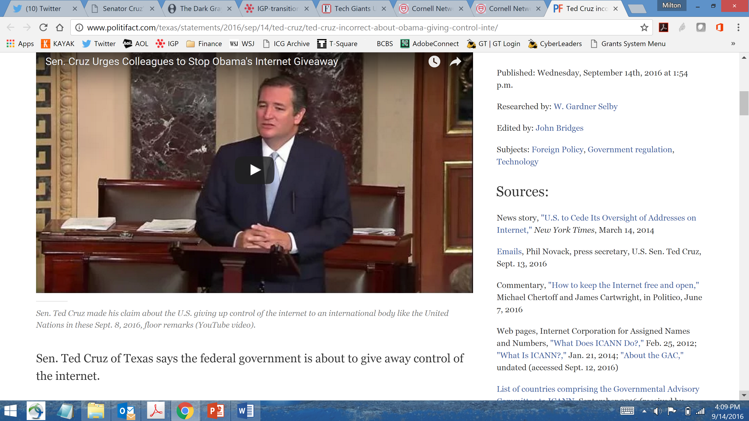
The IANA transition:
First battle for popular sovereignty

Slide 12
Questions?

