Slide 1
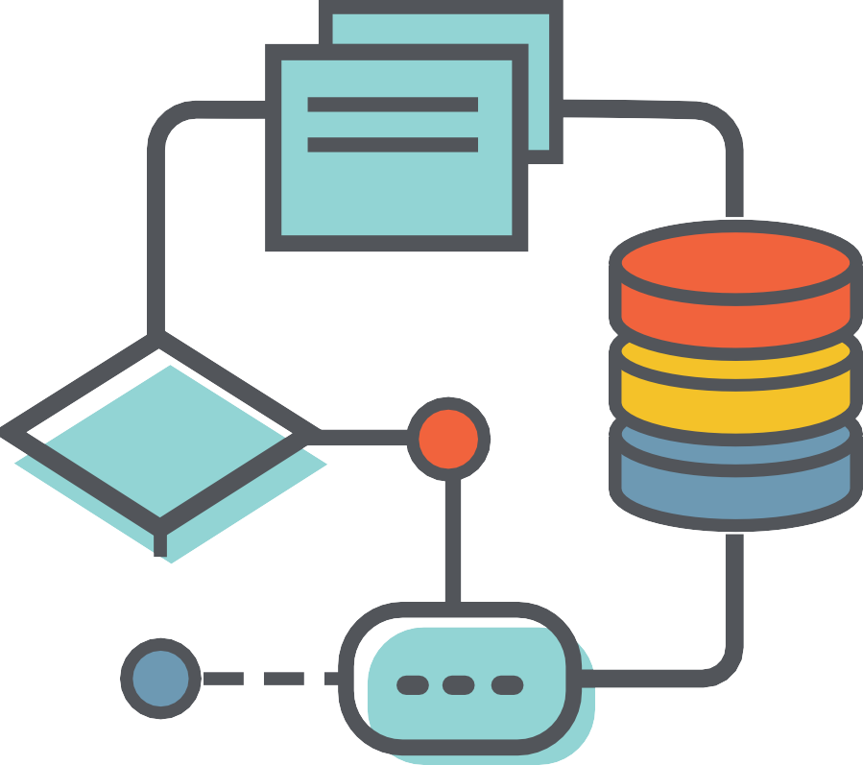
How can I design an ICANN Learn Course?

Slide 2

Course Objectives
Inform the learner how to participate in ISPCP
Explain the role of the ISPCP and how it ﬁts into ICANN
Elaborate on the process to join the ISPCP
Explore leadership roles in the ISPCP

Slide 3
Focus on the learner, not the instructor

Slide 4
Intended learning outcomes:
Be realistic
Start with
a verb
Take into account assessments

Slide 5
Learning Outcomes
Understand what the IPC is
Recognize acronyms relating to the IPC and GNSO
Understand the structure of the IPC
Comprehend the different ways to participage in the IPC
Understand the beneﬁts to joining the IPC and how to join

Slide 6

Consider learners’ diverse needs

Slide 7


Consider different approaches to learning
Surface learning
Long videos
Excessive materials Passive learning
Deep learning
Short videos
Frequent brief assessments and opportunities for reﬂection on learning
Active learning

Slide 8


