Slide 1


Guidelines Review Committee
Update
12 - 13 March 2019, Kobe

Slide 2
Barcelona > Kobe
Document Type | Document Title
Guideline: | IANA Functions Review (review and finalise)
Template: | Working Group Description
 | Assessment of WS2 Recommendations
Guideline: | ccNSO Council Actions with Respect to Selection of ccNSO Appointed Members
 | ccNSO Review

Slide 3
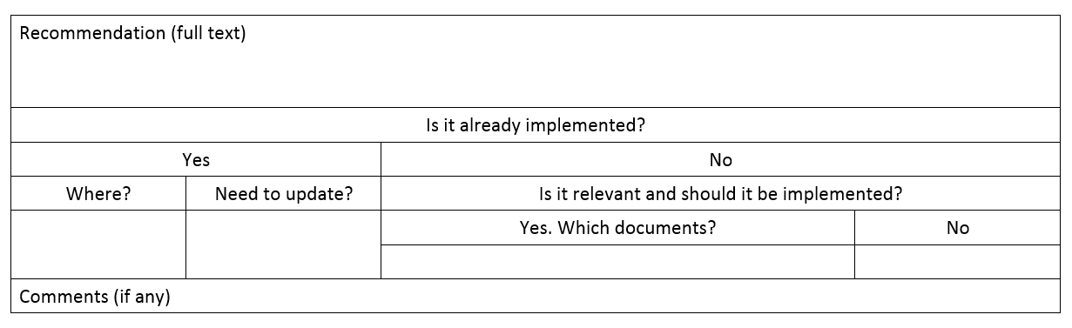
Assessment of WS2 Recommendations
Template

Slide 4
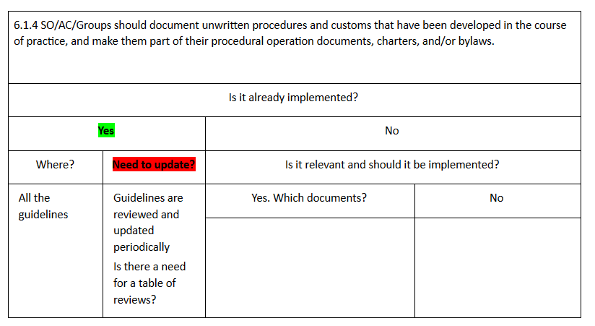
Assessment of WS2 Recommendations
Example 1

Slide 5
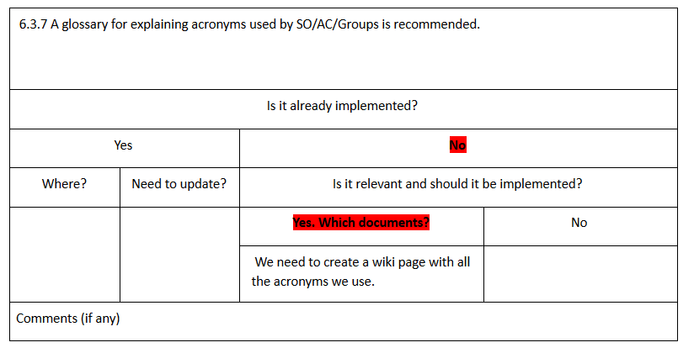
Assessment of WS2 Recommendations
Example 2

Slide 6
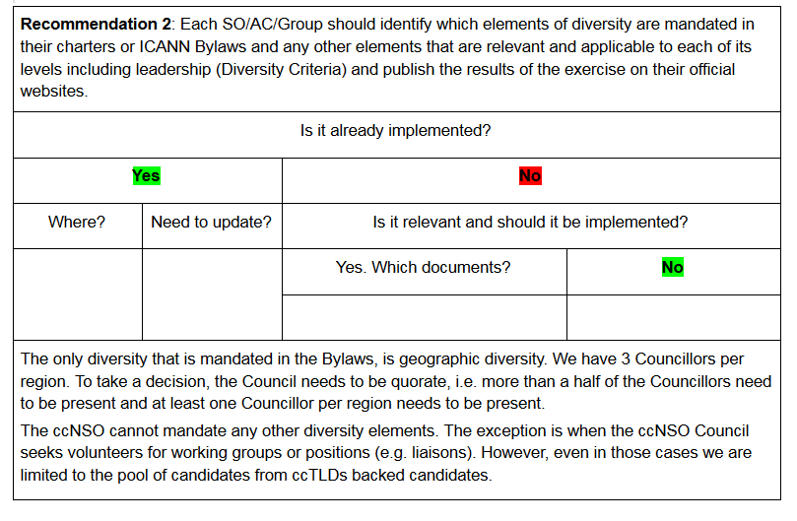
Assessment of WS2 Recommendations
Example 3

Slide 7
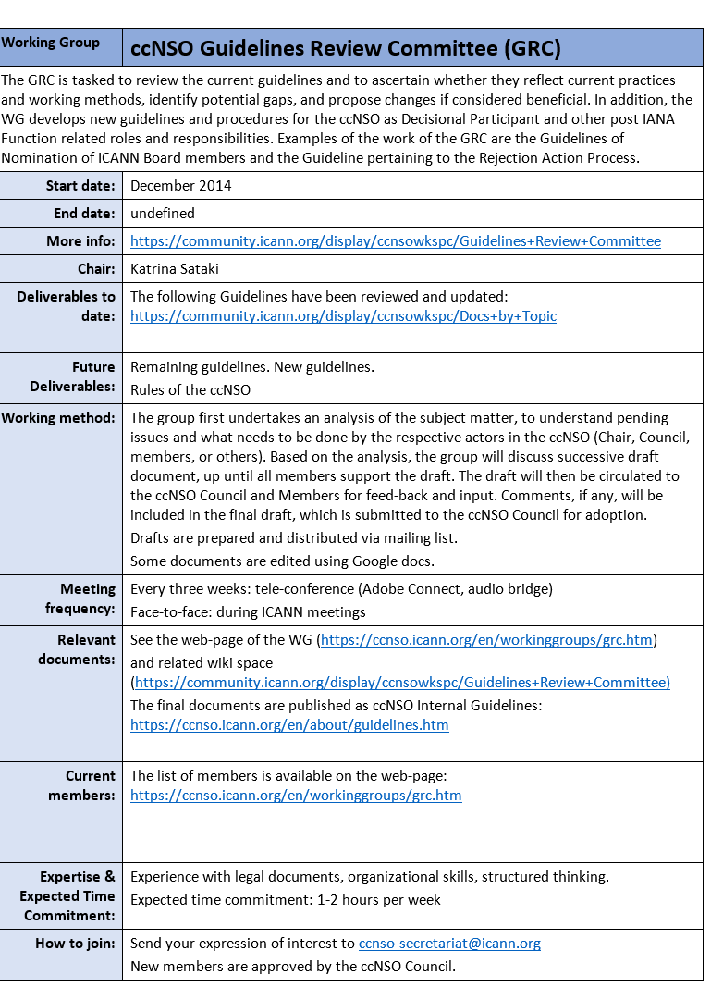
Working Group Template

Slide 8
Kobe > Marrakech
Document Type | Document Title
Guideline: | IANA Functions Review (review and finalise)
Template: | Approval Action notices
Guideline: | Removal of ICANN Board Member(s)
 | ccNSO Review: Recommendations

Slide 9
Thank you!

