Slide 1


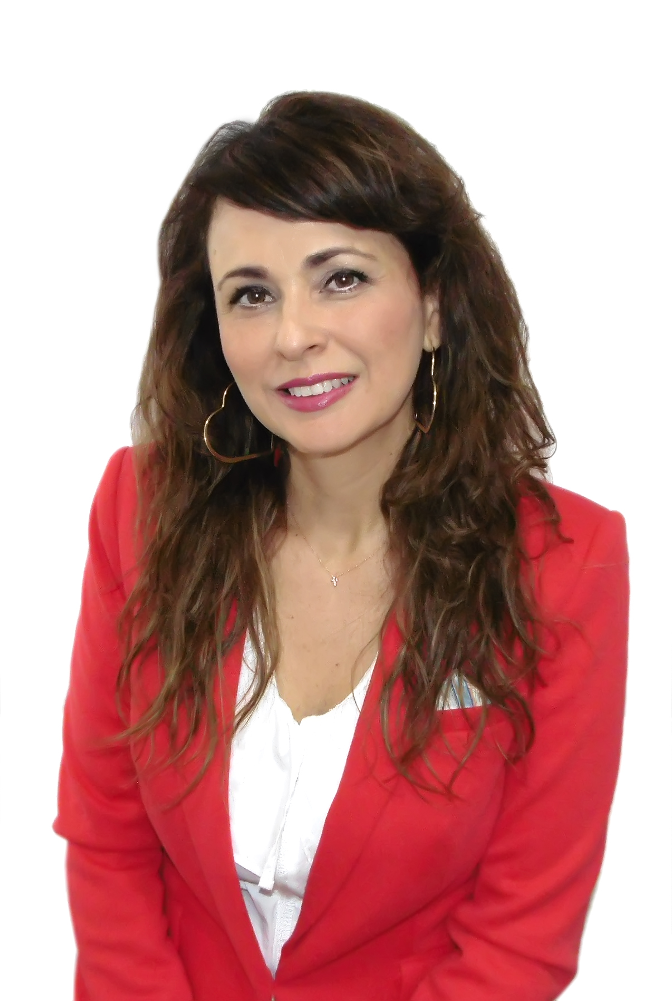
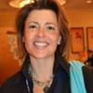

At-Large Staff Support at ATLAS III: Who’s Who
Heidi Ullrich
VP, Policy Development & At-Large Relations
Los Angeles, USA
Languages: English, German
Silvia Vivanco
Sr. Manager, At-Large Regional Affairs
Lima, Peru
Languages: English, Spanish, German
Gisella Gruber
Manager, At-Large Relations and Operations Support
Bath, UK
Languages: English, French, German, Afrikaans
Evin Ashley Erdoğdu
Policy Development Sr. Coordinator
İstanbul, Turkey
Languages: English, Turkish
Notes:
This slide can be used for text, graphics or any other elements.

Slide 2
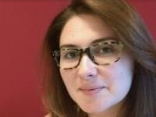
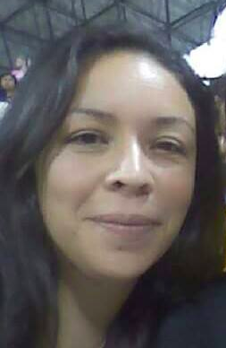
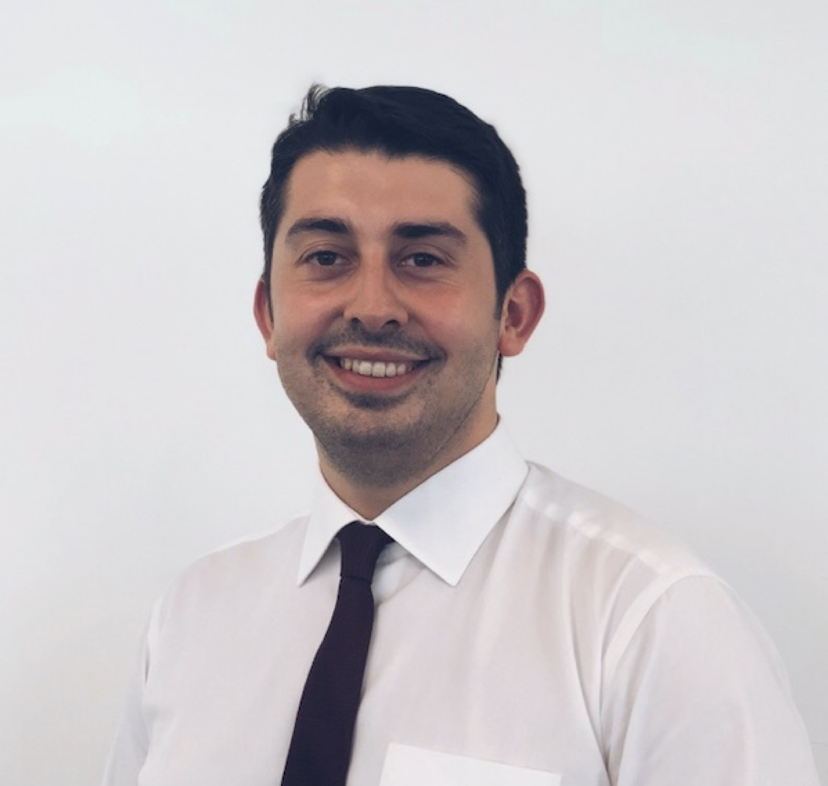
At-Large Staff Support at ATLAS III: Who’s Who
Yeşim Nazlar
ALAC-At-Large Operations Support Lead
İstanbul, Turkey
Languages: English, Turkish
Michelle DeSmyter
SOAC Support
Illinois, USA
Languages: English
Claudia Ruiz (remote support)
SOAC Support
Los Angeles, USA
Languages: English, Spanish
Alperen Eken
At-Large Policy Coordinator – Temp Assignment
Washington, DC, USA
Languages: English, Turkish
Notes:
This slide can be used for text, graphics or any other elements.

Slide 3
ATLAS III Logistical Information
Reminder to REGISTER for ICANN66
Attendance taken at all ATLAS III Sessions
ATLAS III Participant Identification
  Purple Ribbon
ATLAS III Travel Page (RESTRICTED to ATLAS III participants ONLY)
  Allow for shared transport to/from airport
ATLAS III Travel Information
  Transport options from Airport to Hotels
ATLAS III Accommodation (Hotels)
  Listing of hotels and check-in procedures
ATLAS III Social Events
Notes:
This slide can be used for text, graphics or any other elements.

Slide 4
At-Large Advisory Policy Issues
Universal Acceptance (UA)
Subsequent Procedures, Work Track 5 and planning for next gTLD round
EPDP Phase II
Cybersecurity/DNS Abuse
Development of At-Large Policy Platform
Notes:
This slide can be used for text, graphics or any other elements.

