Slide 1
Roadmap to update the IDNccTLD policy
ccNSO Meeting Kobe
12 March 2019

Slide 2
Why are we discussing this?
Current State of Play

Slide 3
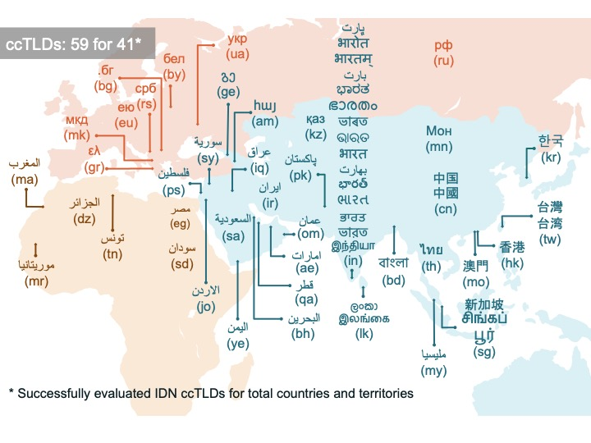
ccTLDs not eligible as member ccNSO

Slide 4
Open Issues
Variance Management & Root Zone LGR
List of County names to be reserved: is it needed?
Increasing divergence Fast Track Process & recommended policy
Financial contribution models IDN ccTLDs and ASCII IDN ccTLDs differ

Slide 5



Divergence
Confusing Similarity Evaluation process Fast Track
DNS Stability Panel
Extended Process Similarity Review Panel (EPSRP)
Risk Mitigation Panel (New)
Need to harmonise and update recommended policy

Slide 6

To
Policy for Selection of IDNccTLD String
Amended ccNSO Article in ICANN Bylaws
From
Fast Track Process
&
Overall IDNccTLD policy proposals
  Selection of IDNccTLD Strings
  Inclusion Of IDNccTLDs in ccNSO
So what is the roadmap?
It is to get

Slide 7

To
An Inviting & Inclusive ccNSO
and Stable, Predictable &
Simple
Policy
To get from
Exclusive ccNSO
And
Open issues
Diverging
Complicated
Method &Proposals

Slide 8
The roadmap
Stop Evolution of Fast Track Process & PDP 2 (IDNccTLD)
Gap Analysis Overall IDNccTLD policy (PDP 2)
    Bylaw change process to include IDNccTLDs
Split PDP2
PDP 4 (policy to select IDN ccTLDs strings)

Slide 9
Step 1: Stop Evolution & PDP 2 Process
Agreed with Board & community in San Juan (ICANN 60March 2018)
Await introduction Risk Mitigation Panel & Guideline (February 2019)
End of evolution: Fast Track Process should remain available for requesting IDNccTLDs!
Next: letter from Council to the Board and vice versa confirming closure And need to review recommended policy
  Alternative approach: Go through motions of Board vote and ask Supplemental Recommendation
  ccNSO to rescind PDP.

Slide 10
Step 2:
Gap Analysis Overall IDNccTLD policy
Council to define scope and working method Gap Analysis
  Working party & Terms of Reference
  ccTLD community members, Issue Manager PDP2, ICANN staff, other interested parties
Light weight Gap Analysis & Review
  Required Bylaw changes to include IDNccTLD in ccNSO
  Changes needed to IDNccTLD string selection process
  Ensuring IDNccTLD are treated similar as ccTLDs
Report to Council & community
  What needs to addressed/ changed and propose way forward

Slide 11
Step 3: Split PDP 2 -> Amendment Article 10
To Include IDNccTLD in ccNSO
Mechanism?
ccNSO to request Bylaw change or PDP
How and when?
To be decided by Council at suggestion of working party Gap Analysis

Slide 12
Step 3: Split PDP 2 -> Launch PDP 4
IDNccTLD string selection process
PDP recommended policy required to replace Fast Track Process
Core of process already defined and proven to be sound & predictable
Gap Analysis basis of what needs to be addressed & Issue Report
Coordination with other SO/ACs required, however under rules of ccNSO
  Harmonise Confusing Similarity
  RZ-LGR/Variant management

Slide 13
When will happen next
At this meeting:
ccNSO Council resolution to send letter to the Board
Request draft ToR for review working party
Call for volunteers
In Marrakesh (ICANN 64)
Discuss Gap Analysis Report & next steps
  Inclusion IDNccTLD: request Bylaw change or PDP
  Need to launch PDP on IDN sting selection policy

Slide 14
?
Questions
?

