Slide 1
Governmental
Advisory
Committee (GAC)

Slide 2
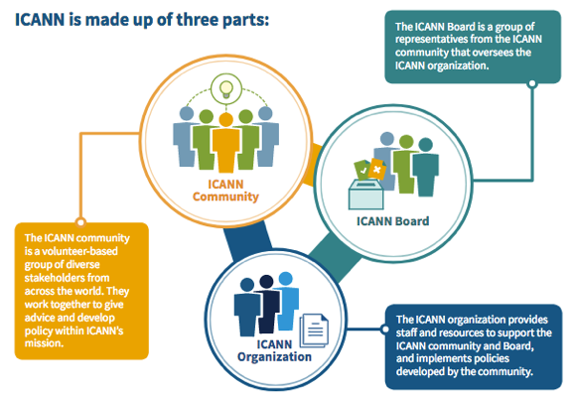

Multistakeholder community
GAC is part of ICANN’s
multistakeholder community

Slide 3

Internet governance is the development and application by governments, the private sector and civil society, in their respective roles, of shared principles, norms, rules, decision-making procedures, and programmes that shape the evolution and use of the Internet.
Art. 34, Tunis Agenda, 2005

Slide 4
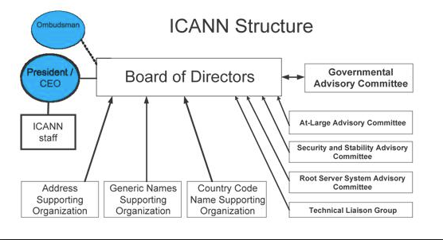

The Governmental Advisory Committee (GAC) is an advisory committee to ICANN, created under the ICANN Bylaws. It provides advice to ICANN on public policy aspects of ICANN's responsibilities with regards to the Internet Domain Name System.
https://gac.icann.org/operating-principles/operating-principles-june-2017#

Slide 5
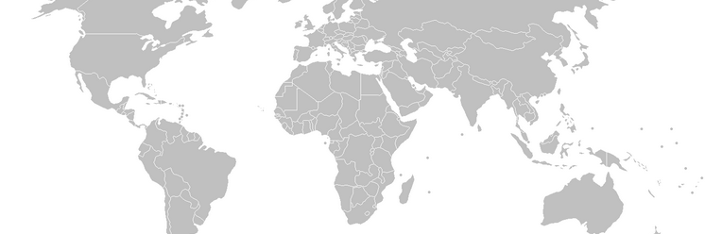















Membership in the GAC is open to all national governments, as well as to Distinct Economies as recognized in international fora, and multinational governmental organizations and treaty organizations, on the invitation of the GAC through its Chair.

Slide 6
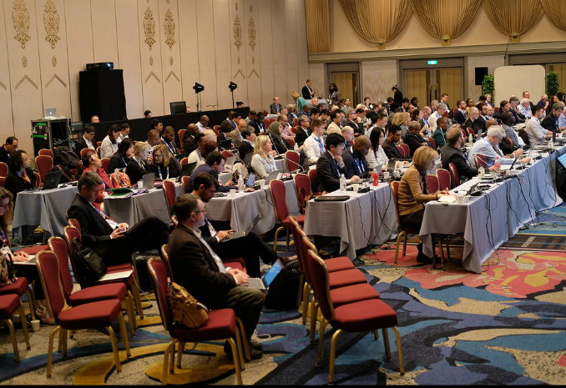
The number of members and observers has constantly increased. There are now 178 members and 37 observers.

Slide 7
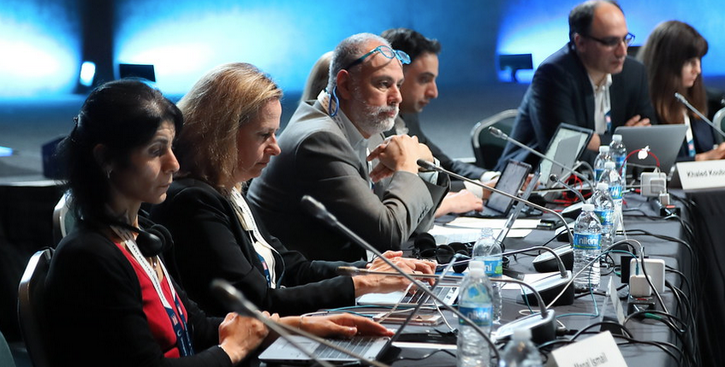
The GAC appoints a non-voting Liaison – in practice, its Chair – to the Board.

Slide 8
ICANN receives input from governments through the Governmental Advisory Committee (GAC). The GAC's key role is to provide advice to ICANN on issues of public policy, and especially where there may be an interaction between ICANN's activities or policies and national laws or international agreements.

Slide 9
The advice of GAC on public policy matters shall be duly taken into account (…) In the event that the ICANN Board determines to take an action that is not consistent with the GAC advice, it shall so inform the Committee and state the reasons why it decided not to follow that advice
ICANN Bylaws, 12/2/a/x

Slide 10
Any GAC advice approved by a full GAC
consensus, understood to mean the practice of adopting decisions by general agreement in the absence of any formal objection ("GAC Consensus Advice"), may only be rejected by a vote of no less than 60% of the Board, and the Governmental Advisory Committee and the Board will then try, in good faith and in a timely and efficient manner, to find a mutually acceptable solution.
ICANN Bylaws, 12/2/a/x

Slide 11
GAC Consensus Advice - Advice adopted by general agreement in the absence of any formal objection
GAC Advice - Advice that enjoys broad agreement but receives one or more formal objections (threshold under discussion) conveying a range of reviews
Failing to reach consensus or broad agreement, the full range of views are conveyed to the Board

Slide 12
If GAC Consensus Advice is rejected by the Board pursuant to Section 12.2(a)(x) and if no such mutually acceptable solution can be found, the Board will state in its final decision the reasons why the Governmental Advisory Committee advice was not followed, and such statement will be without prejudice to the rights or obligations of Governmental Advisory Committee members with regard to public policy issues falling within their responsibilities.

Slide 13
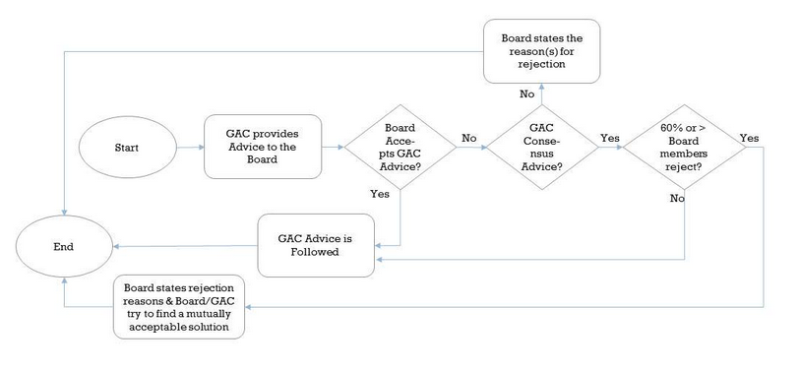
Once more, for those who like flowcharts

Slide 14
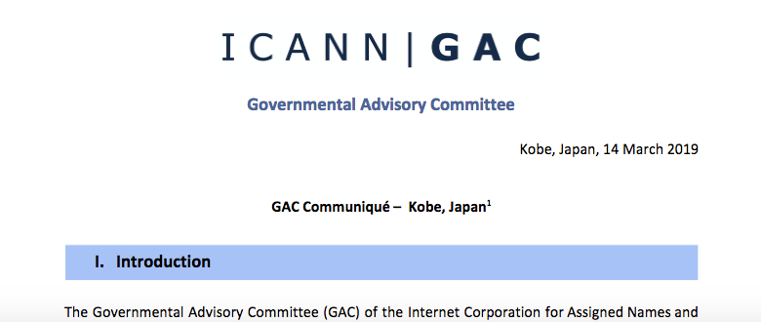
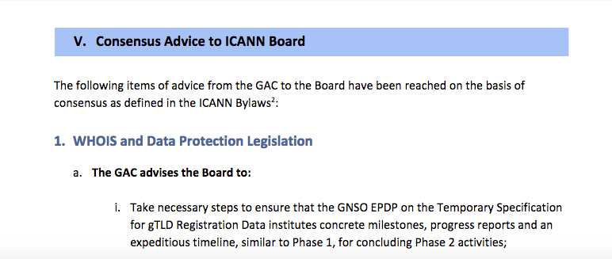
GAC Advice is embodied in a written communication where the specific advice is clearly marked as such, has a clearly stated proposal for action(s) by the Board, and explains the underlying rationale for its Advice.
GAC Advice is usually delivered
in a Communiqué after each ICANN meeting

Slide 15
Other Interaction with the Board
Post-meeting calls to clarify the advice
Correspondence
Board-GAC Interaction Group (BGIG)
Board-GAC joint sessions at ICANN meetings

Slide 16


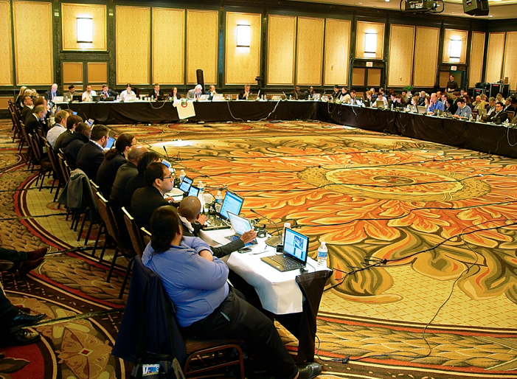
THE gac and the New gtld process
The new gTLD process intensified GAC’s interaction with the Board and the entire community. With early warnings and advice about specific applications, GAC became operationally involved

Slide 17
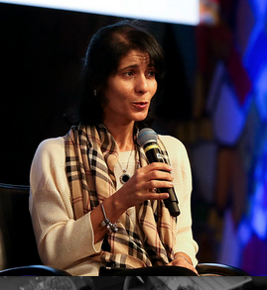

Manal Ismael
Egypt
GAC Chair
Elected for 2 years, renewable once
Argentina
Canada
Niue
Brazil
Senegal
Vice Chairs
Elected for 1 year, renewable once
Plenary
Working Groups
Geo Names
USR WG
Part. NomCom
COPE
HRIL
PSWG
BGIG

Slide 18
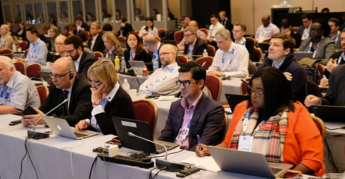
GAC working groups
Geo Names WG
Under-served Regions WG (USR WG)
Participation in NomCom WG
Operational Principles Evolution WG (COPE)
Human Rights and International Law WG (HRIL)
Public Safety WG (PSWG)
Board-GAC Interaction WG (BGIG)

Slide 19

GEO names wG
Examines how geographic names can be protected in any future expansion of the gTLD space

Slide 20
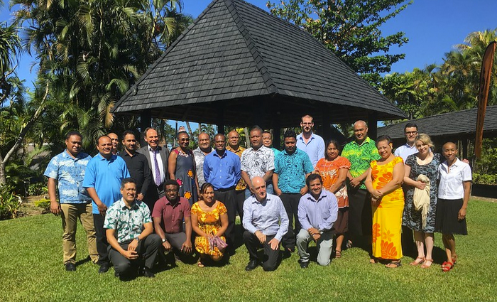
Under-served regions wg
Focuses on regions under-served by the DNS industry, least developed economies and small island developing states, especially in the Africa, Caribbean and Pacific (ACP) regions.

Slide 21
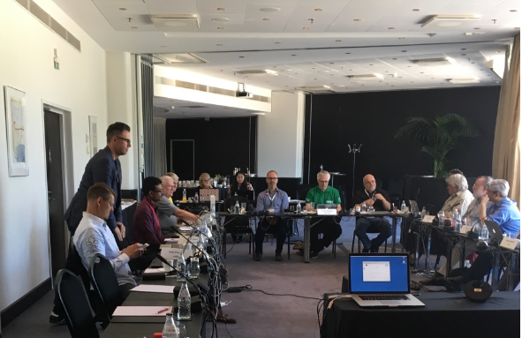
Patrticipation in NomCom WG
According to ICANN Bylaws, the GAC is entitled to a seat on the Nominating Committee. The GAC NomCom Working Group examines if, and how, the GAC could participate in the NomCom process.

Slide 22
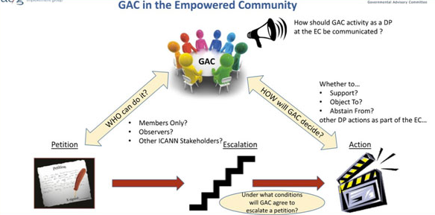
Operational principles evaluation wg
Makes recommendations for changes to the current GAC Operating Principles in order to enable the GAC to operate more effectively and efficiently as a member of the ICANN Empowered Community

Slide 23

HumAN RIGHTS AND INTERNATIONAL LAW WG
Focuses on aspects of ICANN’s policies and procedures which relate to human rights and relevant international law, eg. on how to ensure the management of the DNS in a manner that respects human rights and international law.

Slide 24

Public safety WG
Focuses on aspects of ICANN’s policies and procedures that implicate the safety of the public, eg. develops DNS abuse and cybercrime mitigation capabilities of ICANN and of the law enforcement community.

Slide 25
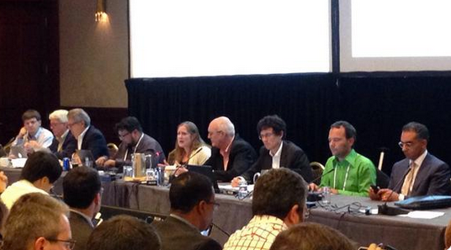
Board-GAC interaction wg
Focuses on improving the processing and tracking of GAC advice. Issues under discussion have included definition of GAC advice and improvements to the process for considering and implementation of GAC advice

Slide 26


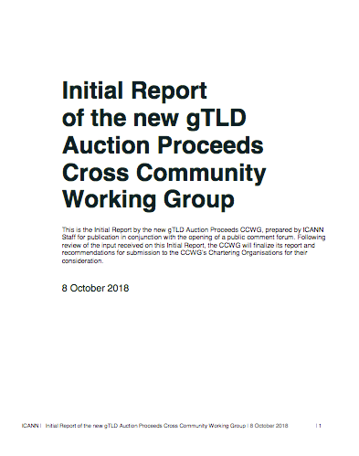
CCWG AND PDP PARTICIPATION
CCWG on auction proceeds
Proceeds generated from 16 gTLD auctions were separated and reserved until the multistakeholder community develops a plan for their use.
PDP on new gTLD Subsuquent Procedures (all work tracks)
PDP on INGO/IGO Curative Rights

Slide 27
ALAC-GAC liaisons
GAC Liaisons to ALAC:
Ana Neves
Charlotte Simoẽs
ALAC Liaison to the GAC:
Yrjö Länsipuro

Slide 28
Questions?

