Slide 1
Introduction: Team, Mandate, ICANN leadership and PTI Open seats & application timelines
ICANN64 - Kobe

Slide 2
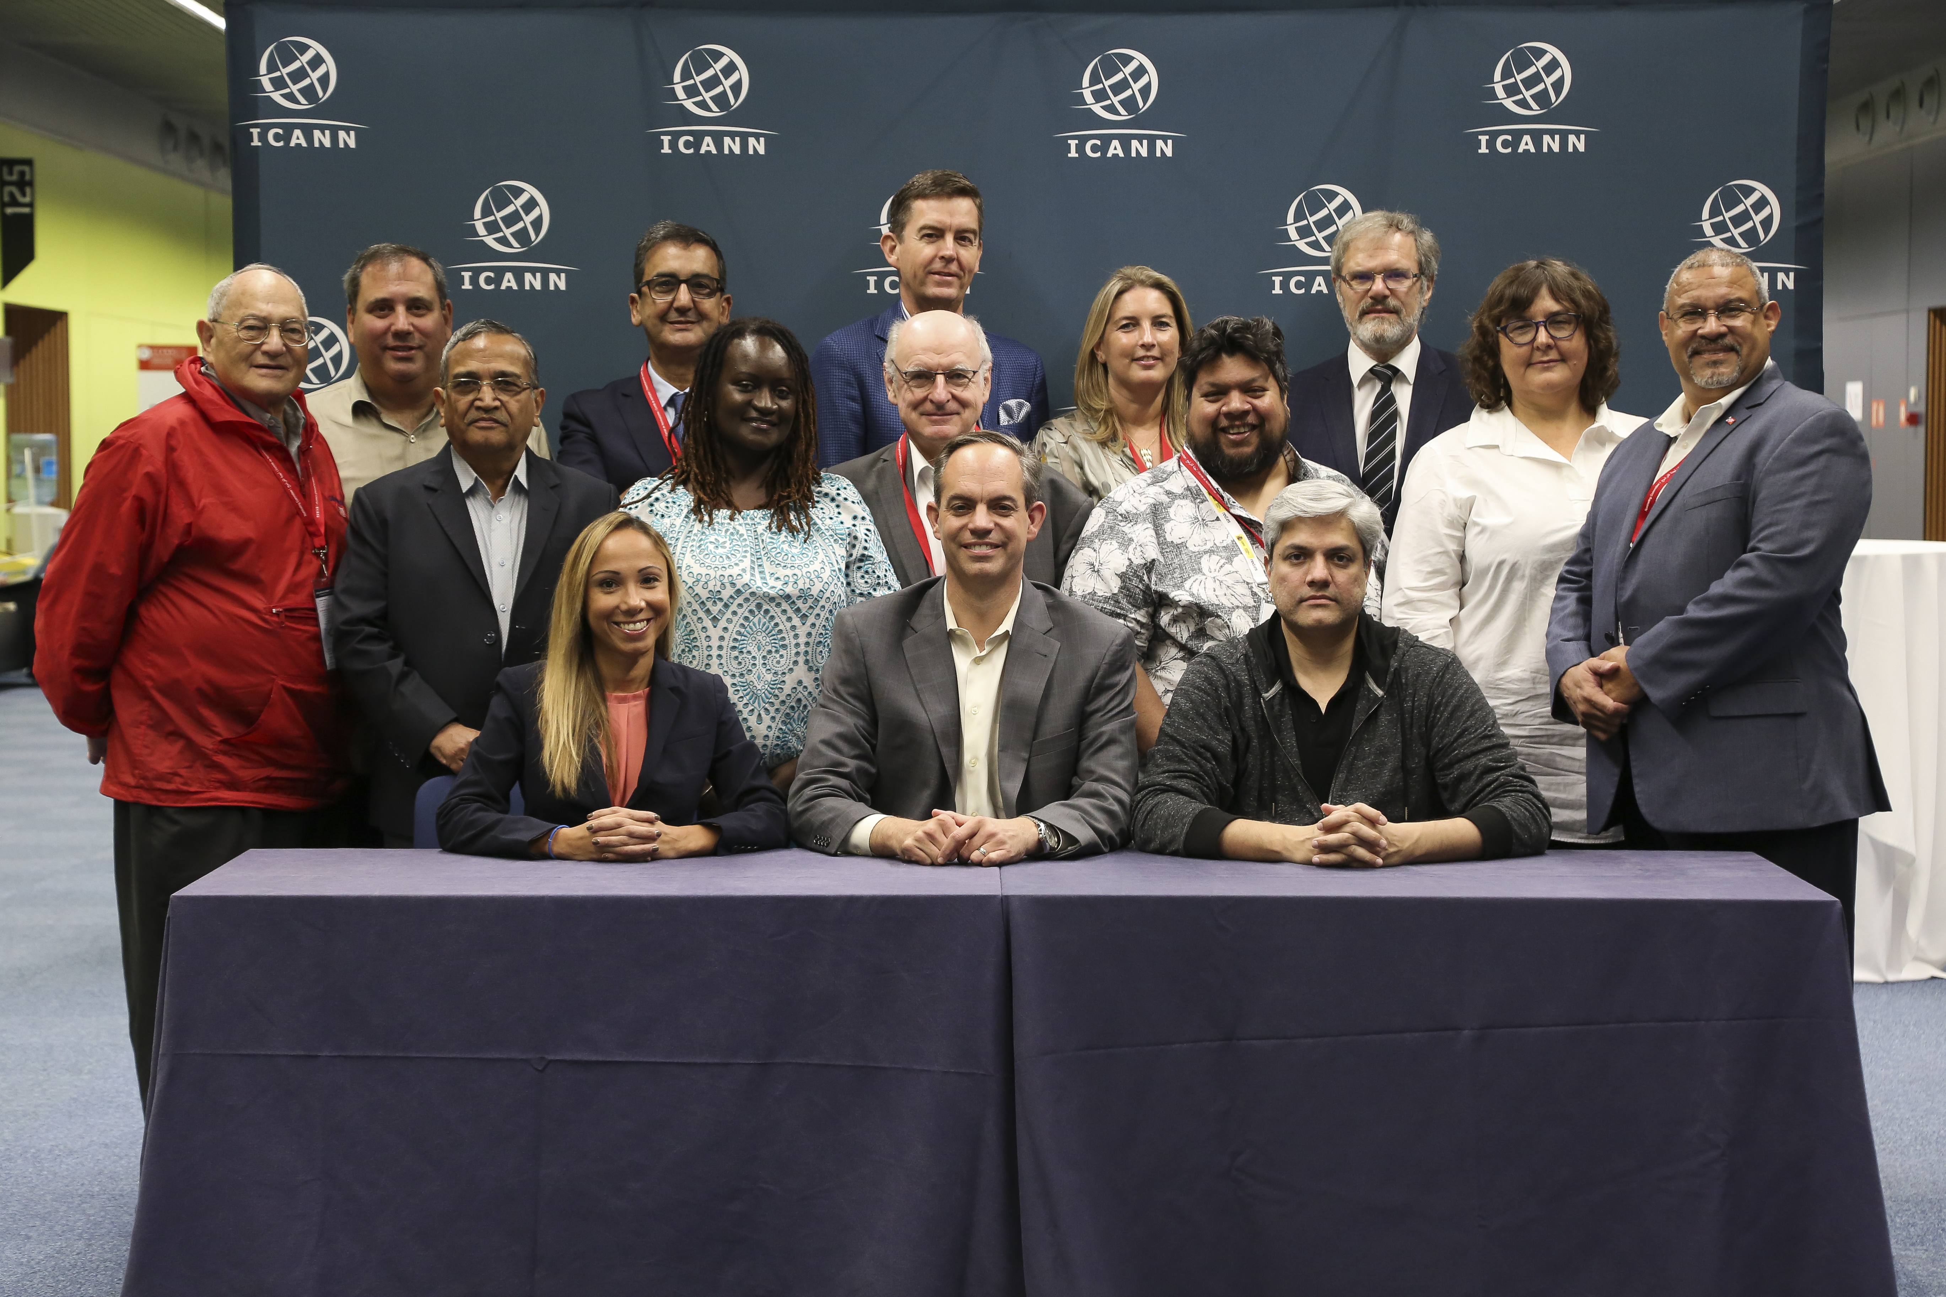
Meet the 2019 ICANN NomCom Members

Slide 3
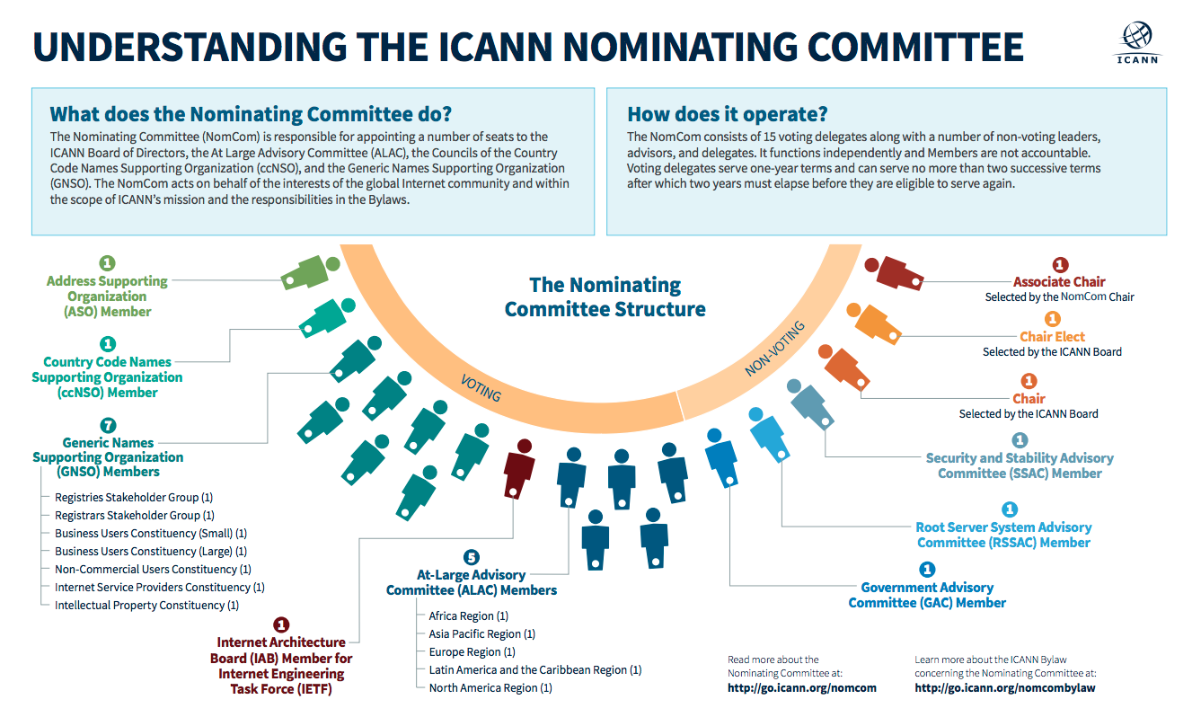
ICANN NomCom Structure

Slide 4
10 Open Leadership Positions to be filled by the 2019 NomCom
Internet Corporation of Assigned Names and Numbers (ICANN)
ICANN Board of Directors
3 seats | 3 year term
GNSO Council
2 seats | 2 year term
Public Technical Identifiers (PTI)
PTI Board of Directors
1 seat | 3 year term
Voting
Non-Contracted
Party House
Voting
Contracted
Party House
At Large Advisory Committee
3 seats | 2 year term
ccNSO Council
1 seat | 3 year term
Asia, Australia &
Pacific Islands
Africa
Latin America &
Caribbean Islands

Slide 5
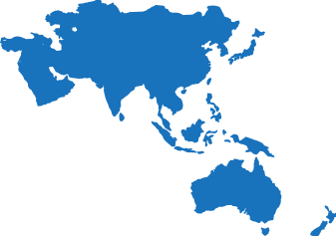
2019 - 2020 ICANN Board – Geographic Diversity*
*Voting Members (Not including ICANN’s President and CEO)
4
Europe (4)
North America (5)
Asia/Australia/
Pacific (2)
Latin America/
Caribbean islands (2)
2
Africa (2)

Slide 6
Description of Positions
  ICANN’s Board of Directors
      Exercises the powers of ICANN, controls its property, and directs its business
      Directors are duty-bound to act in what they reasonably believe are ICANN’s best interests – not as representatives of the entities that selected them, their employers, or any other organizations or constituencies.
      Directors are expected to support the ICANN mission and pursue ICANN’s core values. The Nominating Committee selects fifty percent of the Board (eight Board members) who serve staggered terms.
At-Large Advisory-Committee (ALAC)
  The ALAC considers and gives advice on ICANN activities related to the interests of individual Internet users.
  ALAC members may represent their individual interests or the interests of not-for-profit or for-profit entities.
  The Nominating Committee chooses five ALAC members – one from each of ICANN’s geographical regions – who serve staggered terms.

Slide 7
Description of Positions (Continued)
Generic Names Supporting Organization (GNSO)
  The GNSO develops and recommends to the Board substantive policies for generic top-level domains (gTLDs).
  The GNSO Council consists of various constituencies representing particular groups of stakeholders who manage the GNSO’s policy development and administrative processes.
  The Nominating Committee chooses three Council members who serve staggered terms.
Country Code Names Supporting Organization (ccNSO)
  The ccNSO develops and recommends to the Board global policies for country code top-level domains (ccTLDs) and develops consensus across the ICANN community.
  The ccNSO promotes operational and technical cooperation among ccTLD managers.
  The ccNSO administers the affairs of the ccNSO and manages the development of policy recommendations.
  The Nominating Committee chooses three ccNSO Council members who serve staggered terms.

Slide 8
Description of Positions (Continued)
Public Technical Identifiers (PTI) Board of Directors
  PTI is a not-for-profit public benefit corporation that operates exclusively
  to carry out the purposes of ICANN by performing the Internet Assigned Numbers Authority or IANA functions on behalf of ICANN pursuant to a series of contracts with ICANN.
  IANA functions performed by PTI are: Domain Names, Number Resources, and Protocol Parameter Assignments.
  PTI’s Board of Directors manages the business and affairs of PTI.
  Members of the PTI Board consists of three members employed by ICANN or PTI and two members nominated by ICANN’s Nominating Committee not employed by ICANN or PTI.
  The Nominating Committee selects two seats on the PTI Board of Directors who serve staggered terms.

Slide 9
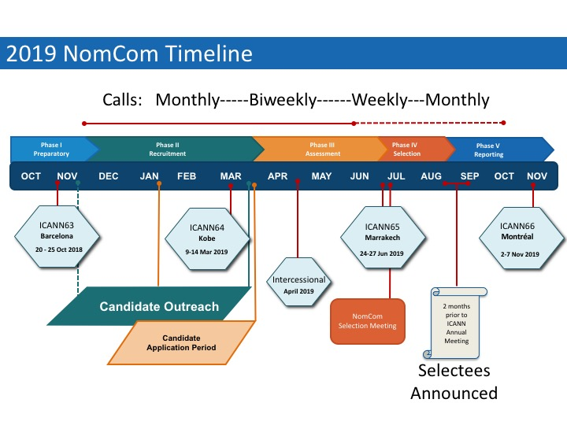
Important Phases

Slide 10
Engage with 2019 ICANN NomCom
/nomcom2019
Email: nomcom2019@ICANN.org

